Slide 1
SOLUTION ARCHITECTURE
2026
Post-Claim Pharmacy
Financial Reconciliation
Four independent feeds, no shared claim number, and one question:
what were we owed, what arrived, and what needs a human?
Every number is computed in Python. The model only explains numbers it was handed.
Post-claim reconciliation
01 / 16

Slide 2
THE PROBLEM
THREE ROADS AND A WITNESS
A drug goes out the door. Three parties now owe money, and none of them talk.
PHARMACY BENEFIT
MEDICAL BENEFIT
340B REBATE
THE BANK
Pills at a counter, billed to a PBM. Adjudicated in seconds, paid in weeks.
Drugs infused in a chair, billed to a medical payer via a clearinghouse.
A manufacturer owes cash back — but only once a TPA rules the dispense qualifies.
Owes nothing. It is the only proof the other three actually landed.
Nobody sends the hospital a statement saying here is what you are owed and here is what you got. That statement is the product.
Post-claim reconciliation
02 / 16

Slide 3
THE ARGUMENT
THREE THREADS
EVERY DESIGN DECISION IS ONE OF THESE THREE WEARING A DIFFERENT HAT
01
Nothing carries one claim number end to end. There is no shared ID. That is the hard part — not the arithmetic.
02
The system never guesses. A wrong match looks identical to a correct one in every report afterwards, so it parks instead.
03
Everything is a replay. Delete every answer it has produced, feed it the same files, get the same answers back.
Post-claim reconciliation
03 / 16

Slide 4
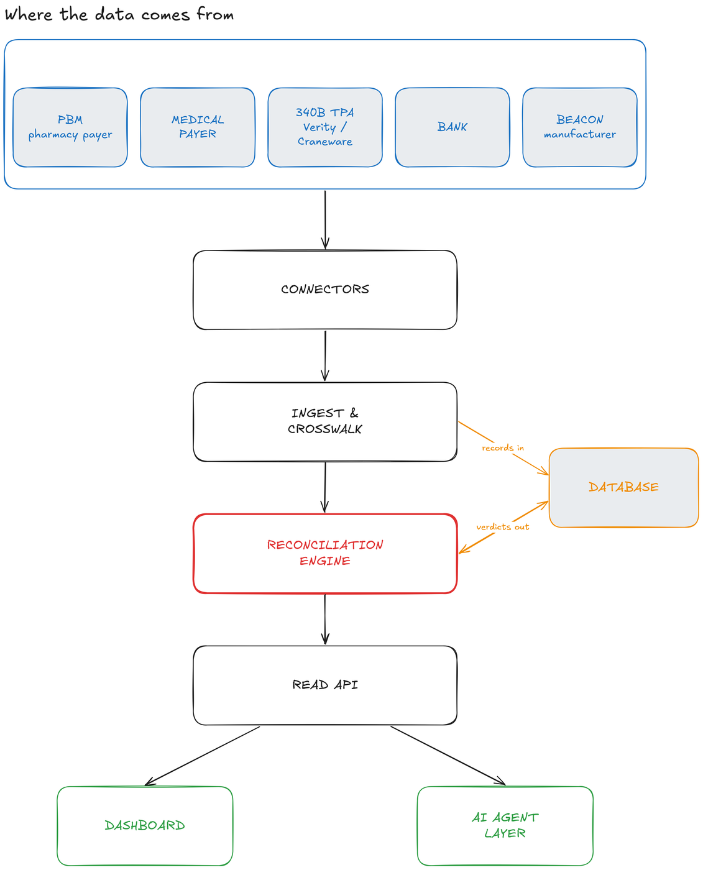
ARCHITECTURE
FIVE BLOCKS
Connectors fetch and never interpret · ingest writes records in · the engine writes verdicts out
04 / 16

Slide 5
ARCHITECTURE
THE RULE
Every number is computed in Python.
The model only explains numbers it was handed.
9
8
0
TOOLS THE AGENTS CAN CALL
OF THEM READ-ONLY
WRITE TOOLS IN ANY MODEL'S TOOL LIST
The one write creates a work item for a human. Role tool lists are built by removing it, so no prompt can reach it — and the record names the person who pressed the button, not the model.
A number a model produced is a number you cannot defend in an audit
05 / 16

Slide 6
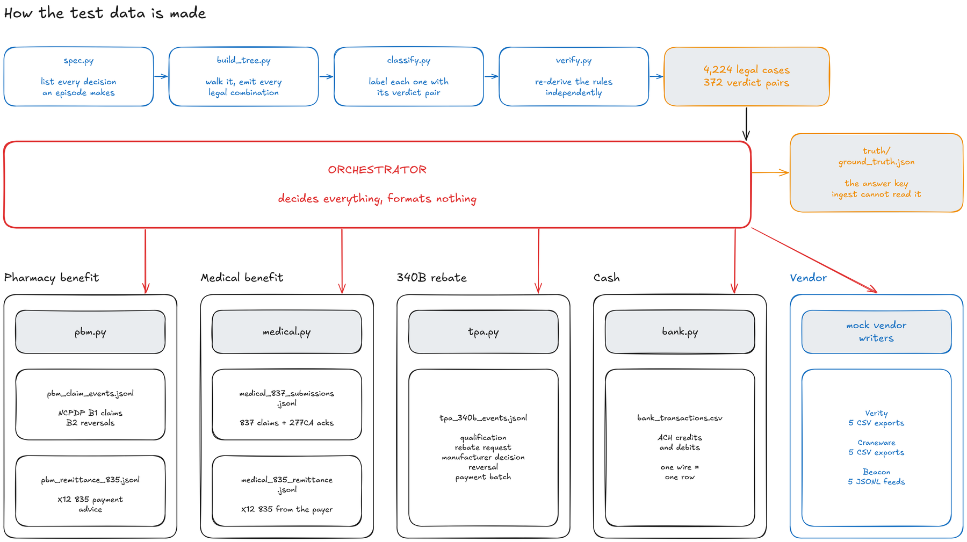
MAKING THE DATA
BUILT BACKWARDS FROM A PROOF
12.09bn
4,224
372
4,224
RAW COMBINATIONS
LEGALLY POSSIBLE
VERDICT PAIRS — ALL REACHABLE
REPRODUCED BY THE ENGINE · NO THRESHOLD
A generator never sees an episode id, a verdict, or an expected amount — asserted at runtime
06 / 16

Slide 7
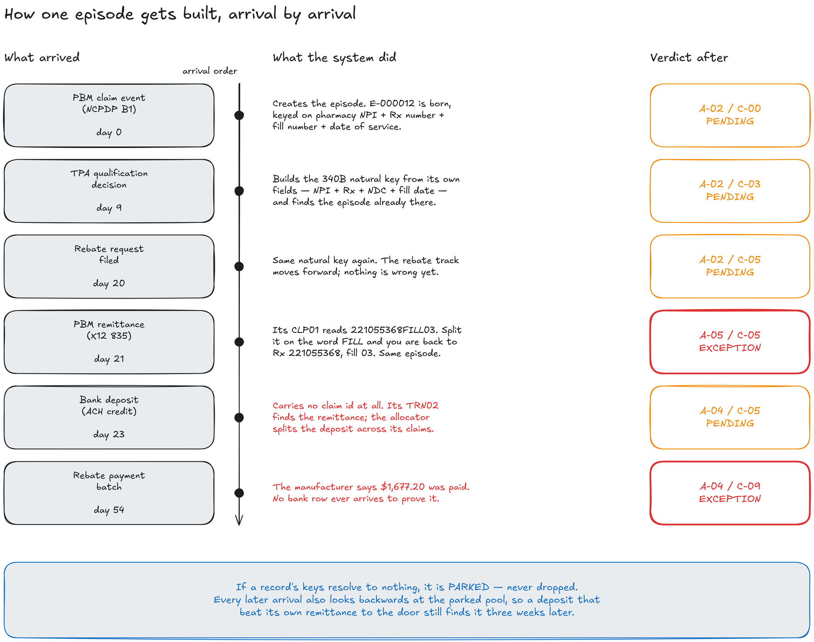
BUILDING AN EPISODE
SIX ARRIVALS, ONE EPISODE
Episode E-000012 · every code read off the running engine · a record that fits nowhere is parked
07 / 16

Slide 8
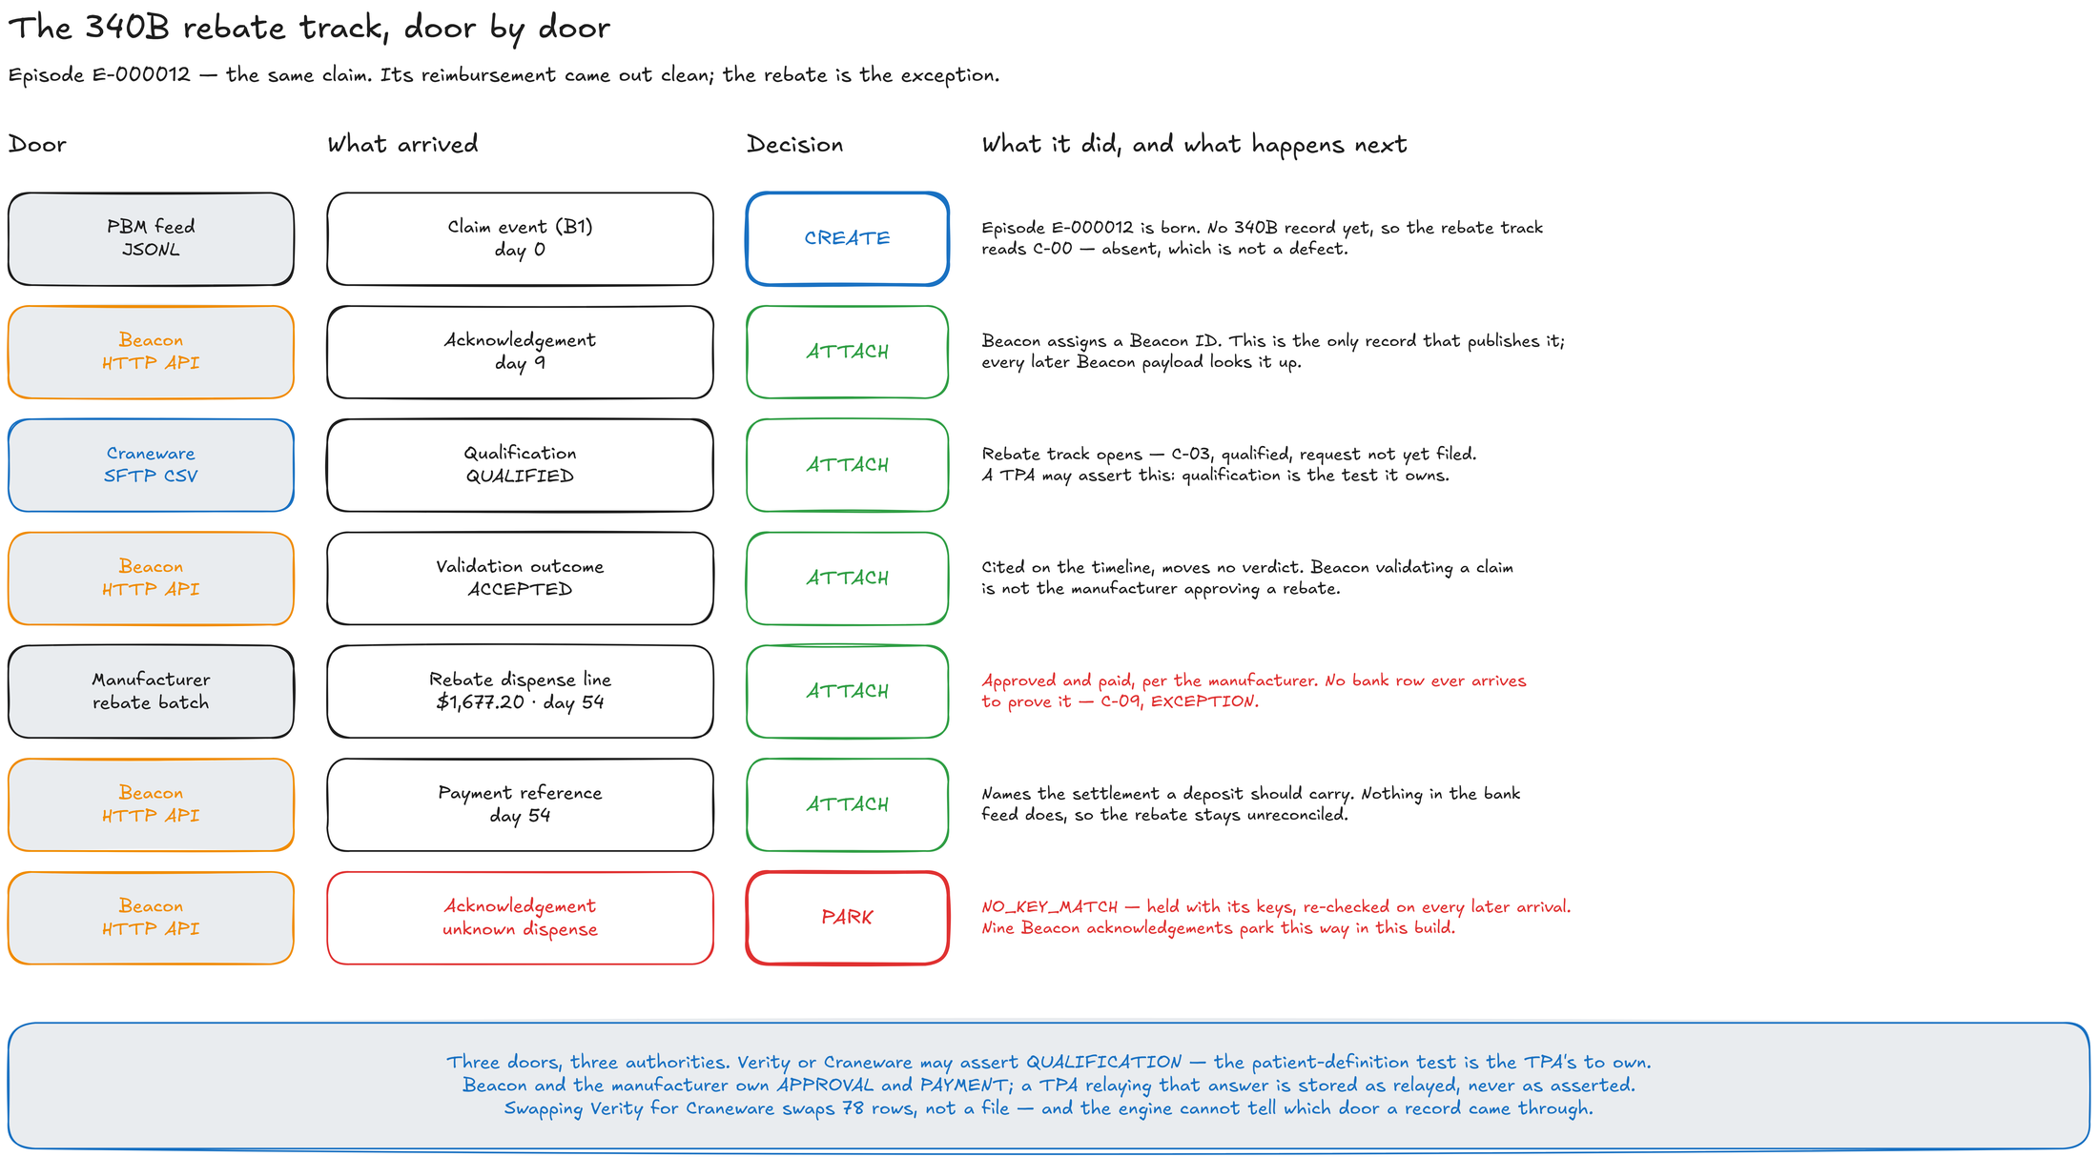
BUILDING AN EPISODE
THE 340B REBATE, DOOR BY DOOR
Qualification is the TPA's to assert · approval and payment belong to Beacon and the manufacturer
08 / 16

Slide 9
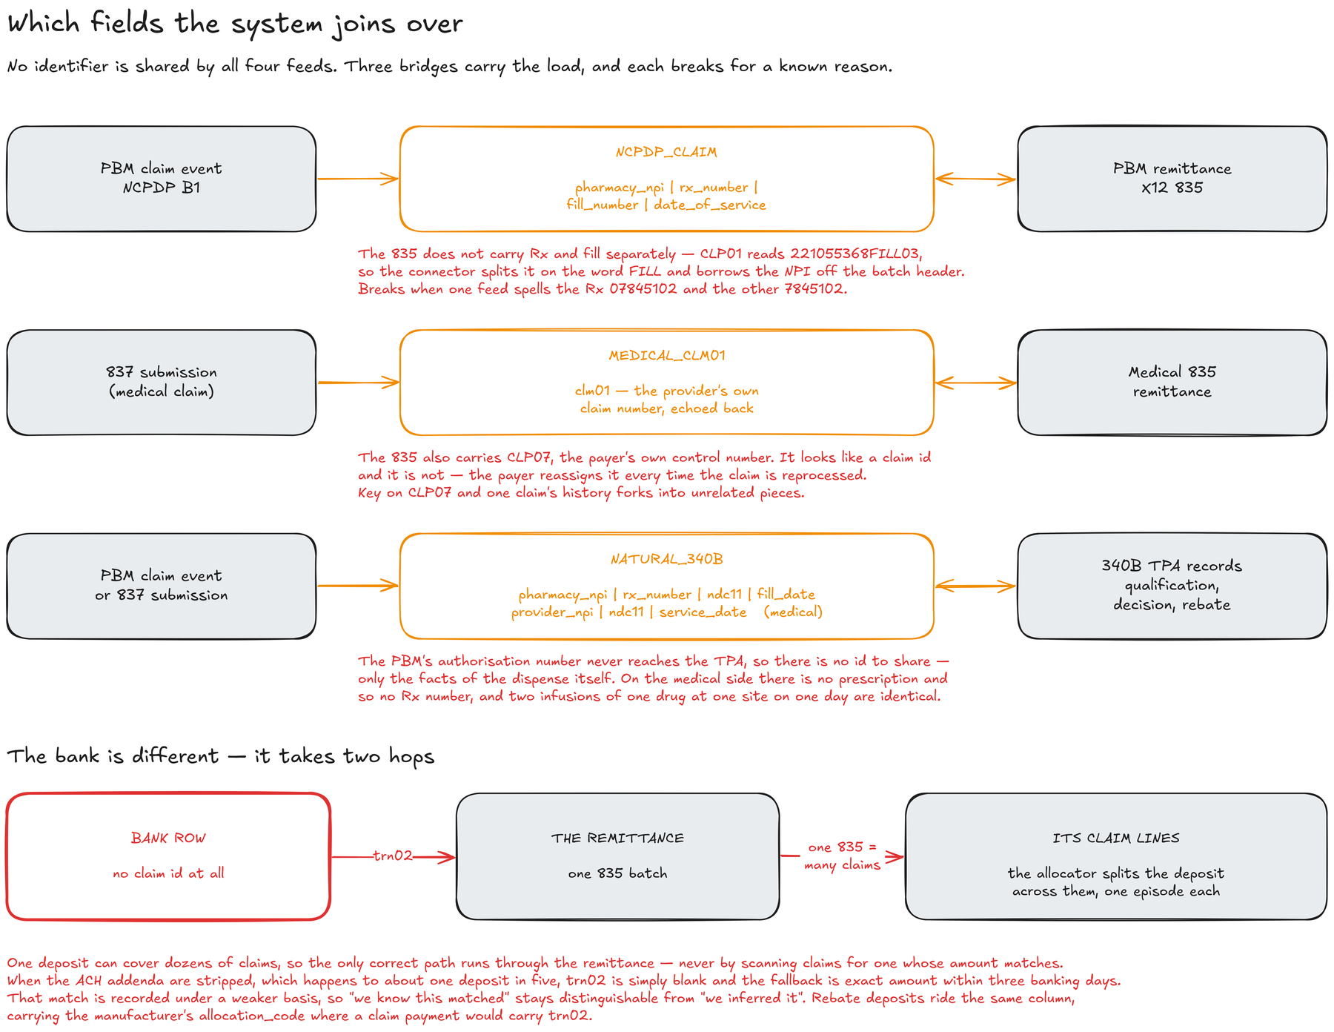
THE HARD PART
THREE BRIDGES, EACH WITH A NAMED FAILURE
No identifier normalisation on the match path — 7845102 and 07845102 build different keys, on purpose
09 / 16

Slide 10
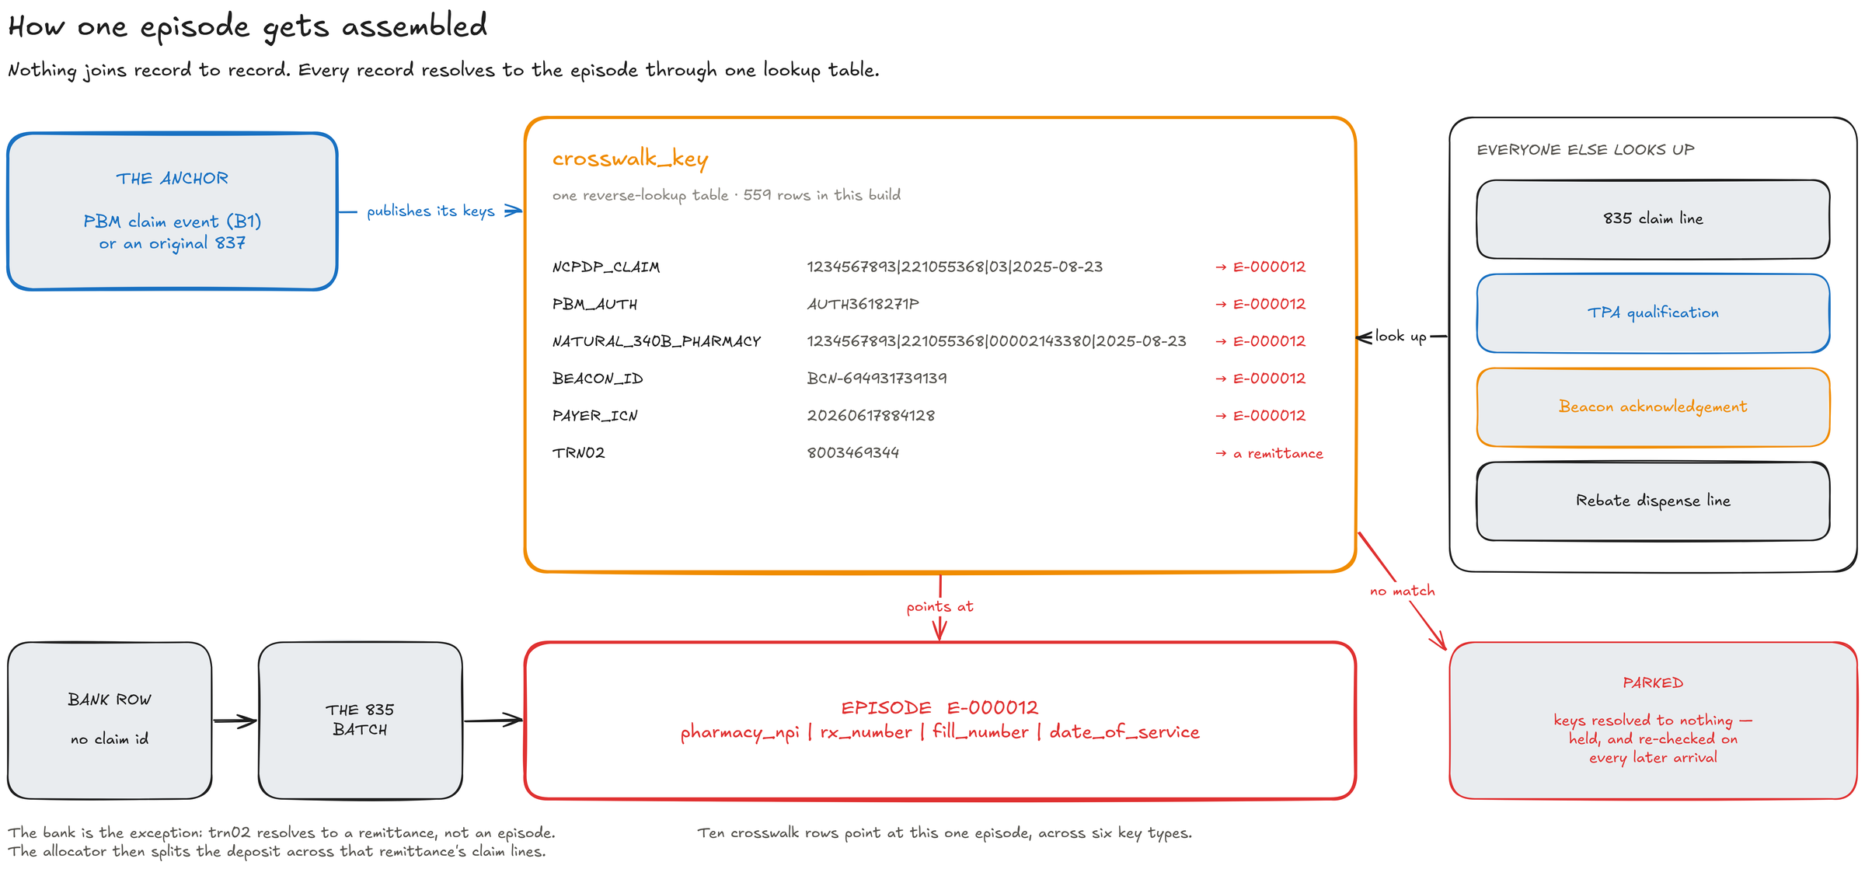
THE HARD PART
HOW ONE EPISODE GETS ASSEMBLED
The episode is the hub · crosswalk_key is the one lookup table · a miss parks and comes back
10 / 16

Slide 11
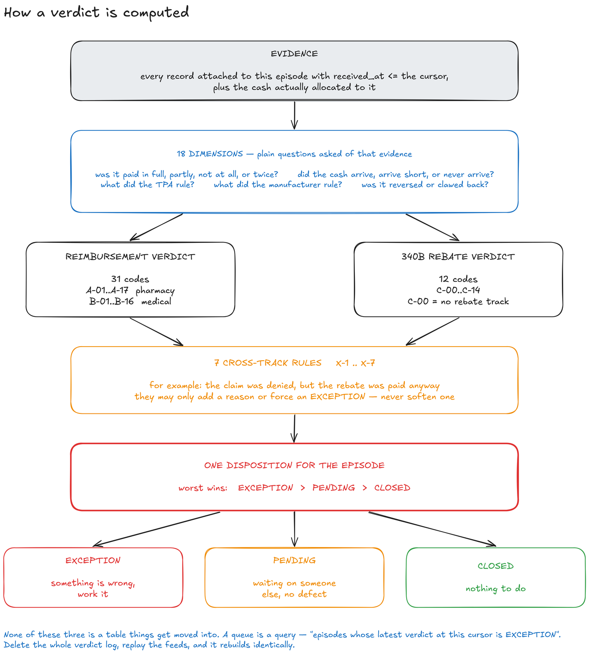
THE ENGINE
EVIDENCE, DIMENSIONS, VERDICT, DISPOSITION
A pure function of (episode, cursor) · 43 track verdicts + 7 cross-track rules · aging is never an input
11 / 16

Slide 12
EVIDENCE
MEASURED, NOT ASSERTED
The difference between a claim and a demonstration.
4,224
99.6%
978
0
OF 4,224 ORACLE CONFIGURATIONS · NO THRESHOLD
CROSSWALK REASSEMBLY AGAINST A WITHHELD KEY
TESTS PASSING · NO API KEY, NO NETWORK
TABLE SCANS · EVERY HOT QUERY PINS ITS PLAN
Stated, not hidden: no authentication and no tenant isolation yet; five of the 1,354 resolvable episodes do not reproduce their intended verdict; one query-plan test fails and is reported as a failure rather than rounded to green.
Post-claim reconciliation
12 / 16

Slide 13
DEMO
WHAT WE BUILT
DEMO
What we built.
A React dashboard over the read API, an episode dossier, the connector fabric, and an agent layer that explains but never calculates.
Post-claim reconciliation
13 / 16

Slide 14
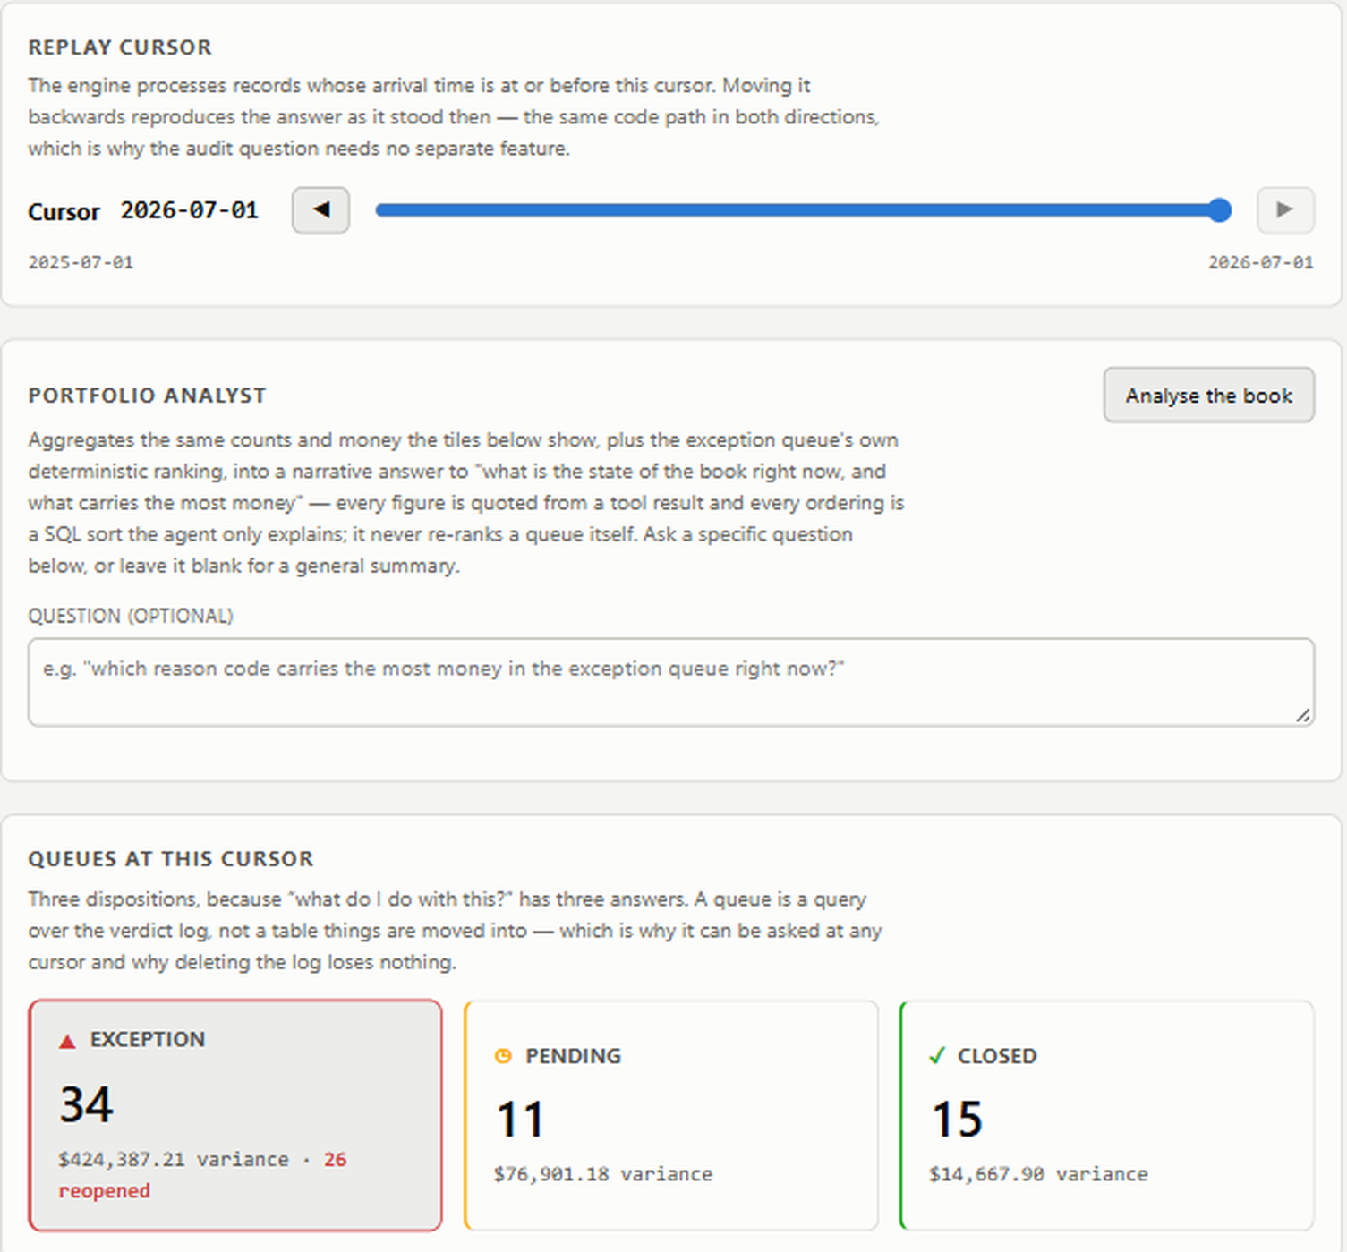
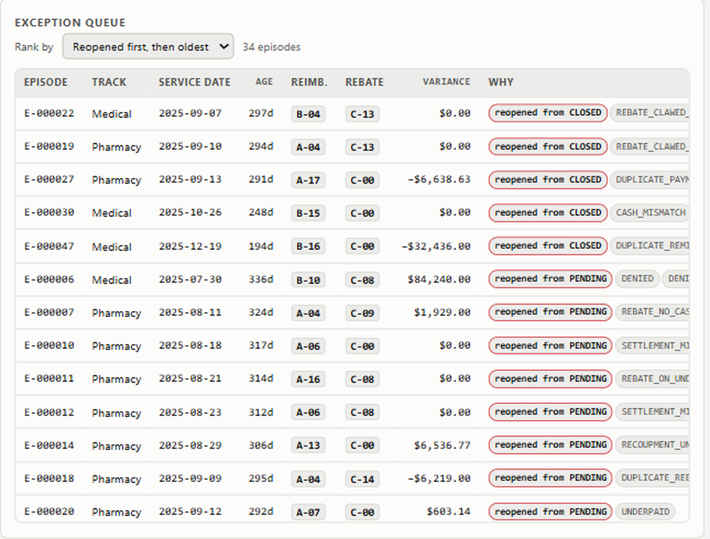
DEMO
THE BOOK AT A GLANCE
REPLAY CURSOR · THREE DISPOSITIONS, COUNTED LIVE
THE EXCEPTION QUEUE — A QUERY, NOT A TABLE
Every figure on screen was written by the engine and is returned verbatim
14 / 16

Slide 15
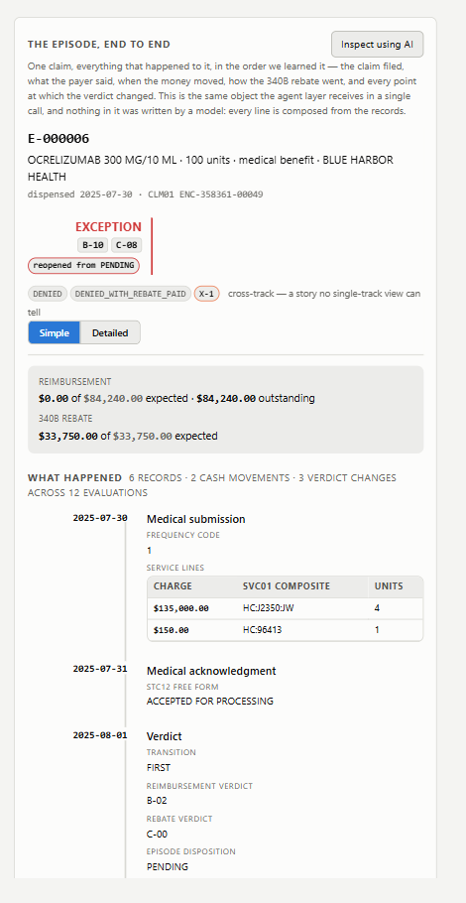
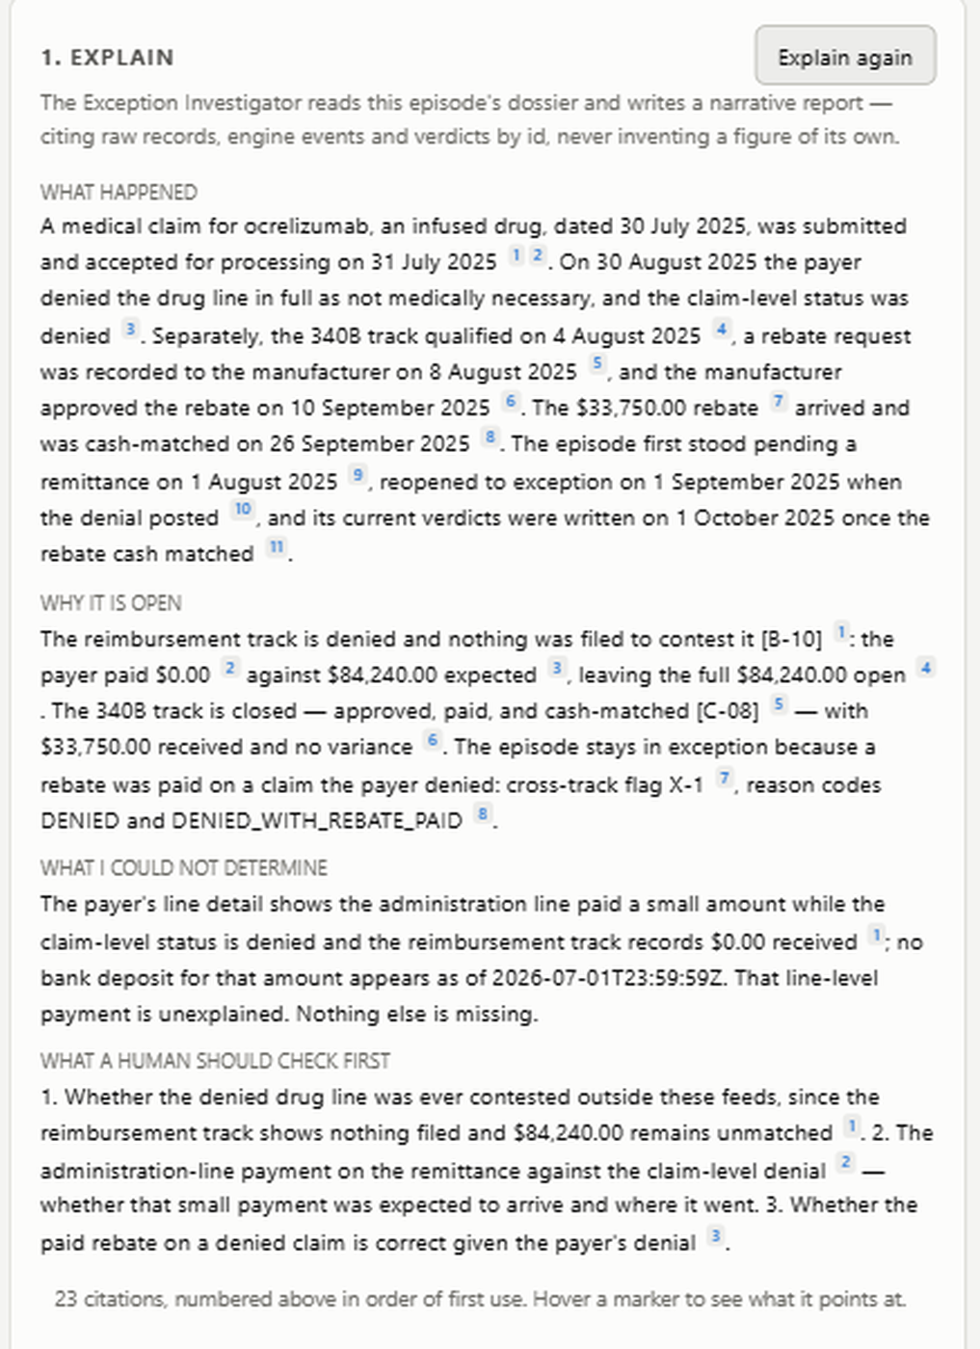
DEMO
ONE EPISODE, THEN THE AGENT
E-000006 · B-10 / C-08 · X-1 CROSS-TRACK
WHAT HAPPENED · WHY IT IS OPEN · WHAT IT COULD NOT DETERMINE
The claim was denied and the rebate was paid anyway — a story no single-track view can tell
15 / 16

Slide 16
DEMO
SWITCHING TO THE APP
LIVE
Let me show you.
1
Drag the replay cursor — the answer as it stood in March
2
Open the exception queue, pick the largest variance
3
Read the dossier — records, cash movements, verdict changes
4
Ask the agent to explain it, then to decide next steps
5
Edit the draft and commit it through the human gate
localhost:5173 · profile demo · seed 20250701
16 / 16

