Slide 1
Dropout Analysis
Problem Id: PID048
Problem Statement: Student dropout analysis for school education.
College Name: Gyanmanjari Institute of Technology.
Team Members:
Ayushi Nagaria (211290107507)
Rohan Jadwani (201290107056)
Harsh Kambad (201290107041)
Kartik Purohit (201290116023)
Ridhi Dave (211290116502)
Satyamsinh Zala (201290107038)
Riddhi Trivedi (201290107004)

Slide 2
Abstract:-
One of the indicators of potential problems in the higher education system may be a large number of student dropouts in the junior years due to poverty and social, economic reasons. An analysis of the existing transaction data provides the information on students that will allow the definition of the key processes that have to be adapted in order to enhance the efficiency of studying. To understand better the problem of dropouts, the government collects data from various categories as:
School wise
Area wise
Gender wise
Caste wise
Age/Standard wise
This website is useful for strategic planning of additional mechanisms to improve the efficiency of studying, and frame different policies useful for decreasing the dropout ratio in the country.

Slide 3
Literature Review/Existing Innovation
If student doesn’t comes to collect the Leaving Certificate then website will be unable to decide if the student is dropout or not.
Because of this report will also be not generated properly and the data will be inconsistent.
Sometimes there's no connection to the server so we cannot get the data reports of the students.
Once data of the student is uploaded in the site as dropout student in the control system and then the student gets admission at other place and the details of that student is not updated in the control system that the student is not dropout and continues his/her study then the data will be inconsistent and report will not be generated properly.

Slide 4
Objectives:-
To lower dropout rates
Reduce paperwork
Reduce human effort
Information storing
Accumulation of all dropped out students
Easy for government to refer dropout students

Slide 5
Idea Details/Solution
In this website, school admin can submit the data of the dropout students which can be reviewed by the government and analyse the dropout ratio easily.
The government can filter the data according to following categories:
Gender
Age/Standard
Caste
School
Area
This data ratio can be retrieved and showed to the government using different charts of the data on the website which helps the government to easily analyse and solve the problem.

Slide 6
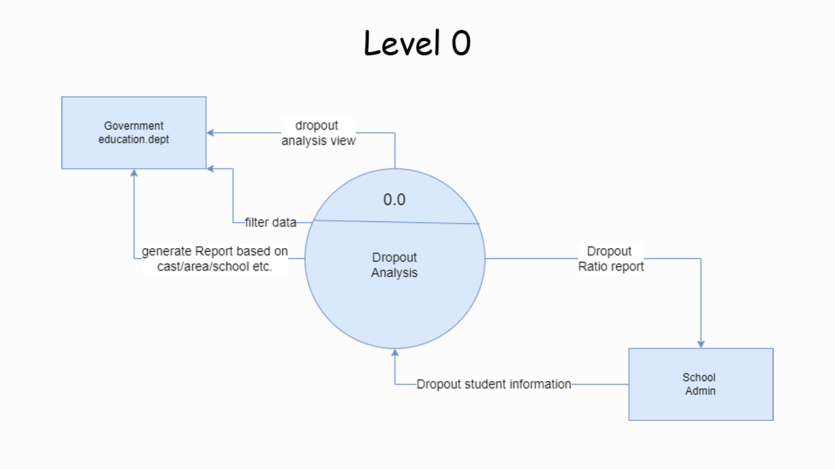
Data Flow Diagram

Slide 7
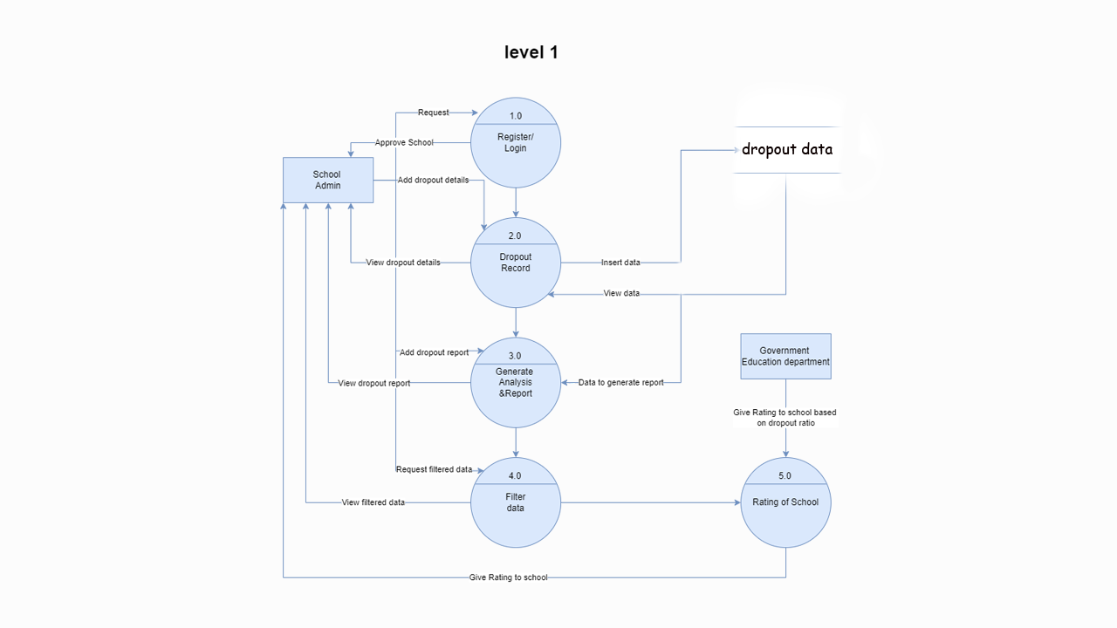

Slide 8
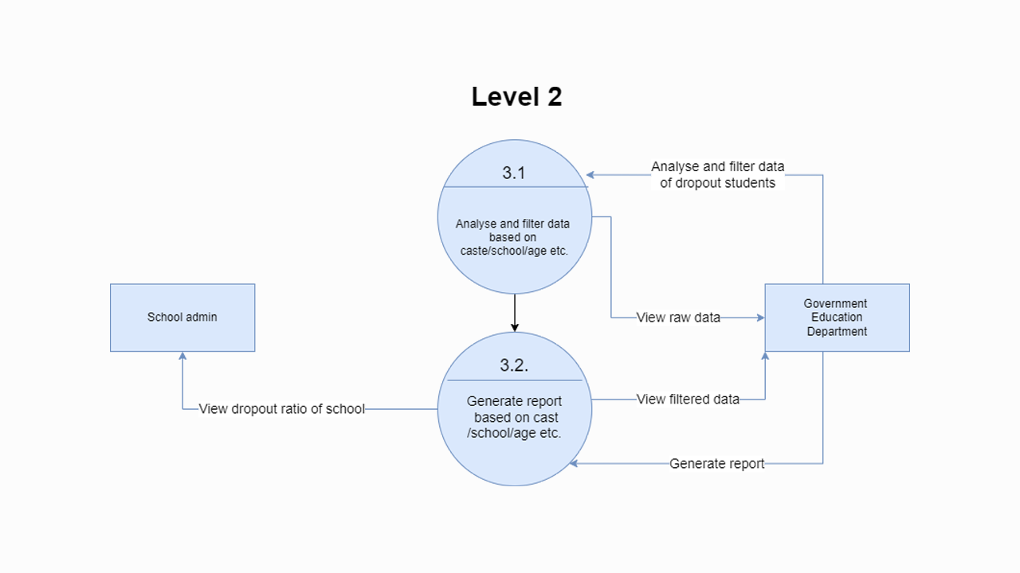

Slide 9
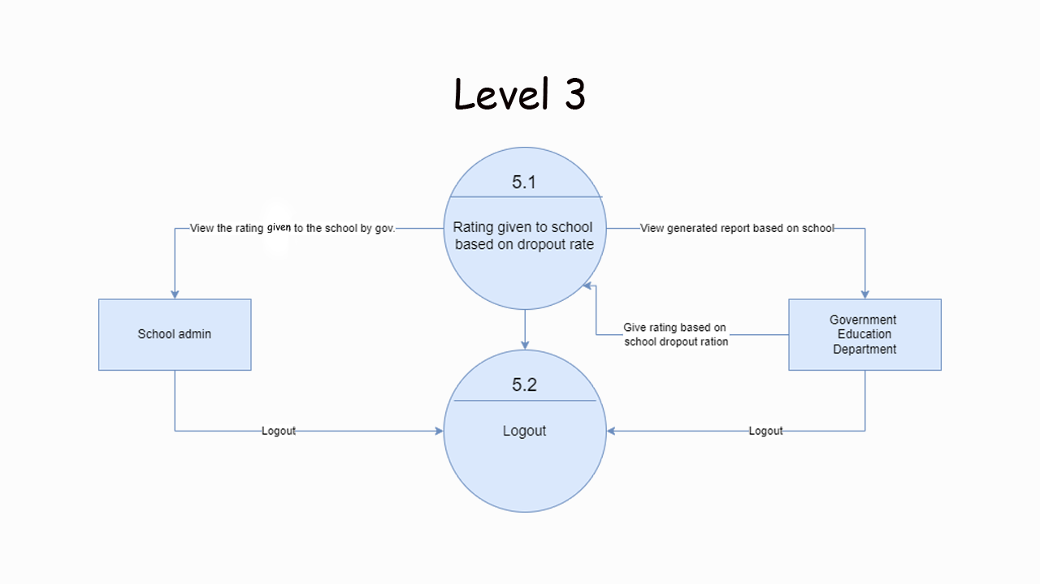

Slide 10
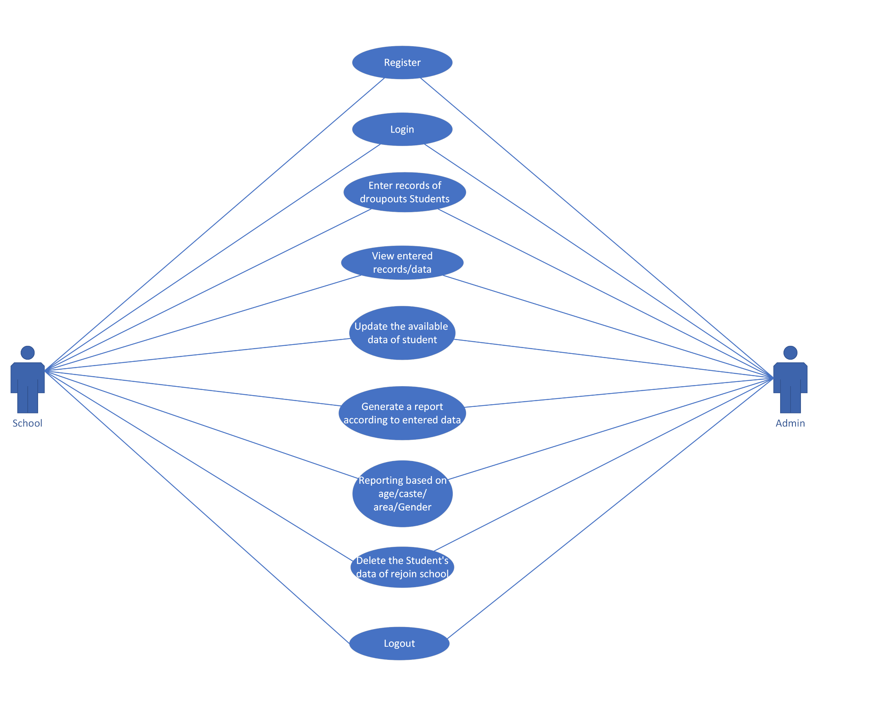
Use-Case diagram

Slide 11
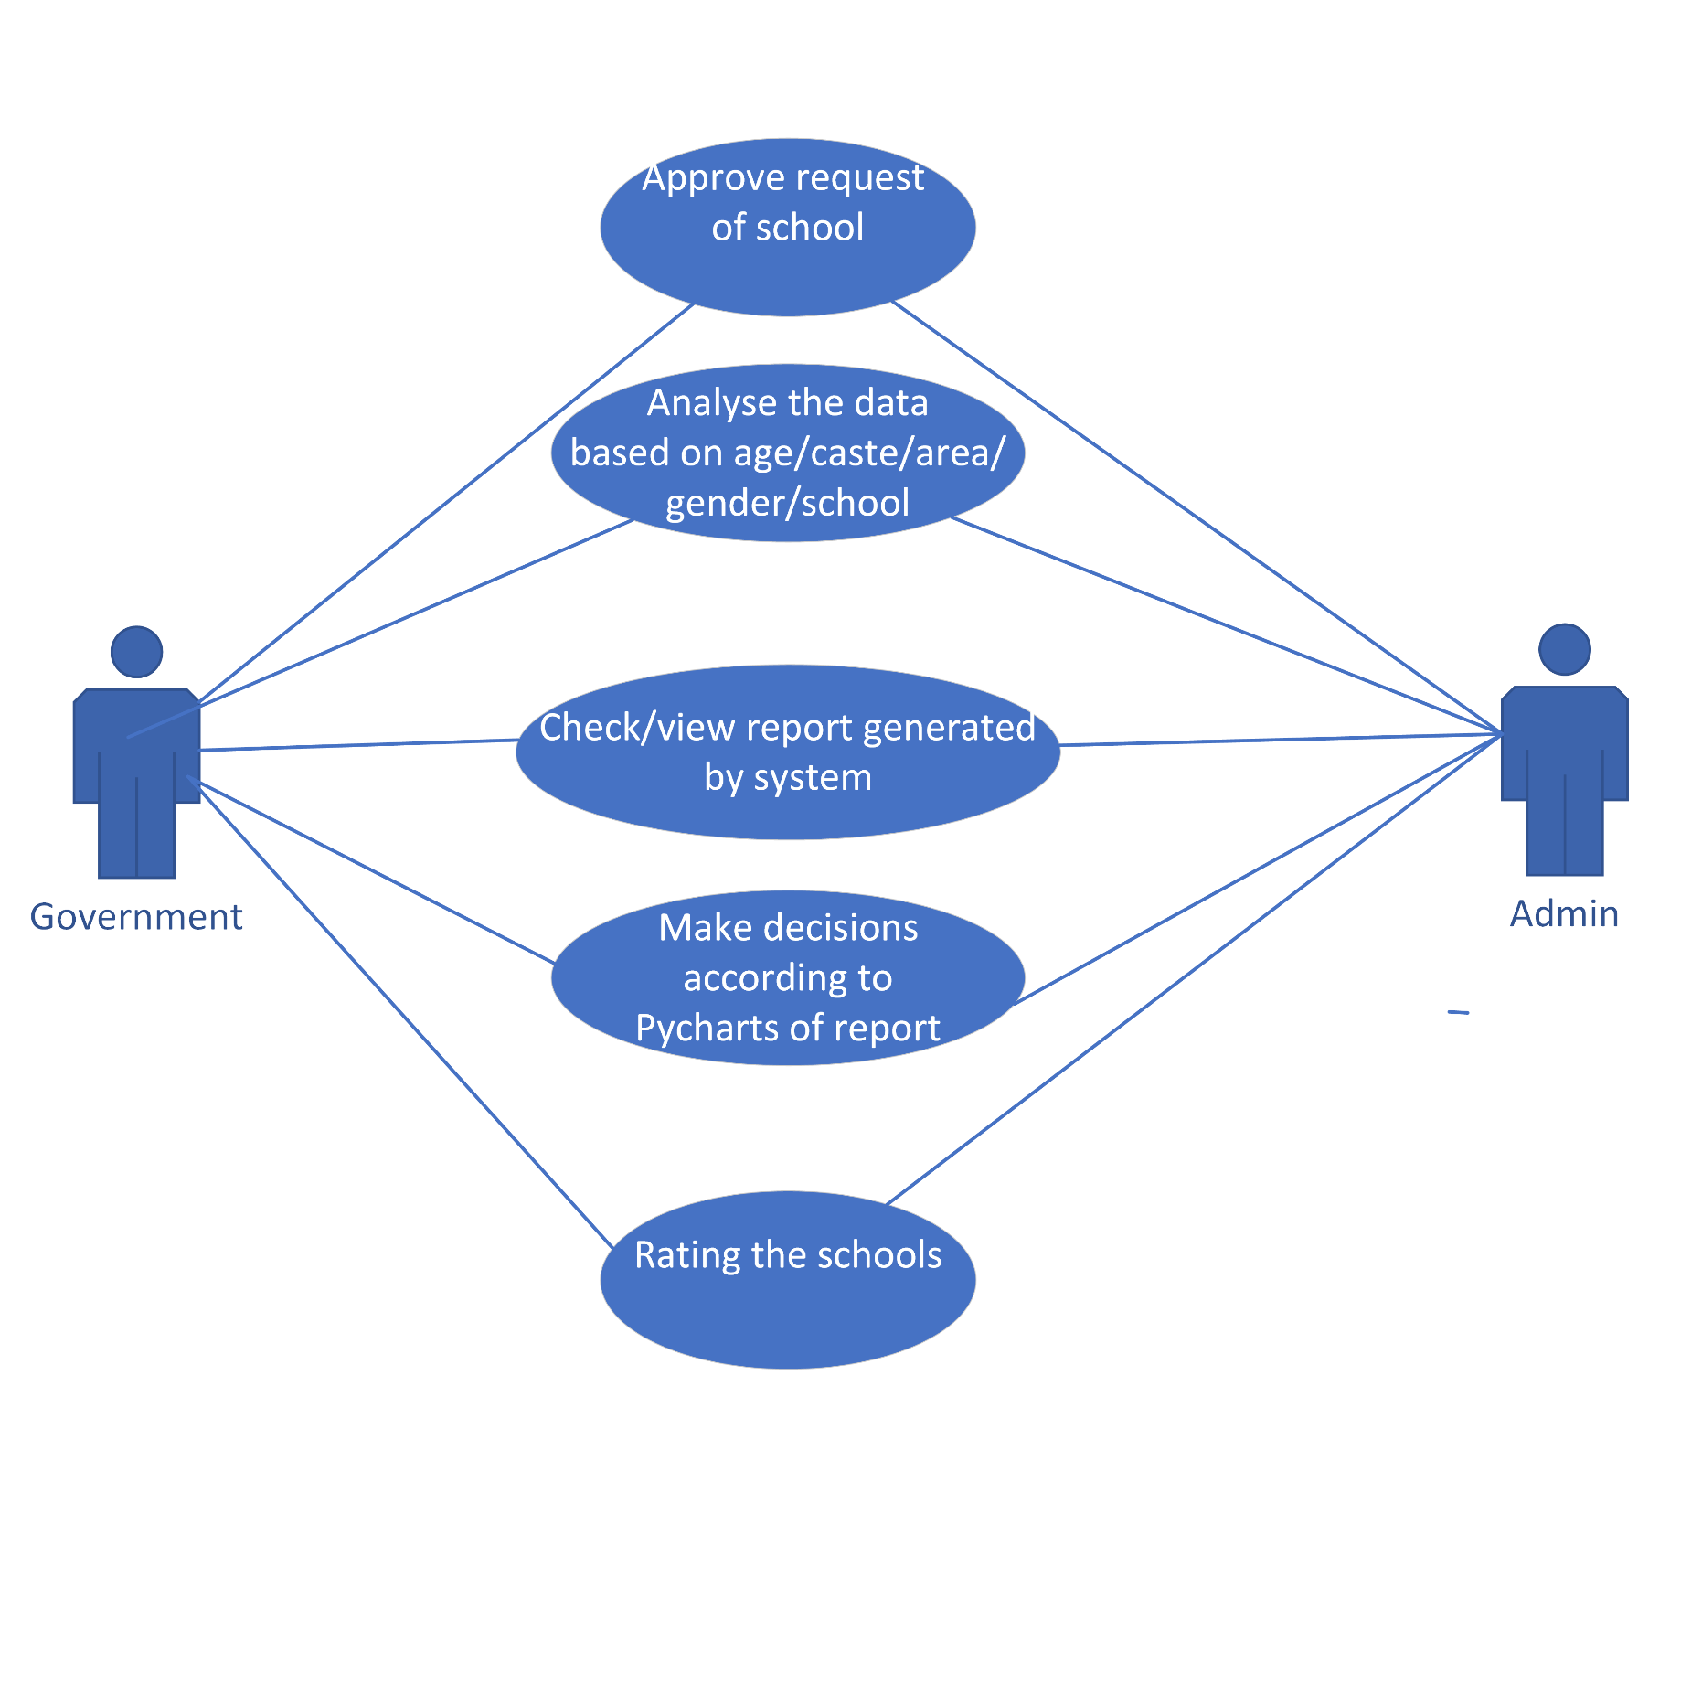

Slide 12
Tools & Technologies
Frontend:-
Bootstrap
Java script
HTML
CSS
Backend:-
PHP for data connection
Ajax
MySQL database

Slide 13
Challenges/Risks
Suppose that if a student takes L.C. from the school & school updates the details of the students in the site as dropouts but the student continues the study in other places & takes admission so the data will be inconsistent as in site it shows as dropout but actually he/she is studying
Suppose that student discontinues his/her studies &drops out of the school without informing the school then school will not know that if the student will continue his study or not so the will not update that on the site and data will be inconsistent

Slide 14
Government benefits
This project helps the government to keep the records of the dropout students across various schools the data is arranged in different categories such as
Age
Group
Schools
Yearly and consistent data helps the government to find various details of the students studying and dropouts at live

Slide 15
Other benefits
Through this project the arrangements of data helps the school to identify in form of charts and graphs this helps the schools to identify the dropouts easily data is updated by various schools which keep the data in consistent state
Through all the dropouts are kept in records the total number of currently drop and student studying at present can be analysed.

