Slide 1
Collection
By: Rohan Joshi

Slide 2
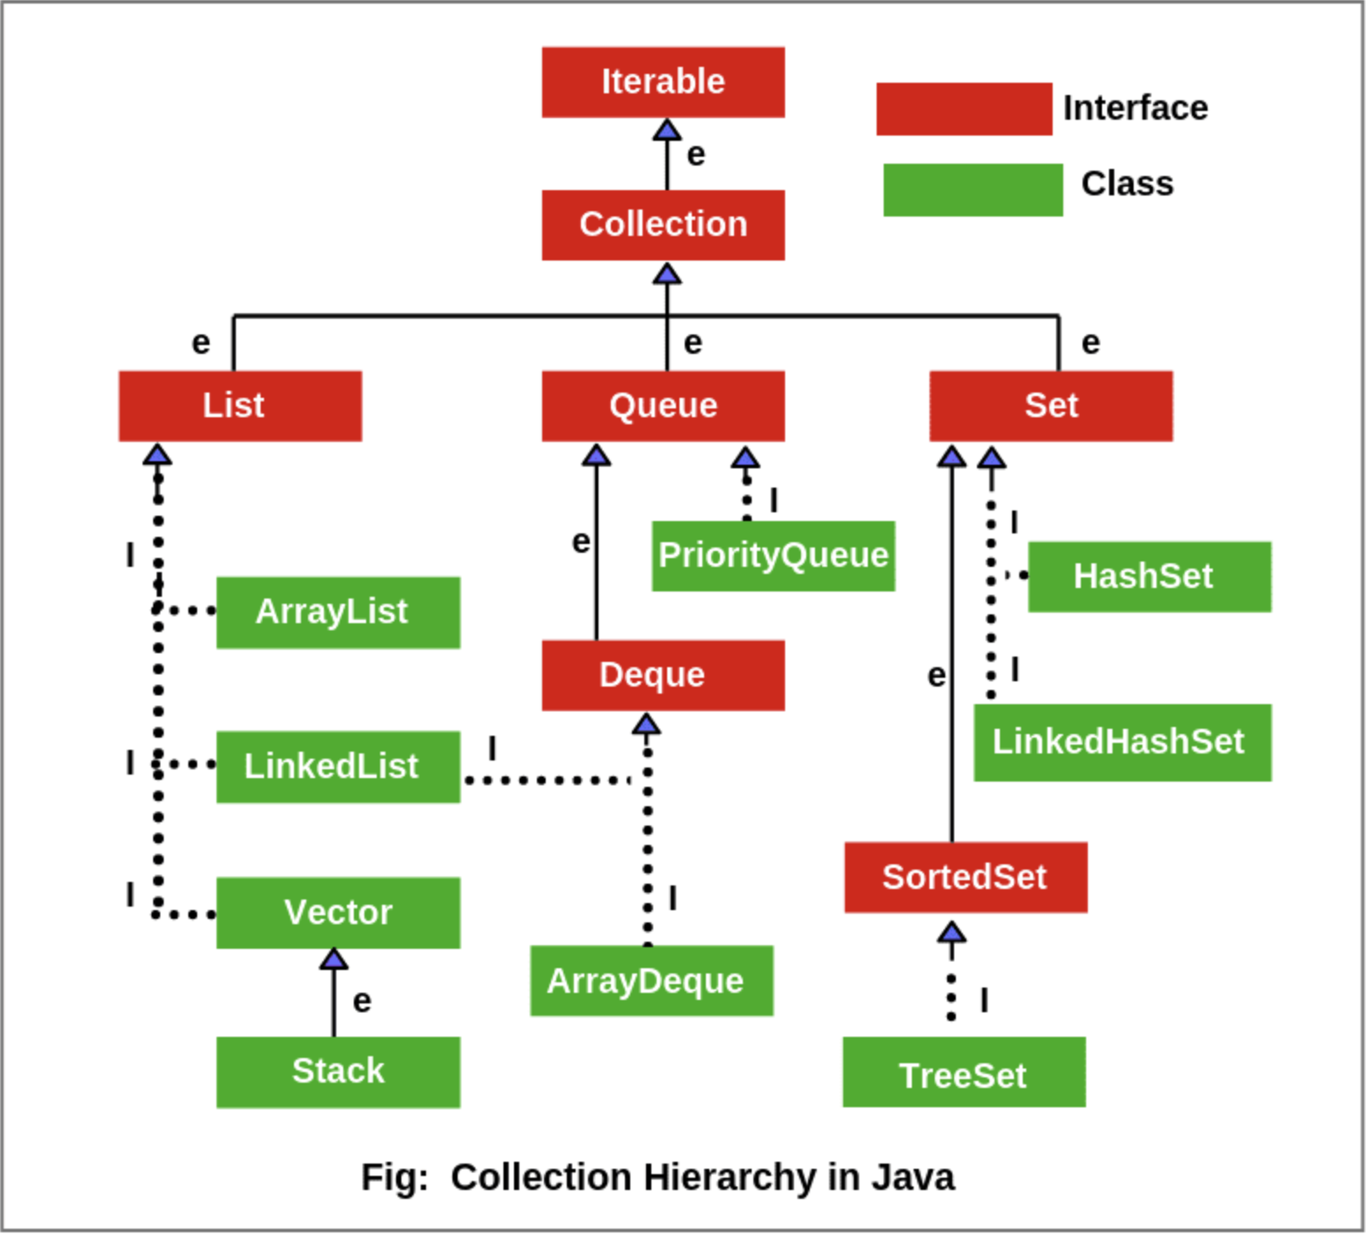
Collection Hierarchy
Retrieved from: Scientech Easy, Collection Hierarchy in Java | Collection Interface. https://www.scientecheasy.com/2020/09/collection-hierarchy-in-java.html/

Slide 3
Collection is an Interface not a Class
What is an Interface? An interface is a completely "abstract class" that is used to group related methods with empty bodies
To access the interface methods, the interface must be "implemented" by another class with the implements keyword (instead of extends). The body of the interface method is provided by the "implement" class
Why not to implement the interface directly, why to extend other classes that implement interface?
It is necessary that we should override all the methods from an Interface and the class we create may not need all the methods. All the classes like ArrayList, Treeset override all these methods from their particular Interfaces and then we can easily pick methods from the Parent class.

Slide 4
ArrayList
Arraylist is class that implements List Interface.
Unlike built in arrays, ArrayList is resizable and comes with many methods which are then used to manipulate this ArrayList.
We can perform many operations on ArrayList with methods like add(), remove(), get(), set().
We can set the datatype of an ArrayList as shown in the example ArrayList<String> cars = new ArrayList<String>
ArrayList could be of any datatype String, Integer, Object.

Slide 5
LinkedList
LinkedList is just like an ArrayList in which previous element holds the reference to the next element.
When to use ArrayList
You want to access random items frequently
You only need to add or remove elements at the end of the list
When to use a LinkedList
You only use the list by looping through it instead of accessing random items
You frequently need to add and remove items from the beginning or middle of the list
There are two types of LikedLists. Singly LinkedList and Doubly LinkedList. Doubly linkedlist holds the reference to the previous element.

Slide 6
Vector
Vector class implements List interface.
Vectors are very similar to the ArrayList but the only difference is that vectors are synchronized.
Important points regarding Increment of vector capacity: If increment is specified, Vector will expand according to it in each allocation cycle but if increment is not specified then vector’s capacity get doubled in each allocation cycle.
Even Vector class have some inbuilt methods in it like add(), addAll().

Slide 7
Set
The set interface present in the java.util package and extends the Collection interface is an unordered collection of objects in which duplicate values cannot be stored.
The interface Set, extends the Collection interface which extends Iterable Interface.
Set class is further extended by HashSet and LinkedHashSet.

Slide 8
HashSet
The HashSet class implements the Set interface, backed by a hash table which is actually a HashMap instance. No guarantee is made as to the iteration order of the set which means that the class does not guarantee the constant order of elements over time.
HashSet does not allow the the user to insert duplicate values.

Slide 9
LinkedHashSet
The LinkedHashSet is an ordered version of HashSet that maintains a doubly-linked List across all elements. When the iteration order is needed to be maintained this class is used.
When iterating through a HashSet the order is unpredictable, while a LinkedHashSet lets us iterate through the elements in the order in which they were inserted.

Slide 10
TreeSet
Java TreeSet class implements the Set interface that uses a tree for storage. It inherits AbstractSet class and implements the NavigableSet interface. The objects of the TreeSet class are stored in ascending order.
Java TreeSet class contains unique elements only like HashSet.
Java TreeSet class doesn't allow null element.
Java TreeSet class maintains ascending order.
public class TreeSet<E> extends AbstractSet<E> implements NavigableSet<E>, Cloneable, Serializable

Slide 11
HashMaps
A HashMap store items in "key/value" pairs, and you can access them by an index of another type (e.g. a String).
HashMap extends an abstract class AbstractMap which also provides an incomplete implementation of Map interface.
It also implements Cloneable and Serializable interface. K and V in the above definition represent Key and Value respectively.
HashMap doesn’t allow duplicate keys but allows duplicate values. That means A single key can’t contain more than 1 value but more than 1 key can contain a single value.
HashMap allows null key also but only once and multiple null values.

Slide 12
HashTable
This class implements a hash table, which maps keys to values. Any non-null object can be used as a key or as a value. To successfully store and retrieve objects from a hashtable, the objects used as keys must implement the hashCode method and the equals method.
It is similar to HashMap, but is synchronised.
Hashtable stores key/value pair in hash table.
In Hashtable we specify an object that is used as a key, and the value we want to associate to that key. The key is then hashed, and the resulting hash code is used as the index at which the value is stored within the table.

Slide 13
Queue
The Queue interface present in the java.util package and extends the Collection interface is used to hold the elements about to be processed in FIFO(First In First Out) order. It is an ordered list of objects with its use limited to insert elements at the end of the list and deleting elements from the start of the list, (i.e.), it follows the FIFO or the First-In-First-Out principle.
The Queue is used to insert elements at the end of the queue and removes from the beginning of the queue. It follows FIFO concept.
The Java Queue supports all methods of Collection interface including insertion, deletion etc.
If any null operation is performed on BlockingQueues, NullPointerException is thrown.

Slide 14
Deque
The Deque interface is present in java.util package is a subtype of the queue interface. The Deque is related to the double-ended queue that supports addition or removal of elements from either end of the data structure. It can either be used as a queue(first-in-first-out/FIFO) or as a stack(last-in-first-out/LIFO). Deque is the acronym for double ended queue

Slide 15
Comparable
Java Comparable interface is used to compare objects and sort them according to the natural order.
Natural ordering is referred to as its compareTo() function. The string objects are sorted lexicographically, and the wrapper class objects are sorted according to their built-in compareTo() function (like how Integers objects are sorted in ascending order).
Comparable provides a single sorting sequence. In other words, we can sort the collection on the basis of a single element such as id, name, and price.
Comparable affects the original class, i.e., the actual class is modified.
Comparable provides compareTo() method to sort elements.

Slide 16
Comparator
Comparator interface is used to order the objects of user-defined classes. A comparator object is capable of comparing two objects of two different classes. Following function compare obj1 with obj2
we can sort the collection on the basis of multiple elements such as id, name, and price etc.
Comparator doesn't affect the original class, i.e., the actual class is not modified.
Comparator provides compare() method to sort elements.

