Slide 1
Collection
By: Rohan Joshi

Slide 2
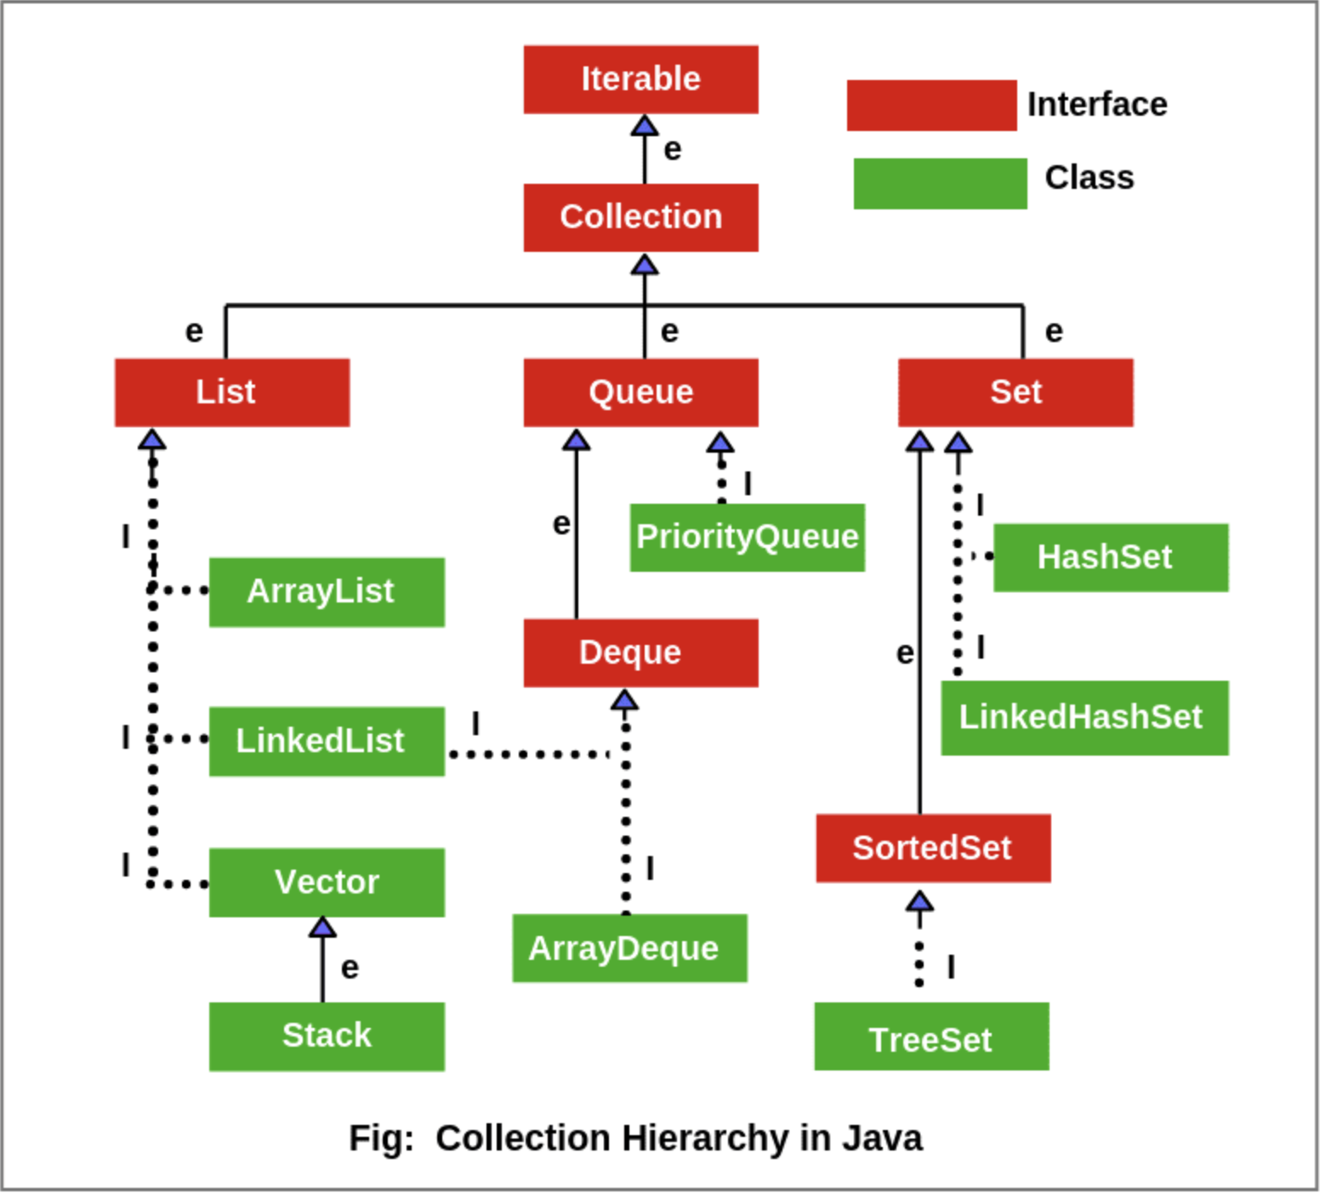
Collection Hierarchy
Retrieved from: Scientech Easy, Collection Hierarchy in Java | Collection Interface. https://www.scientecheasy.com/2020/09/collection-hierarchy-in-java.html/

Slide 3
Collection is an Interface not a Class
What is an Interface? An interface is a completely "abstract class" that is used to group related methods with empty bodies
To access the interface methods, the interface must be "implemented" by another class with the implements keyword (instead of extends). The body of the interface method is provided by the "implement" class
Why not to implement the interface directly, why to extend other classes that implement interface?
It is necessary that we should override all the methods from an Interface and the class we create may not need all the methods. All the classes like ArrayList, Treeset override all these methods from their particular Interfaces and then we can easily pick methods from the Parent class.

Slide 4
ArrayList
Arraylist is class that implements List Interface.
Unlike built in arrays, ArrayList is resizable and comes with many methods which are then used to manipulate this ArrayList.
We can perform many operations on ArrayList with methods like add(), remove(), get(), set().
We can set the datatype of an ArrayList as shown in the example ArrayList<String> cars = new ArrayList<String>
ArrayList could be of any datatype String, Integer, Object.

Slide 5
LinkedList
LinkedList is just like an ArrayList in which previous element holds the reference to the next element.
When to use ArrayList
You want to access random items frequently
You only need to add or remove elements at the end of the list
When to use a LinkedList
You only use the list by looping through it instead of accessing random items
You frequently need to add and remove items from the beginning or middle of the list
There are two types of LikedLists. Singly LinkedList and Doubly LinkedList. Doubly linkedlist holds the reference to the previous element.

Slide 6
Vector
Vector class implements List interface.
Vectors are very similar to the ArrayList but the only difference is that vectors are synchronized.
Important points regarding Increment of vector capacity: If increment is specified, Vector will expand according to it in each allocation cycle but if increment is not specified then vector’s capacity get doubled in each allocation cycle.
Even Vector class have some inbuilt methods in it like add(), addAll().

Slide 7
Set
The set interface present in the java.util package and extends the Collection interface is an unordered collection of objects in which duplicate values cannot be stored.
The interface Set, extends the Collection interface which extends Iterable Interface.
Set class is further extended by HashSet and LinkedHashSet.

Slide 8
HashSet
The HashSet class implements the Set interface, backed by a hash table which is actually a HashMap instance. No guarantee is made as to the iteration order of the set which means that the class does not guarantee the constant order of elements over time.
HashSet does not allow the the user to insert duplicate values.

Slide 9
LinkedHashSet
The LinkedHashSet is an ordered version of HashSet that maintains a doubly-linked List across all elements. When the iteration order is needed to be maintained this class is used.
When iterating through a HashSet the order is unpredictable, while a LinkedHashSet lets us iterate through the elements in the order in which they were inserted.

