Slide 1
Configuring X-bee in unicast mode
AGENDA OF DISCUSSION
Introduction to Xbee and Unicast configuration.
Hardware Connection and configuration of Xbee.
Working demonstration of Xbee in unicast mode in X-CTU software.

Slide 2
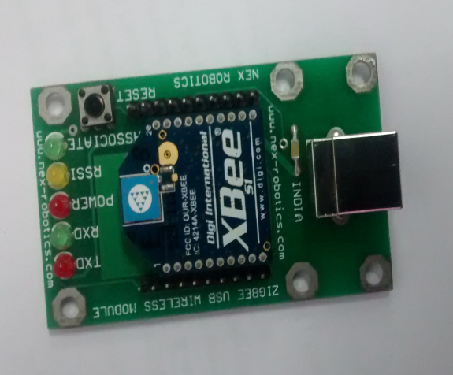
X-BEE WIRELESS MODULE
The XBee and XBee-PRO OEM RF Modules were engineered to meet IEEE 802.15.4 standards and support the unique needs of low-cost, low-power wireless sensor networks. The modules require minimal power and provide reliable delivery of data between devices.

Slide 3
UNICAST MODE:
In unicast mode there is data transfer from one server to end user and this is a bidirectional data transfer from server to end user and vice versa. Unicast is otherwise called as peer to peer communication.
There are two ways of transmitting in unicasting
16bit address mode
64bit address mode
Server
End user

