Slide 1
Image Defogging Algorithm Based on Metaheuristic Dark Channel Prior
Submitted by- Divyansh Jain-E23CSEU1042
Yousuff-E23CSEU1242 Shaurya singh pundir-E23CSEU1062
Rohan pandey-E23CSEU1076
Submitted to- Mr.Prashant Shukla

Slide 2

What Is Image Defogging and Why Does It Matter?
Image Defogging Defined
The process of computationally removing haze and fog from degraded images to restore clarity, contrast, and color fidelity.
Why Fog Degrades Images
Airborne particles scatter and absorb light, reducing visibility, flattening contrast, and introducing color distortion.
Real-World Importance
Critical for autonomous driving, traffic surveillance, remote sensing, and any vision system operating in outdoor environments.

Slide 3
Problem Statement
Challenges in Foggy Images
Limitations of Existing Methods
Low Contrast
Image Enhancement
Scene details become washed out, reducing edge sharpness and depth perception.
Histogram equalization amplifies noise and introduces halos without physical modeling.
Color Distortion
Classic Dark Channel Prior
Haze introduces a white-gray cast that shifts true color values across the image.
Fails in sky regions and bright surfaces; sky segmentation is often ignored.
Information Loss
Deep Learning Models
Fine-grained textures and distant objects are entirely lost in thick fog conditions.
Require large labeled datasets, heavy computation.

Slide 4
Proposed Solution -A Hybrid Approach
This research combines physics-based modeling with intelligent optimization to overcome the limitations of each individual technique.
Sky Segmentation
Dark Channel Prior
Separates sky and non-sky regions for accurate atmospheric light estimation without sky-region bias.
Estimates scene transmission using the statistical observation that haze-free images have very dark pixels in local patches.
PCA Refinement
RBMO Optimization
Principal Component Analysis refines the transmission map, reducing noise and preserving edge integrity.
A metaheuristic optimizer fine-tunes defogging parameters for maximum PSNR and SSIM performance.

Slide 5

System Architecture — Processing Pipeline
Atmospheric Light
Input
Estimate ambient illumination
Foggy image
Isolate bright sky regions
DCP + PCA estimation
Sky Segmentation
Transmission Map
Each stage is modular and physics-grounded: sky segmentation isolates problematic bright regions, the DCP+PCA block computes a clean transmission map, and RBMO optimally tunes parameters before final image reconstruction.

Slide 6

Key Concepts — The Physics Behind Defogging
Atmospheric Scattering Model
Dark Channel Prior
The fundamental equation relating observed hazy image I(x) to the scene radiance J(x):
For a haze-free image, the dark channel Jdark in most local patches is near zero:
J(x) — Scene radiance (dehazed image)
t(x) — Transmission map (fog density)
A — Global atmospheric light
Fog violates this prior — patches appear brighter. The degree of violation directly estimates the transmission t(x), enabling fog removal without ground-truth data.

Slide 7
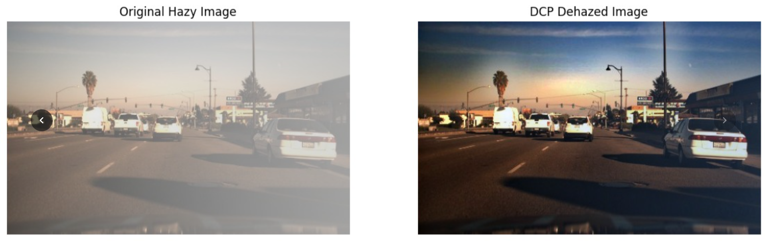
Optimization Technique YOLOv8 Nano
1
Introduction
YOLOv8 Nano (YOLOv8n) is a lightweight version of YOLO used for real-time object detection.
It is designed to detect objects quickly and efficiently with low computational cost.
2
Objective
Detect objects in real-time
Identify important regions in an image
Work efficiently on low-resource devices
3
Overview
YOLOv8 Nano is an efficient object detection model that provides fast and accurate results, making it ideal for real-time systems like Drive Guardian.

Slide 8
Results & Performance Comparison
Evaluation Datasets
Key Performance Gains
Higher PSNR & SSIM
YOLO-V8 NANO
DEHAZE
Outperforms classic DCP, CLAHE, and CNN-based methods across all four benchmark datasets.
Synthetic outdoor test set
Hybrid subjective test set
Reduced Halos & Artifacts
O-HAZE
I-HAZE
Sky segmentation eliminates the over-saturation and halo artifacts common in standard DCP at boundary regions.
Real outdoor hazy scenes
Real indoor hazy scenes

Slide 9
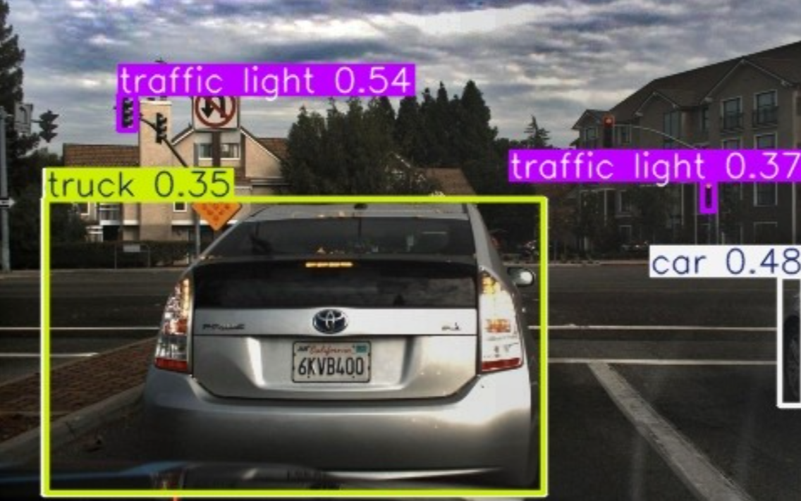
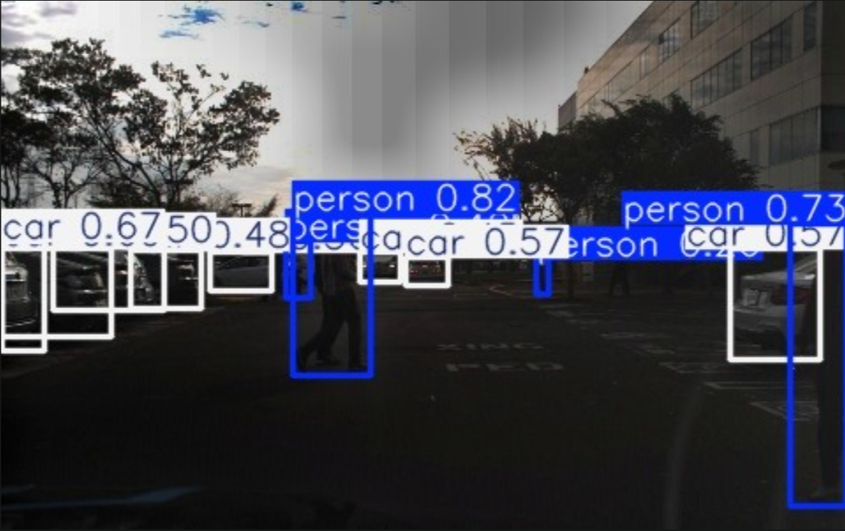
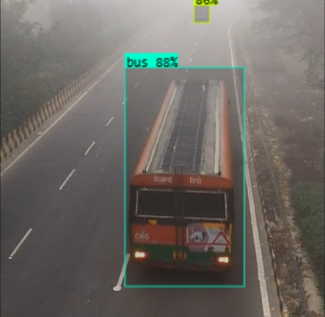

Advantages & Real-World Applications
Autonomous Driving
Surveillance & Security
Remote Sensing
Enhances camera feeds in low-visibility conditions, enabling reliable object detection and lane tracking in fog or haze.
Restores clarity in CCTV footage captured in adverse weather, improving facial recognition and incident detection accuracy.
Processes hazy satellite and drone imagery for accurate land mapping, disaster response, and environmental monitoring.
Key advantage: The hybrid approach preserves fine detail and works robustly on real-world images without requiring paired training data.

Slide 10

Conclusion & Future Scope
Summary of Contributions
Future Research Directions
Dark Region Handling: Extend the model to handle nighttime and underexposed foggy scenes
Real-Time Processing: Optimize for embedded and edge computing platforms
Deep Integration: Combine RBMO with lightweight neural networks for adaptive defogging
Video Defogging: Extend the pipeline to temporal video sequences with temporal consistency
Novel hybrid pipeline combining Sky Segmentation, DCP, PCA, and RBMO optimization
Eliminates sky-region bias — a critical gap in traditional DCP methods
Metaheuristic tuning achieves superior PSNR/SSIM with fewer artifacts
Validated on four real and synthetic benchmark datasets
This research advances the state-of-the-art in physics-based image restoration by bridging classical priors with modern metaheuristic intelligence.

