Slide 1
Neural Probabilistic Language Model
Teaching Computers to Predict Words Like Humans
Presented by: Rohan Sanjay Patil, Riya BIJU

Slide 2
The Big Problem: Curse of Dimensionality
1. 10 words with 100,000 vocabulary = 10⁵⁰ - 1 combinations!
2. Traditional n-grams just 'glue' short pieces together
3. Can't capture word similarity or long contexts only the frequency.
4. We need something smarter 🧠

Slide 3
How N-Gram Models Work
Predict words by counting what came before
Training Data:
The cat is sleeping
The cat is walking
The dog is barking
Prediction:
Given: “The cat is“
P(walking | The cat is) = count('The cat is walking') / count('The cat is’)
⚠ Problems:
❌ Need exact phrase matches
❌ Short memory (typically 2-4 words)
❌ Sparse data - most test combinations never seen

Slide 4
The Brilliant Idea
      A distributed representation of words
      Each word → feature vector in ℝᵐ space
      Similar words sit close together(Low hamming distance)
      Learn representations + probabilities together
      Similar Words: cat≈dog bedroom≈room the≈a walking≈running

Slide 5
The Magic of Generalization
Training on:
The cat is walking in the bedroom
Automatically understands:
A dog was running in a room ✓
The cat is running in a room ✓
A dog is walking in a bedroom ✓
The dog was walking in the room ✓
Similar words = Similar vectors = Similar probabilities!

Slide 6
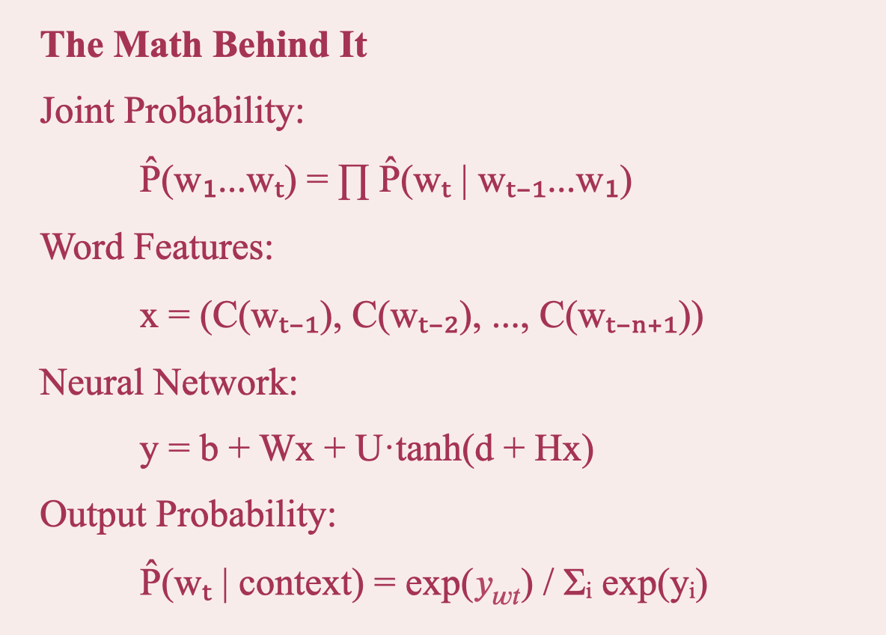

Slide 7
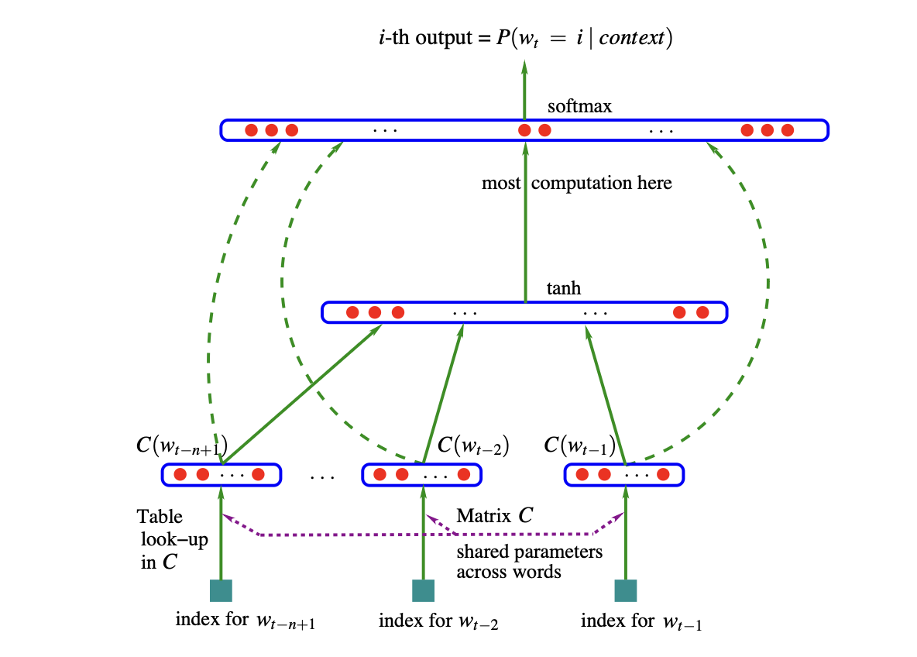
Neural Network Architecture
Input Layer
Word feature vectors C (|V| × m matrix)
↓
Hidden Layer tanh activation, h units
↓
Output Layer
Softmax for probabilities
🔑 Shared parameters across all words!

Slide 8
Optimizing training in Large Scale
Data-Parallel (Synchronous and Asynchronous)
Multiple processors, shared memory
Parameter-Parallel
Split output parameter computation (99.7% of work!)
  Linux Clusters dealing with fast communication

Slide 9
The Results: Impressive!
Brown Corpus
24% better
Test perplexity: 252 vs 336
AP News (14M words)
8% better
Test perplexity: 109 vs 117
Neural Network Wins! 🏆

Slide 10
Performance Comparison
Model | Test Perplexity
MLP10 (Neural Net) | 252
Best Class-based n-gram | 312
Kneser-Ney back-off | 321
Deleted Interpolation | 336

Slide 11
Why Does It Work?
Exponential Generalization
One sentence teaches exponentially many similar sentences
Smooth Functions
Small changes in features = small changes in probability
Linear Scaling
Not exponential! Scales linearly with vocabulary
Long Contexts
Can use 5-6 words of context effectively

Slide 12
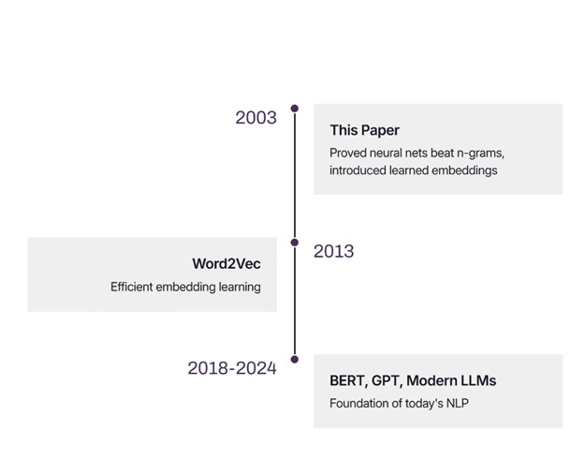
Conclusion and Where are we after 17 years…

Slide 13
Thank you

