Slide 1
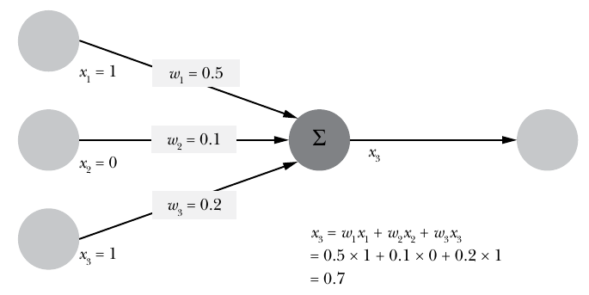
Mathematical model of a single neuron: the output is a function of the
three inputs.

Slide 2
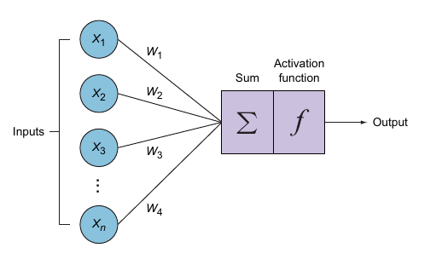
Input vectors are fed to the neuron, with weights
assigned to represent importance. Calculations performed within
the neuron are weighted sum and activation functions.

Slide 3
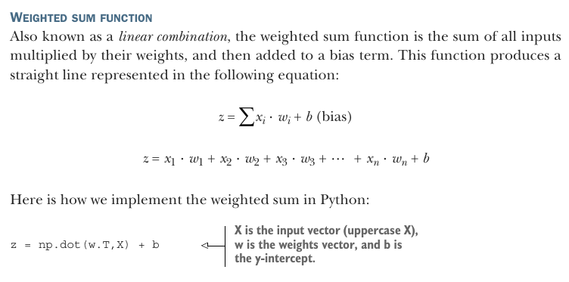

Slide 4
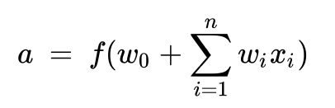
And after the sum of the products of weight and input pairs are calculated >
the resultant weighted-sum is followed by an
additional function f (the bias term + sum of products).
The function f is the activation function.
At a high level, a neural network is a collection of nodes where each node has an
adjustable float value and the nodes are interconnected as a graph to return outputs
in a format that is dictated by the architecture of the network. The network constitutes
three main parts: the input layer, the hidden layer(s), and the output layer.

Slide 5
Input layer—Contains the feature vector.
Hidden layers—The neurons are stacked on top of each other in hidden layers.
They are called “hidden” layers because we don’t see or control the input going
into these layers or the output. All we do is feed the feature vector to the input
layer and see the output coming out of the output layer.
Weight connections (edges)—Weights are assigned to each connection between the nodes to reflect the importance of their influence on the final output predic-
tion. In graph network terms, these are called edges connecting the nodes.
Output layer—We get the answer or prediction from our model from the output
layer. Depending on the setup of the neural network, the final output may be a
real-valued output (regression problem) or a set of probabilities (classification
problem). This is determined by the type of activation function we use in the
neurons in the output layer.

Slide 6
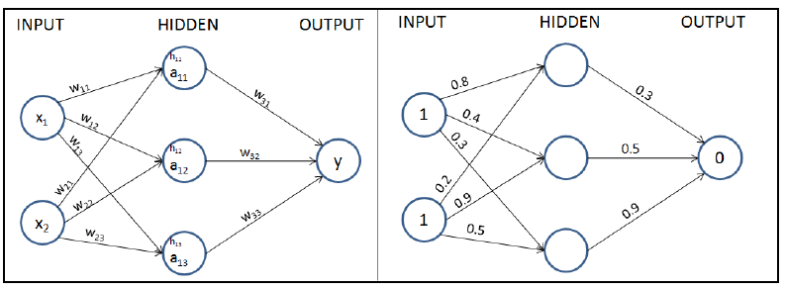

Slide 7
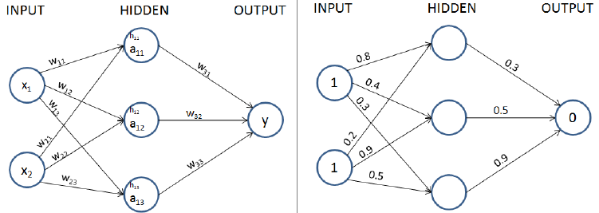
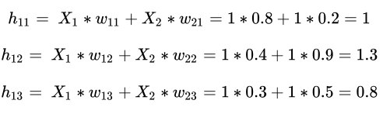

Slide 8
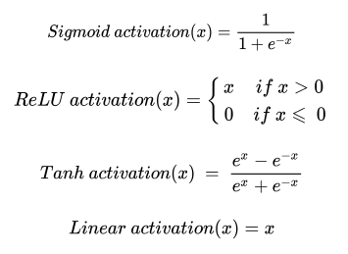
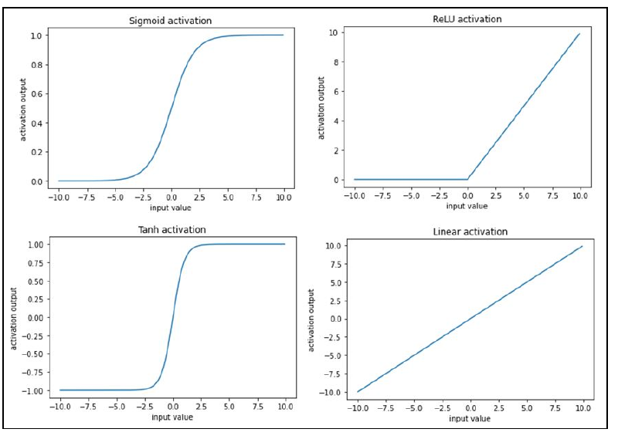

Slide 9
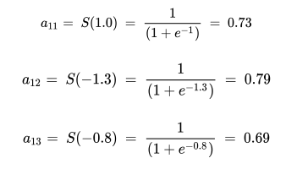
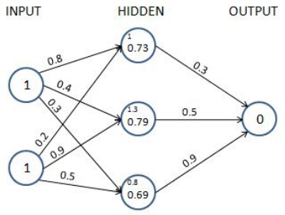


Slide 10
Two way to calculate loss values
- Categorical variable prediction
- Continuous variable prediction

Slide 11
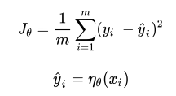

Calculating loss for continuous variable prediction

Slide 12


Calculating loss during categorical variable prediction
Binary cross-entropy
Categorical cross-entropy

Slide 13
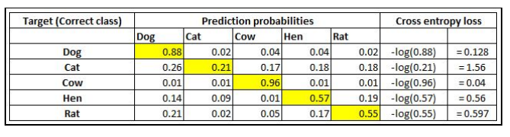

Slide 14
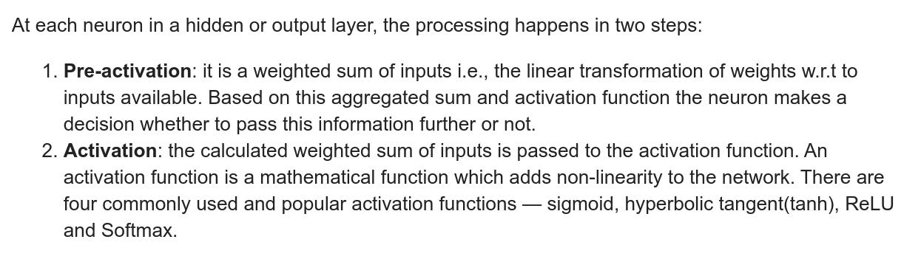

Slide 15
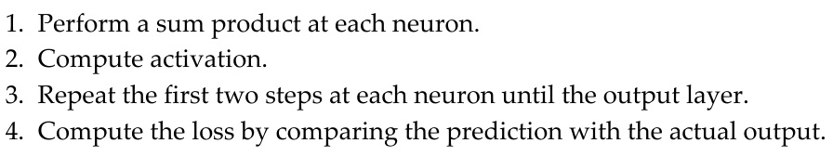

Slide 16
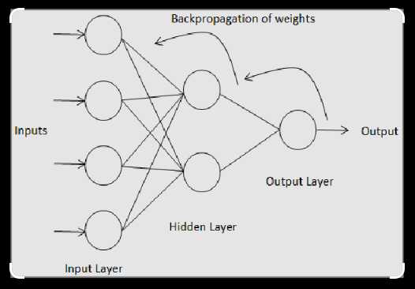

Slide 17
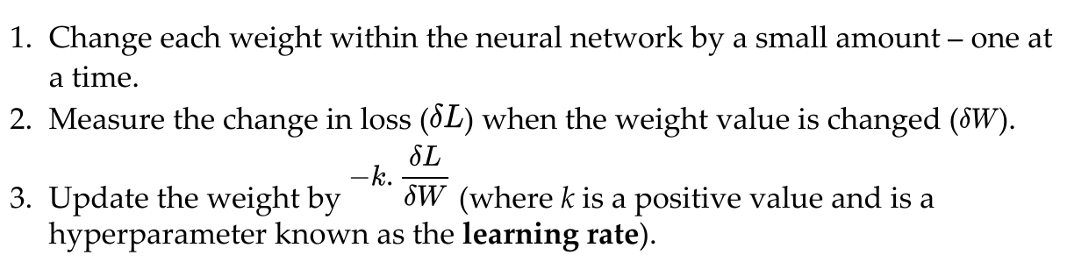
Implementing backpropagation

Slide 18
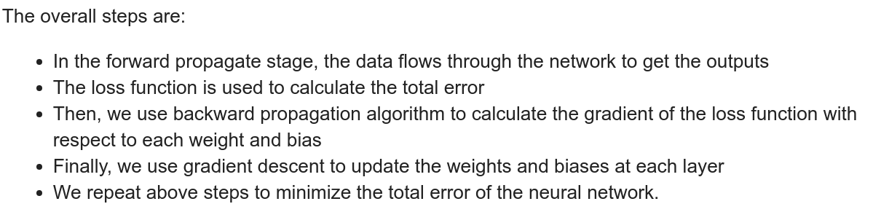

Slide 19


