Slide 1

Final Project Spark: Event Stream Processing and Spark machine learning
Pulekar, Rohan
CSCI E-63 Big Data Analytics
2016
Harvard University Extension School
Prof. Zoran B. Djordjević

Slide 2
What is the project about?
Processing a live feed with Kafka and Spark streaming
Produce a live streaming visualization of the processed data from the stream
Use machine learning to make near future predictions of live streaming data
Show those predictions in the visualization output

Slide 3
What’s the input to the project?
Mass DoT live highway info xml feed:
https://www.massdot.state.ma.us/feeds/traveltimes/RTTM_feed.aspx

Slide 4
How often is the live feed read?
Once every 5 mins

Slide 5
What information is read from the feed?
Average speed on each highway section

Slide 6
What information is read from the feed?
Average speed on each highway section
From this I deduce average speed on each highway

Slide 7
Where is this information sent?
Information of highway and average speed is sent to Kafka broker

Slide 8
Who reads messages from Kafka broker?
Spark streaming windowed streaming consumer

Slide 9
What does spark streaming consumer do next?
writes speed information of last 1 hour for each highway to a csv or AWS S3 file

Slide 10
What about speed prediction?
The consumer program while writing the csv file also predicts speed what the speed will be after 5 mins

Slide 11
Who reads the csv file?
The visualization component

Slide 12
What’s the visualization component?
An html file that plots a graph of highways and their speeds

Slide 13
What’s the visualization component?
An html file that plots a graph of highways and their speeds
It uses D3 javascript library to do the plotting

Slide 14
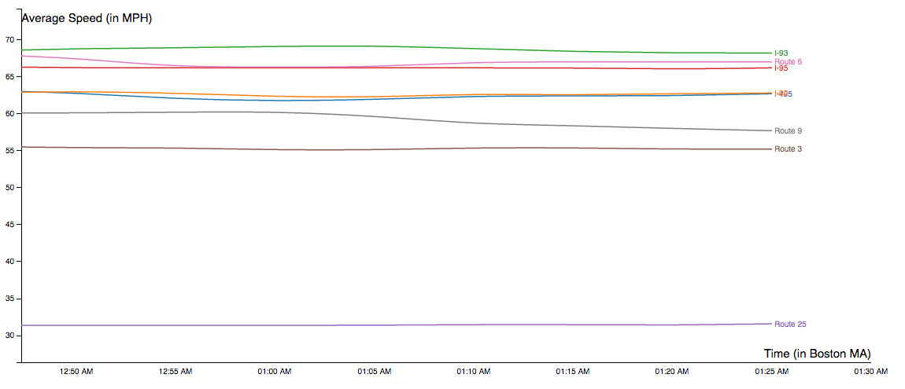
What’s the visual output look like?

Slide 15
Potential future enhancements
Different streaming libraries other than Spark can be used e.g. Apache Storm

Slide 16
Potential future enhancements
More pieces of live information about each highway can be processed and displayed to the user, e.g. accidents, construction work

Slide 17
Potential future enhancements
The machine learning module that predicts the speed of next 5 mins can be improved by giving it the input of actual instances of predicted data.

Slide 18
Is the application deployed somewhere?
Yes
It can be accessed at:
https://s3.amazonaws.com/e63-course-final-project/html/final_project_e63_visualization.html

Slide 19
YouTube URLs
Two minute (short):
15 minutes (long):

