Slide 1

“Work Prism: Work Compilance System”
Presented By
Satyen Patil
Rohan Raut
Rutuja Shingate
Muaz Mursal
Guided by:- Prof. Devyani Bonde
“Towards Ubiquitous Computing Technology”
Department of Computer Engineering
“Techno-Social Excellence”
Marathwada Mitra Mandal’s Institute Of Technology, Lohgaon, Pune-47

Slide 2
Topics
Introduction
Problem Statement
Objectives
Literature Review
Functional Requirements
Non-functional Requirements
Hardware & Software Requirements
System Architecture
Algorithm
UML Diagram
Advantages & Disadvantages
Applications
References

Slide 3
Introduction
The Work Compliance System is used to automate the process of admin and user management and user task. The work is under observation of the higher authorities. The project provides online platform to accomplish day to day task in a college department. The proposed software will help the higher authorities and faculty to communicate with each other. The system easily assigns tasks so as to avoid all the time-consuming and unnecessary meetings. The management of task is easy from both end. The task is provided to the faculty of a department by the HOD of the respective department. This software provides facilities to assign task, send message, send and view notification to the users of this software. The purpose for developing this project is to generate a platform where the higher authorities(Principal, HOD) can do operations like assign, add users and view operations. Work as it enables users to organize and prioritize projects efficiently and with flexibility. The Online task manager Software starts with the task and end up with checkmarks, the deadline and track the works will be notified.

Slide 4
Management
Principal
HOD Comp
HOD Mech
HOD Civil
Faculty
Teaching Staff
Non Teaching Staff

Slide 5
Motivation
Maintaining the workflow in the organization is very important. It helps in improving the overall productivity.
Keeping track of the workflow and ensuring that the deadlines are followed are important aspects in swift working of an organization.
Hence, we introduce Workprism - a work compliance system , which helps organizations maintain their workflow.

Slide 6
Problem Statement
Assigning tasks, setting deadlines and maintaining the workflow in an organization like a college, NGO, etc.

Slide 7
Objective
Maintain the workflow in an organization
The users can complete the tasks according to the due date and the importance of the task.
The entire task assignment process, keeping a track of the tasks and maintaining the workflow becomes easy.
The head of the organization can keep a check on the work of different departments

Slide 8
Literature Survey
Sr. No. | Title | Publication year | Remark
1 | Automated Task Management system using Analytical Hierarchy Process | 2020 Authors:Sonya Meitarice , Mumtaz Begum Peer Mustafa , Dedek Okta Andi | This research presents the research and development of an automated task management system using Analytical Hierarchy Process (AHP) measurement for task monitoring and provides alerts for university students, which can continuously monitor the student’s task performance.
2 | An Interactive Dashboard for Monitoring the Spread of COVID-19 in Sudan | 2020 Authors:Alaa M. O. Abdelsamad | An online interactive dashboard was designed to overcome the shortcomings of the current COVID-19 reports issued by the Federal Ministry of Health. The dashboard comprises different interactive graphs and charts that reflect the geographical and temporal distribution of COVID-19 cases in Sudan. Users can filter data by state, case type (confirmed, death, and recovered), or time (day, month), in addition to the ability to view testing details and summary.

Slide 9
Sr. No. | Title | Publication year | Remark
3 | Survey Paper: Framework of REST APIs | 2020 Autors: Sujan Y M, Dr. Shashidhara H R, Dr. Rohini Nagapadma | Restful API is a simple, flexible and easy maintainable API that is built on the REST architecture. Restful Architecture, proposes the APIs from the client application in a stateless manner. The client can perform different operations using the Restful service.REST stands for Representational State Transfer. REST uses a useful resource identifier to discover the specific resource worried in an interaction between components. Resources have relationships with different resources and a fixed of techniques or verbs to perform between those resources. Then you may have a group of sources that could interact as a group with one or extra sources or collections
4 | Online Task Management System (OTMS) | 2018 Authors:Grishma Hedoo , Priyanka Thoke , Raksha Tabhane , Shubham Meshram , Swapnil Kumbhalkar , PROF. Mukesh Barapatre | The Online Task Management System is used to automate the process of admin and user management and user task. The work is under observation of the higher authorities. The project provides online platform to accomplish day to day task in a college department. The proposed software will help the student and teacher to communicate with each other. The system easily assigns tasks so as to avoid all the time-consuming and unnecessary meetings. Teacher can periodically share all the details regarding the assignment with the Student. The management of assignment or task is easy from both end.

Slide 10
Functional Requirements
Validation of Users.
Defining the roles of users.
User should be able to assign task to other user.
User should be able to forward the task which was assigned to him/her.
Collecting and storing data in database.
The system should notify user about the deadlines of tasks.

Slide 11
Non-Functional Requirements
1. Availability:
The system should respond to the requests within two seconds or less.
2. Maintainability:
The software should be maintainable and adding new features and making changes should be as simple as possible.
System Recovery:
If the system fails it should recover within an hour or less.

Slide 12
Hardware & Software Requirements
Browser
2. Internet Connection
3. Minimum 4 GB RAM
4. Minimum i3 processor
5. Minimum 1 GB of Hard-disk

Slide 13

System Architecture
Databases
Server
SQL
SQL
SQL
API Services
Interactive dashboard
Notification
Trigger
Web
App
Android
App
IOS
App

Slide 14
Algorithm
BFS on Tree:
Map<string, list<string>> tree;
Map<string,int> levels;
queue<string> q;
q.push(“Management”);
curr_level = 1;
While(!q.empty){
int sz = q.size();
while(sz--){
string role = q.front();
q.pop();
levels[role] = curr_level;
for(int i = 0; i < tree[role].size(); i++){
q.push(tree[role][i]);
}
}
curr_level++;
}

Slide 15
UML Diagrams

Slide 16
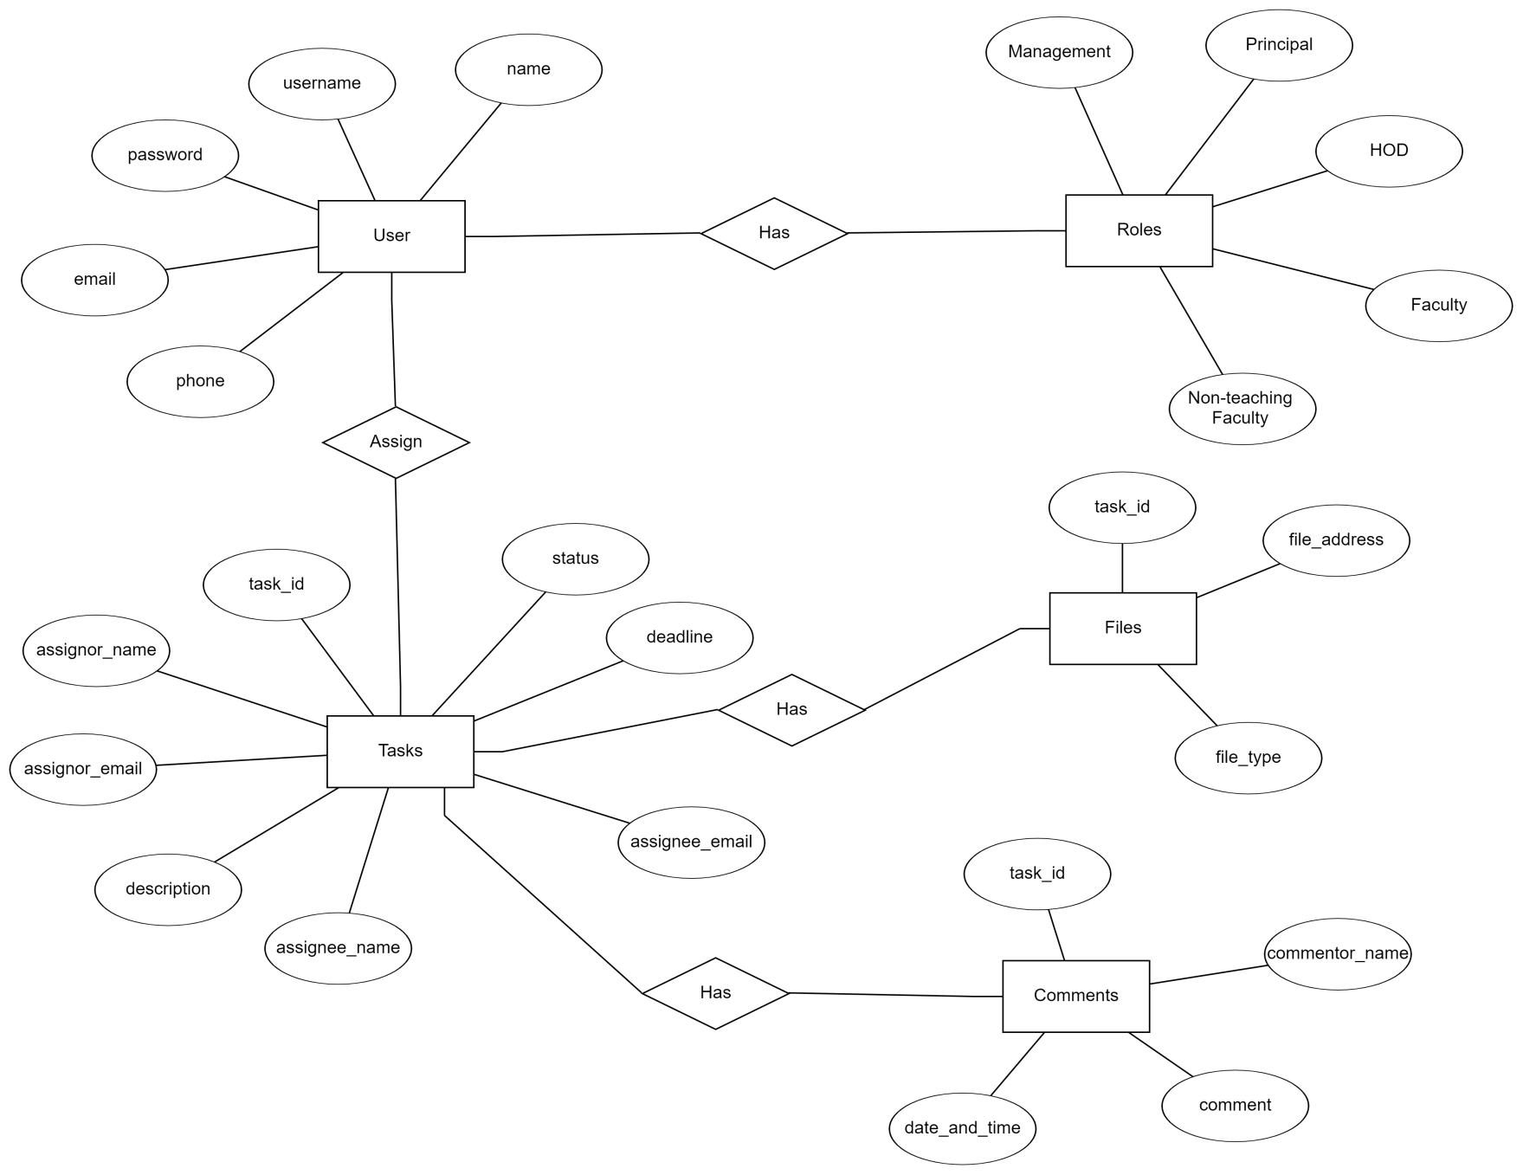
ER Diagram

Slide 17
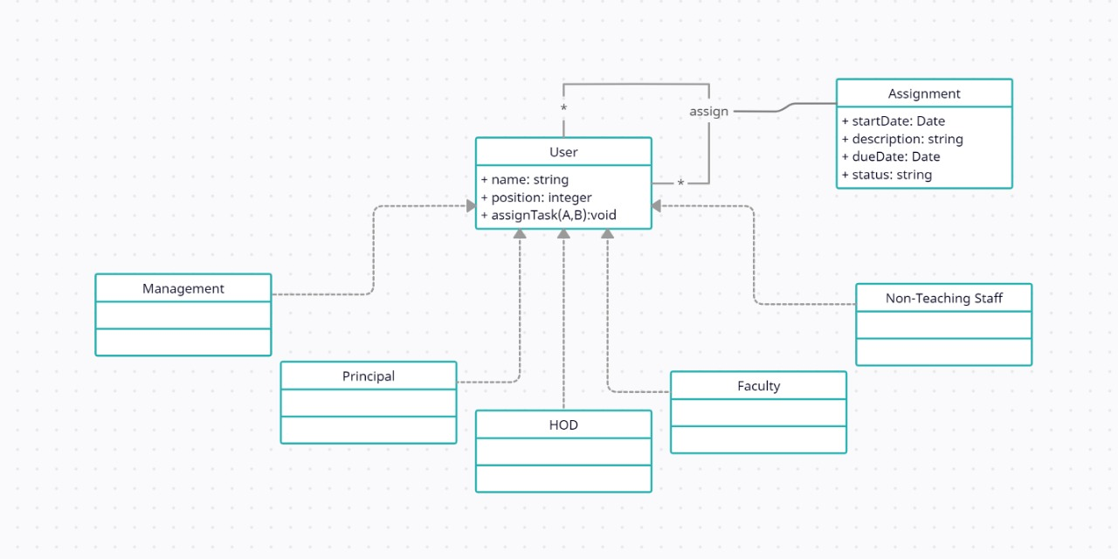
Class Diagram

Slide 18
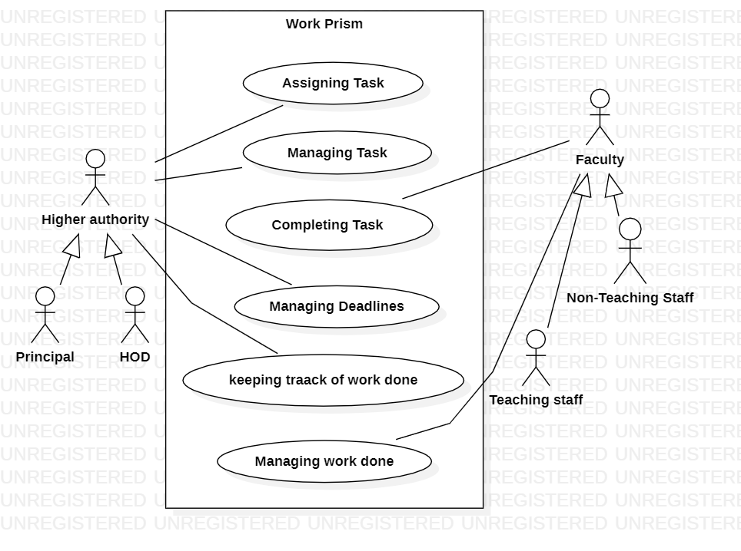
Use Case Diagram

Slide 19
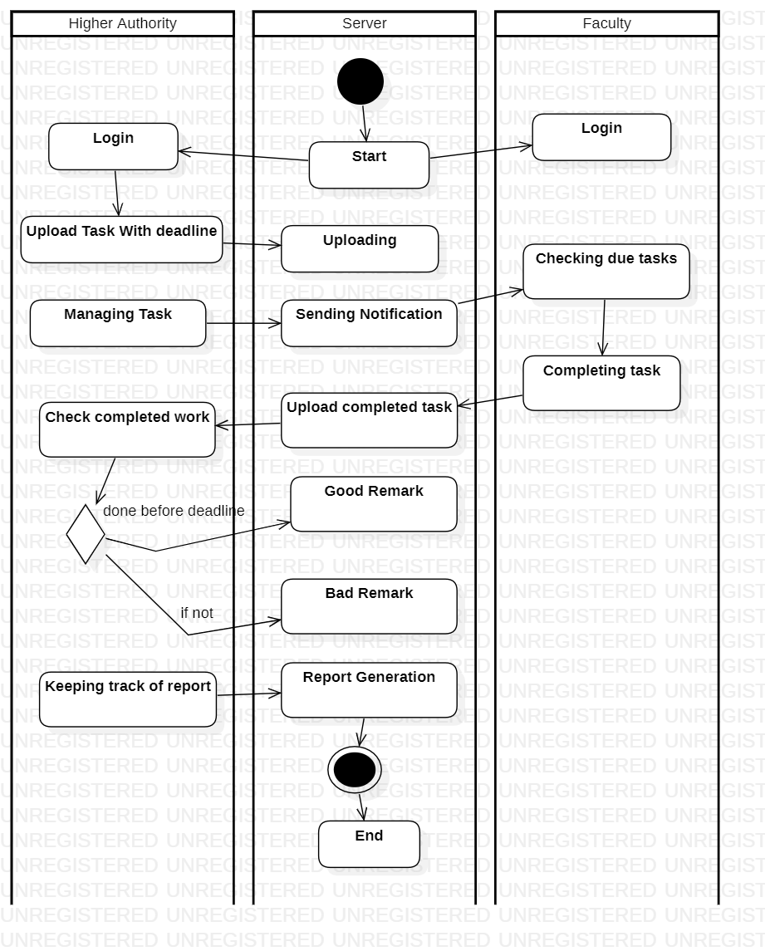
Activity Diagram

Slide 20
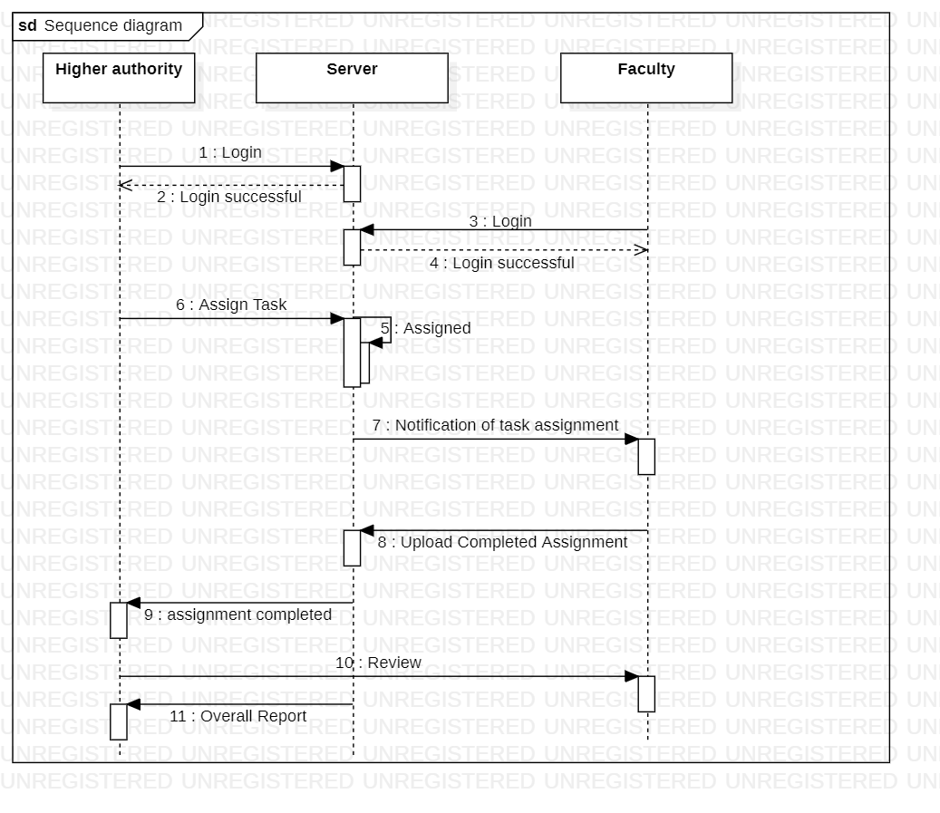
Sequence Diagram

Slide 21
Advantages
Contains a To-Do List, which improves efficiency of work.
Easy to manage and complete the tasks.
Users can complete the tasks based on priority.
All the users remains connected.
Speeds up the assignment process.
Effective communication and sharing

Slide 22
Disadvantages
1. Large size team management can be expensive.
2. If the admin goes rogue, the data can be compromised.
3. Regularly making sure that automated controls work properly.
4. Having to collect and store much more data than an organization usually does.

Slide 23
Applications
Can be used in :
1.Offices
2.Colleges/Schools
3.Organizations
4.Project management system

Slide 24
Conclusion
Through this presentation we have highlighted the architecture of our project and the importance of task management in an organization.

Slide 25
References
[1] An Interactive Dashboard for monitoring the spread of Covid-19 in Sudan,2020.
[2] Online Task management system, 2018.
[3] Survey Paper: Framework of REST APIs, 2020
[4] A study on task Management system,2016.

Slide 26
THANK YOU

