Slide 1


Implementation of Chatbot
NAME :-ROHAN AMRIT SAMBRE
AICTE ID:- STU61c2c07ce8f661640153212

Slide 2

Learning Objectives
Enhancing User Interaction: The chatbot should be able to engage with users in a natural, intuitive, and helpful way, understanding their queries and responding effectively.
Providing Efficient Customer Support: Chatbots should be able to answer frequently asked questions, resolve issues, and provide assistance on a range of topics related to the service or product.
Improving Problem-Solving Capabilities: The chatbot should learn from user interactions and become better at solving problems over time, ensuring that it can handle complex queries.
GOAL
Source :
www.freepik.com/

Slide 3
Learning Objectives
Language Understanding and Processing: A core objective is for the chatbot to understand and process natural language, including slang, varied sentence structures, and domain-specific terminology.
Reducing Response Time: By automating responses to common queries, chatbots can reduce the amount of time users need to wait for assistance, making the process more efficient.
Encouraging User Engagement: Chatbots should be designed to keep users engaged, offer them valuable information, or even entertain, depending on the context.
GOAL
Source :
www.freepik.com/

Slide 4
Tools and Technology used
1. Natural Language Processing (NLP) Technologies
NLP is the core technology that enables chatbots to understand and generate human language. These tools help chatbots interpret user inputs and respond appropriately.
NLTK (Natural Language Toolkit): A popular Python library used for text processing, tokenization, stemming, and other NLP tasks.
2. Machine Learning (ML) and Deep Learning
These technologies help chatbots learn and improve over time based on past interactions.
TensorFlow: An open-source machine learning framework used to develop neural networks for NLP tasks, allowing chatbots to improve their accuracy and response generation.
3.Logistic regression is a supervised machine learning algorithm widely used for binary classification tasks, such as identifying whether an email is spam or not and diagnosing diseases by assessing the presence or absence of specific conditions based on patient test results.

Slide 5
Methodology
Flow Process:
Import some basic library
Load intents from the JSON file
Create the vectorizer and classifier
Preprocess the data
training the model
Create a sidebar menu with options
Home Menu
Check if the chat_log.csv file exists, and if not, create it with column names

Slide 6
Methodology
Convert the user input to a string
Get the current timestamp
Save the user input and chatbot response to the chat_log.csv file
Conversation History Menu

Slide 7
Problem Statement:
Inconsistent Response Times: Traditional customer service channels often lead to delayed responses, especially during off-hours or peak times, resulting in a negative user experience
High Operational Costs: Manual customer support can be costly in terms of labor and resources, especially when dealing with repetitive or routine inquiries
Limited Availability: Customers expect instant responses, but human support agents are not available 24/7, leading to unmet customer expectations
Lack of Personalization: Traditional support models often fail to deliver personalized experiences, leading to lower customer satisfaction and engagemen

Slide 8
Solution:
Natural Language Understanding: Developing a chatbot that can accurately understand and process natural language inputs from users, including slang, typos, and varied sentence structures.
Context Awareness: Ensuring the chatbot maintains context during conversations and provides appropriate, coherent responses even when conversations extend over multiple interactions.
Integration with External Systems: Integrating the chatbot with existing databases, APIs, and third-party systems (e.g., e-commerce platforms, CRM systems) to provide relevant, real-time information to users
User Privacy and Security: Ensuring the chatbot complies with privacy regulations (e.g., GDPR, HIPAA) and handles sensitive user data securely

Slide 9
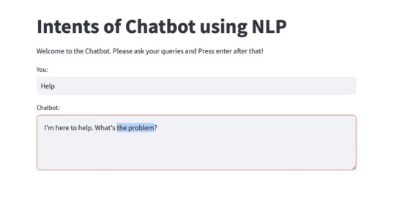
Screenshot of Output:

Slide 10
Conclusion:
Enhanced Customer Satisfaction: The ability to respond quickly, accurately, and at any time provides users with a seamless experience, fostering greater customer satisfaction and loyalty
Operational Efficiency: Chatbots automate routine tasks, reduce the need for human intervention in repetitive inquiries, and allow customer service teams to focus on more complex issues, ultimately lowering operational costs
Scalability: Unlike human agents, chatbots can handle an unlimited number of conversations simultaneously, making it easier to scale customer support operations during high-demand periods without compromising quality
Github link:-https://github.com/rohan-sambre97/CHATBOT_USING_NLP_AICTE_Cycle4.git

