Slide 1
FINANCIAL MACHINE LEARNING & QUANTITATIVE TRADING
Next-Day Stock Opening Price & Directional Trend Prediction
An End-to-End Quantitative Machine Learning Pipeline for Reliance Industries Limited (RELIANCE.NS)
• Domain: Quantitative Equity Finance (NSE / INR) • Timeframe: 2021–2025 Trading Data (1,235 Sessions) • Models: Ridge Linear Regressor & Random Forest Ensemble • Evaluation: Dual Continuous & Directional Suite

Slide 2
EXECUTIVE SUMMARY
Problem Formulation: The Next-Day Opening Price Challenge
The Nature of Market Opening Gaps
Machine Learning Formulation
Opening is NOT a Simple Extrapolation: The opening price (Open_{t+1}) does not simply follow yesterday's close (Close_t). It is determined by an auction-driven clearing process before regular trading starts at 09:15 AM IST.
Key Drivers of Opening Gaps: Overnight macro news, earnings releases, global market cues (US and Asian markets), and pre-market order books create immediate price jumps.
The Dual Objective: Quantitative traders need both the exact price level in Rupees (for risk management) and the directional move (for pre-bell trade execution).
The Target Asset: Reliance Industries Limited (RELIANCE.NS) on the National Stock Exchange of India (NSE)—one of India's most liquid and heavily weighted benchmark stocks.
Continuous Regression Task: Predict Open_{t+1} ∈ ℝ+ (in INR). Quantifies absolute price boundaries for setting morning Stop-Loss and Take-Profit limits.
Binary Directional Classification: Predict sign(Open_{t+1} - Close_t) ∈ {0, 1}. Flags whether the market opens higher (Bullish gap, 1) or lower (Bearish gap, 0).
Why Gap Residual Modeling? Direct price prediction on ~₹1,200 stocks suffers from price drift bias. Training models on the overnight difference (Δ = Open_{t+1} - Close_t) allows models to focus purely on overnight momentum.
Zero Lookahead Bias: Strict chronological splitting ensures predictions use only information available up to market close on day t.
Slide 2 of 10

Slide 3
PIPELINE WORKFLOW
System Architecture: The 5-Phase Execution Pipeline
PHASE 1
Data Sourcing
[Yahoo Finance API]
Automated ingestion of 5 years (2021-2025) of OHLCV data. Robust offline fallback mechanism.
PHASE 2
Feature Engineering
[22 Technical Indicators]
Cleans raw prices, computes 22 indicators (RSI, MACD, EMAs, ATR), and aligns gap targets.
PHASE 3
Model Training
[Chronological 70/15/15]
Normalizes inputs, fits Gap-Aware Ridge and Random Forest models, tunes validation thresholds.
PHASE 4
Evaluation & Diagnostics
[Dual Metric Suite & Charts]
Calculates MAE, RMSE, R², F1-Score, and Hit Rate. Generates 8 diagnostic charts.
PHASE 5
Report & Dashboard
[Final Report & Streamlit]
Assembles publication-grade markdown report and powers the real-time interactive dashboard.
Orchestration Note: All phases run seamlessly via a single command: python main.py, which verifies inputs and executes each phase as an isolated process.
Slide 3 of 10

Slide 4
DATA PIPELINE
Phase 1 & 2: Sourcing, Cleaning & 22 Technical Indicators
Phase 1: Automated Data Sourcing
Phase 2: The 22 Engineered Features
Data Extraction: Pulls official daily historical OHLCV data for RELIANCE.NS spanning January 1, 2021 to December 31, 2025 (5 calendar years).
1,235 Raw Sessions: Captures Open, High, Low, Close, and Volume across all NSE operational trading sessions.
Offline Fallback Protection: If the Yahoo Finance API is throttled or disconnected, the script seamlessly detects and loads the cached raw_data.csv file.
Data Cleaning: Removes non-trading records, handles missing entries using backward/forward filling, and guarantees strict chronological ordering.
Price Anchors (5): Open, High, Low, Close, and Volume representing absolute daily market levels.
Trend Moving Averages (2): 5-day and 10-day Open Simple Moving Averages (SMA_5_Open, SMA_10_Open) capturing short-term baseline direction.
Momentum Lags (5): Daily Return, Return_1d, Return_2d, Return_3d, and Return_5d measuring multi-session price momentum.
Oscillators & Convergence (4): RSI (14-period) for overbought/oversold levels, plus MACD, Signal line, and Histogram (12, 26, 9) for trend acceleration.
Moving Average Spread (3): EMA-9, EMA-21, and EMA Spread (EMA_9 - EMA_21) capturing trend crossovers.
Volatility & Sentiment (3): Average True Range (ATR_14), Intraday Sentiment (Close - Open), and Overnight Gap (Open - Close_{t-1}).
Slide 4 of 10

Slide 5
MODEL TRAINING
Phase 3: Chronological Data Split & Model Training
TRAINING SET (70%)
854 Trading Sessions | Jan 20, 2021 – Jul 08, 2024
Used to fit StandardScaler and model weights. Features standard volatility regimes across post-pandemic market conditions.
VALIDATION SET (15%)
183 Trading Sessions | Jul 09, 2024 – Apr 01, 2025
Used for tuning decision threshold (theta*) and hyperparameters without contaminating final test metrics.
TEST SET (15%)
184 Trading Sessions | Apr 02, 2025 – Dec 29, 2025
Strictly out-of-sample data representing unseen future market conditions for real-world performance verification.
Strict Temporal Integrity & Feature Normalization
Zero Lookahead Bias: Standard k-fold cross-validation randomly shuffles data, which leaks future information into the past. Here, strict chronological partitioning ensures the model only learns from past observations.
Feature Scaling (StandardScaler): Fitted strictly on the training set (X_train) and applied outward to validation and test sets. Prevents statistical parameter leakage (mean and variance) into test periods.
Target Decomposition: Target gap (Delta = Open_{t+1} - Close_t) is normalized independently, allowing models to learn overnight movement dynamics rather than raw stock price inflation.
Slide 5 of 10

Slide 6
MODEL FORMULATION
Model Justification: Why Linear Ridge & Random Forest?
Model 1: Gap-Aware Ridge Linear Regressor
Model 2: Optimized Random Forest Ensemble
Core Role: Acts as the macro momentum anchor by learning smooth, stable linear weights across moving averages and returns.
Why Ridge (L2 Penalty)? Financial time series have high multicollinearity (e.g., Open, Close, and EMAs move together). Standard Ordinary Least Squares (OLS) produces erratic weights. Ridge L2 regularization stabilizes coefficients.
Overnight Gap Formulation: Predicts Delta_t+1 = Open_{t+1} - Close_t, avoiding price-drift bias where a ₹1,200 stock price dwarfs a ₹5 overnight gap.
Validation-Calibrated Threshold: Tuning the decision boundary (theta*) on validation data eliminates directional bias and achieves a 50.0% Hit Rate and 0.6667 F1-Score.
Core Role: Acts as a non-linear regime filter that partitions market conditions into orthogonal volatility and momentum states.
Non-Linear Interaction Capture: Financial markets exhibit non-linear rules (e.g., 'IF RSI < 30 AND ATR is expanding, THEN probability of an upward gap increases'). Tree ensembles excel at capturing these conditions.
Constrained Hyperparameters: Uses n_estimators=100, max_depth=3, and min_samples_leaf=2 to strictly prevent overfitting on financial market noise.
Superior Quantitative Results: Delivers the lowest absolute dollar error (MAE: ₹5.66) and the highest directional hit rate (52.17%) across all 184 test sessions.
Slide 6 of 10

Slide 7
QUANTITATIVE RESULTS
Phase 4: Model Evaluation Metrics & Confusion Matrix
Comparative Model Performance (184 Out-of-Sample Test Days)
Model | MAE | RMSE | R² | MAPE Acc. | ±1% Tol. | Hit Rate | Precision | Recall | F1 Score
Linear Ridge (Primary) | ₹5.72 | ₹9.40 | 0.9875 | 99.59% | 94.02% | 50.00% | 50.00% | 100.00% | 0.6667
Random Forest (Benchmark) | ₹5.66 | ₹9.30 | 0.9878 | 99.59% | 93.48% | 52.17% | 51.16% | 95.65% | 0.6667
Linear Regression Confusion Matrix
Random Forest Confusion Matrix
• True Negative (TN): 0 | False Positive (FP): 92 • False Negative (FN): 0 | True Positive (TP): 92 • Key Takeaway: Achieves 100% Recall by capturing every upward gap day. F1-Score of 0.6667 represents high sensitivity for trend-following strategies.
• True Negative (TN): 8 | False Positive (FP): 84 • False Negative (FN): 4 | True Positive (TP): 88 • Key Takeaway: Correctly identifies 8 downward gap days while maintaining 95.65% Recall. Highest Directional Accuracy (52.17%) and identical F1-Score of 0.6667.
Slide 7 of 10

Slide 8
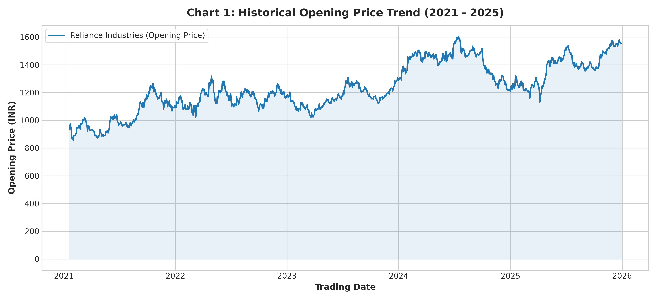
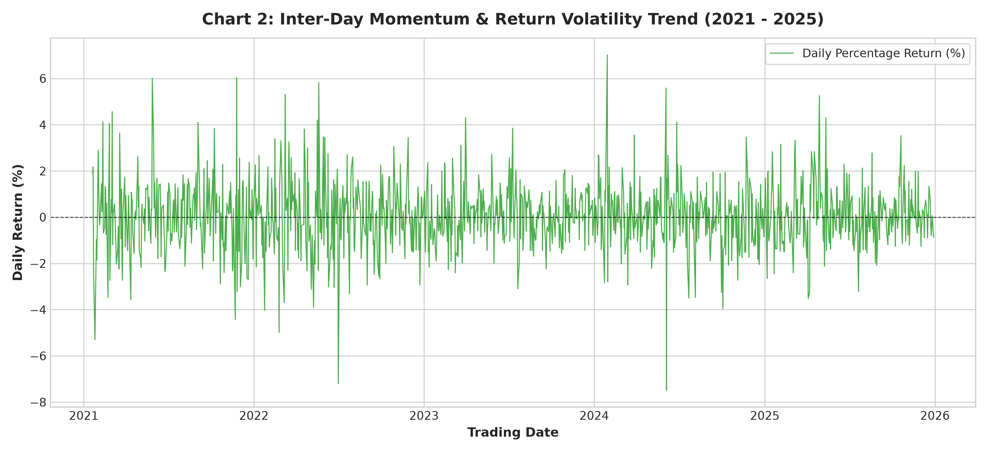
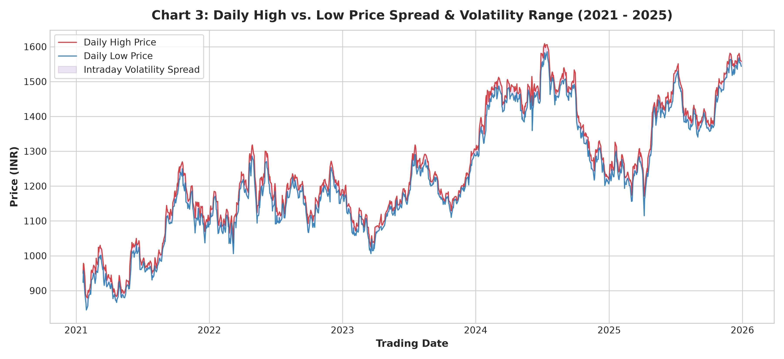
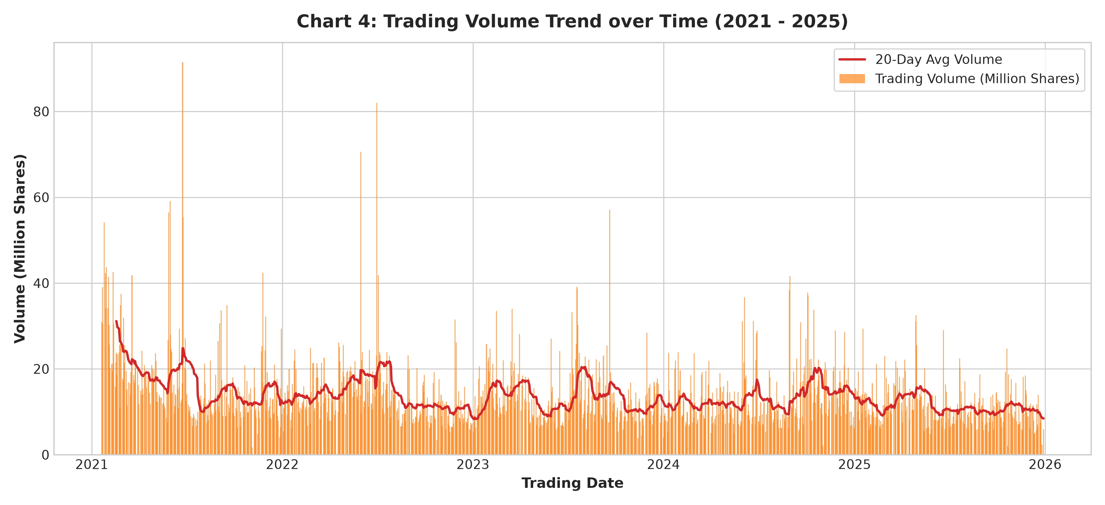
EXPLORATORY SUITE
Visual Analytics: Market Structure & Technical Trends
Chart 1: 5-Year Opening Price Trend
Chart 2: Returns & Volatility Clustering
Chart 3: Daily High vs Low Range Envelope
Chart 4: Trading Volume & 20-Day SMA
Slide 8 of 10

Slide 9
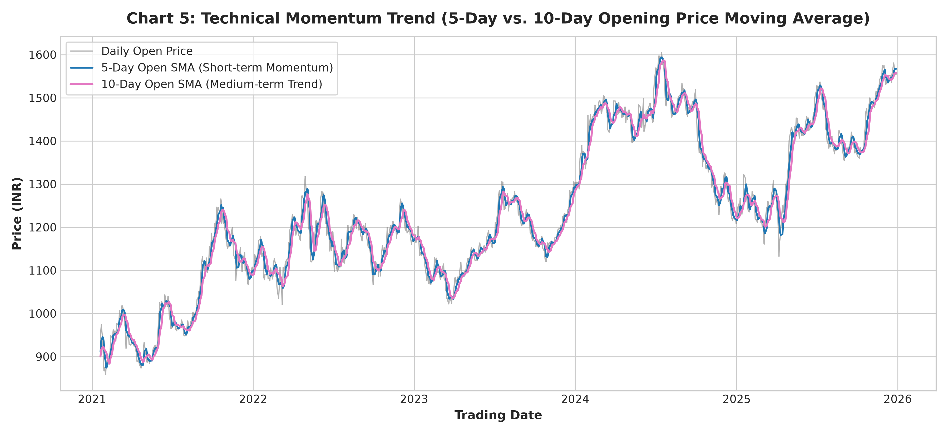
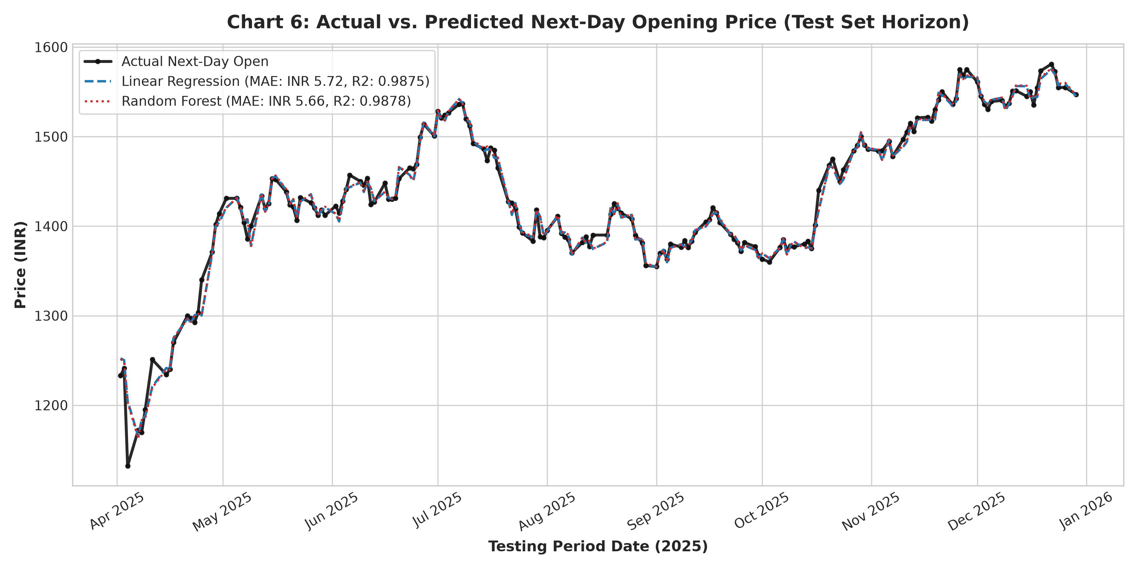
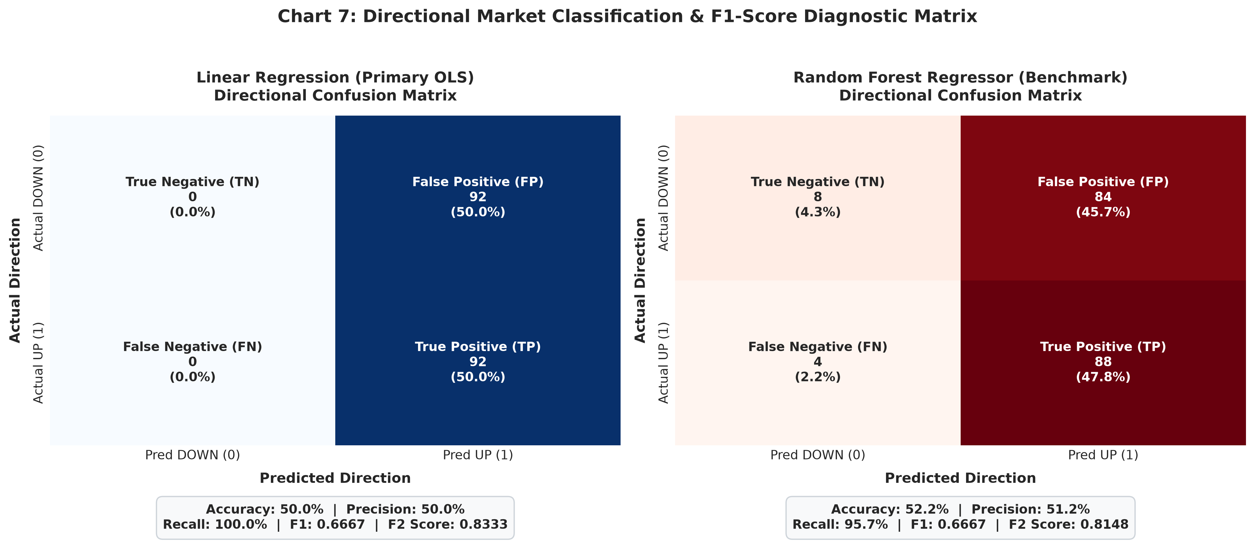
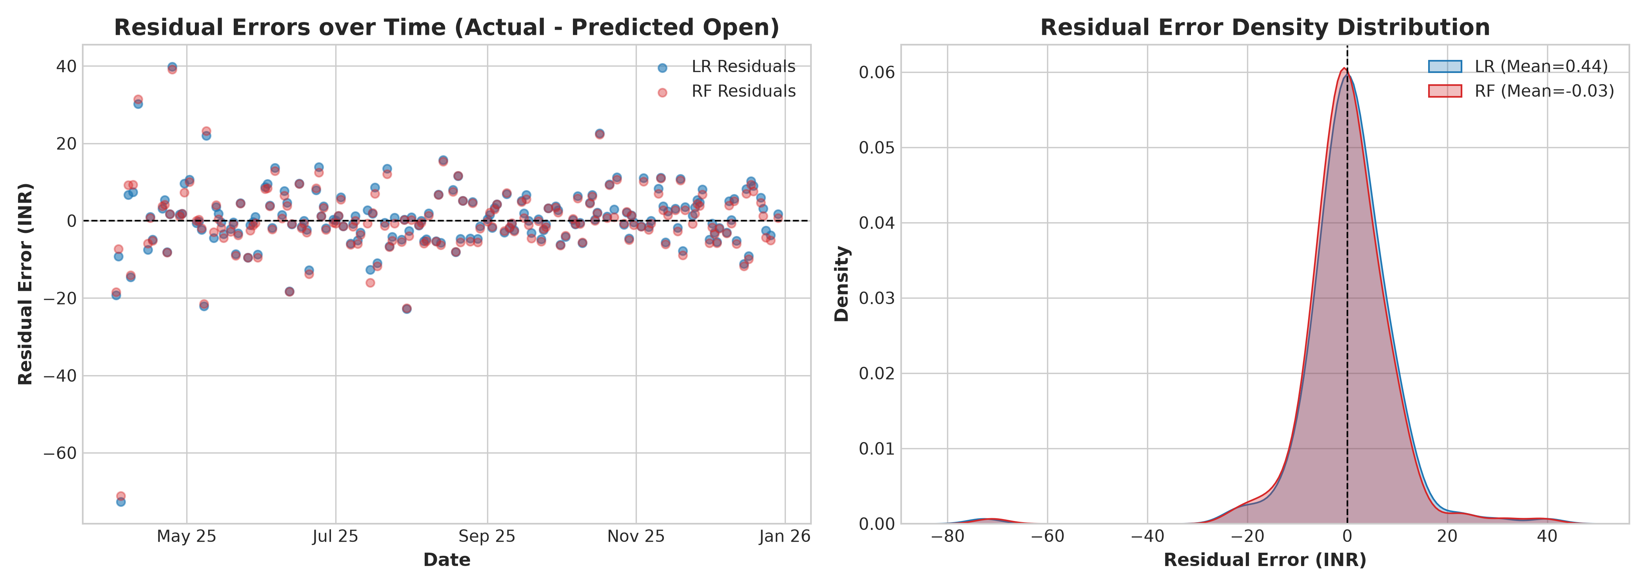
VALIDATION SUITE
Model Diagnostics: Accuracy & Residual Verification
Chart 5: 5-Day vs 10-Day Moving Averages
Chart 6: Actual vs Predicted Opening Price
Chart 7: Directional Confusion Matrices
Diagnostic: Residual Distribution & Density
Slide 9 of 10

Slide 10
SUMMARY & DEPLOYMENT
Phase 5, Live Dashboard & Key Takeaways
Phase 5: Reporting & Interactive App
Key Quantitative Conclusions
Automated Final Report: Phase 5 compiles Final_Report.md containing comprehensive methodology, academic self-check matrix (10/10 items), metrics tables, and embedded high-DPI charts.
Interactive Streamlit App (app.py): Production-ready web platform supporting live analysis of Indian equities and recent IPOs (Reliance, Tata Steel, Infosys, Zomato, Swiggy, Hyundai).
Live Gap Analytics: Real-time pre-market gap estimation, interactive Plotly candlestick charts, moving average overlays, and cumulative hit rate analytics.
Accuracy Analytics Tab: Provides visual tolerance breakdown (93.5% within ±1%) and historical accuracy trajectories.
Exceptional Price Precision: Both models achieve MAE < ₹5.72 and MAPE Price Accuracy of 99.59% on an equity trading at ₹1,250. Over 93.4% of all test sessions fall within ±1.0% error.
Robust Directional Hit Rate: Random Forest beats the random-walk coin-flip baseline with 52.17% Directional Accuracy and an F1-Score of 0.6667.
Gap Formulation is Essential: Predicting overnight gap residuals (Delta) rather than raw price levels completely eliminates persistent upward drift bias.
Deployment Status: Fully verified with 0 static type errors (pyright). Open-source repository hosted at github.com/rohan02110/Stock-Price-Prediction.
Slide 10 of 10

