Slide 1
Playwright CLI
Rohan Patil

Slide 2
MCP
MCP is powerful but expensive on context, making it less practical for agents already handling large codebases or frequent browser interactions.

Slide 3
Why CLI over MCP?
CLI commands are token-efficient — no heavy tool schemas or accessibility trees loaded into context
Agents use concise, purpose-built commands instead of verbose inputs
Better suited for coding agents juggling browser automation + large codebases within limited context windows
CLI + SKILLs = the preferred pattern for high-throughput agentic workflows

Slide 4


Skills

Slide 5
CLI & Skills
npm install -g @playwright/cli@latest
playwright-cli –help
playwright-cli install --skills

Slide 6
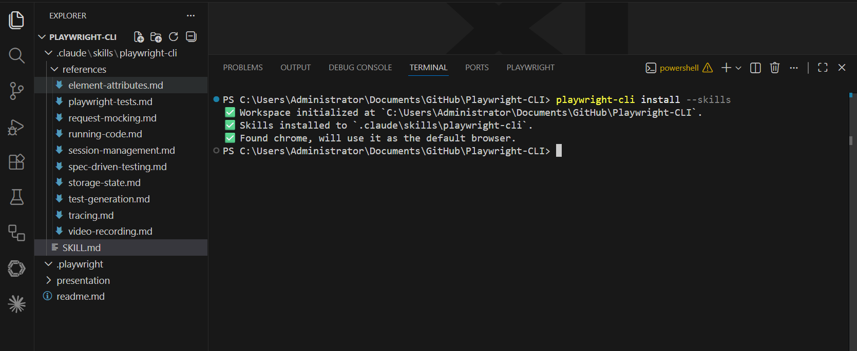

Slide 7
Examples & Prompts
Use Playwright cli, goto website www.saucedemo.com , login with existing credentials. Complete the checkout process.
Record a video, save it using –filename=demo.mp4
can you make a test plan & save the plan.md file in this repo

Slide 8
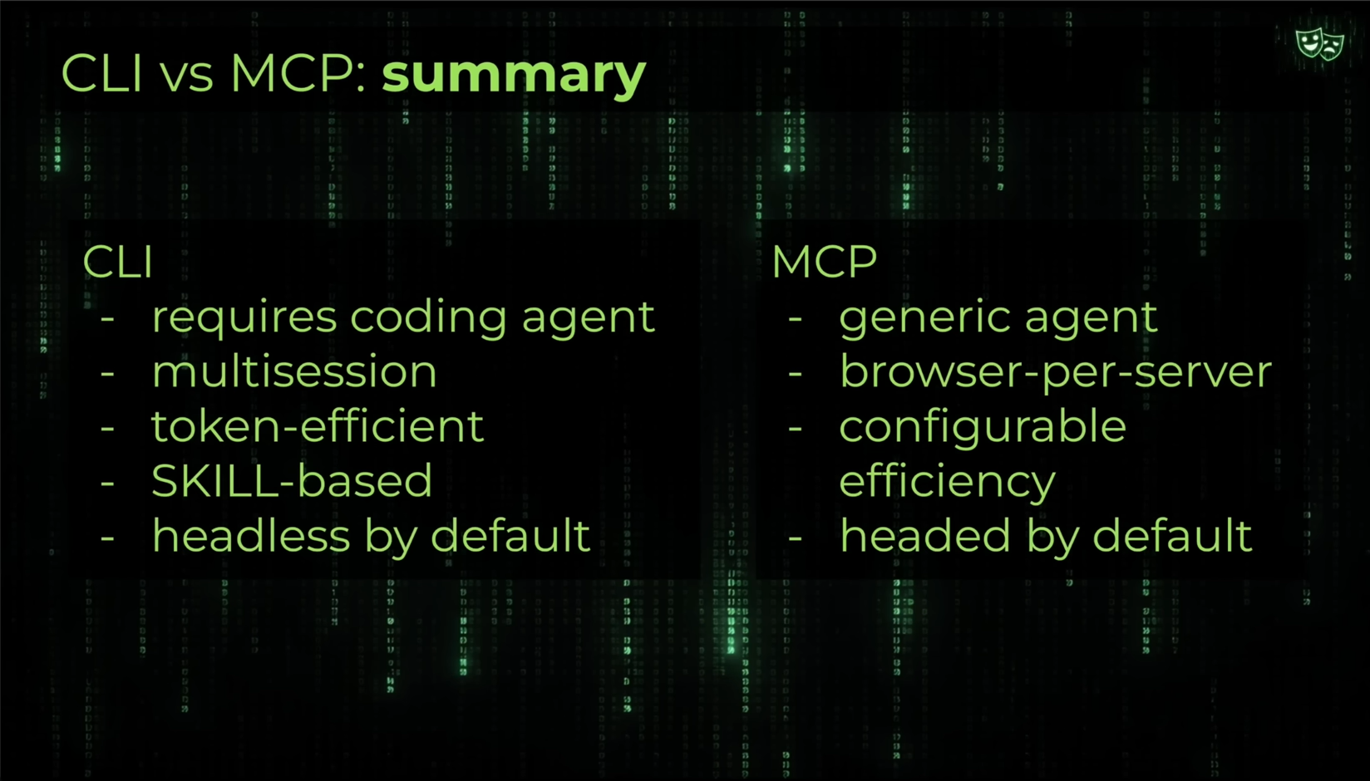

Slide 9
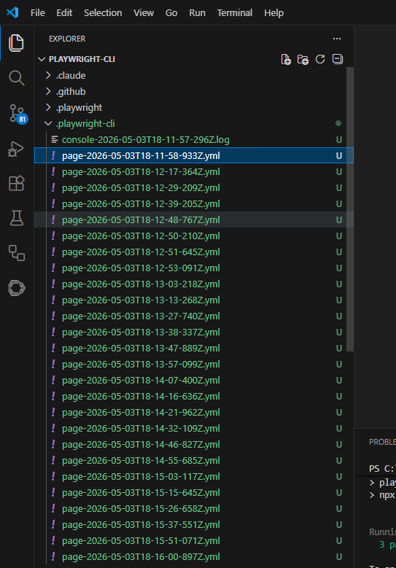

Slide 10
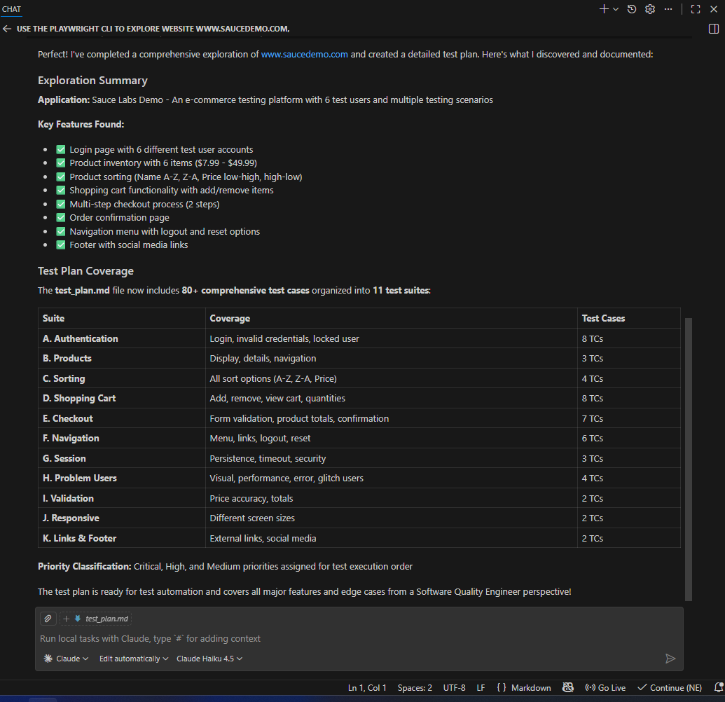

Slide 11
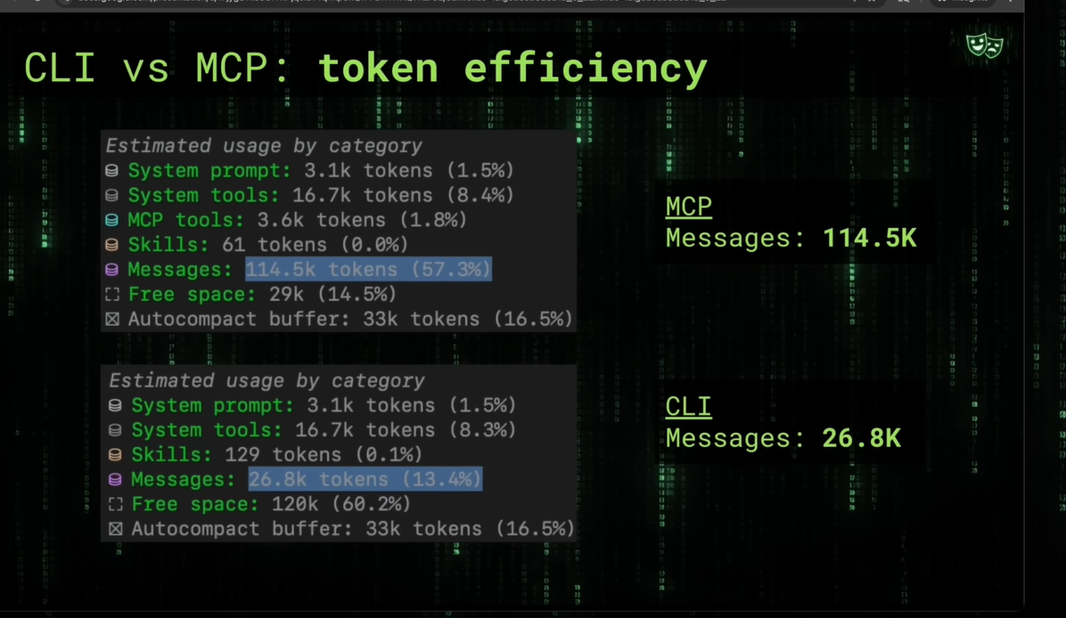

Slide 12
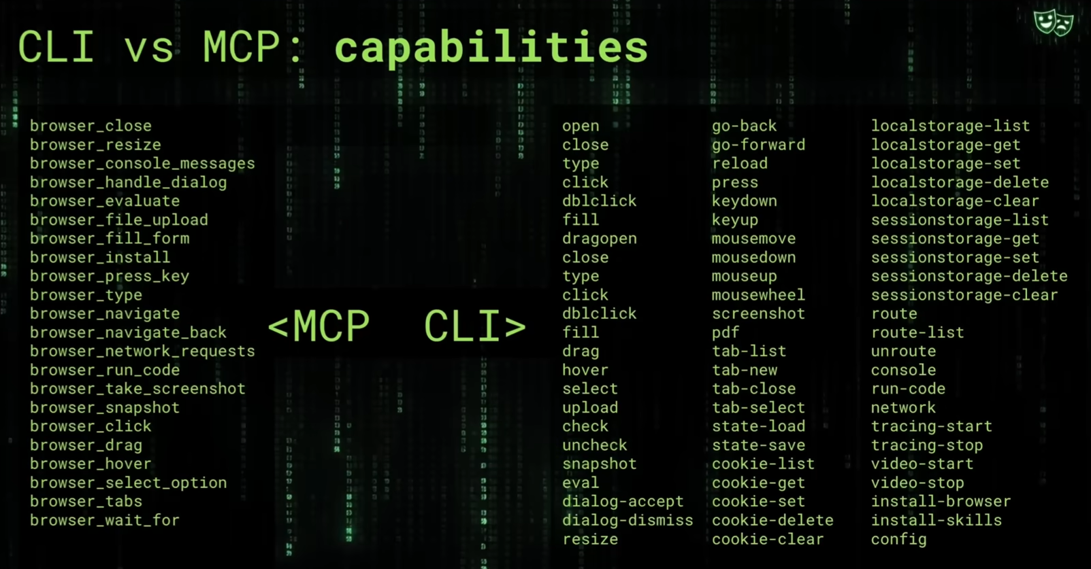

Slide 13
Trace
For previous prompt, record a trace with screenshots=true, snapshots=true, save as trace.zip
npx playwright show-trace trace.zip

