Slide 1
AIQE
Rohan Patil

Slide 2
4 Steps
Explore > Plan > Prepare > Automate

Slide 3
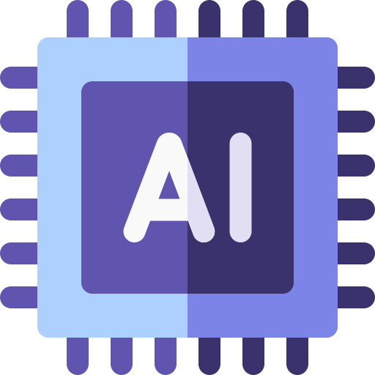
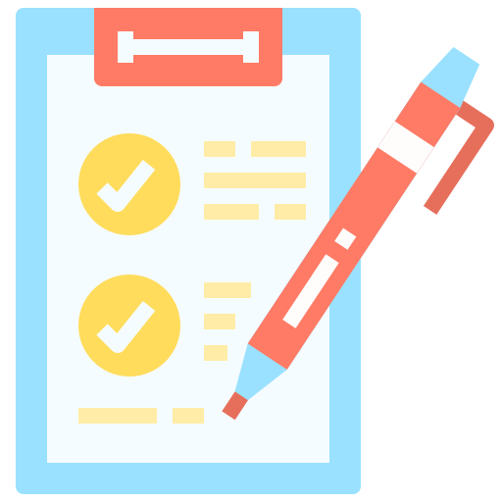
Explore
Plan
AI explores the application to gain contextual knowledge.
Business Requirements => context
AI helps to craft comprehensive Test plan listing all features & scenarios

Slide 4
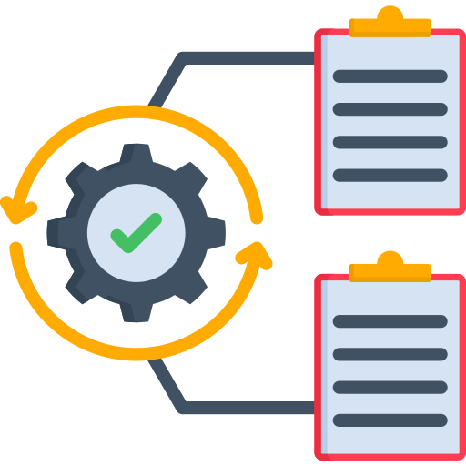
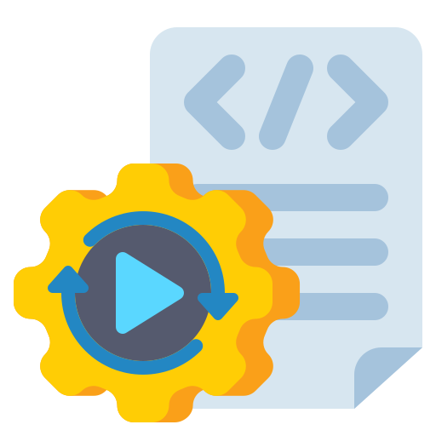
Automate
Prepare
Test Plan can be used to prepare list of Test Cases
AI uses the testcases & Playwright CLI to write test automation scripts

Slide 5
MCP
Model Context Protocol — lets AI directly connect to & control a browser using pre-built tools. After EVERY action, the browser sends AI the ENTIRE page state.
MCP is powerful but expensive on context, making it less practical for agents already handling large codebases or frequent browser interactions.
Token Cost Per Action:
playwright_navigate(url) → ~8,000 tokens
playwright_click(selector) → ~8,000 tokens
playwright_get_text() → ~8,000 tokens
TOTAL for 3 actions: ~24,000 tokens

Slide 6
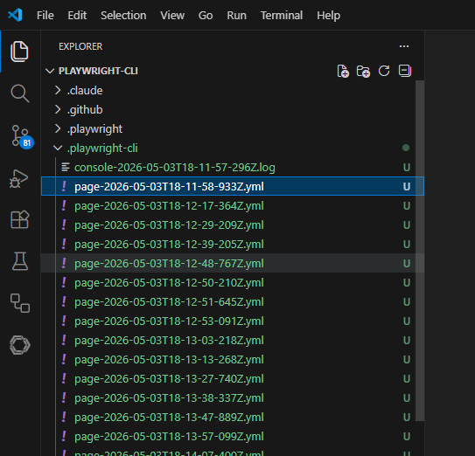
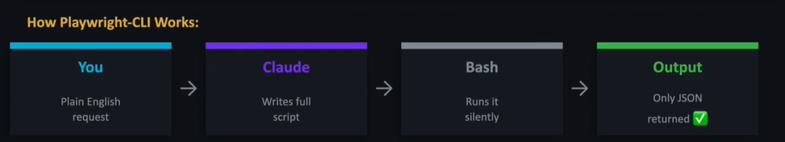
Playwright CLI
A standalone tool by Microsoft built specifically for AI agents.
AI writes complete scripts and runs them via command line interface.
Token efficient

Slide 7
Skill
A Skill is a SKILL.md file that gives AI pre-built best practices for a specific task — before it writes a single line of code.
Think of it as AI's instruction manual.
With skill (SKILL.md)
AI reads instructions FIRST
Knows best practices immediately
Right approach, first try, fewer tokens
Without skill
AI figures it out by trial & error
Makes mistakes → uses more tokens
Slower, unpredictable results
The Playwright-CLI Skill tells AI to:
1. Use CLI commands, not MCP
2. Batch all actions in one script
3. Be surgical — only extract what’s needed
4. Return clean JSON only

Slide 8
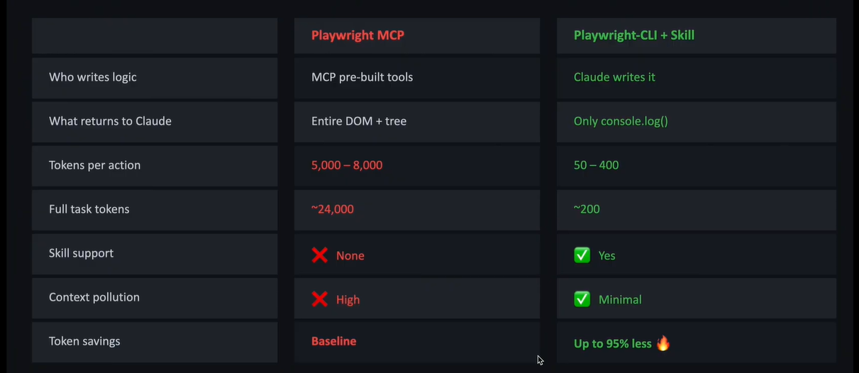
MCP vs PlaywrightCLI

Slide 9
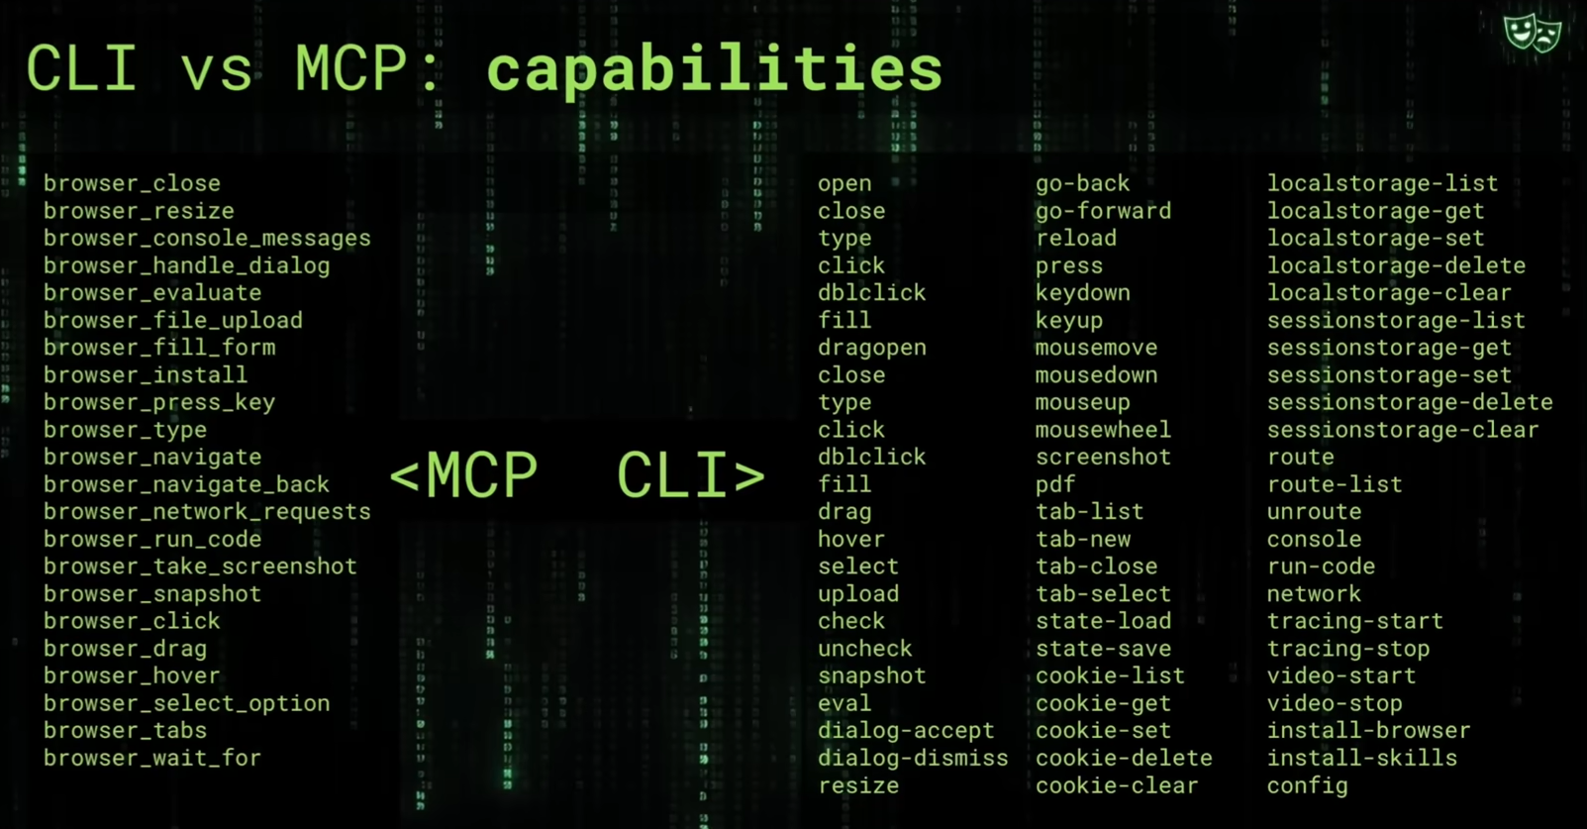

Slide 10
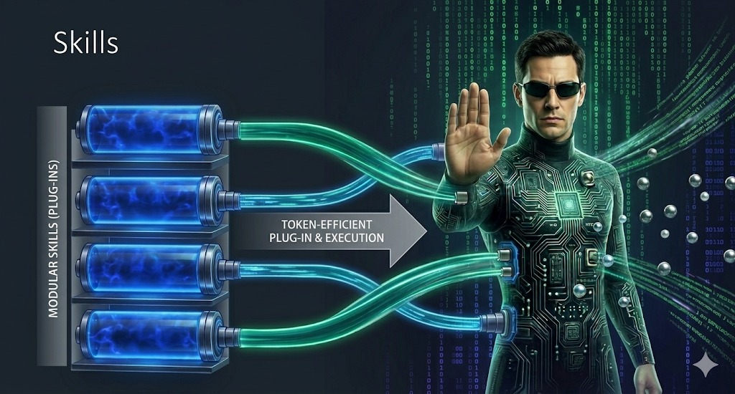

Slide 11
Links
https://playwright.dev/
https://playwright.dev/mcp/introduction
https://playwright.dev/agent-cli/introduction

Slide 12
Thank you

