Slide 1
SHOPPING MALL MANAGAEMNET SYSTEM
MEMBERS :
Rohan Jain(15012101009)
Kanishka Prajapati(15012101011)

Slide 2
PROJECT DEFINTION :
Shopping mall management system

Slide 3
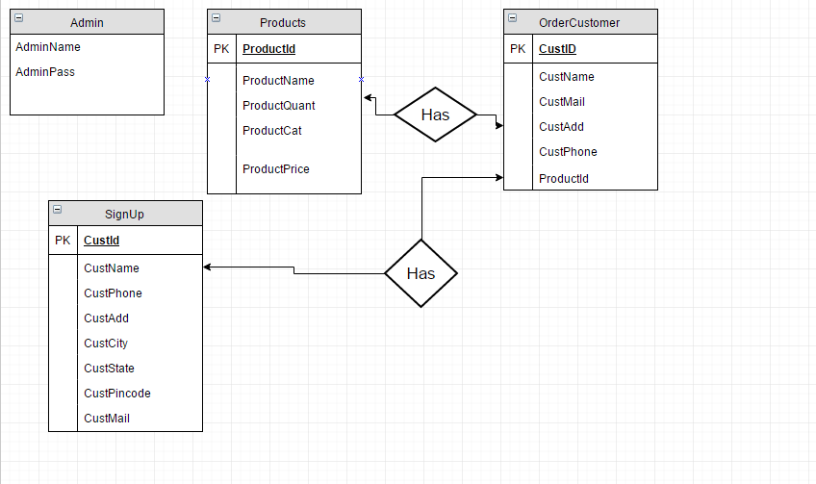
E-R DIAGRAM :

Slide 4
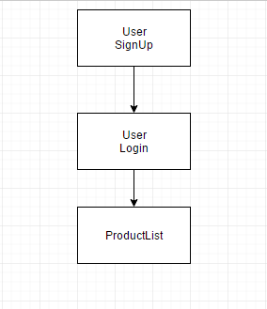
USER FLOW CHART

Slide 5
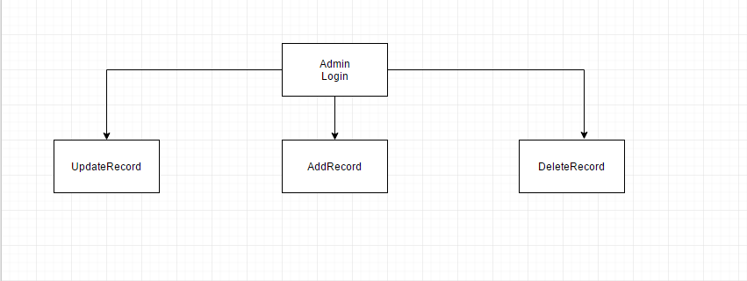
ADMIN FLOWCHART

Slide 6
TABLE STRUCTURE

Slide 7
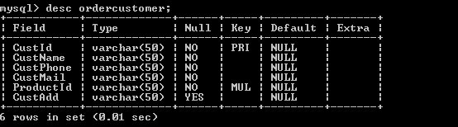
ORDERCUSTOMER TABLE :

Slide 8
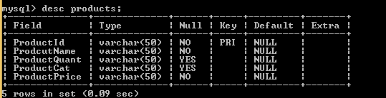
PRODUCTS TABLE :

Slide 9
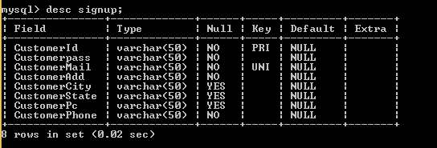
SIGNUP TABLE :

Slide 10
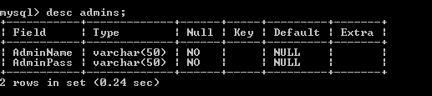
ADMIN TABLE

Slide 11
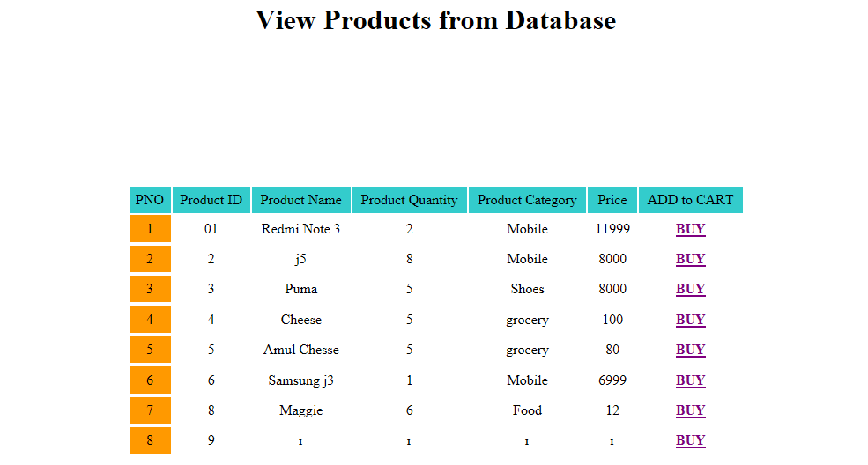

Slide 12
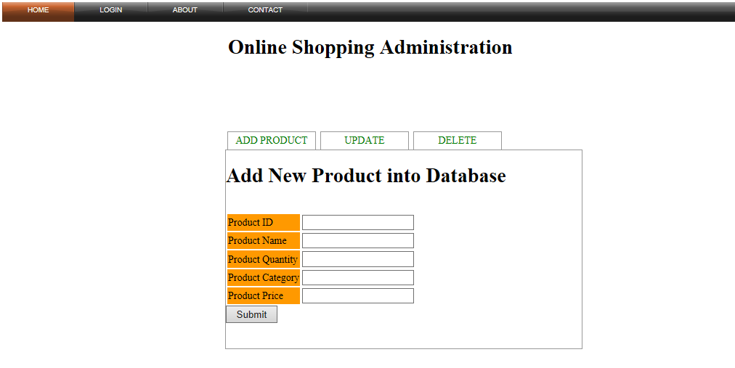

Slide 13
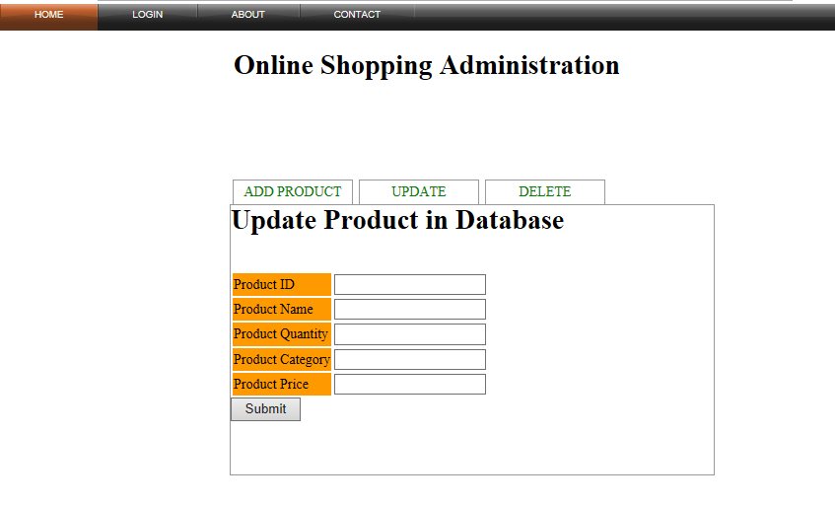

Slide 14
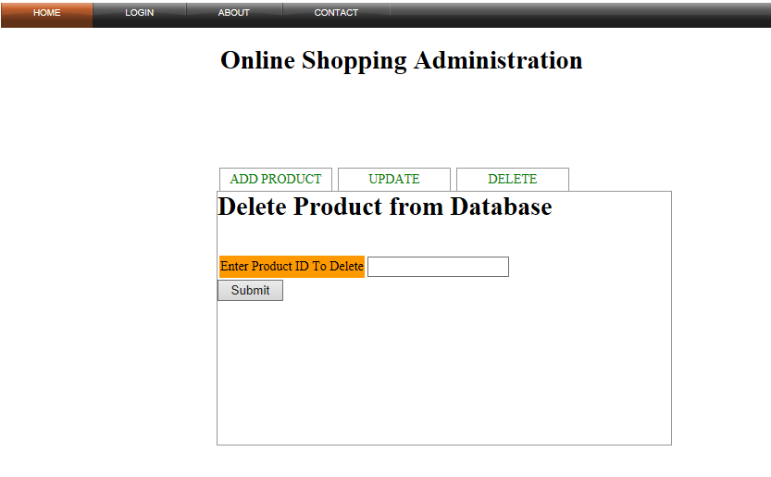

Slide 15
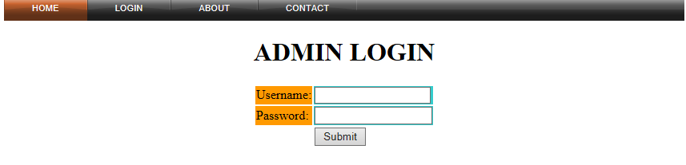


Slide 16
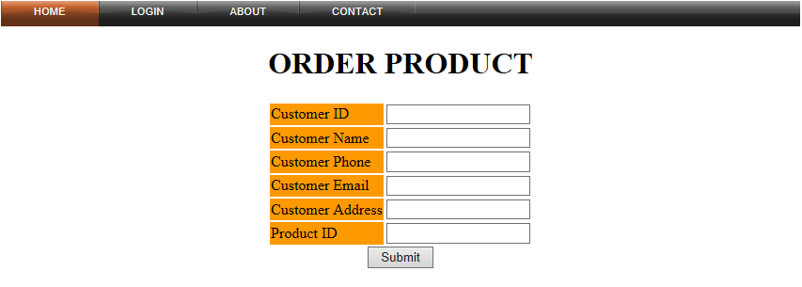

Slide 17
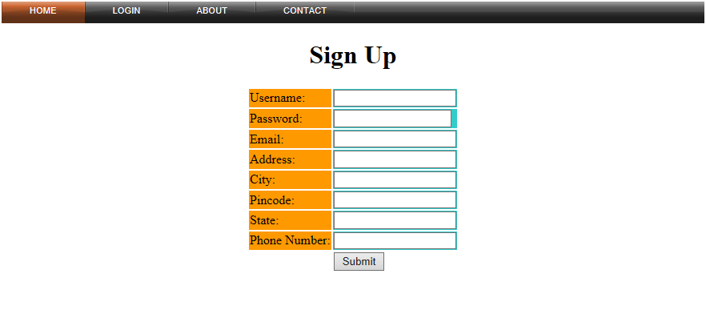

Slide 18
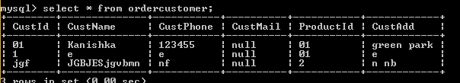
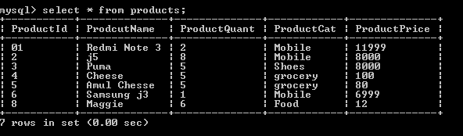

Slide 19
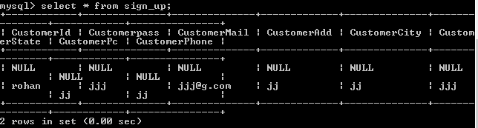
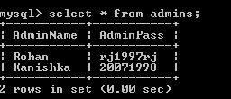

Slide 20
THANK YOU

