Slide 1
A comparison of Machine Learning algorithms for Classification and Timeseries Forecasting
-By
Rohan Narayan Koli
MSc. Data Analytics - A
(19224842)

Slide 2
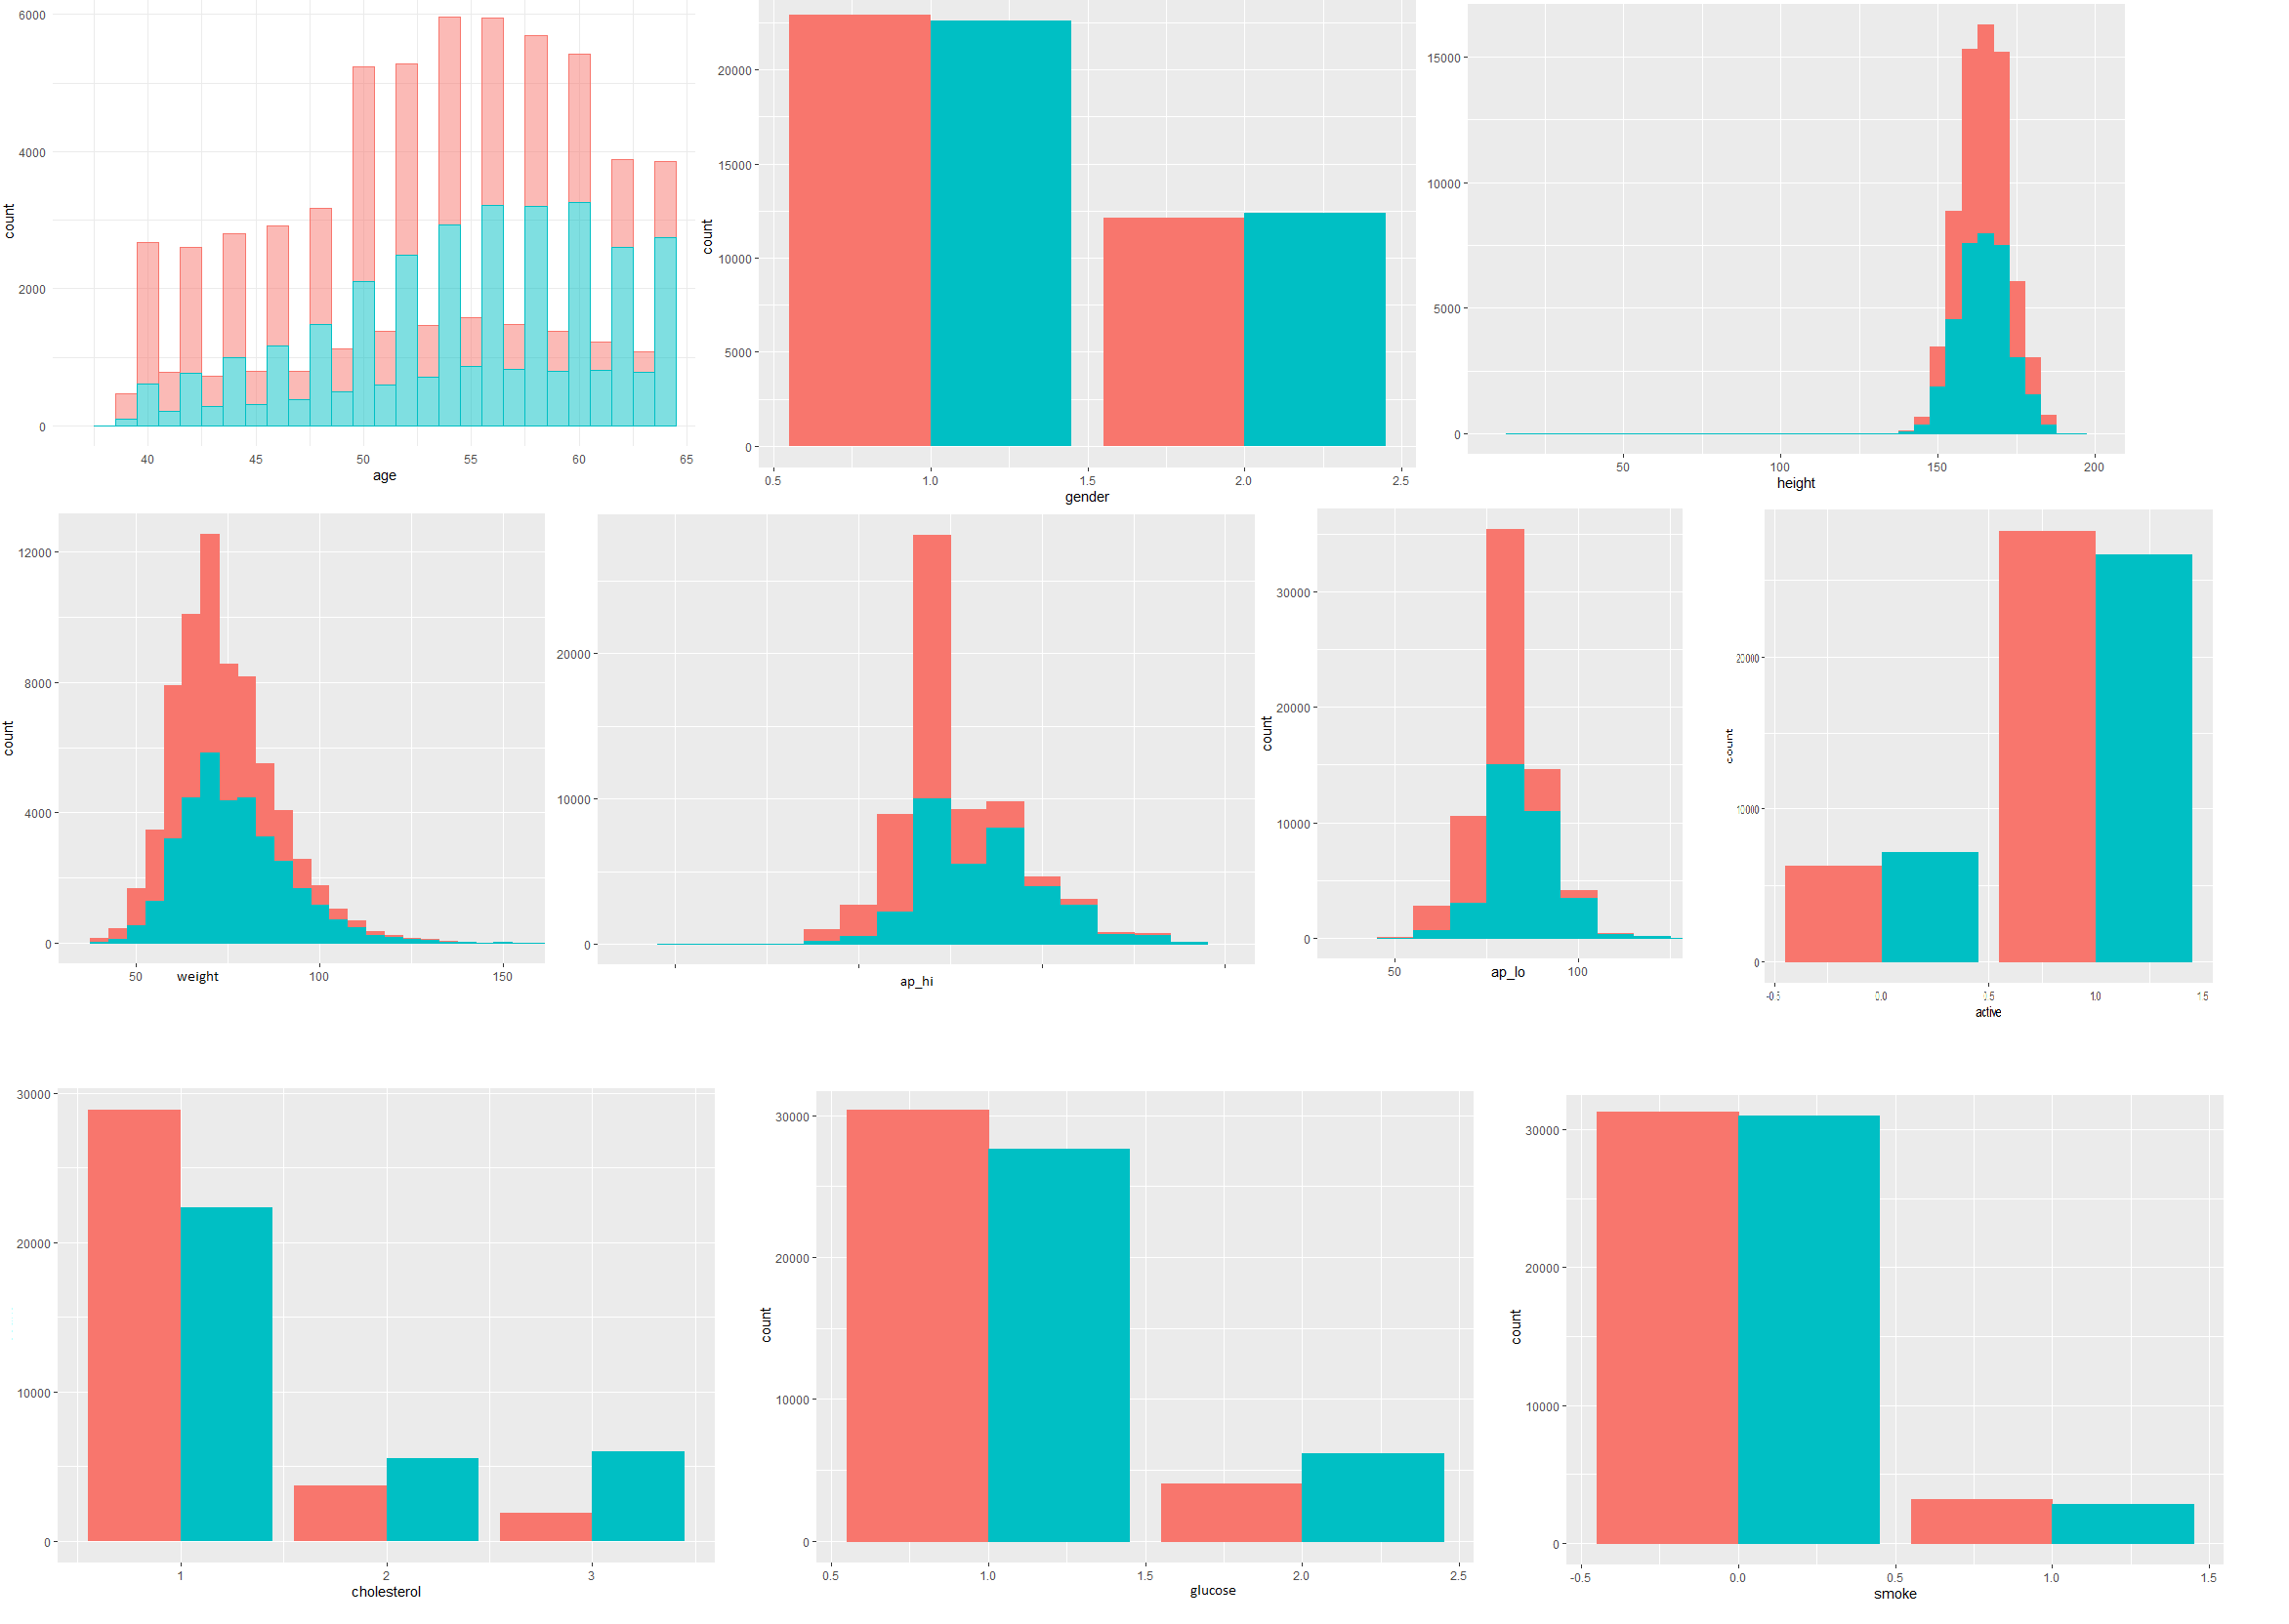
DATASET 1 – Predicting cardiovascular disease
Data Preprocessing
Restricting to a range
Rescaling for svm and random forests
Using 5-fold cross validation to train algorithms

Slide 3
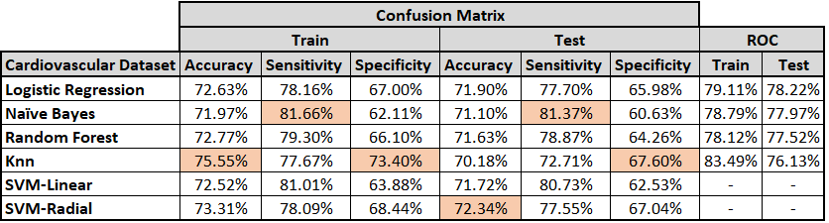
MODEL PERFORMANCES

Slide 4
DATASET 2 – Predicting CREDIT CARD DEFAULT
Data Preprocessing
Collapsing levels for better model performance
Restricting to a range

Slide 5
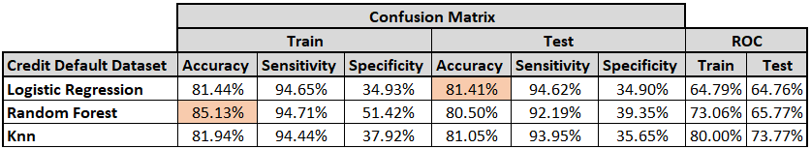
MODEL PERFORMANCES

Slide 6
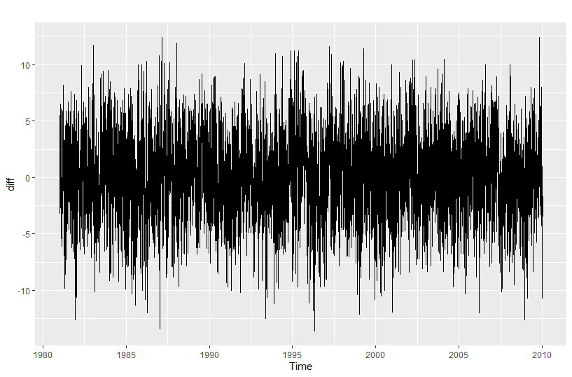
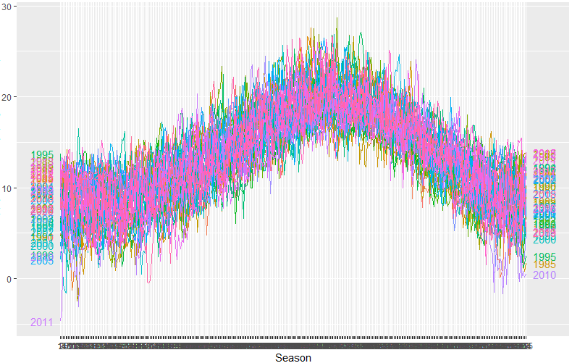
DATASET 3 – FORECASTING DUBLIN,IRELAND TEMPERATURE

Slide 7
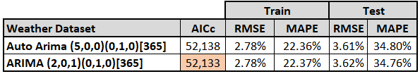
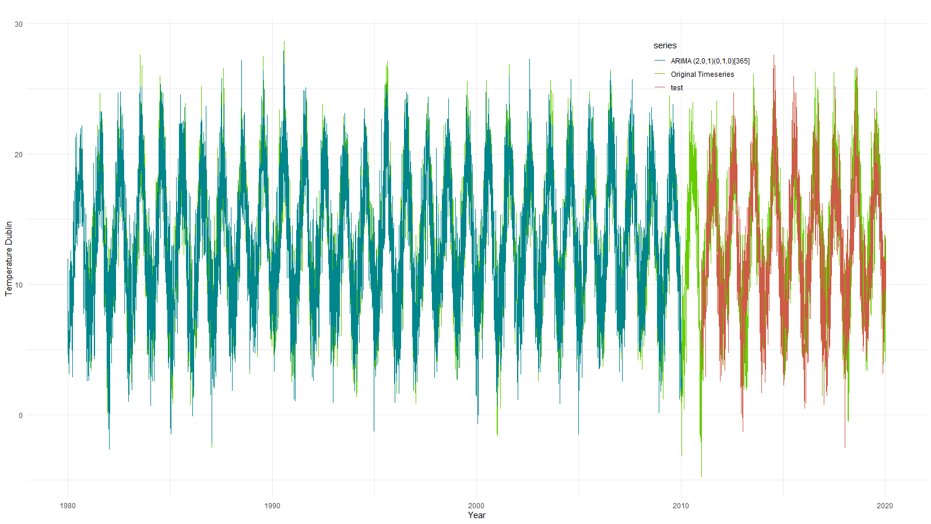
MODEL PERFORMANCES

Slide 8
Thank you

