Slide 1

Assignment-1 YouTube API v3 and Google News Data
Team Devs

Slide 2
Part-1: YouTube Data

Slide 3
Dataset Description
Shape of the dataset: (15141, 9)
NUMERICAL COLUMNS: view_count, like_count, comment_count, favorite_count
CATEGORICAL COLUMNS: video_id, title, description, duration, comments
No Null Values for significant columns.
No duplicate entries.

Slide 4
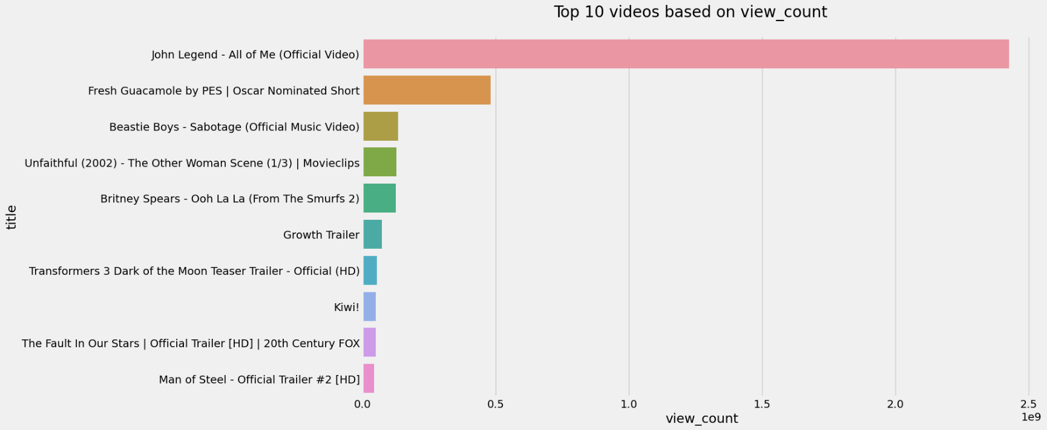
Analysis Results
Top 10 Videos based on View Count

Slide 5
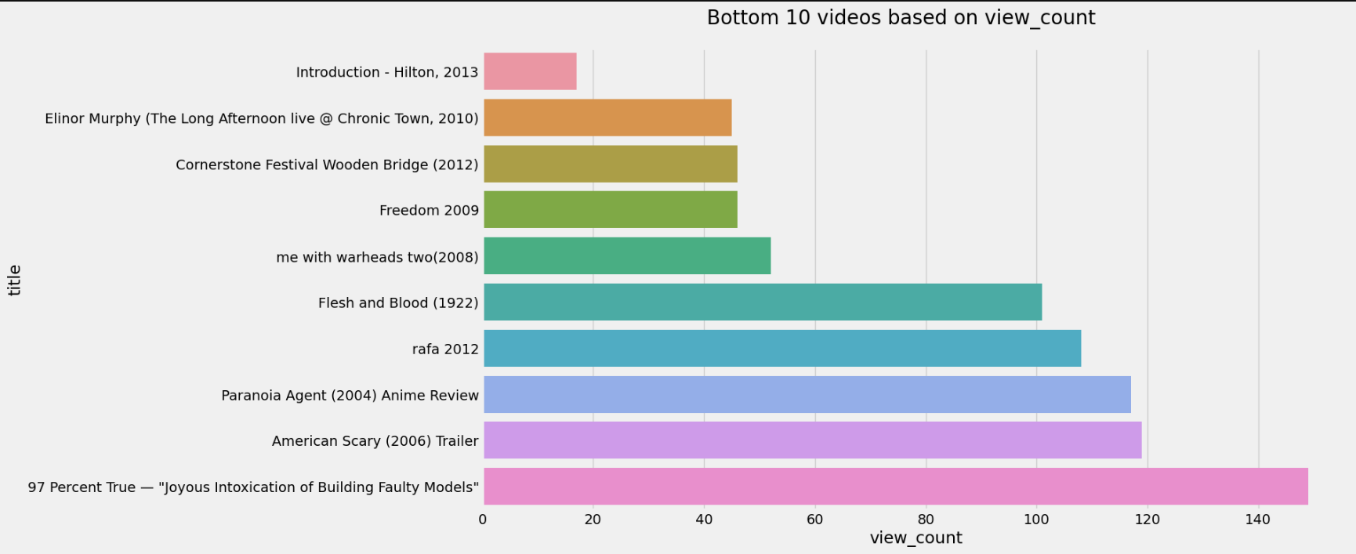
10 Least watched Videos

Slide 6

Most Liked Video:

Slide 7

Least Liked Video:

Slide 8

Highest Duration video

Slide 9
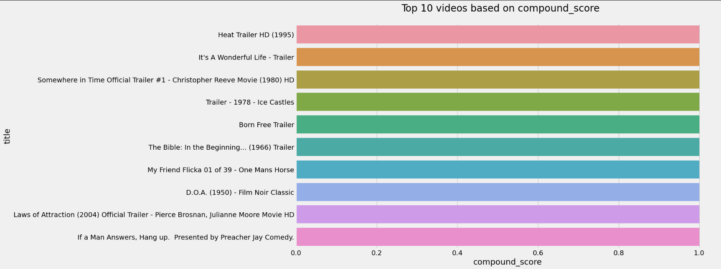
Top 10 Positive reviewed Videos

Slide 10
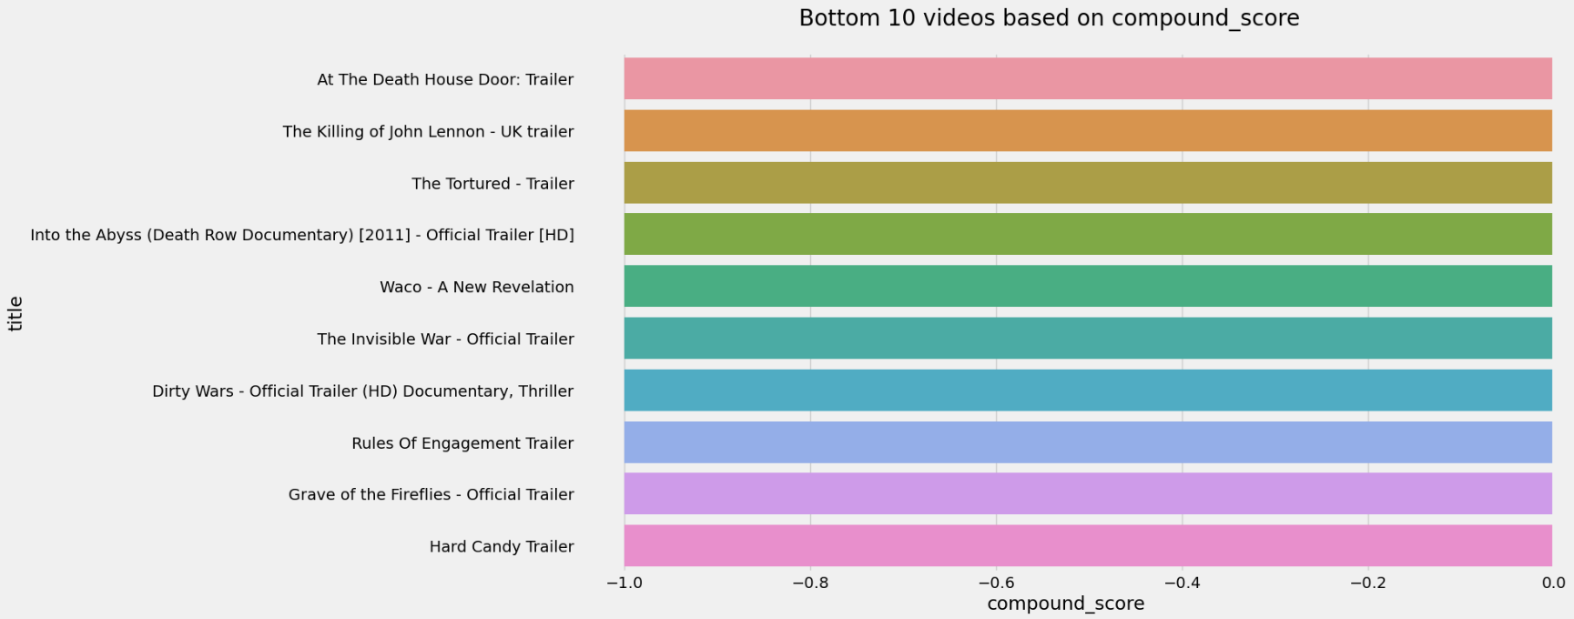
Top 10 Negative Reviewed Videos

Slide 11
Part-2: Google News Data

Slide 12
Dataset Description
Shape of the dataset: (6128, 8)
List of Features: title, Published_on, News_agency, URL, summary, Country, language, tag.
No Null Values
No duplicate entries

Slide 13
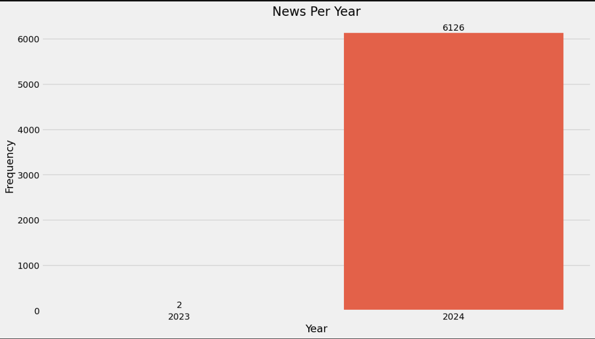
Exploratory Data Analysis
Most of the Articles were from the year 2024.

Slide 14
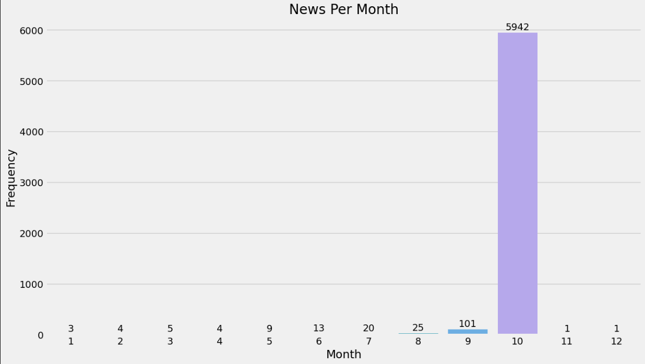
EDA..
Most of the news was from the 10th month (October)

Slide 15
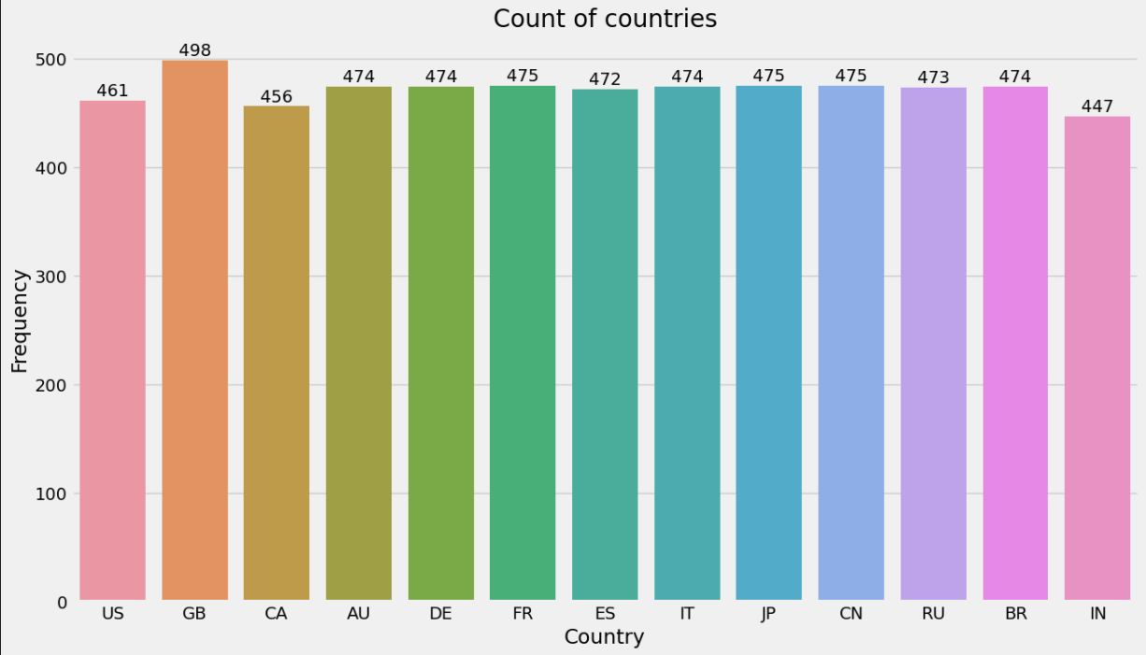
EDA..
Mostly balanced but saw slight imbalances for few countries..

Slide 16
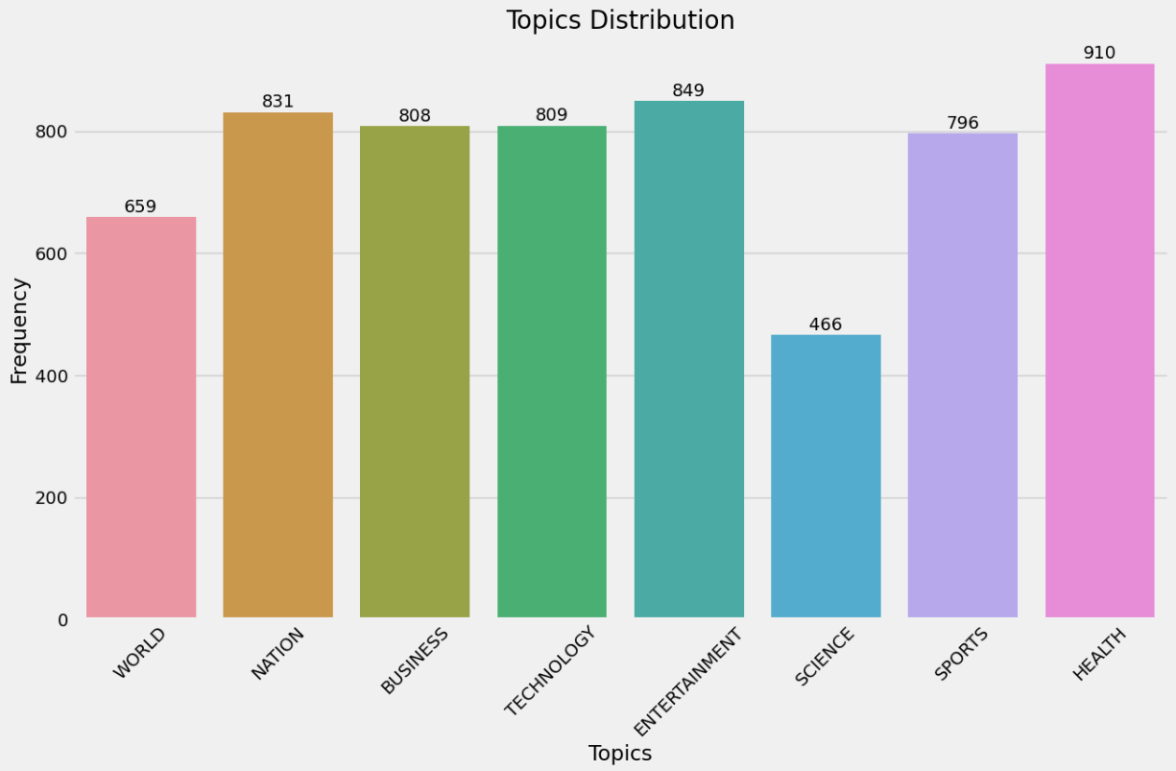
EDA..
We saw imbalance for Science and World data tags

Slide 17
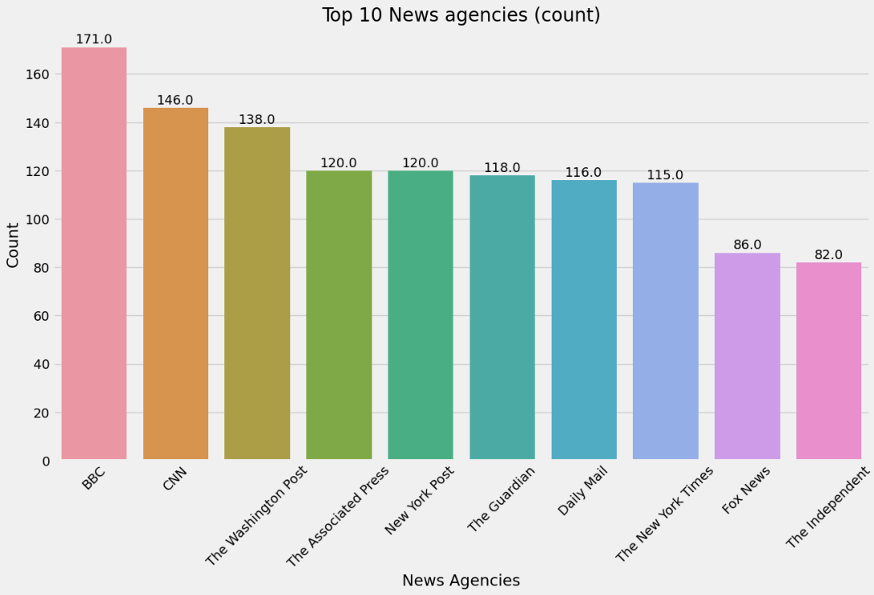
EDA..
Most of the records were from BBC News Agency..

Slide 18
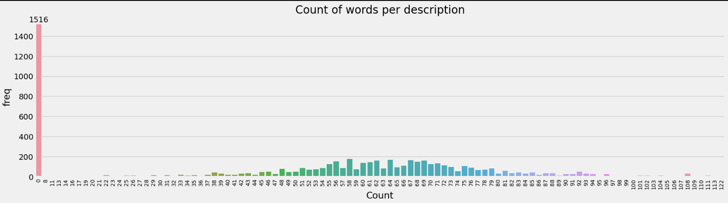
EDA..
Most of the data was normally distributed for word count.

