Slide 1
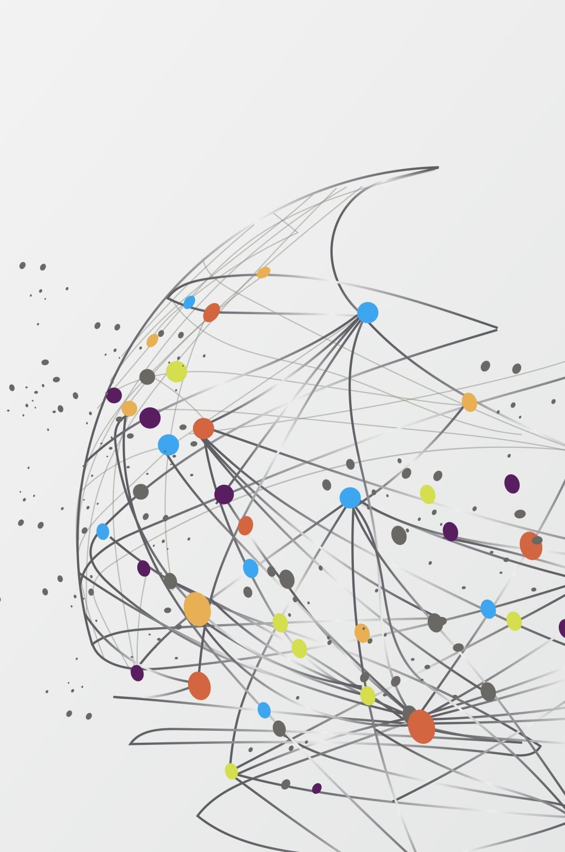
Assignment-1 YouTube API v3 and Google News Data
Team Devs

Slide 2
Part-1: YouTube Data

Slide 3
Dataset Description
Shape of the dataset: (15141, 9)
NUMERICAL COLUMNS: view_count, like_count, comment_count, favorite_count
CATEGORICAL COLUMNS: video_id, title, description, duration, comments
No Null Values for significant columns.
No duplicate entries.

Slide 4
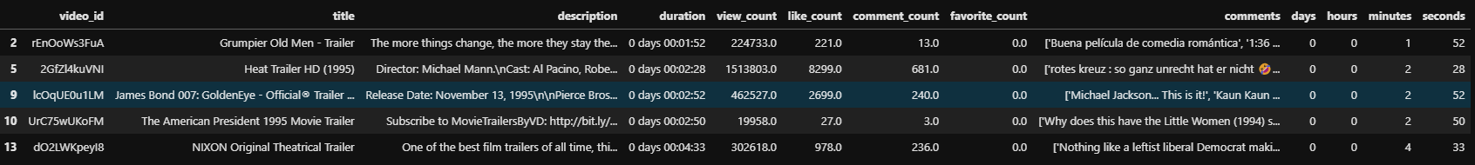
Data Cleaning
Dropped records where all the values were null (Private or Deleted videos)
Corrected durtation format from ISO 8601 duration format to separate features for days, hours, minutes and seconds.

Slide 5
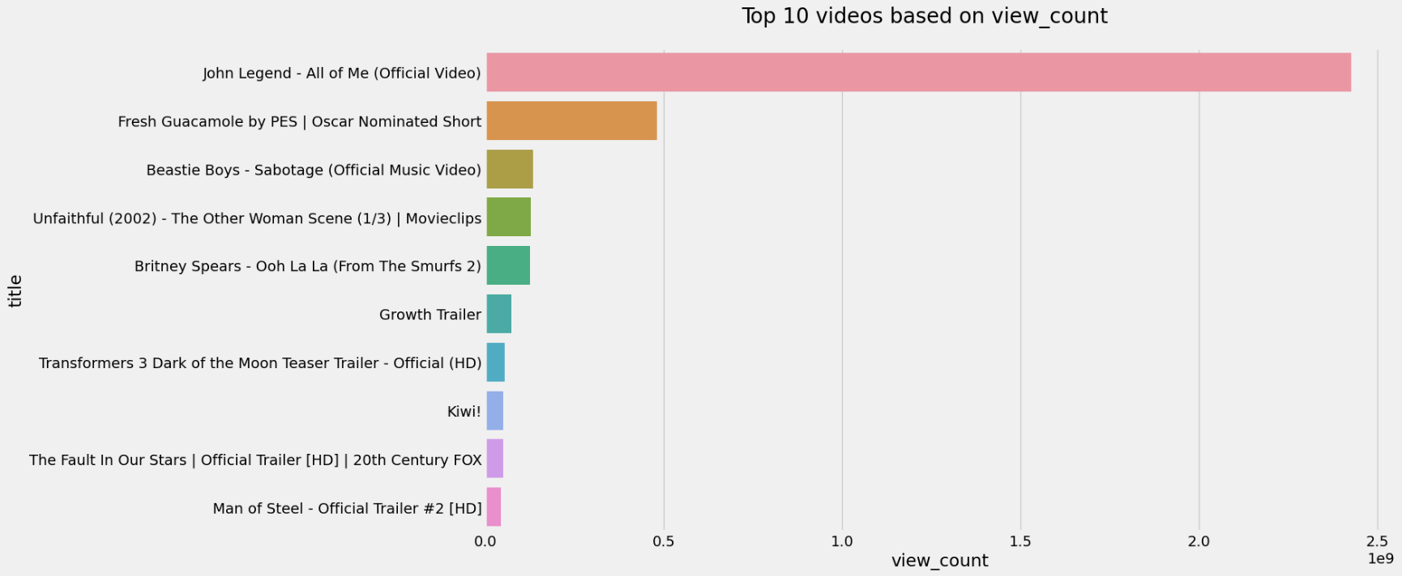
Analysis Results
Top 10 Videos based on View Count

Slide 6
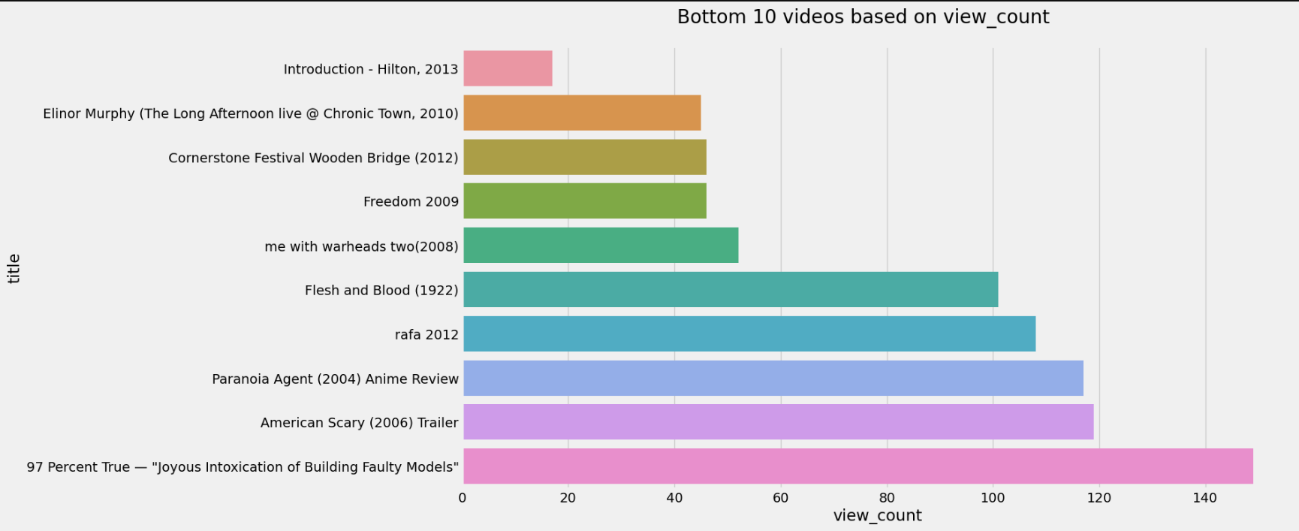
10 Least watched Videos

Slide 7
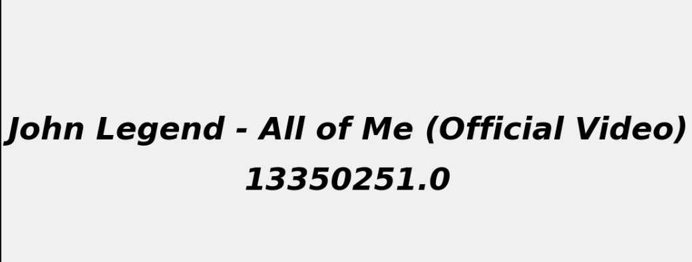
Most Liked Video:

Slide 8

Least Liked Video:

Slide 9
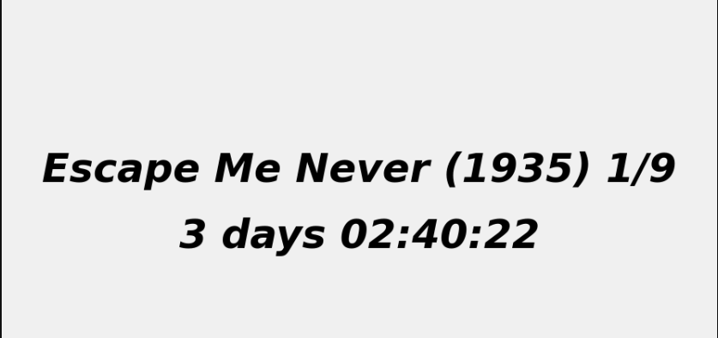
Highest Duration video

Slide 10
Sentiment ANalysis:
Preprocessing:
Removed irrelevant punctuations.
Cleaned whitespaces.
Text Lowering.

Slide 11
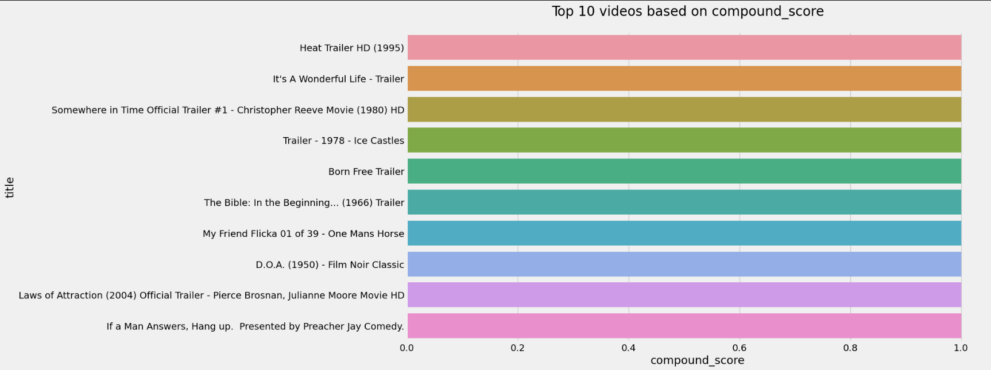
Top 10 Positive reviewed Videos

Slide 12
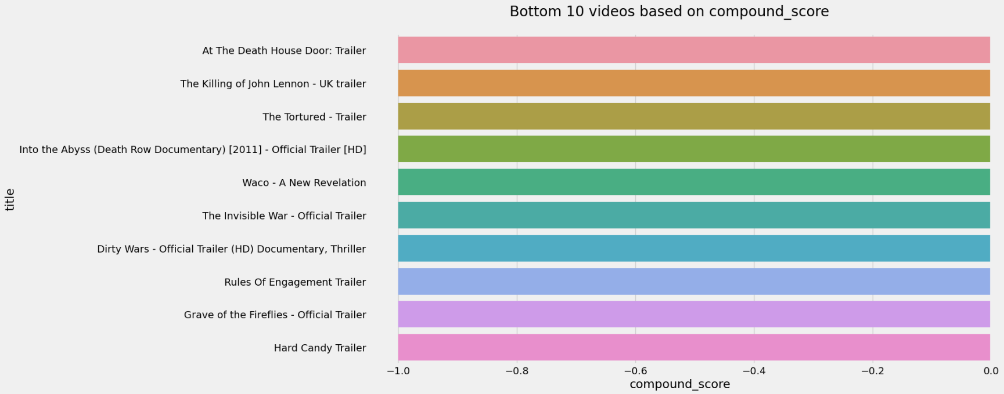
Top 10 Negative Reviewed Videos

Slide 13
Part-2: Google News Data

Slide 14
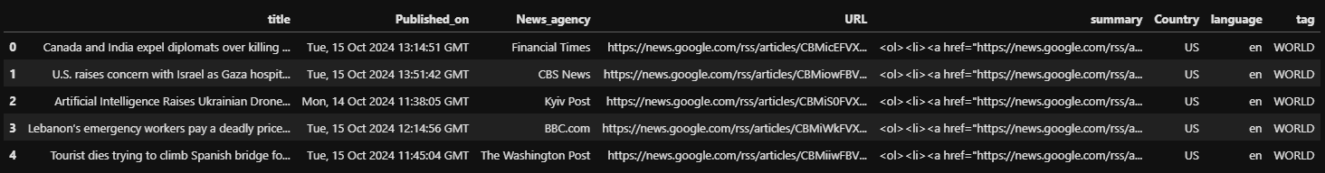
Dataset Description
Used Pygooglenews to extract news articles from Google News.
Shape of the dataset: (6128, 8)
List of Features: title, Published_on, News_agency, URL, summary, Country, language, tag.
No Null Values
No duplicate entries

Slide 15
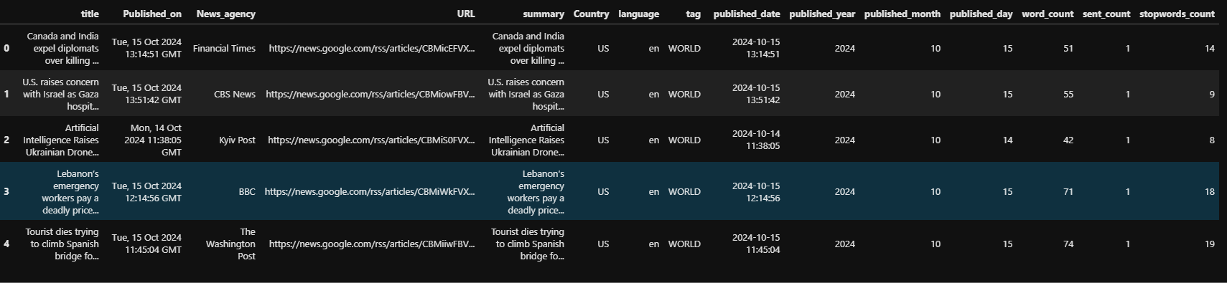
Data Cleaning
Extracted days, months, and years data from the published_on column
Cleaned Summary column : HTML Text
Cleaned News Agency column: Unwanted Extensions (.com, .au, .org etc)
Created 3 new features: word count, sentence count, stop words count to understand summary patterns for each news data tag.

Slide 16
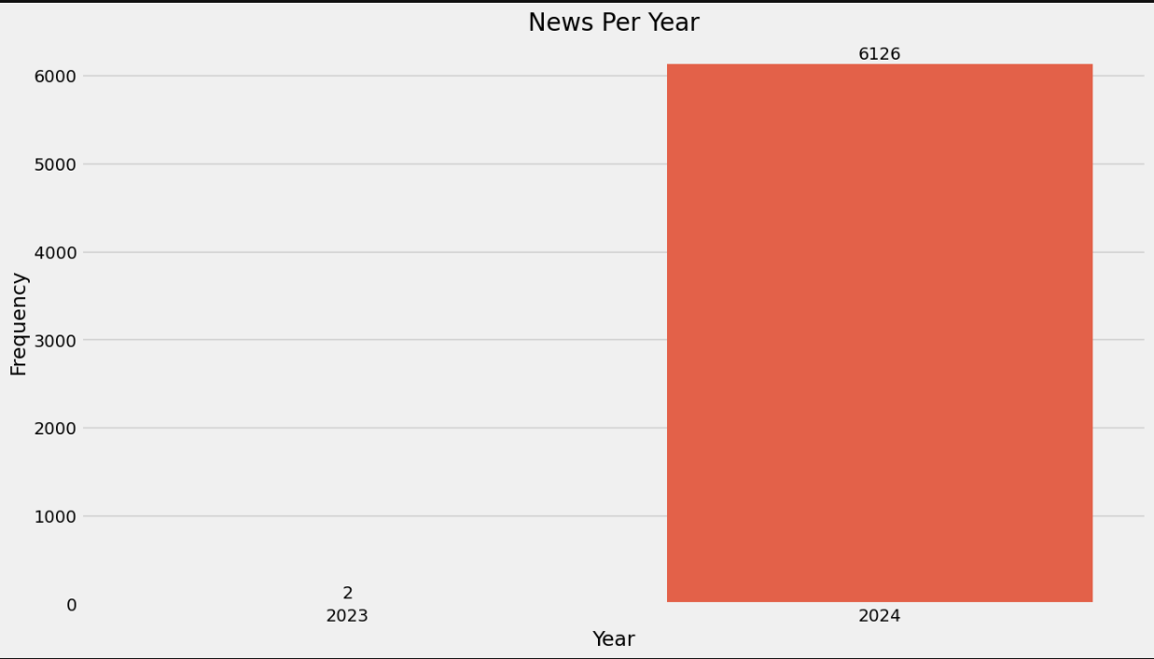
Exploratory Data Analysis
Most of the Articles were from the year 2024.

Slide 17
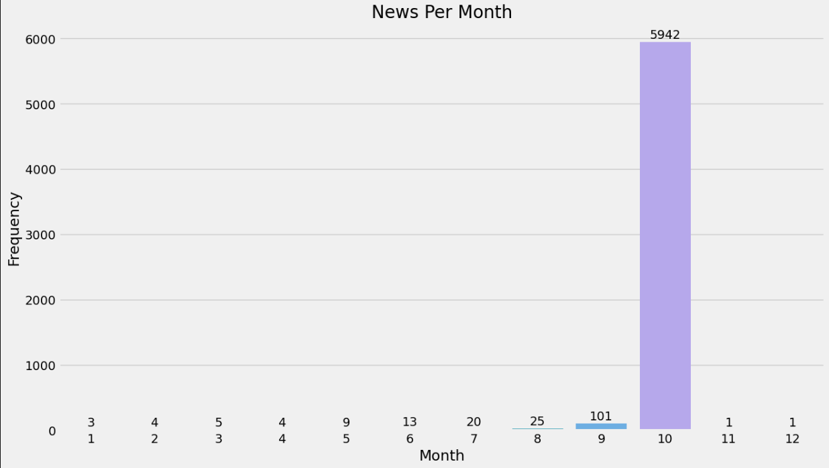
EDA..
Most of the news was from the 10th month (October)

Slide 18
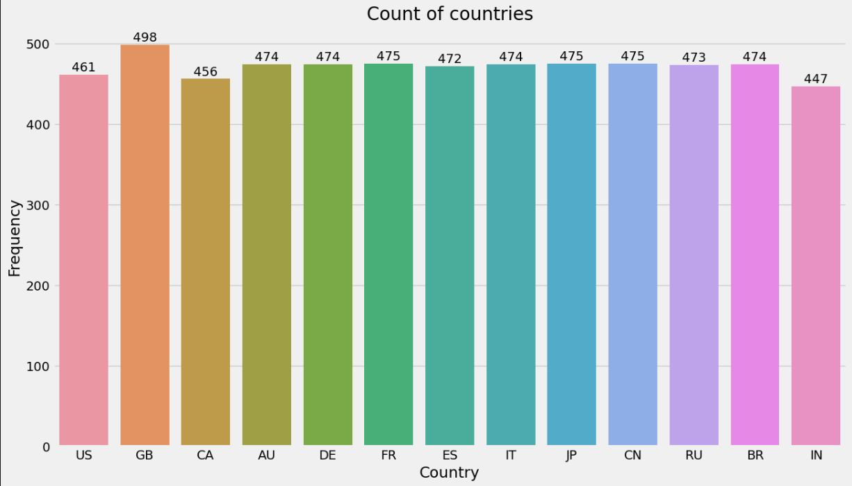
EDA..
Mostly balanced but saw slight imbalances for few countries..

Slide 19
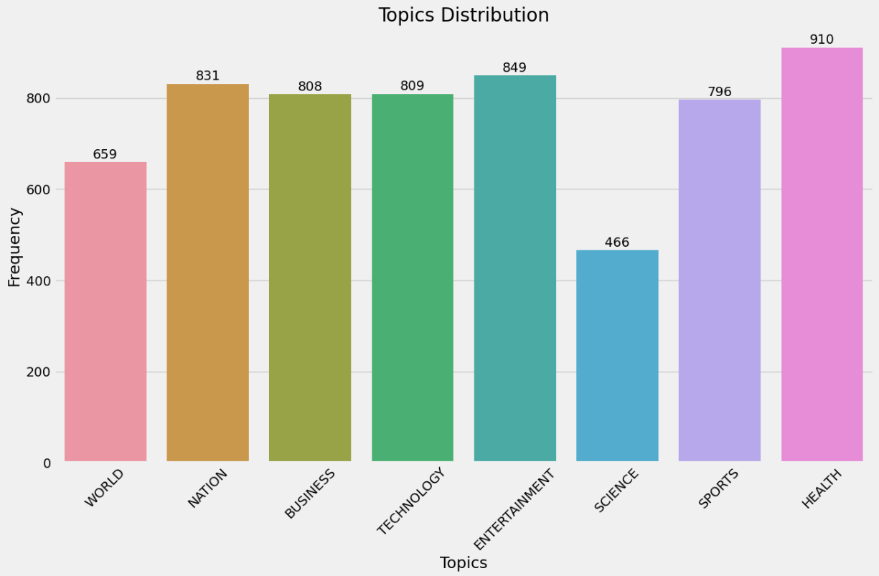
EDA..
We saw imbalance for Science and World data tags

Slide 20
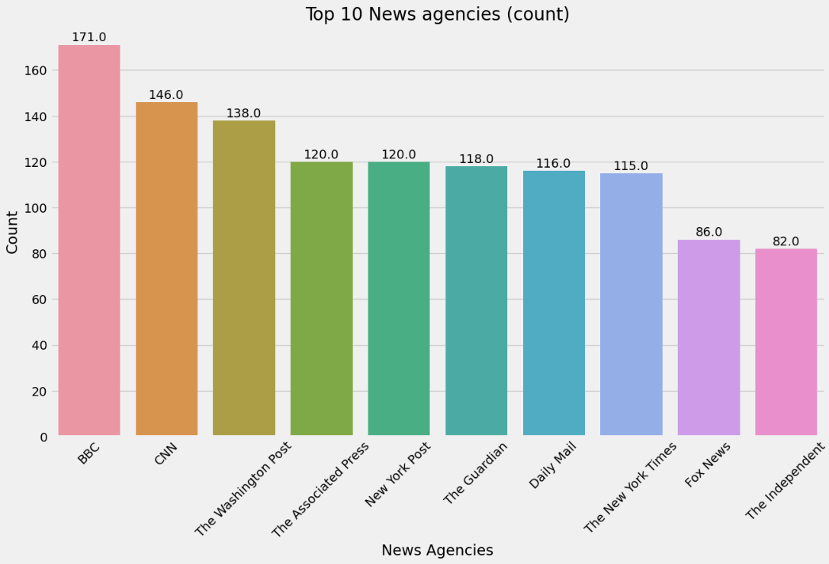
EDA..
Most of the records were from BBC News Agency..

Slide 21
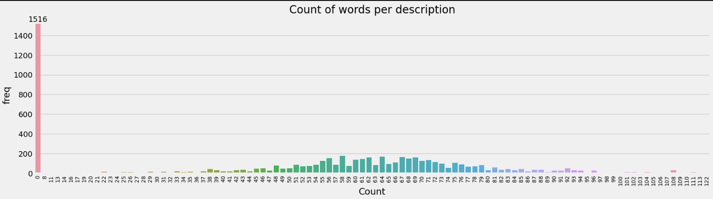
EDA..
Most of the data was normally distributed for word count.

Slide 22
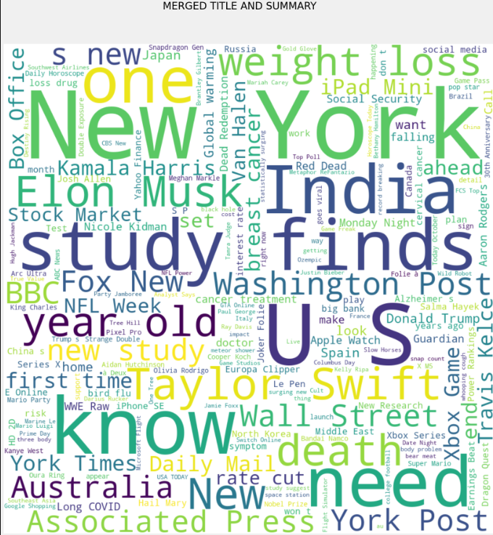
Word Clouds
Merged Title and Summary

Slide 23
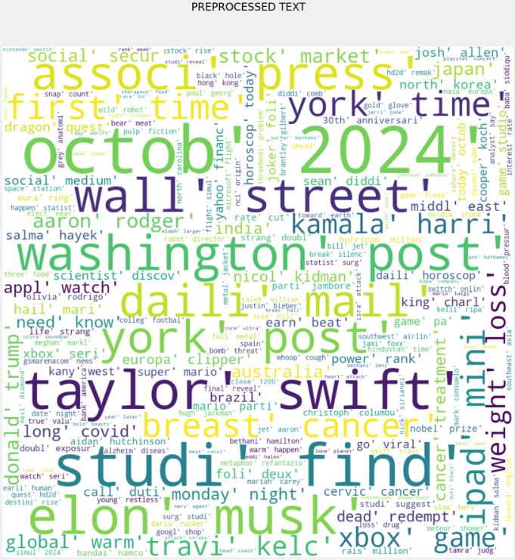
Word Cloud
Preprocessed Text:

Slide 24
Topic Modeling: VADER
NLP PREPROCESSING PIPELING:
Lowering Text
Removing White Spaces
Tokenization
Remove Stop Words
Lemmatize and Stemming

Slide 25
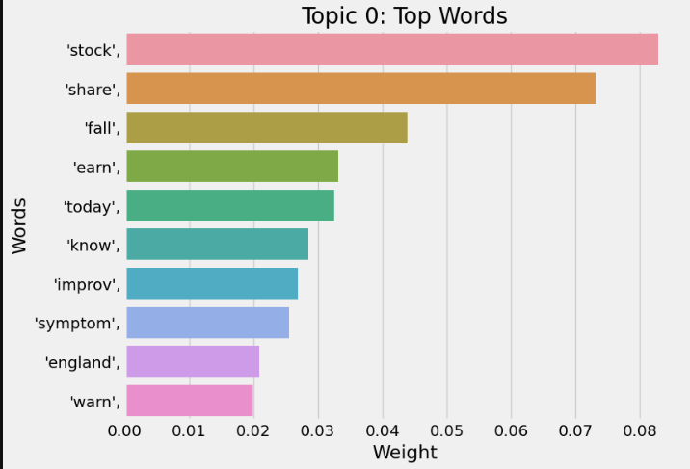
Top 3 Topics and relevant words

Slide 26
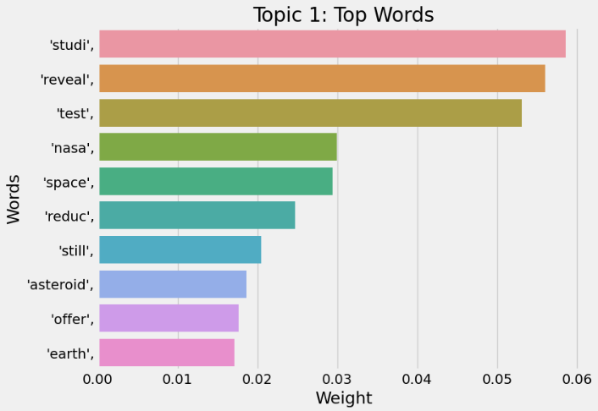
Topic 1

Slide 27
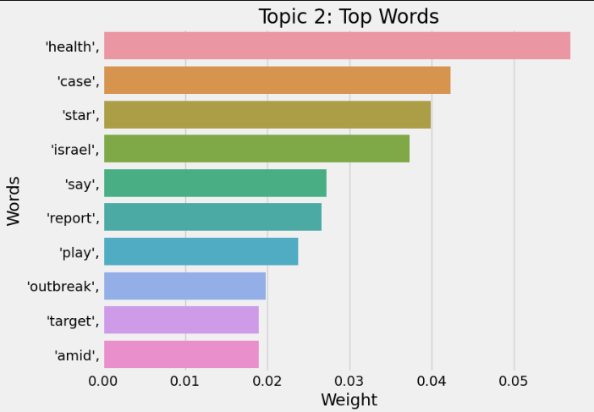
Topic 2

Slide 28
Thank you

