Slide 1

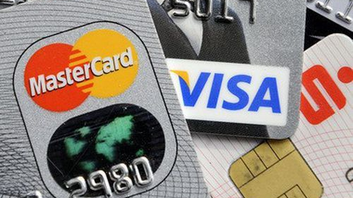
Responsible AI Project Predicting credit card Default
Group Members:
Deep Usdadiya | Kashyap Shekhada | Neil Dave Rohan Mehta |Sumit Tiwari | Yash Turakhia

Slide 2
Business Case Study
White bank has approached us for a solution to their decreasing profitability and increasing customer defaults despite the increase in the number of customers in the credit division.
On exploration, we found an insight that credit card was a major contributor to the bank’s profitability.
We have performed various analysis and predicted well in advance which customers are likely to default maintaining data privacy, bias, and fairness to reduce the default rate and increase profitability.
We try to maintain fairness in the modelling and testing keeping in mind AI should be ethical ,responsible and good for society.
Notes:
White bank has approached us for a solution to their decreasing profitability despite the increase in the number of customers in the credit division.
On exploration, we found an insight that credit card was a major contributor to the bank’s profitability. We have performed various analysis and predicted which customers are likely to default maintaining data privacy, bias, and fairness to reduce the default rate and increase profitability.

Slide 3
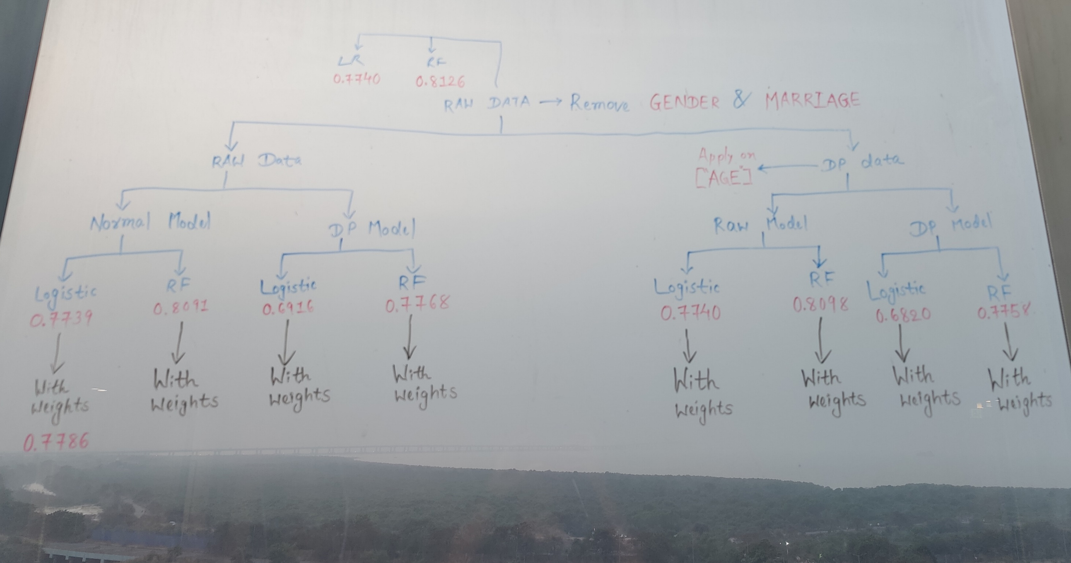



Approach
RAW
DATA
EDA &
FEATURE
ENGINEERING
PII & NON-PII,
TARGET
VARIABLE
BASIC CHECKS FOR BIAS
(IF ANY)
SP - 0.0339
DI - 1.1632
EPSILON (DP
ON “AGE” & “LIMIT_BAL”
COSINE
SIMILARITY
FOR PROXY
XAI
MODELING
REWEIGHING TWO
PROTECTED FEATURES OF
PII DATA
Notes:
Statistical Parity (SP<0.1)
Disparity Impact (0.8<DI<1.25)

Slide 4
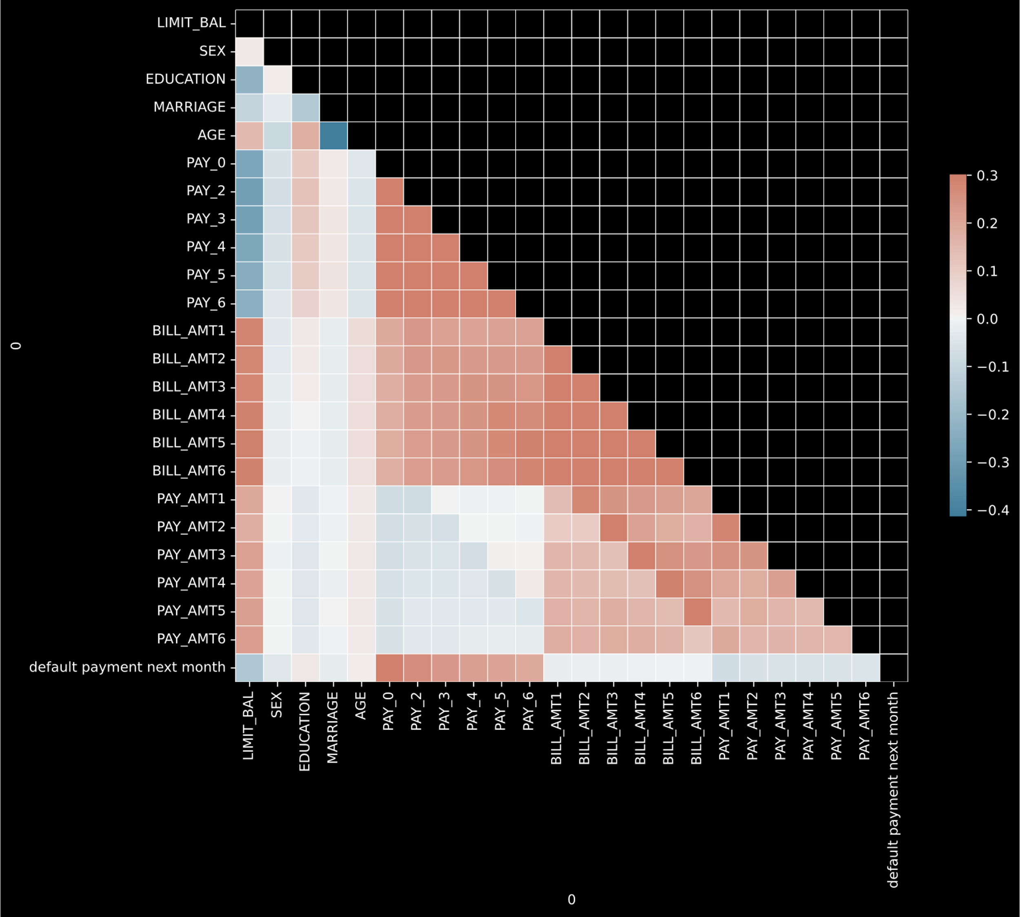
Exploratory Data Analysis & Feature engg.
Data Description
ID: ID of each client
LIMIT_BAL: Amount of given credit in NT dollars (includes individual and family/supplementary credit
SEX: Gender (1=male, 2=female)
EDUCATION: (1=graduate school, 2=university, 3=high school, 4=others, 5=unknown, 6=unknown)
MARRIAGE: Marital status (1=married, 2=single, 3=others)
AGE: Age in years
PAY_0 to PAY_6 Repayment status from September 2005 to April 2005
BILL_AMT 1 TO BILL_AMT_6 Amount of bill statement FROM SEPTEMBER 2005 TO APRIL 2005
PAY_AMT1: Amount of previous payment in September 2005 TO APRIL 2005
Default_payment_next_month: Default payment (1=yes, 0=no)

Slide 5

LR
0.78
0.65
Raw Data Dropped PII
DP Data [on “LIMIT_BAL”]
Normal Model
DP Model
Normal Model
DP Model
LR
RF
LR
RF
LR
RF
LR
RF
RF
0.81
0.76
RAW
DATA
0.78
0.65
0.81 0.71 0.78 0.78
0.75 0.55 0.65 0.66
0.79
0.70
0.71
0.54
0.79
0.60
ACCURACY –
AUC –
Less difference in Accuracy than RF,
RF has more complexity,
Banking Regulations
LR = Logistic Regression Model, RF = Random Forest Model

Slide 6
REWEIGHING
“SEX”
RAW DATA
DROPPED PII
RAW DATA
DROPPED PII
DP DATA
LR
RF
“MARRIAGE”
LR
RF
DP DATA
2.52% 1.81%
1.14% 0.05%
2.71% 0.99%
1.54% 1.33%
ACCURACY DIFF. –
AUC DIFF. –
LR = Logistic Regression Model, RF = Random Forest Model

Slide 7

Additive Counterfactual Fairness
Aims to take out the impact of the protected feature from the model if it in a discriminatory way.
States that a protected feature should not be a cause for the predictor to be discriminatory – or that the predicted outcome should not change if the value of the protected feature is changed from a privileged group to an unprivileged group or vice versa
Fairness Metrices for Raw data
Metrics | Baseline Model | ACF Fair Model
Equal Opps | 0.001387 | 0.000000
PredEq | 0.000694 | 0.000694
Equal Odds | 0.002081 | 0.000694
PredParity | 0.333333 | 0.000000
DemoParity | 0.000833 | 0.000555
AOD | 0.001041 | 0.000347
Fairness Metrices for DP data (LIMIT_BAL)
Metrics | Baseline Model | ACF Fair Model
Equal Opps | 0.005501 | 0.033755
PredEq | 0.008268 | 0.021202
Equal Odds | 0.013769 | 0.054958
PredParity | 0.000882 | 0.035760
DemoParity | 0.011228 | 0.026202
AOD | 0.006885 | 0.027479
Residual 1 - $(X−X^{′})$

Slide 8
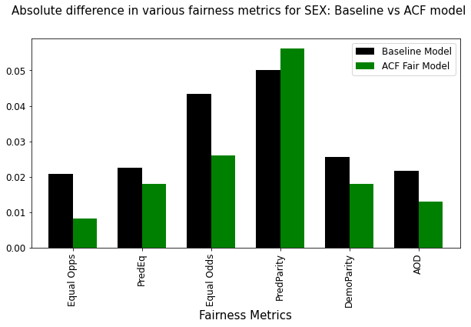

ACF
Residual 2 ${\left(X−X^{′}\right)}^{2}$
Fairness Metrices for RAW Data
Metrics | Baseline Model | ACF Fair Model
Equal Opps | 0.001387 | 0.000908
PredEq | 0.000694 | 0.001677
Equal Odds | 0.002081 | 0.000769
PredParity | 0.333333 | 0.125000
DemoParity | 0.000833 | 0.001115
AOD | 0.001041 | 0.000384
Fairness Metrices for DP data (LIMIT_BAL)
Metrics | Baseline Model | ACF Fair Model
Equal Opps | 0.005501 | 0.005708
PredEq | 0.008268 | 0.010415
Equal Odds | 0.013769 | 0.016123
PredParity | 0.000882 | 0.057165
DemoParity | 0.011228 | 0.010464
AOD | 0.006885 | 0.008062

Slide 9
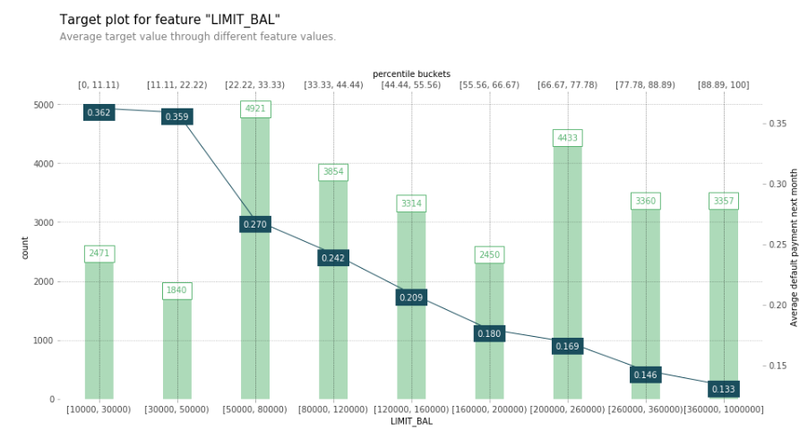
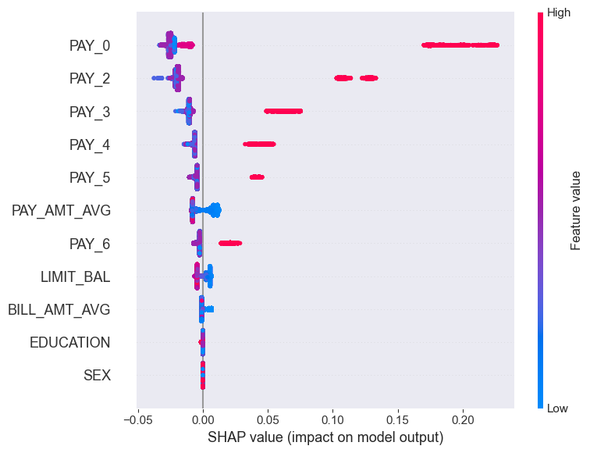
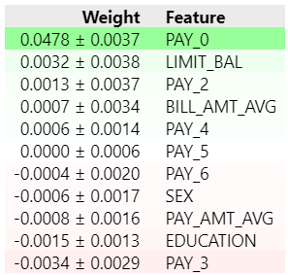
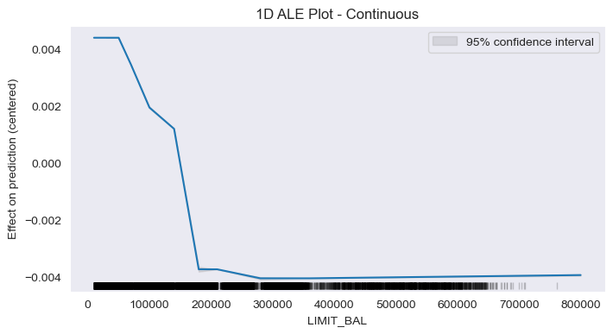
XAI
Feature Engineering, Noise and DP
SEX – Swap Noise
LIMIT_BAL – Laplacian noise
BILL_AMT1 to BILL_AMT6 – sum(column)/6
PAY_AMT1 to PAY_AMT6 – sum(column)/6
Model
Raw Data + Logistic Regression
DP Data + Random Forest

Slide 10
Problem Statement
Analyze and predict which customers are likely to default in the next month maintaining minimal data privacy, bias, and high fairness to reduce the default rate and increase profitability
Data Sources |  | Protected features | Data users | Privacy | Privacy | Fairness Metrics |  | Bias
”Default of Credit Card clients Data Set” – UCI Machine Learning Repository Number of instances – 30,000 Attributes – 24 Attribute Characteristic – Integer, Real Task – Classification |  | SEX EDUCATION MARRIAGE AGE | Developers | LIMIT_BAL – added noise using Laplacian SEX – used the swap method Additive Counterfactuals Fairness | LIMIT_BAL – added noise using Laplacian SEX – used the swap method Additive counterfactuals | Equal opportunities Predictive equality Equal odds Predictive parity Demographic parity Average odd difference |  | Data
 |  |  |  |  |  |  |  | Analysis on PII Data
 |  |  |  |  |  |  |  | Model Logistic regression, Random Forest Logistic DP-Model RandomForest DP-Model
 |  | Proxies |  |  |  | Model
 |  | PAY_AMT_AVG: Average payment of the last 6 months PRCT_UTILIZATION: PAY_AMT_AVG divided by LIMIT_BAL to show average credit utilization. |  |  |  | Algorithm | L, RF | Prediction Default payment next month
 |  |  |  |  |  | Logistic Regression | Random Forest
 |  |  |  |  |  | Evaluation
 |  |  |  |  |  | AUC difference | Accuracy
 |  |  |  |  |  | F1 score | GINI
Monitoring |  |  | Explainability |  |  |  |  | Stakeholders
Data |  |  | Data |  | Techniques | Counterfactuals |  | Internal | External
Model |  |  | RAW data DP DATA |  | Information Value plot SHAP ELI5 |  |  | Team White Walkers | Sray Aggarwal
Fairness
Date |  | Version – 1.0 | Type – Classification of default payment next month |  |  |  | Owners/Approvers
Test/train | 70/30 | Usage -

Slide 11

References
Dataset: https://www.kaggle.com/datasets/uciml/default-of-credit-card-clients-dataset
Responsible AI - Implementing Ethical and Unbiased Algorithms by Sray Agarwal, Shashin Mishra
https://github.com/srayagarwal/JIO_RAI/blob/main/Ch%203%20Bias%20in%20Data.ipynb
https://github.com/srayagarwal/JIO_RAI/blob/main/Ch%205%20Remove%20Bias%20from%20ML%20Model%20I.ipynb

