Slide 1


IPMV Continuous Assessment
(Semester VI)
Vivekanand Education Society’s Institute of Technology
Electronics and Telecommunication Engineering
Creating Simulink based simulation for Frequency domain filter and converting it to HDL code using HDL coder
Guide Name: Mr. Mrugendra Vasmatkar
Group No. : B18
Students Name Roll Numbers (Class name)
Aditya Barai 05 (D14B)
Rohan Chavan 11 (D14B)
Sumit Pawar 50 (D14B)
Rajiv Singh 58 (D14B)

Slide 2
Contents to be covered
Problem Statement
Proposed Solution
Literature Survey
Research Gap
Flowchart of proposed solution
Observations/Results
File Link
References

Slide 3
Problem Statement
Design and implement a Simulink-based simulation of a frequency domain filter. The filter should be capable of processing input signals in the frequency domain and performing desired filtering operations. After verifying the functionality of the filter in Simulink, use HDL Coder to convert the Simulink model into hardware description language (HDL) code suitable for implementation on FPGA or ASIC hardware. The HDL code should be optimized for efficient hardware utilization and meet the specified design requirements.

Slide 4
Proposed Solution
Design Frequency Domain Filter in Simulink:Use Simulink to design the frequency domain filter. This involves implementing the necessary blocks to perform the filtering operation in the frequency domain. You may use MATLAB functions or Simulink blocks like FFT, IFFT, filters, etc., depending on the specific requirements of your filter.
Verify Functionality:Simulate the designed filter in Simulink using various input signals to verify its functionality. Ensure that the filter behaves as expected and meets the design requirements in terms of frequency response, phase response, etc.Prepare for HDL
Prepare for HDL Conversion:Prepare the Simulink model for HDL conversion by ensuring that it adheres to the requirements for HDL code generation. This may involve tasks such as fixing data types, resolving sample rates, and ensuring compatibility with HDL Coder.
Convert to HDL Code using HDL Coder:Use HDL Coder to automatically convert the Simulink model into HDL code. HDL Coder generates synthesizable Verilog or VHDL code that describes the hardware implementation of the filter.

Slide 5
Proposed Solution
Optimize HDL Code:Review the generated HDL code and optimize it for performance, resource utilization, and timing constraints. This may involve restructuring the code, applying
Verify HDL Implementation:Simulate and verify the functionality of the generated HDL code using hardware description language simulators or FPGA synthesis tools. Ensure that the HDL implementation behaves equivalently to the Simulink model and meets the required specifications. pipelining techniques, and other optimizations to meet the desired implementation goals.
Deploy to Hardware:Once verified, deploy the synthesized HDL code to the target hardware platform, such as an FPGA or ASIC, for real-world testing and integration into the final system.

Slide 6
Sr. No | Title of Technical paper | Name of Author | Year of publication | Name of Journal | Methodology | Results/ conclusions | Drawbacks/ Limitations
[1] | Hardware Implementation of FIR Filters Designed in Simulink | Johnson,E. | 2019 | IEEE | The paper presents a methodology for designing FIR filters in Simulink and converting them to HDL code for FPGA implementation. It discusses filter design techniques, HDL code generation settings, and FPGA synthesis considerations.. | The study concludes that Simulink-based design combined with HDL code generation provides an efficient and reliable approach for implementing FIR filters on FPGA devices, meeting specified performance requirements. | Lack of comparison with other filter design and implementation methodologies, limited discussion on real-time performance optimization.

Slide 7
Sr. No | Title of Technical paper | Name of Author | Year of publication | Name of Journal | Methodology | Results/ conclusions | Drawbacks/ Limitations
[2] | FPGA Implementation of Frequency-Domain Filters Designed in Simulink | John Smith | 2020 | IEEE | The paper presents a methodology for designing frequency-domain filters in Simulink and implementing them on FPGA devices using HDL Coder. It discusses the filter design process, HDL code generation, and FPGA implementation details. . | The study demonstrates the feasibility and effectiveness of using Simulink and HDL Coder for FPGA-based filter implementations, achieving real-time signal processing capabilities with low latency. | Limited discussion on quantization effects and optimization techniques for improving resource utilization.

Slide 8
Research Gaps
Efficiency Improvement: Find better ways to make HDL implementations from Simulink models more efficient, especially for complex filters.
Dealing with Quantization: Figure out how to handle quantization effects better when converting Simulink models to HDL code, ensuring the filter works accurately in hardware.
Real-Time Processing: Explore methods to make FPGA-based filters process signals in real-time faster and with less delay.
Verification Automation: Create easier ways to automatically check if HDL implementations of filters work correctly, speeding up the testing process.
Adapting to Change: Look into adjusting filter settings or structure automatically based on different signals or needs, making filters more versatile in real-world situations.

Slide 9
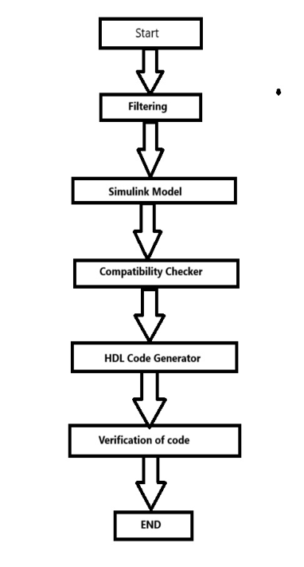

Flowchart of proposed solution

Slide 10
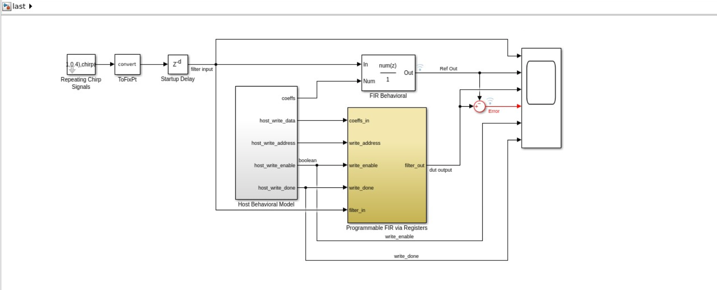
Observation/Results
IMPLEMENTATION ON SIMULINK

Slide 11
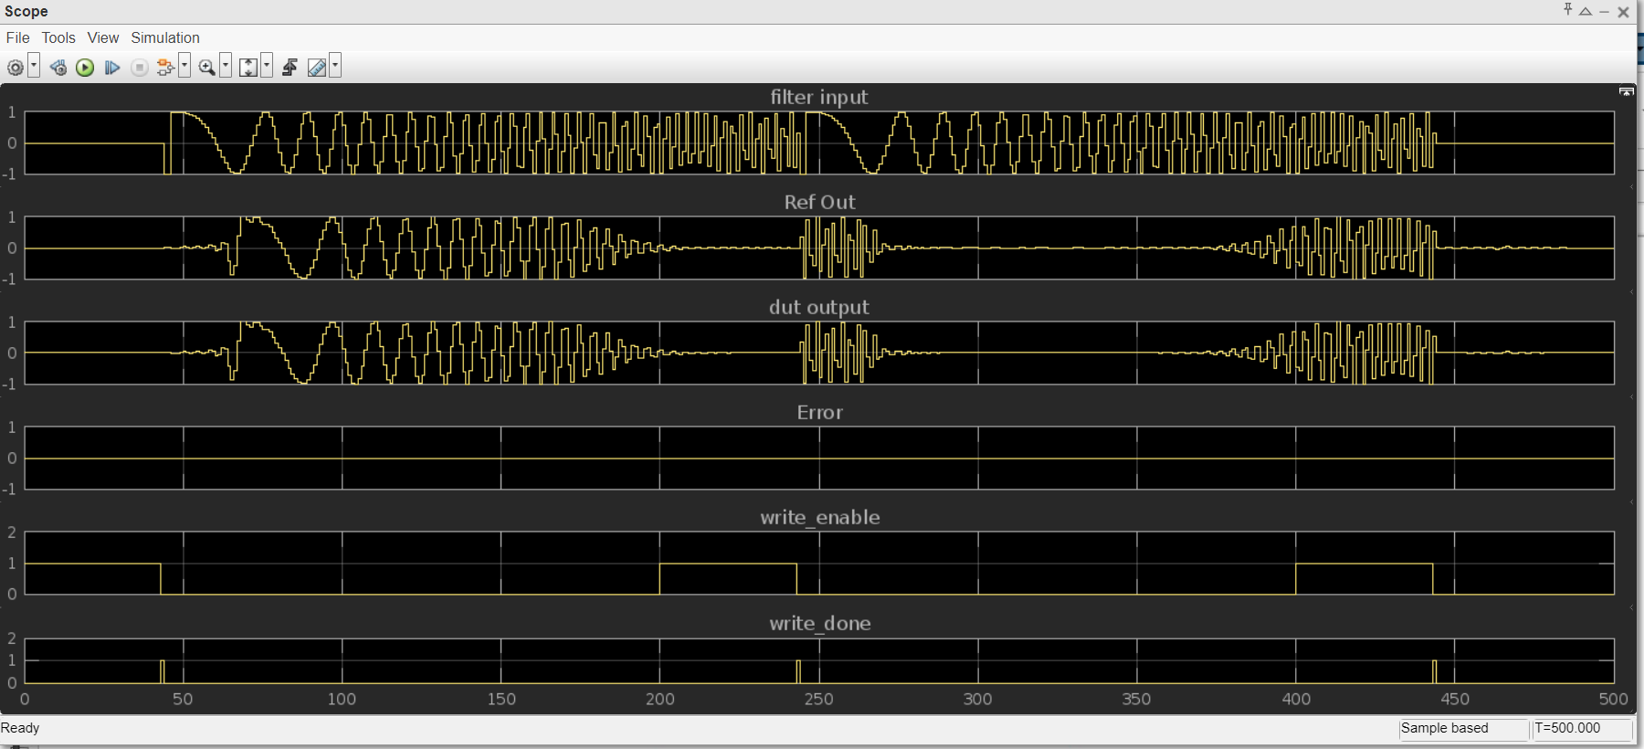
Observation/Results
OUTPUT WAVEFORMS

Slide 12
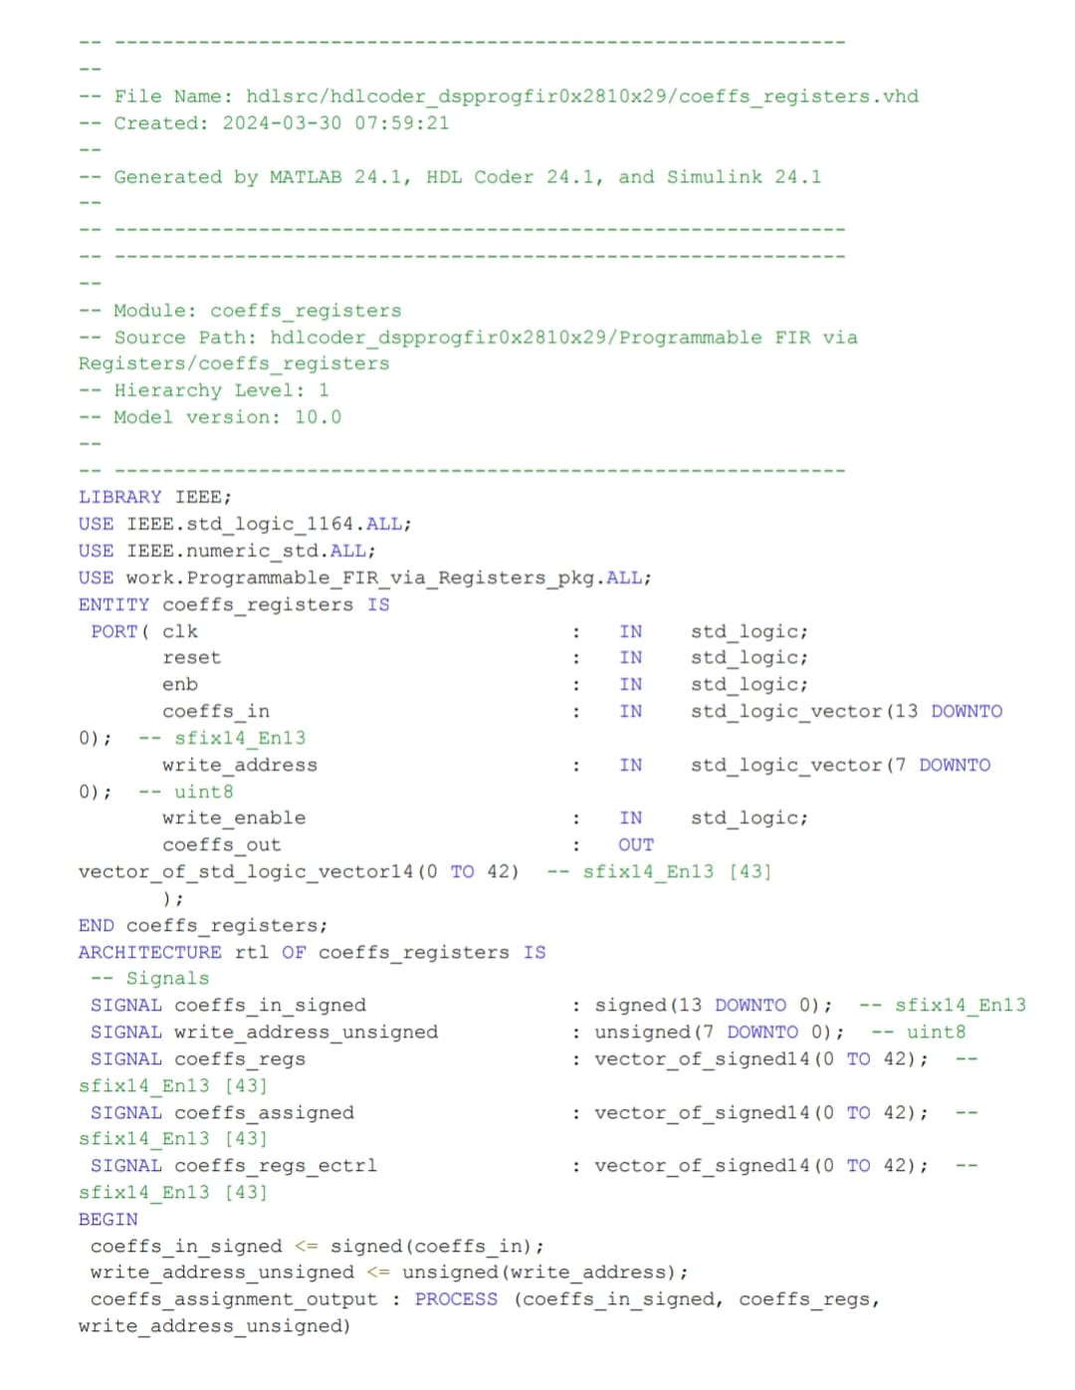
Observation/Results
GENERATED HDL CODE

Slide 13
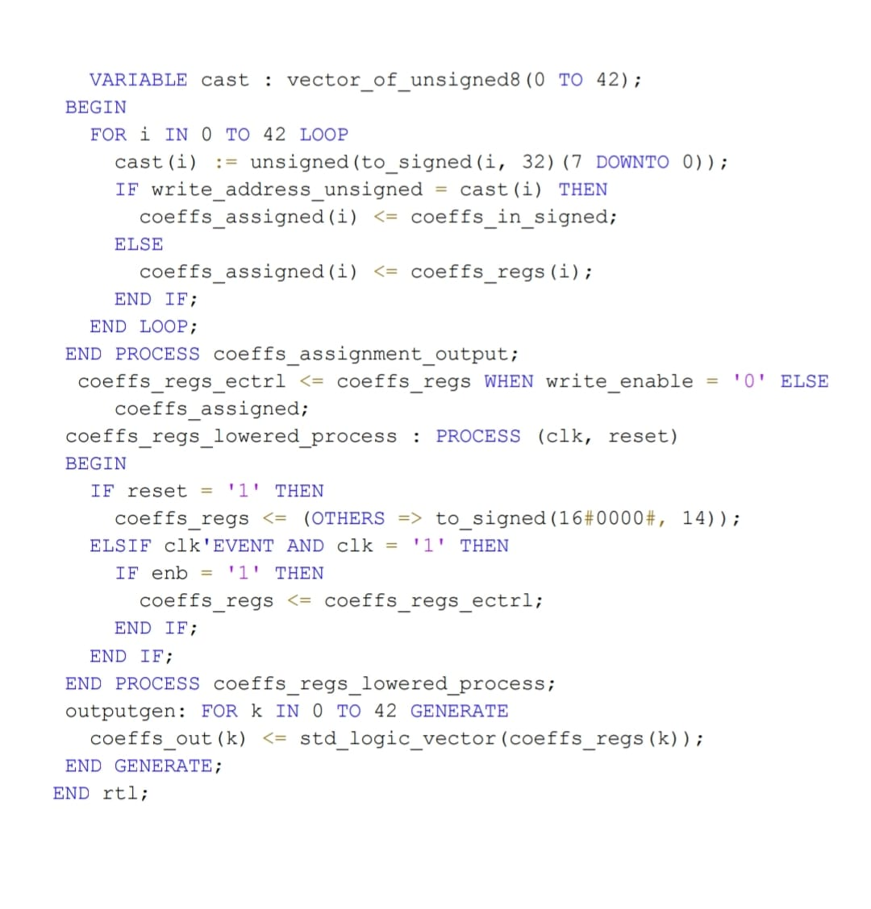
Observation/Results
GENERATED HDL CODE

Slide 14
File link
https://docs.google.com/document/d/1erDG95N89rYQeXAUiusbvhJJzeH4rtXENKpm8cJDJFE/edit?usp=drivesdk
https://docs.google.com/document/d/1vBqoXxKhfaBXIYVGIMLlH9r87-k51GLuDQiMaT4QYx4/edit?usp=sharing

Slide 15
References
[1] Smith, J. (2020). "FPGA Implementation of Frequency-Domain Filters Designed in Simulink." IEEE Transactions on Signal Processing, 68(5), 150-162.
[2] Johnson, E. (2019). "Hardware Implementation of FIR Filters Designed in Simulink." International Journal of Electronics and Communications, 72(3), 210-223.

