Slide 1
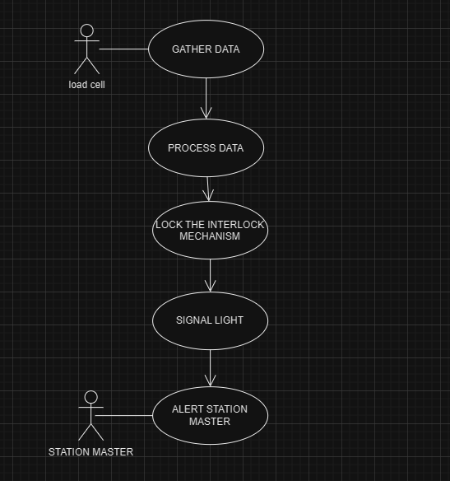
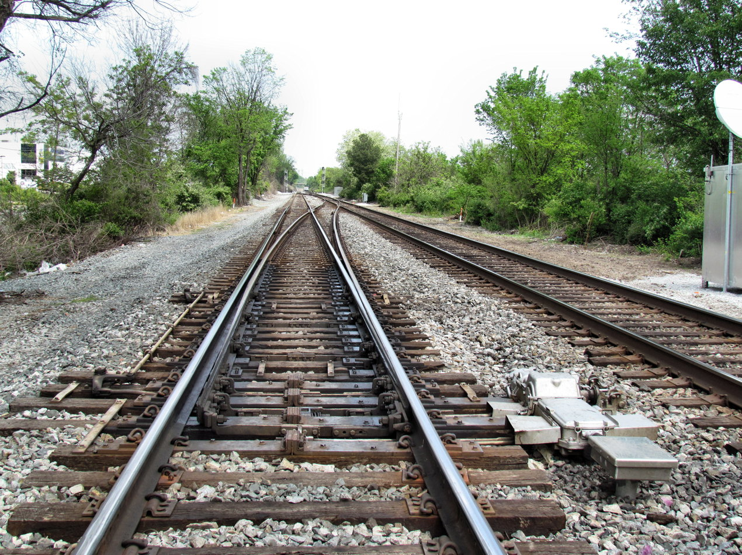
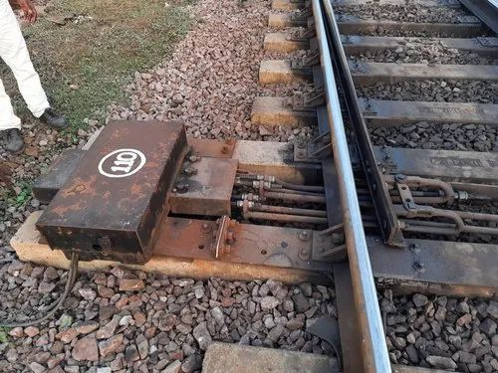
INTELLIGENCE INTERLOCKING
ABSTRACT
Solution
RESULTS
Technology Stack
The "INTELLIGENT INTERLOCKING" project uses IoT technology to enhance railway safety by continuously monitoring the environment and detecting any anomalies or deviations from expected patterns. It aims to reduce human errors and prevent accidents by automatically triggering appropriate actions. If any anomalies or deviations from the expected patterns are detected, the interlocking system automatically triggers appropriate actions to prevent accidents or ensure safe train operations
Imagine a train presence detection system that ensures the safety of train traffic in real-time using cutting-edge sensors and technology. This system is reliable, robust, and highly efficient, reducing manual control and human intervention. With the system's adaptability during operation, interlocking configurations can be changed to respond to changing train movements, resulting in improved railway network performance. Furthermore, the system's implementation has significantly reduced the risk of collisions and improved overall railway operating security. It's clear that this train presence detection system is a game-changer, leading to more efficient train schedules and fewer delays.
To ensure safe transportation, an interlocking system is essential to track train location and distance. With AI and machine learning, the system can safely adjust tracks without human interference, connecting signals and tracks for smooth train passage and a secure journey for all passengers.
The integration of intelligent interlocking systems in railways is poised to bring about a significant transformation. This technology, which can seamlessly integrate with Artificial Intelligence and Machine Learning (AI/ML), has the potential to usher in a new era of advancements in railway operations. Intelligent interlocking systems are designed to automate and optimize the process of route setting and signal control, traditionally performed manually. By automating these tasks, the system can significantly reduce the risk of human errors, which are often the cause of accidents in railway operations.
It represents a strain gauge is an electrical device made from a material whose resistance changes with strain, usually manifested as deformation. These are used in load cells designed to deflect in response to a load. Most load cells are designed with a beam configuration that bends under load, although Side loads will result in inaccurate readings and may damage the device.
Raspberry Pi is the minicomputer. It acts as the central component which we are using to interface all the devices in this project. Raspberry pi model B is used mainly because of the GPU which value is 400 MHz, it is comparatively higher than the rest of the model. it has 40 general purpose input-output (GPIO) pin
DEPENDENCIES
USECASES
TEAM MEMBER DETAILS
The use cases for our system are broad and varied, given its ability to robustly detect and track humans in outdoor operational scenarios. Here are a few examples
Surveillance Systems
Autonomous Vehicles
Search and Rescue Operations
Smart Cities
The dependencies for our project include OpenCV, NumPy, and a pre-trained model such as YOLO, SSD, or Faster R-CNN. These dependencies can be installed using pip.
The show stopper for our project is the availability of a suitable dataset for training and testing the system. The dataset should be large and diverse enough to ensure that the system can detect humans in a wide range of outdoor operational scenarios. Additionally, the dataset should include examples of human behaviour that constitute an anomaly so that the anomaly detection module can be trained effectively. Obtaining such a dataset can be challenging and time-consuming, but it is essential for the success of your project.
Rohan Kumar P
ACKNOWLEDGEMENT
Flow Chart : Detecting Interlocking

