Slide 1

Creating a bot in java for an ascii-based game
Rohan Bhattacharya

Slide 2



What is a bot?
A player controlled by the computer.
Autonomously makes moves.
(Attempts to) play ideally for each given position.

Slide 3
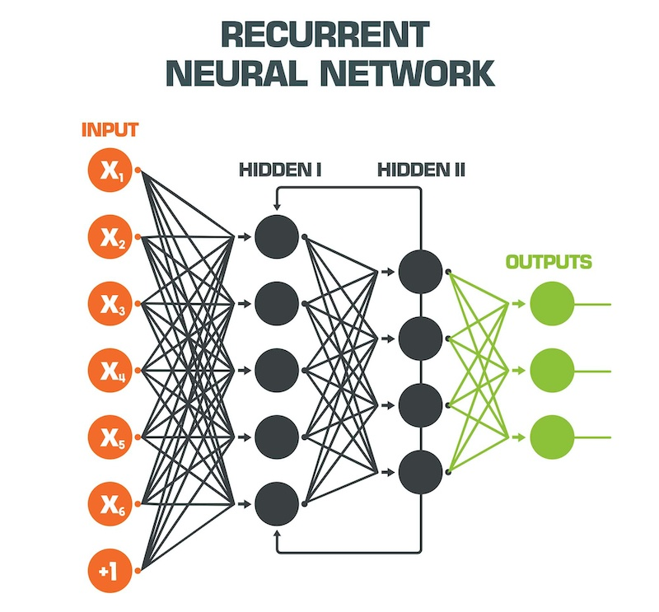
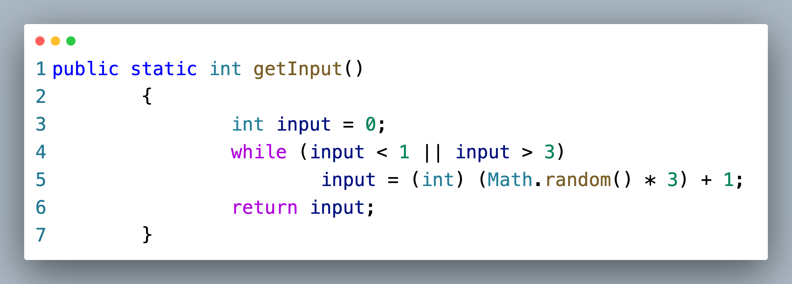
What’s up with randomness?
Dice Rolls vs Probabilities

Slide 4
What does a bot need to succeed?
Inputs
Inputs
Inputs

Slide 5

Let’s make our own with nim

