Slide 1

A Secure and Efficient Messaging and Document Sharing Collaborative Platform

Slide 2
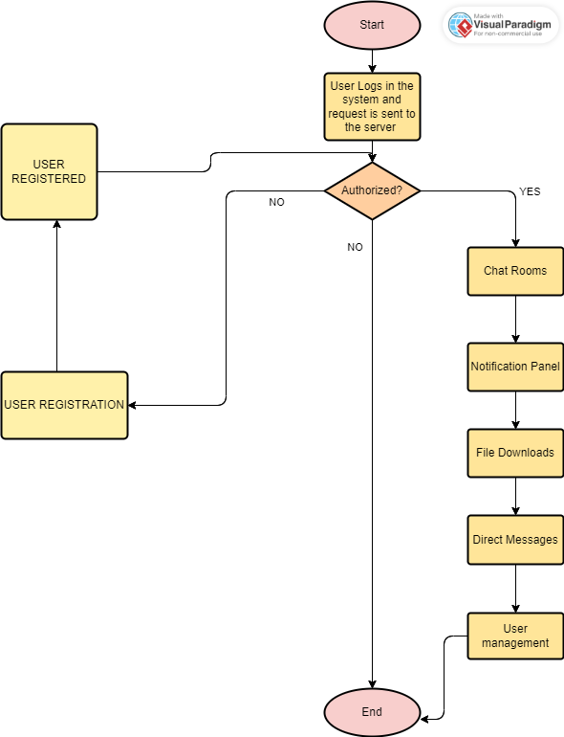
Flow of the Project/Application

Slide 3
Thread Programming in this project?
In this project, thread programming is used to enable the application to process numerous requests at once. The server creates a new thread to handle a user's request to conduct an action on the application while still allowing the main thread to handle other requests. This makes it easier to make sure the application is responsive and capable of managing several queries at once, which is crucial for a web application.
Task Flow of Thread in this project:
User request: A user sends a request to the server to perform an action.
Thread creation: The server creates a new thread to handle the user's request.
Processing: The thread processes the user's request, performing any necessary actions and accessing the database if needed.
Response: Once the thread has finished processing the request, it sends a response back to the user.
Thread cleanup: The thread is cleaned up and destroyed once it has completed its task.

Slide 4
The approach used in this project involves designing the application in such a way that it can handle multiple requests concurrently using threads. This requires careful consideration of how data is shared between threads and how to ensure that each thread has access to the resources it needs without causing conflicts or data corruption.
To implement this approach, the application is designed using a server-client architecture where the server handles incoming requests from clients and creates a new thread to process each request. The threads are managed using a thread pool to ensure that resources are used efficiently and that the application can handle a large number of concurrent requests without overwhelming the system.
Threads are to be carefully design and management of threads to ensure efficient use of resources and avoid conflicts.

