Slide 1
BINARY SEARCH TREES IN C++
By Rohan Das

Slide 2
WHAT IS BINARY SEARCH TREE?
A Binary Tree is a tree in which every node can have at max two children.
A Binary Tree is called a Binary Search Tree(BST) if all the following conditions are satisfied:
The left sub-tree of a node will have all the nodes whose keys are lesser than the node’s key.
The right sub-tree of a node will have all the nodes whose keys are greater than the node’s key.
The left and right sub-tree will also be a BST.

Slide 3
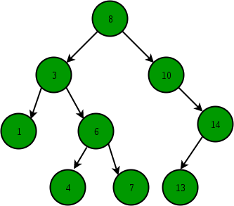
HOW A BST LOOKS LIKE?

Slide 4
HEIGHT OF A BINARY TREE?
The height of a binary tree is the height of the root node in the whole binary tree.
In other words, the height of a binary tree is equal to the largest number of edges from the root to the most distant leaf node.
Height of this BST is 3

Slide 5
NUMERICALS ON BST
If there are N nodes in binary tree, maximum height of the binary tree is (N-1) and minimum height is floor(log2N).
The maximum number of nodes at level ‘l’ of a binary tree is 2^{l}.
The Maximum number of nodes in a binary tree of height ‘h’ is (2^{h} – 1)
In a Binary Tree with N nodes, minimum possible height or the minimum number of levels is log₂(N+1)

Slide 6
TYPES OF BINARY TREE
There are many types of a Binary Tree. Some of the most common types of Binary Trees are:
Full Binary Tree: A Binary Tree is a full binary tree if every node has 0 or 2 children. The following are the examples of a full binary tree. We can also say a full binary tree is a binary tree in which all nodes except leaf nodes have two children.
Complete Binary Tree: A Binary Tree is a Complete Binary Tree if all the levels are completely filled except possibly the last level and the last level has all keys as left as possible
Perfect Binary Tree: A Binary tree is a Perfect Binary Tree in which all the internal nodes have two children and all leaf nodes are at the same level.

Slide 7
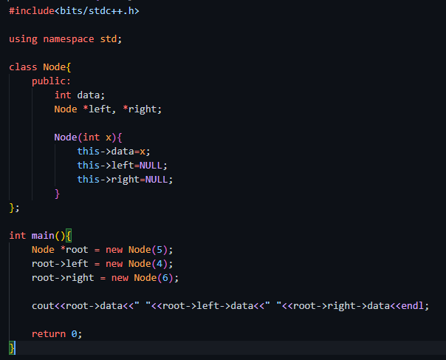
C++ REPRESENTATION OF BST

Slide 8
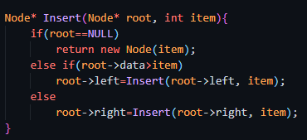

INSERTION OF A NEW NODE IN A BST
Algorithm:
If the item to be inserted is lesser than the root node, insert at the left node data
If the item to be inserted is greater than the root node, insert at the right node data
If the root node is NULL, then insert at that node

Slide 9
TRAVERSALS IN BST
In-order Traversal: In the case of binary search trees (BST), In-order traversal gives nodes in non-decreasing order.
Pre-order Traversal: Pre-order traversal is used to create a copy of the tree. Preorder traversal is also used to get prefix expression on an expression tree.
Post-order Traversal: Post-order traversal is used to delete the tree.
Level Order Traversal:

Slide 10
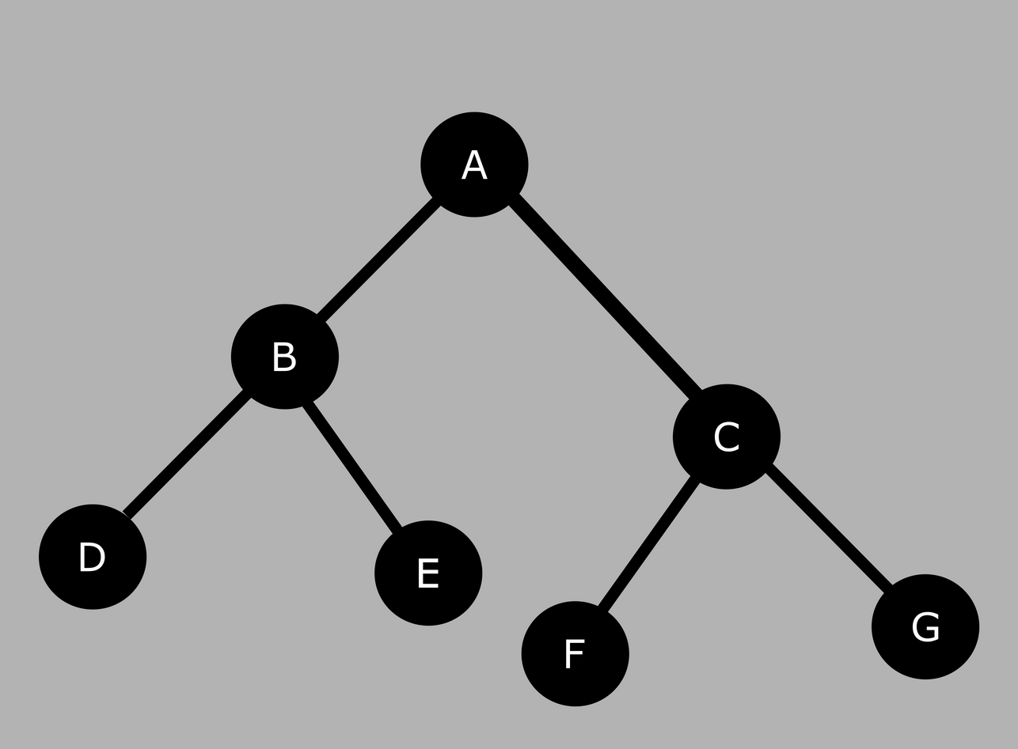
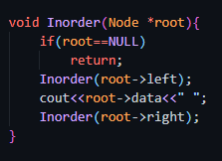
IN-ORDER TRAVERSAL
In-order (Left, Root, Right)
The In-order Traversal of the BST is:
D, B, E, A, F, C G

Slide 11
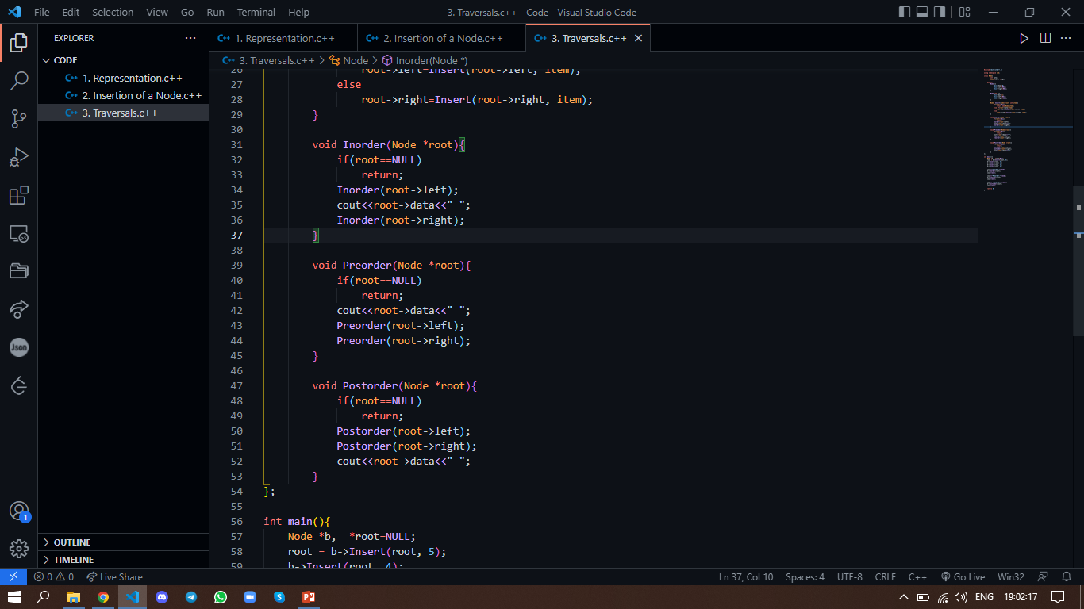
PRE-ORDER TRAVERSAL
Pre-order (Root, Left, Right)
The Pre-order Traversal of the BST is:
A, B, D, E, C, F, G

Slide 12
POST-ORDER TRAVERSAL
Post-order (Left, Right, Root)
The Post-order Traversal of the BST is:
D, E, B, F, G, C, A

Slide 13
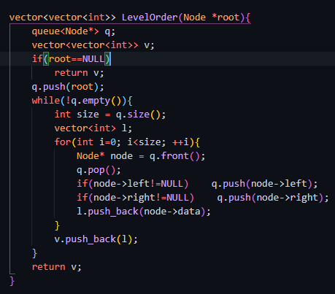
LEVEL-ORDER TRAVERSAL
Level-order (Root)
The In-order Traversal of the BST is:
A,
B, C,
D, E, F, G

Slide 14


