Slide 1
Uber Fare Prediction
Rohan Rao

Slide 2

Task
Summary
I conducted regression analysis on a dataset of Uber trips in New York to predict the fares of potential trips based on factors such as distance, year, month etc.
It is a supervised learning project that involves regression
Dataset
I will be using a dataset that consists of uber trips in and around New York ranging from the years 2009 to 2015
200000 samples in raw data
Dataset Link: https://www.kaggle.com/datasets/yasserh/uber-fares-dataset
Models
Linear regression, Random forest regression, Gradient boosting regression
Notes:
In this project I will be conducting regression analysis on a dataset of Uber trips in New York to predict the fares of potential trips. My goal is to train a machine learning model that can accurately predict the fare of an Uber taxi ride given relevant information such as the pickup and drop-off longitude and latitude, time of day, and distance traveled. To do this, we will use regression techniques to build a model that can make continuous predictions.
In this project, I will try to cover the following steps:
Data preparation, cleaning and exploratory data analysis
Model selection and training
Model evaluation and improvement

Slide 3
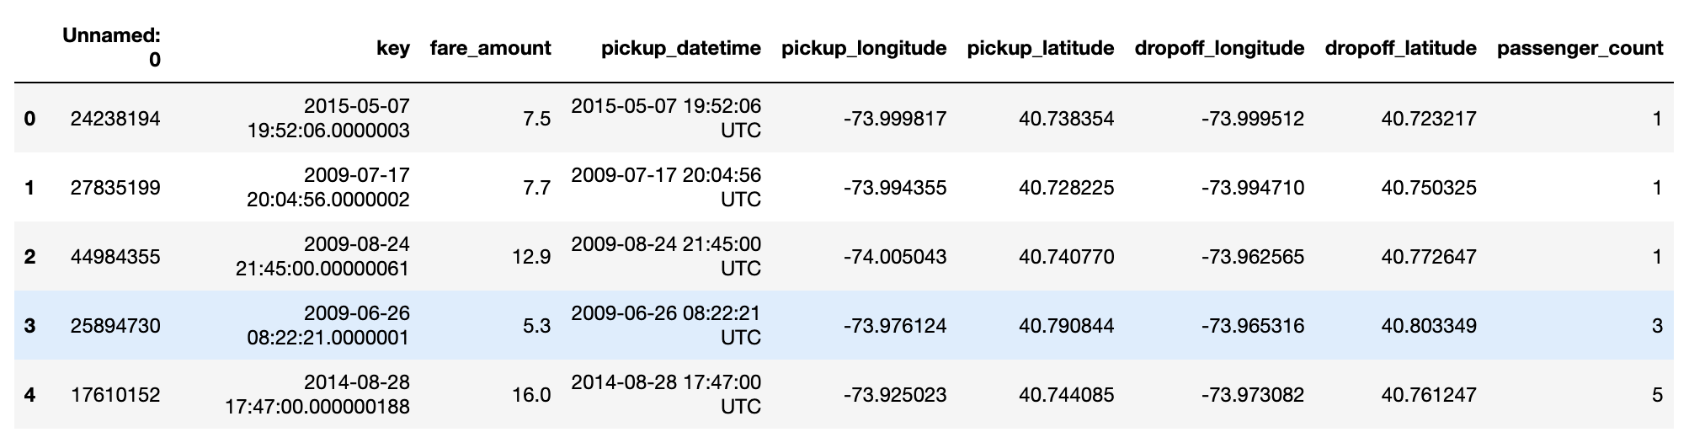
Data
Pre-Processed Data
Number of samples | 200000
Target | Fare_amount (numerical variable)
Number of features | 8 numerical variables
Missing Values | 1
Duplicate Values | 0

Slide 4
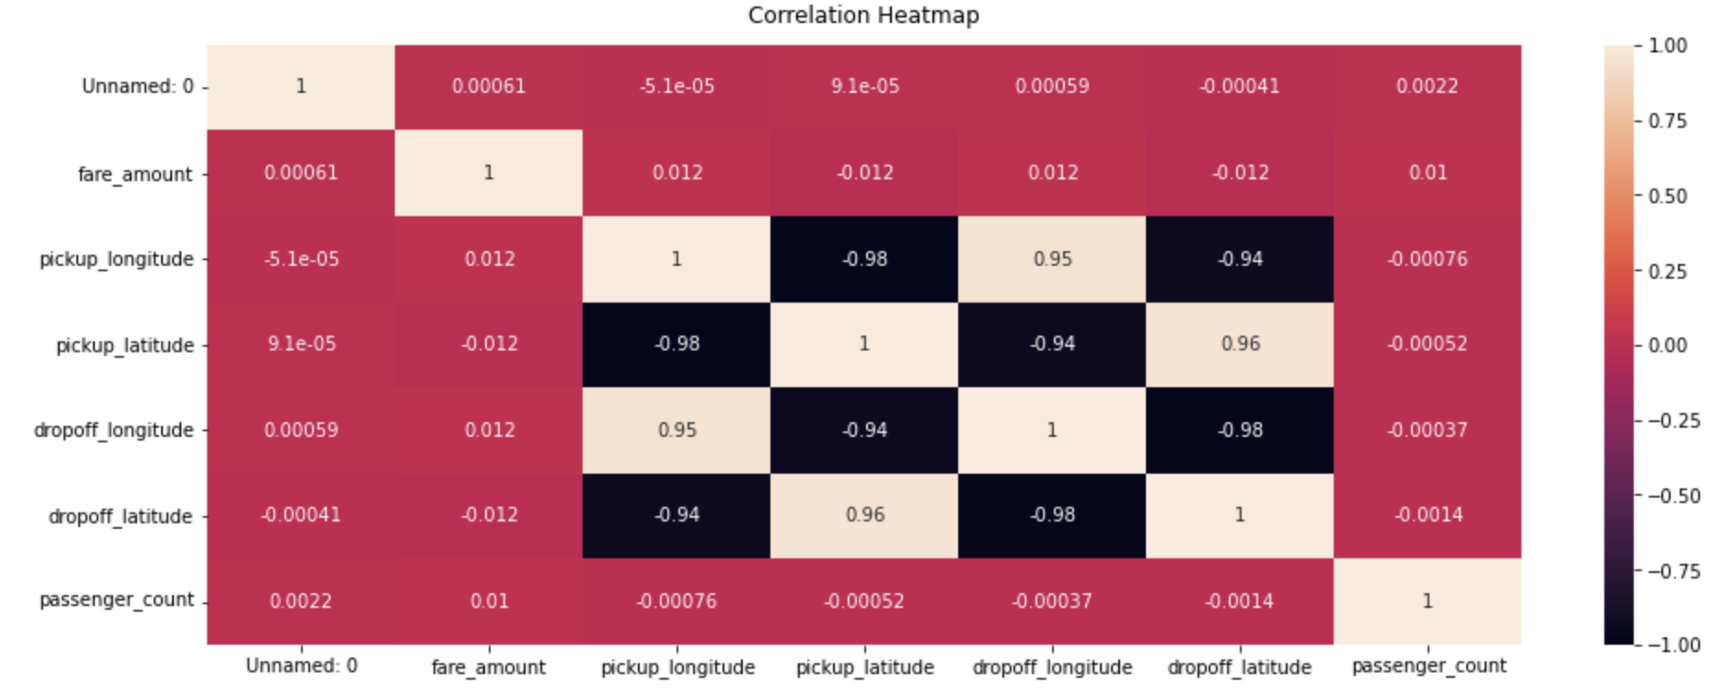
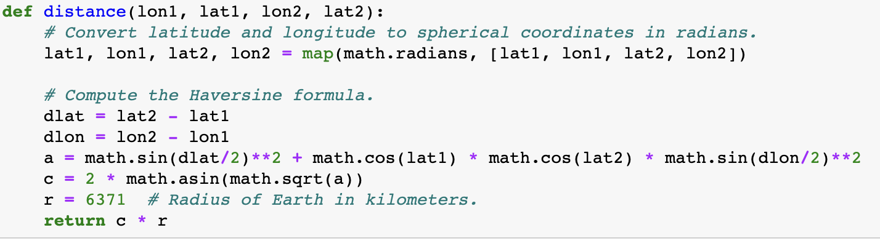
Pre-Processing Steps
Barely any correlation between fare_amount and the other features.
Converted pickup_datetime to type datetime to extract year, month, day, hour
Used the haversine formula to calculate the distance from the coordinates
Also calculated the absolute difference between the longitude and latitude values
Cleaned the data for outliers by looking at distribution of values

Slide 5
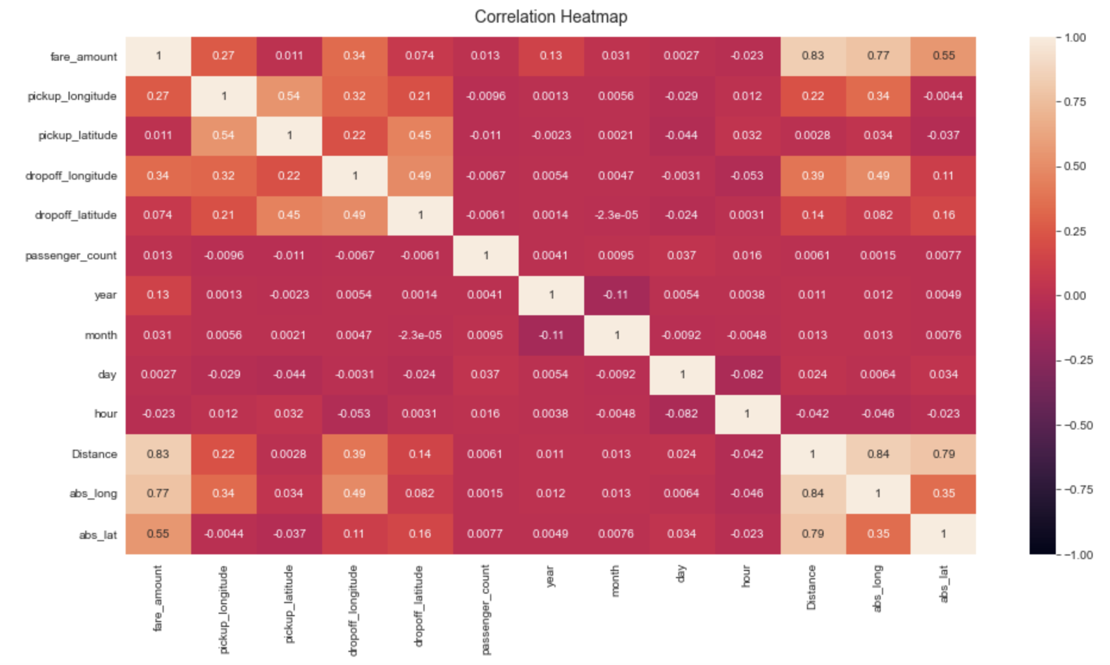
Lots of multicollinearity present so I dropped the abs_long, abs_lat.
Since I did not need the coordinates anymore, I dropped the pickup and dropoff columns as well

Slide 6
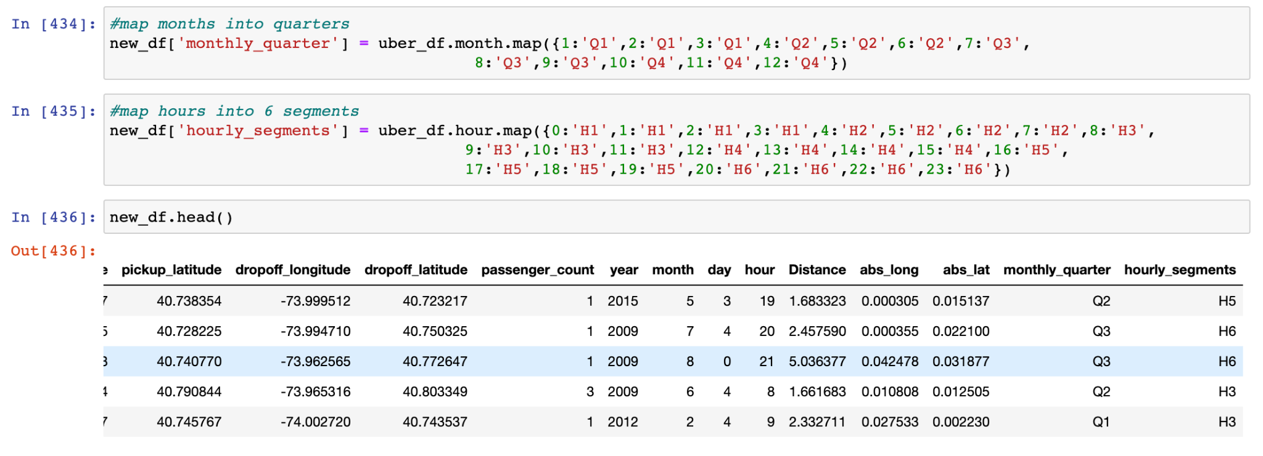
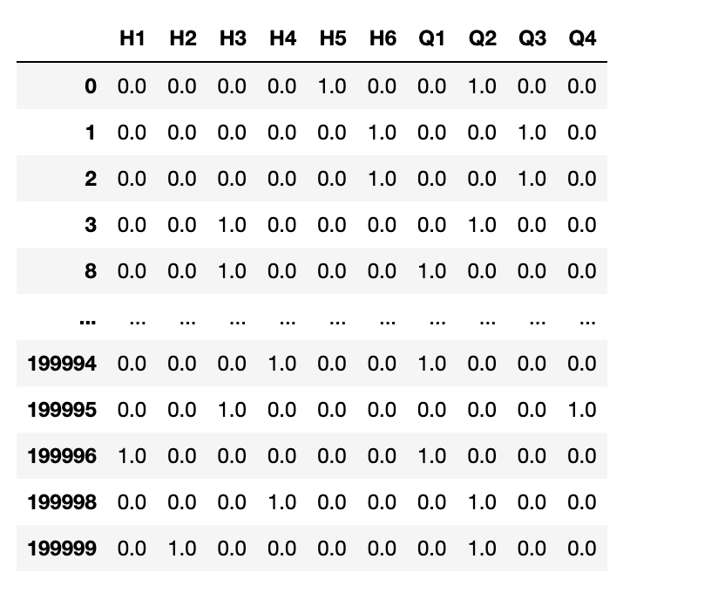
Mapped values of months and hours into segments
Dropped the categorical columns
Used one hot encoding to transform the monthly_quarter, hourly_segments and day columns so that they can be used for regression analysis.
Decided to use one hot encoding since they are cyclic variables and if I treated them like numeric variables it might affect the coefficients
Standardize all numeric variables using StandardScaler()

Slide 7
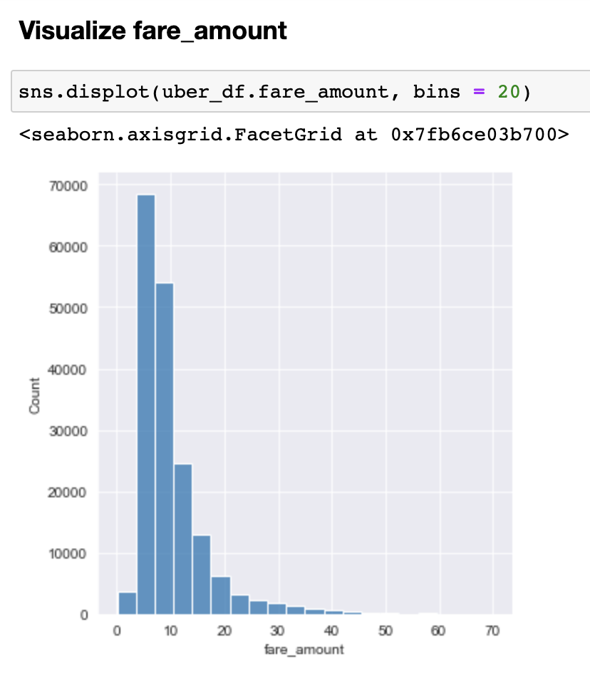
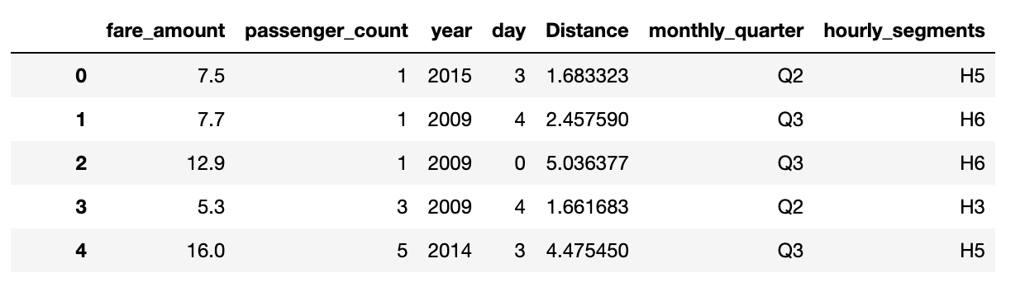
Number of samples | 180751
Number of features | 6 features (3 categorical, 3 numerical)
Train-Test Split | 80:20
We see a slightly skewed distribution in the fare_amount
We see a peak in the 5-10 dollar range

Slide 8
Models
Model | Linear Regression
Parameters | N/A
R-Square | 0.7252616156991065
MSE | 12.431387555268733
MAE | 1.9886596247580672

Slide 9
Models
Model | Gradient Boosting Regressor
Parameters | RandomizedSearchCV: 'learning_rate': [0.1,0.03, 0.05], ‘subsample' : [1], 'n_estimators' : [100,300], 'max_depth' : [3, 6] Best: ‘subsample': 1, 'n_estimators': 100, 'max_depth': 3 , 'learning_rate': 0.05
R-Square | 0.762340274965514
MSE | 10.753648987564095
MAE | 1.8368721888325856

Slide 10
Models
Model | Random Forest Regressor
Parameters | RandomizedSearchCV: 'max_depth': [10, None], ‘max_features': ['auto', 'log2'], 'n_estimators': [50, 100, 250], 'bootstrap' : [True] Best: 'n_estimators': 100, 'max_features': 'auto', 'max_depth': 10, 'bootstrap': True
R-Square | 0.7625786003470603
MSE | 10.742865218889769
MAE | 1.8410981355173242

Slide 11
Model Comparison
Model | R-Square | MSE | MAE
Linear Regression | 0.7252616156991065 | 12.431387555268733 | 1.9886596247580672
Gradient Boosting Regressor | 0.762340274965514 | 10.742865218889769 | 1.8410981355173242
Random Forest Regressor | 0.7625786003470603 | 10.742865218889769 | 1.8410981355173242
Potential Solutions:
Try different ratio of training and testing data (70:30)
Regularization to prevent overfitting
Use GridSearchCV to get a definitive set of the best parameters

Slide 12
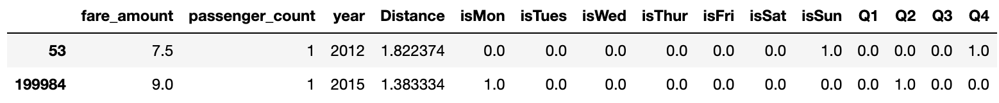
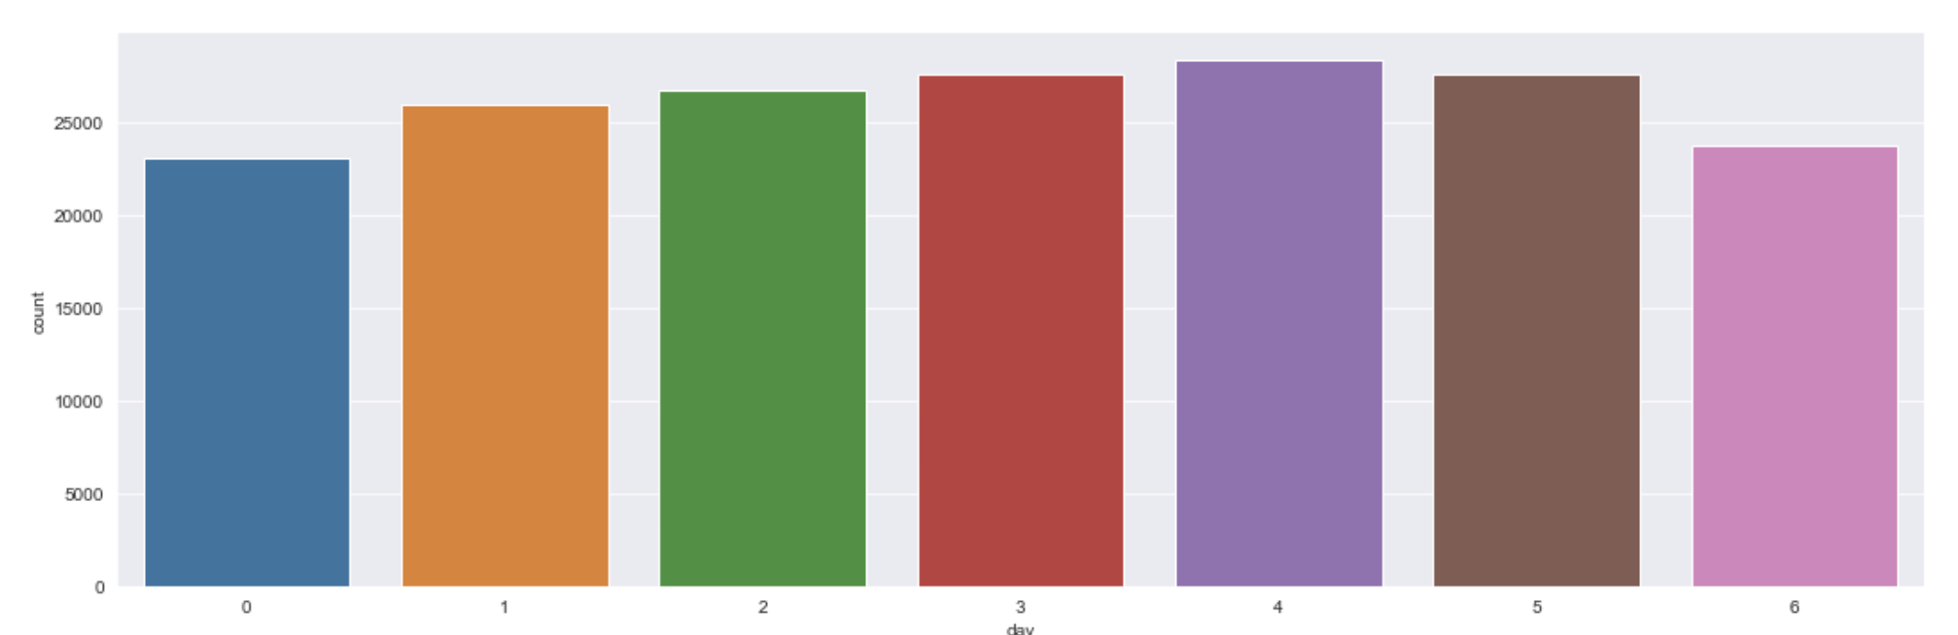
Error Analysis
Found values from X_test data with large differences with predicted data from Random Forest Model
Can see a pattern in data as these were rides recorded on Sunday or Monday
Number of rides recorded on Sunday or Monday are lower when compared to rest of the days of the week
Possible Solutions could include generating data for Mondays and Sundays

Slide 13
Thank You!

