Slide 1

JOB BLITZ
The AI command center for your job search.
From job description to job offer - one intelligent workflow.

Slide 2
REAL-WORLD IMPACT · THE SCALE OF IT
Job hunting has become a numbers game - and the odds are brutal.
32
~3%
74%
applications sent, on average, before a job seeker gets an offer
of applications ever make it to an interview
of applications receive no response at all
Career.IO, 2025
CareerPlug, 10M+ applications, 2026
TurboResume, 2026
The bottleneck isn't effort. It's fragmentation.

Slide 3
THE PROBLEM
One job application touches nine disconnected steps.
Our Job-Blitz AI specially gives Prep Plan, Insights from Shortlisted Candidates, Expected Questions for Interview for selected Job role
Select Job from Pool/ Scan any Job Poster
Understand
Requirements by Job-Blitz AI
Job Blitz Evaluates and Identifies the skill gaps
Visually Tracks &
Follow Up the application
1
2
3
4
5
6
7
8
9
Read JD fetched from official Postings
Checks Fit to the role automatically by user Uploaded resumes
Gives Readiness Score
For that role
Matches current user resume to JD
Each step usually means a different tab, tool, or spreadsheet - repeated for every single role.

Slide 4
NOVELTY · WHY WE BUILT IT
Existing tools solve one step. None solve the workflow.
TYPICAL TOOLS
JOB BLITZ
Data
Scattered Data, shows only fixed postings on fixed sites
Clustered Data, Watches maximum sites to fetch immediate job postings to dashboard
Scope
One step at a time - search, or a resume, or a tracker
The entire pipeline, start to finish
Personalization
Generic keyword matching against a job title
Explainable fit & readiness scores, per role
Where it runs
Cloud dashboard, desktop-only
Mobile-first, with a purpose-built backend
Output
A list of jobs, or a formatted document
A ready-to-act application workspace

Slide 5







THE SOLUTION
Job Blitz turns nine steps into one workflow.
Job Blitz actively watches Job postings on many trusted sites(LinkedIn, Greenhouse, Indeed etc.), MNC official carrier pages fetches them to your dashboard, scores your fit, finds the gaps, builds your prep plan, tailors your documents, and tracks the outcome - automatically.
Phone-first AI Camera and voice input, backed by an AI pipeline built for rapid, on-the-go interaction.
Explainable scoring Fit and readiness scores you can actually trace back to evidence.
ONE WORKSPACE
End-to-end workspace Job info, prep, documents, and status - together in one place.

Slide 6
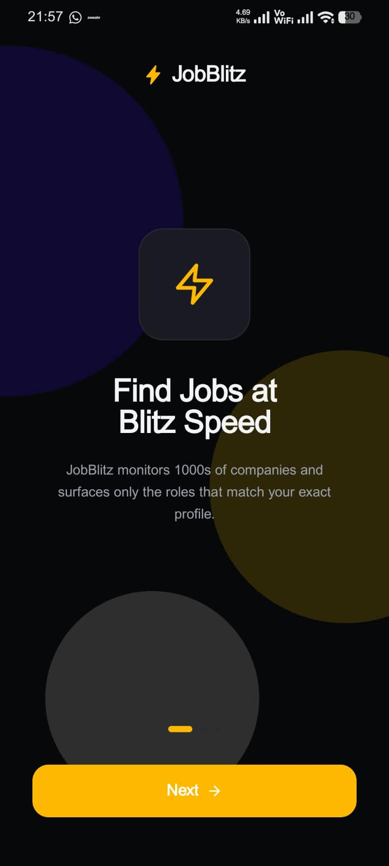
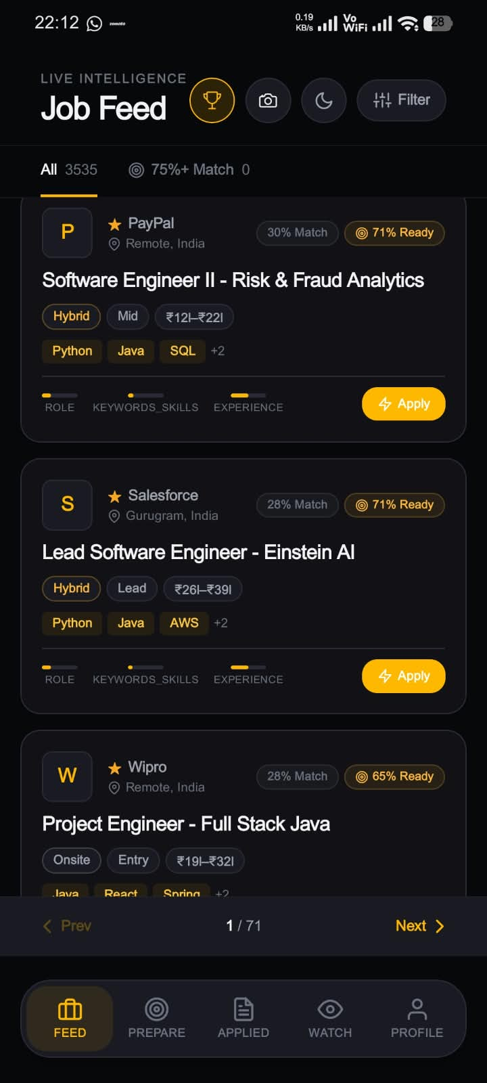
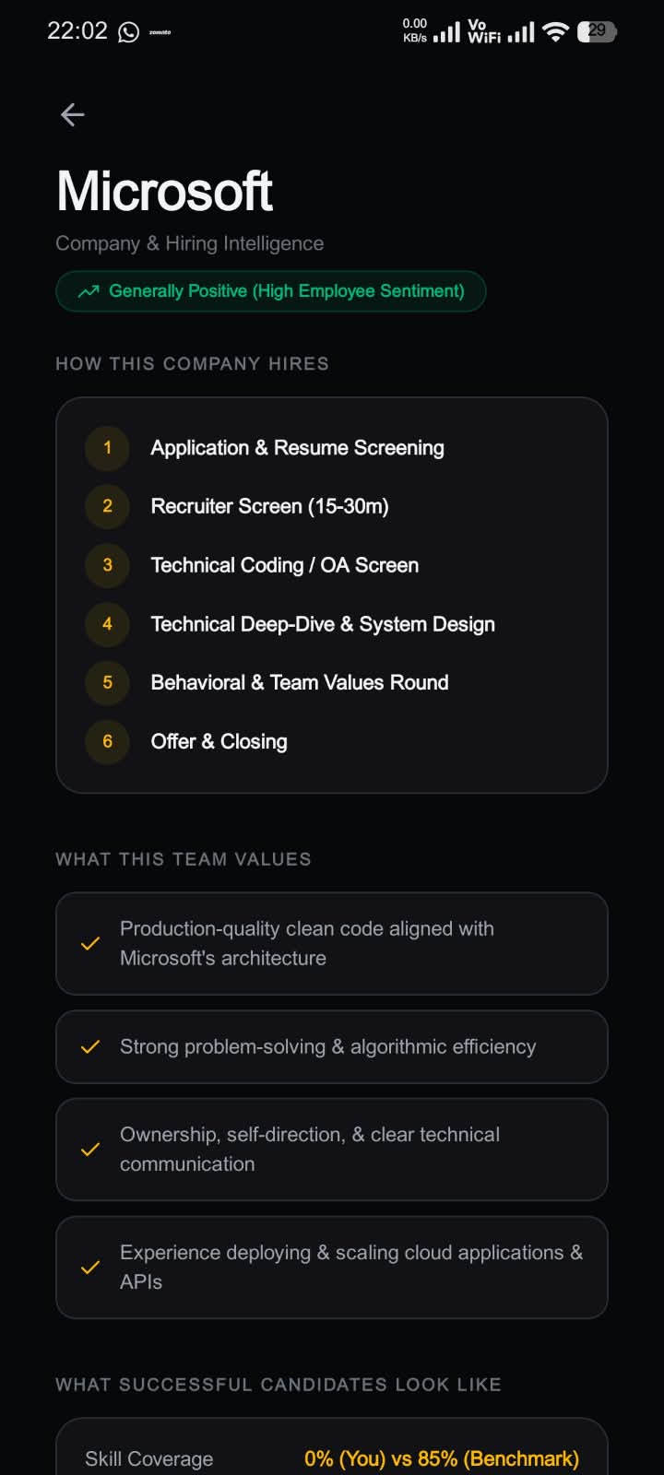
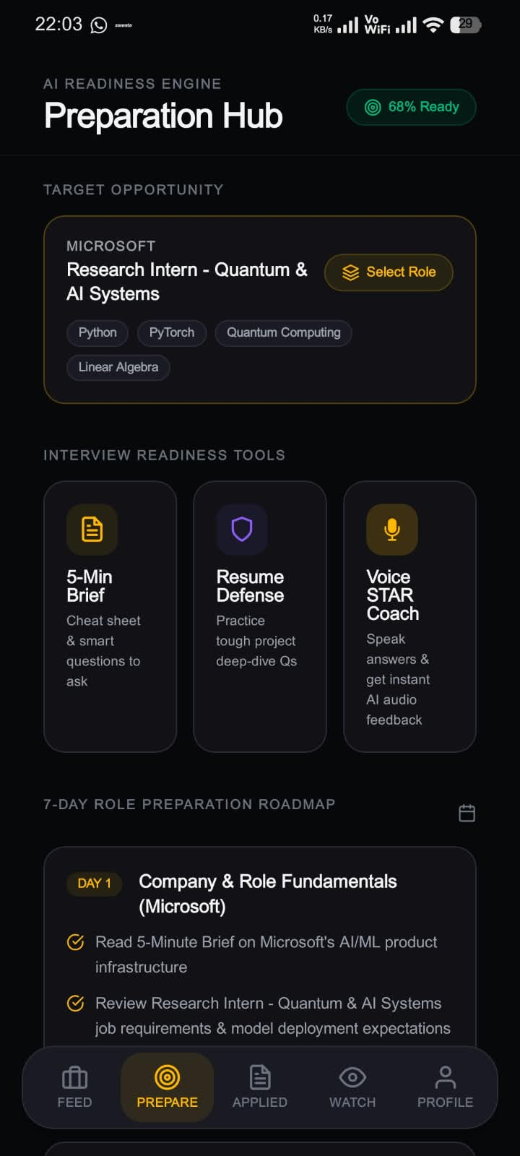
INSIDE THE APP
Everything the candidate needs, right below the job description.
Mobile-first: one screen - JD in, requirements and a personalized roadmap out.

Slide 7
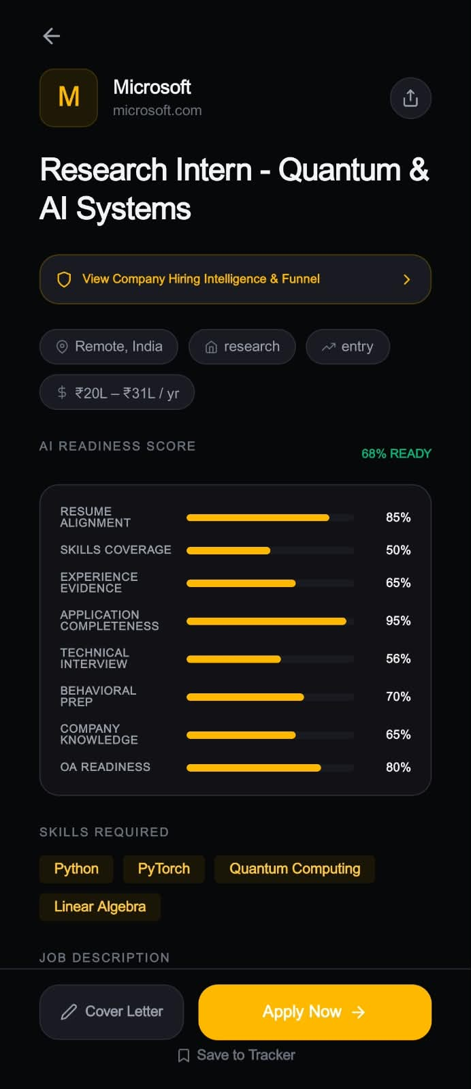
HOW IT DECIDES
An explainable score, not a black box.
Fit Score
78/100
Readiness Score
65/100
AI Job Intelligence extracts the skills, responsibilities, and keywords a role actually needs.
The Skill Gap Engine compares that to your profile and ranks what's missing by how much it matters - not just what's missing.
Missing: Kubernetes
HIGH PRIORITY
Weak: System Design
MEDIUM PRIORITY
Missing: Public Speaking
LOW PRIORITY
Every number traces back to a sentence in the job description - never a guess.

Slide 8

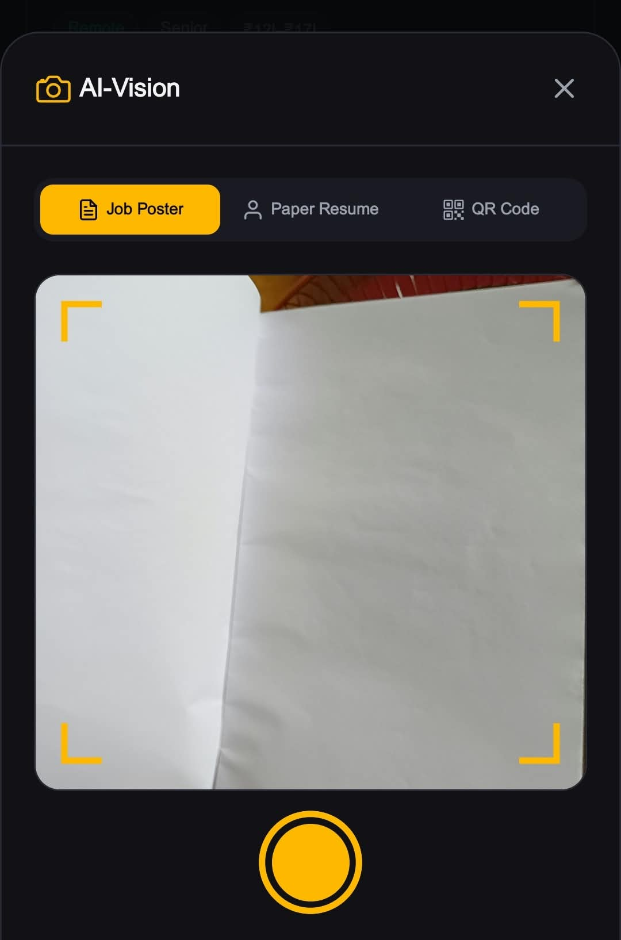
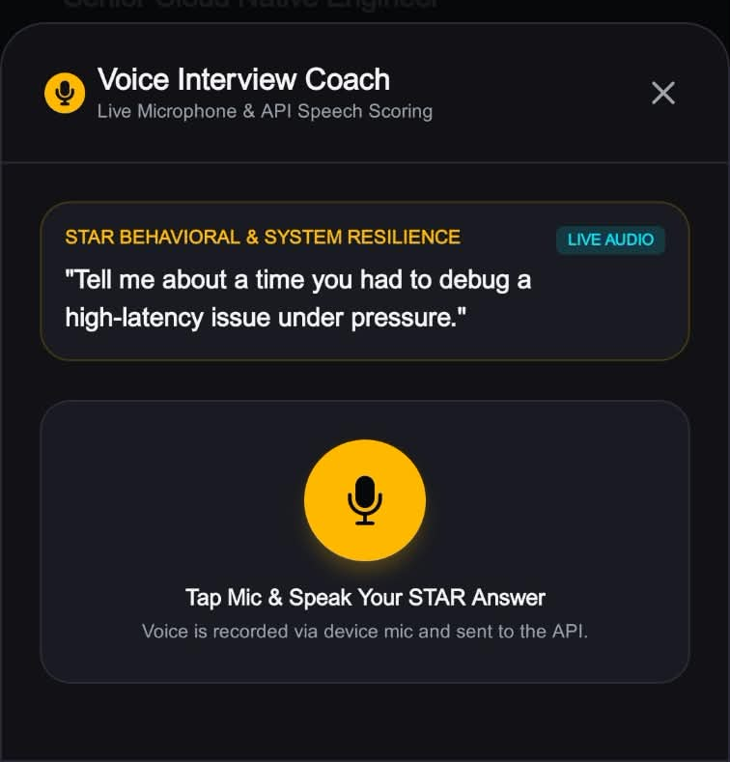
CREATIVE PHONE USE & HARDWARE
Camera and microphone, working for the candidate.
HackTracker Data Captured
On-Device AI-Vision
Real-time Voice AI
Camera, microphone, and on-device AI activity, recorded by HackTracker as measured device data.
Camera usage for scanning flyers and screens locally, turning them into a posting the AI can read.
Microphone usage for low-latency interview simulation, so mock interviews feel like the real thing.

Slide 9



CORE WORKFLOW
A closed loop, not a checklist.
Discover
Learn &
Improve
Analyze
Track
Match
Apply
Identify
Gaps
Tailor
Prepare

Slide 10
KEY FEATURES
Everything a candidate needs, in one workspace.
1 / 2
AI Job Intelligence
Match & Readiness Engine
Skill Gap Engine
Extracts skills, responsibilities, and keywords from any job description.
An explainable fit score and application-readiness score.
Finds missing or weak skills and prioritizes them by importance.
AI Preparation Roadmap
Resume & Cover Letter Tailoring
Interview Copilot
An actionable prep plan built for the specific role.
Adapts documents to the role while keeping facts accurate.
Role-specific questions, plus AI-run mock interviews.

Slide 11

KEY FEATURES
Everything a candidate needs, in one workspace.
2 / 2
Application Workspace
Application Tracker
Phone-First AI
Office Kit Workflow
Feedback Loop
Job info, prep tasks, documents, and status - one place.
Deadlines, follow-ups, interviews, and outcomes, tracked.
Camera and voice input for fast, on-the-go interaction with the AI backend.
Phone-Laptop Bridge: hands off to the laptop for document transfer and deep work.
Outcomes become insights that sharpen future recommendations.

Slide 12
SIMULATION
One job posting. A workspace in under a minute.
1
0:05
Paste the job link - Job Blitz parses role, seniority, and required skills.
2
0:12
Fit score computed against your profile: 78/100, explainable line by line.
3
0:20
Gaps surfaced and ranked - “Kubernetes” flagged as the top-priority gap.
4
0:35
A 3-step prep roadmap and a tailored resume are generated.
5
0:55
Interview questions are ready. The application is logged and tracked.
Same phone. Same tab. No spreadsheet in sight.

Slide 13

TECHNICAL DEPTH · RELIABILITY BY DESIGN
Built to stay fast, even under real AI workloads.
Never blocks the UI
Scraping, parsing, and AI calls run as Celery background jobs on Redis - the app stays responsive while the heavy lifting happens off-thread.
Local Ai
Fine Tuned Llama power the pipeline, so extraction, scoring, tailoring, and interview prep can each lean on whichever model fits best.
Production-grade from day one
PostgreSQL with Alembic migrations, Dockerized for local dev, and continuously deployed to Hugging Face with 16Gb ram with a managed database up to 10GB.

Slide 14
JOB BLITZ
Job hunting shouldn't feel like a second job.
One phone. One workflow. Every application, blitzed.
END PRODUCT QUALITY
Sticky, Production-Ready, and built for Daily Active Use.
Team Red Hawks
1. Kompella Satya Rohan
2. Mavuri Tarun Sai

