Slide 1
Hotel Management Web Application
Java Full Stack Project Presentation

Slide 2
Project Introduction
- Hotel Management Web Application
- Automates hotel operations
- Built using Java technologies
- Stores data in database
Hotel Management Web Application Presentation

Slide 3
Technologies Used
- Java
- JSP
- Servlets
- Hibernate
- Maven
- MySQL
- Apache Tomcat
- HTML & CSS
Hotel Management Web Application Presentation

Slide 4
Project Modules
- User Registration
- User Login
- Room Booking
- Food Ordering
- Payment Handling
- Logout
Hotel Management Web Application Presentation

Slide 5
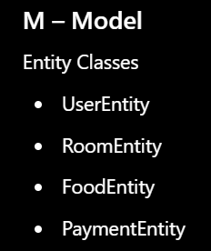
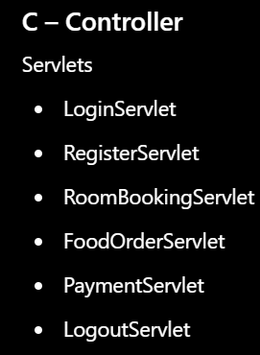
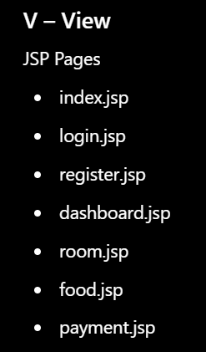
Project Architecture (MVC)
Model:
- Entity Classes
View:
- JSP Pages
Controller:
- Servlets
Hotel Management Web Application Presentation

Slide 6
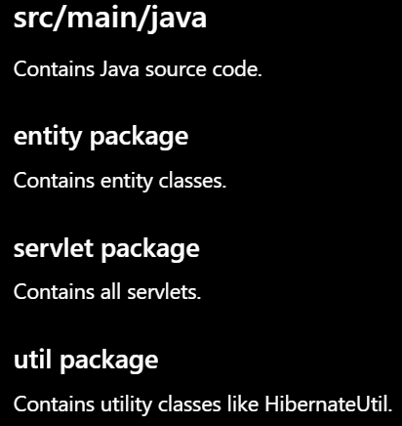
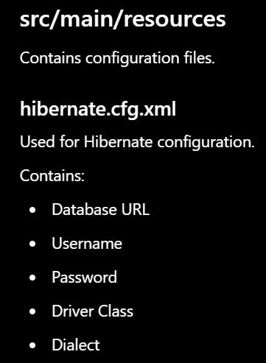
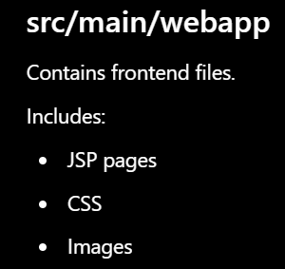
Folder Structure Explanation

Slide 7
Project Flow
1. User opens application
2. User registers/logins
3. Request goes to Servlet
4. Hibernate connects to database
5. User performs hotel operations
Hotel Management Web Application Presentation

Slide 8
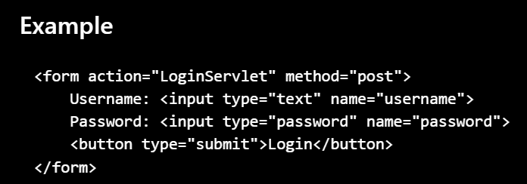
Understanding JSP
- JSP = Java Server Pages
- Used for frontend UI
- Combines HTML + CSS + Java
- Displays dynamic web pages
Hotel Management Web Application Presentation

Slide 9
Understanding Servlets
- Servlet is a Java class used to handle HTTP requests.
- Servlet acts as controller
- Processes business logic
- Connects frontend with backend
- Sends response to browser
Hotel Management Web Application Presentation

Slide 10
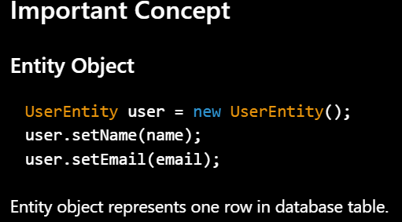
Registration Module
Purpose
Allows new users to create account.
Flow
User opens register.jsp
User fills form
Data goes to RegisterServlet
RegisterServlet creates UserEntity object
Hibernate saves object into database

Slide 11
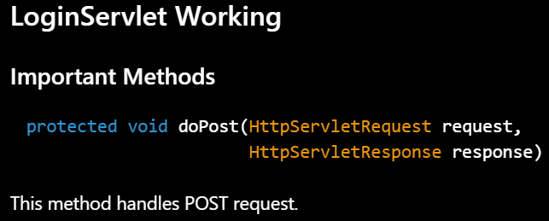
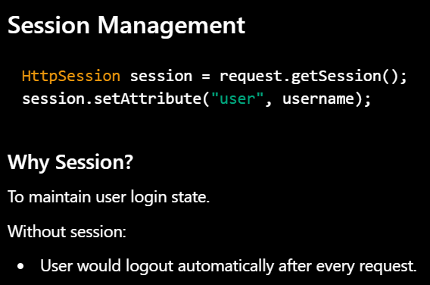
Login Module Explanation
Flow
Step 1
User opens login.jsp
Step 2
User enters:
Username
Password
Step 3
Form submits data to LoginServlet
Step 4
LoginServlet checks database using Hibernate
Step 5
If credentials are correct:
Session is created
User redirected to dashboard
Else:
Error message displayed

Slide 12
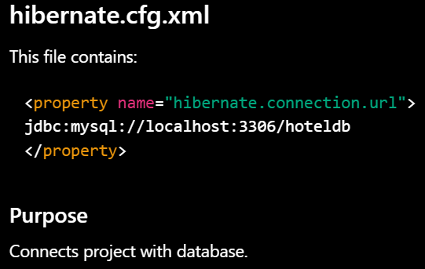
Hibernate Explanation
- ORM Framework
- Maps Java objects with database tables
- Reduces SQL coding
- Simplifies database operations
Hotel Management Web Application Presentation

Slide 13

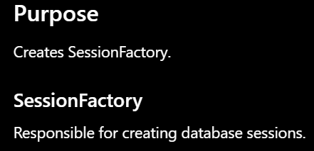
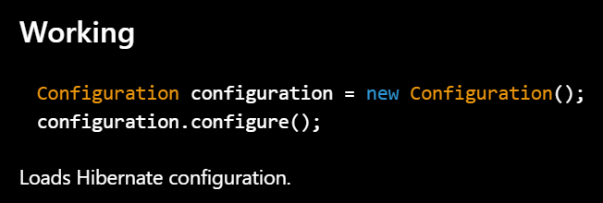
Hibernate Configuration & Hibernate Util Class

Slide 14
Database Connectivity
- Hibernate reads configuration
- JDBC driver loads
- Connection established
- Data stored/retrieved
Hotel Management Web Application Presentation

Slide 15
Entity Classes Explanation
UserEntity
Represents user table.
Fields:
id
name
email
password
RoomEntity
Represents room booking table.
Fields:
roomId
roomType
customerName
bookingDate
FoodEntity
Represents food order table.
Fields:
foodId
foodName
quantity
Price
PaymentEntity
Represents payment table.
Fields:
paymentId
amount
paymentMode

Slide 16
Login Module
1. User enters credentials
2. LoginServlet validates data
3. Session created
4. Dashboard displayed
Hotel Management Web Application Presentation

Slide 17
Registration Module
1. User fills registration form
2. RegisterServlet receives data
3. UserEntity created
4. Data stored in database
Hotel Management Web Application Presentation

Slide 18
Room Booking Module
- User selects room
- Data goes to RoomBookingServlet
- RoomEntity object created
- Hibernate stores booking details
- RoomEntity used
- Confirmation generated
Hotel Management Web Application Presentation

Slide 19
Food Ordering Module
- User selects food items
- Quantity entered
- FoodOrderServlet processes request
- Data stored in database
Hotel Management Web Application Presentation

Slide 20
Payment Module
- User enters payment details
- PaymentServlet handles request
- PaymentEntity created
- PaymentEntity stores payment info
Hotel Management Web Application Presentation

Slide 21
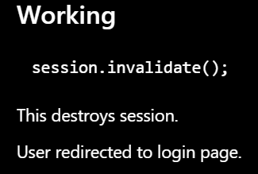
Logout Module
Purpose
Ends user session securely.

Slide 22
Session Management
- Maintains user login state
- Stores user information
- Improves security
- Prevents repeated login
Hotel Management Web Application Presentation

Slide 23
Database Connectivity
Steps
Hibernate reads configuration
JDBC driver loads
Connection established
Queries executed
Data stored/retrieved

Slide 24
Apache Tomcat
- Web server
- Runs JSP and Servlets
- Handles HTTP requests/responses
Hotel Management Web Application Presentation

Slide 25
Maven
- Build automation tool
- Dependency management
- Creates WAR file
- Simplifies project setup
Hotel Management Web Application Presentation

Slide 26
Advantages of Project
- User friendly
- Reduces manual work
- Fast processing
- Permanent data storage
Hotel Management Web Application Presentation

Slide 27
Future Enhancements
- Online payment gateway
- Admin dashboard
- Email notifications
- AI chatbot integration
Hotel Management Web Application Presentation

Slide 28
Frequently Asked Viva Questions
Q: Why Hibernate?
A: Reduces SQL coding.
Q: Why Servlet?
A: Handles backend logic.
Hotel Management Web Application Presentation

Slide 29
Project Summary
Hotel Management Web Application developed using Java Full Stack technologies following MVC architecture with Hibernate and database connectivity.
Hotel Management Web Application Presentation

Slide 30
Thank You
Questions & Answers
Hotel Management Web Application Presentation

