Slide 1
DuoChat

Slide 2
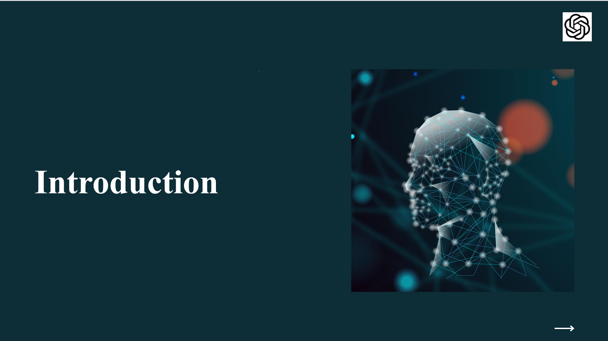

Slide 3
Theme customer service
Topic
A chatbot to solve queries while registering to tantrotsav

Slide 4
Scenarios where it is used
We designed this bot for answering major queries of a technical fest Tantrotsav
It can be generalized for any customer service based applications

Slide 5

DIALOGFLOW
PLATFORM USED:
Dialogflow is a natural language understanding platform used to design and integrate a conversational user interface into mobile apps, web applications, devices, bots, interactive voice response systems and related uses.

Slide 6
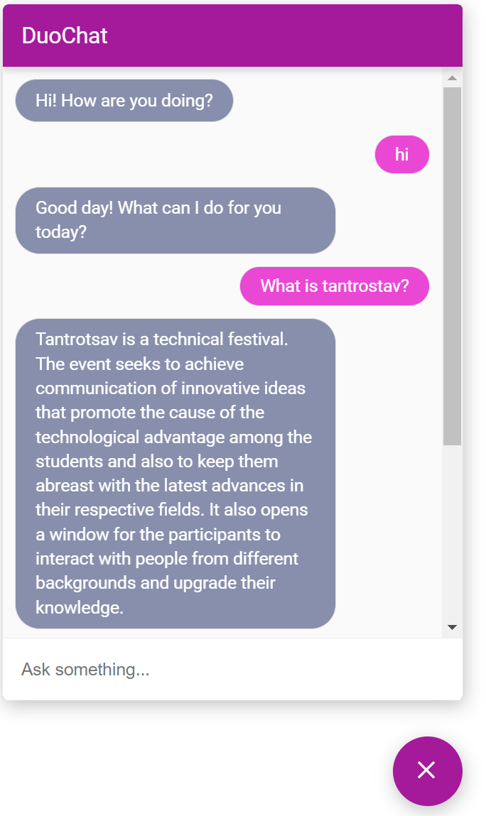
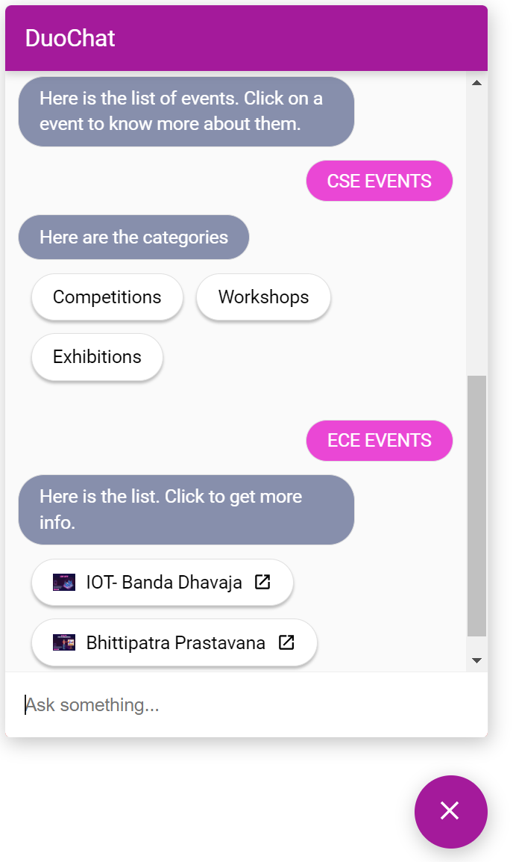

Slide 7
