Slide 1
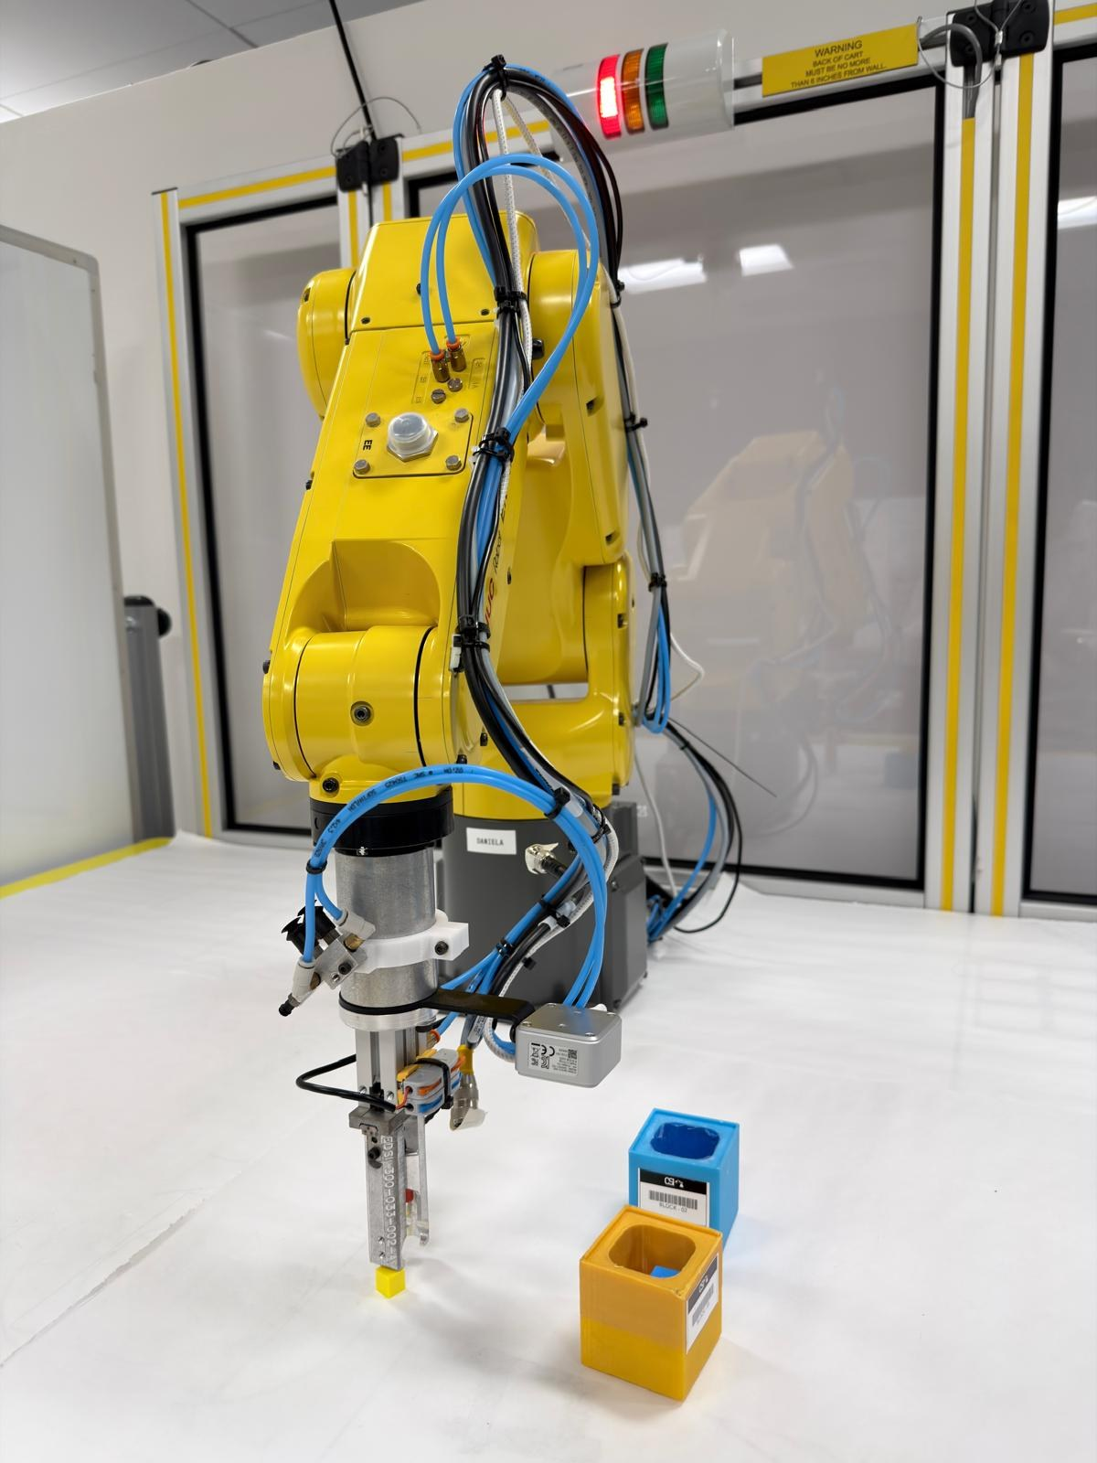
TwinCheck x Wicked
Sim-trained grasping that checks every pick
Arshdeep Singh
Team Leader
Rohan Gaikwad
Software Developer
Adam Erickson
Operations Manager
Team Wicked · Dataset 3: Grasping and Sorting · FANUC ER-4iA
Notes:
Robots today don't know when they've failed. TwinCheck keeps a digital twin and cameras alongside the arm, so the robot knows what should happen, notices when reality disagrees, and recovers. Everything the AI knows, it learned in simulation.

Slide 2
Taught robot programs fail silently when parts move
±3 mm
5-33mm
Factories teach the robot fixed spots and replay them forever.
On a high-mix line, parts never arrive exactly in place: the robot grabs air, knocks the part, or crashes into it.
Nobody notices until a person spots the empty bin or the stopped cell.
room the 12 mm jaws leave around a 10 mm cube
how far hand-placed cubes sat from the taught spot (real cell)
1-3 cm
0 / 10
how far hand-placed bins sat from their planned spot
rollouts a blind taught program sorted on the real cell (official score)
All figures measured on the real FANUC cell (Oct 23-30 recordings and the organizers' official scores).
Notes:
This is not a lab curiosity. The jaws leave about 3 mm either side of a 10 mm cube; the parts a person placed by hand were 5 to 33 mm off the taught spot, and the bins 1 to 3 cm off. A fixed program cannot cope with that, and it does not know it failed.

Slide 3

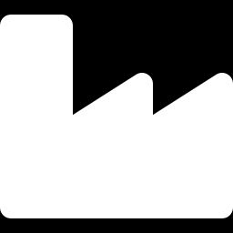
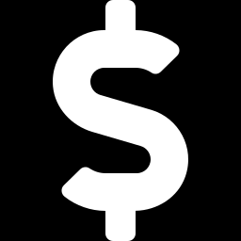
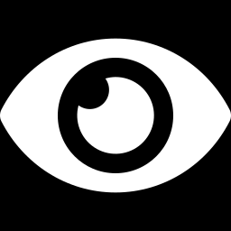
Why it matters to manufacturers
High-mix, low-volume
Decades-old robots
Every new variant means re-teaching positions: days of an expert's time per changeover.
Plants run equipment up to ~40 years old. They need help that bolts on, without reprogramming.
Defects cost billions
Little AI on the floor
US discrete manufacturers lose an estimated $32-58B a year to defects (NIST).
Only about 3% of manufacturers used AI for inspection (2020 Annual Business Survey).
Notes:
Rockwell told us what they want: faster, more reliable changeovers with fewer experts, help for decades-old equipment without reprogramming, and AI operators can trust. NVIDIA wants proof that models built in a physically based twin work on the real floor.

Slide 4
Under the hood: the tech stack
1
Simulation
2
AI model
3
Runtime on the real cell
▪ NVIDIA Isaac Sim 6.0, the organizers' FANUC ER-4iA starter cell (v0.5)
▪ Cameras placed with the organizers' calibration: the twin sees what the real camera sees
▪ Omniverse Replicator renders 1920×1080 images; labels projected from 3D geometry
▪ Randomized per image: part pose and colour, bins anywhere, arm pose, lighting, clutter, distractors, camera jitter, sensor noise
▪ Ultralytics YOLO11n-OBB: oriented boxes give each part's centre and angle
▪ 2.66 M parameters, 5.7 MB; 3 classes: cube, screw, bin
▪ v4: 3,000 images (~12,000 labels), 1280 px input, 60 epochs, AdamW, batch 16
▪ Fine-tuned round by round (pretrained YOLO11n-OBB → v1 → v4) on an NVIDIA DGX Spark, ~1.7 h
▪ Tested on held-out 100-image simulator exams
▪ Python policy on a laptop GPU (RTX 5060); organizers' client sends image + arm pose, we return fingertip targets at 10 Hz
▪ Organizers' calibration: pixel → robot mm (parts at their height, bins at rim height)
▪ TwinCheck core: 3 checks, Watch/Guide logic, wait-for-arrival (2 mm), grasp-angle band, wrist and workspace guards
▪ 56 unit tests; every check logged with the camera frame
Test bench: the same policy runs closed-loop in Isaac Sim against the twin before every real slot (20/20 rollouts).
Notes:
Three layers. Simulation: NVIDIA Isaac Sim with the organizers' FANUC cell; the cameras sit exactly where the real ones are calibrated, and Replicator renders randomized images with labels computed from the 3D geometry. The AI model: a small Ultralytics YOLO11 oriented-box detector, 2.66 million parameters, trained on 3,000 simulated images on an NVIDIA DGX Spark in under two hours. Runtime: a Python policy on a laptop GPU talks to the organizers' cell ten times a second; their calibration converts pixels to millimetres; our core logic runs the checks, waits for the arm to arrive, and keeps the wrist and workspace in safe limits. And the same policy runs closed-loop in the twin before every real slot.

Slide 5
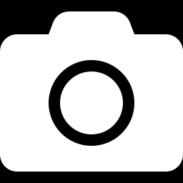
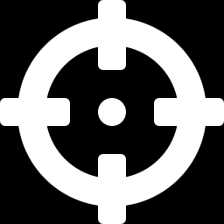

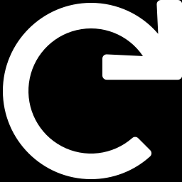
TwinCheck: look before every pick, check after it
Look
Act
Check x3
Recover
Table camera finds every part and bin (AI trained only in simulation)
Arm aims where the part really is and turns its fingers to match
Part there? In the hand? In the right bin?
Missed grasp: retry from a fresh look. Anything else: alert the operator
The digital twin is the answer key: it defines what should happen. The cameras show what did happen. TwinCheck marks every pick right or wrong.
Notes:
Think of a blindfolded worker who always reaches for the same spot. TwinCheck adds a supervisor with cameras. The twin is the answer key, the cameras read what actually happened, and the software marks every pick right or wrong, then fixes it.

Slide 6
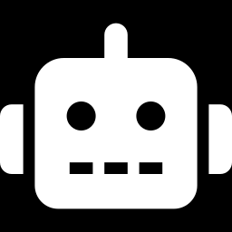
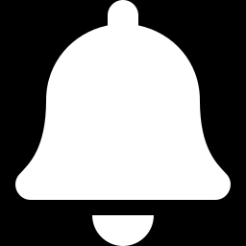
One system, three levels of adoption
Baseline
Watch
Guide
Today's taught program
Bolt-on monitor
Full TwinCheck
Fixed spots, no cameras in the loop. Our comparison point.
Same motion, cameras check every pick and alert before and after a failure. No program change: works on legacy robots.
Aims at what the camera sees, finds the real bins, retries a missed grasp, never loses track of a part.
Plants start with Watch (cameras + a GPU PC, no reprogramming) and upgrade to Guide once they trust the alerts.
Notes:
Watch is the lowest-friction adoption: cameras and a PC, no change to the robot's program, so it fits a 40-year-old robot. Guide is the upgrade once a plant trusts the alerts.

Slide 7
System architecture
OFFLINE · built and tested in simulation (NVIDIA Isaac Sim on a DGX Spark)
Digital twin
FANUC cell, parts, bins, calibrated cameras
Randomized renders
3,000 images; labels from geometry, no real images
Train detector
YOLO11n-OBB, ~1.7 h
Twin test bench
Same policy in closed loop before robot time (20/20)
trained model (5.7 MB)
ONLINE · every rollout on the real FANUC cell
TwinCheck policy runs on a laptop GPU
Organizers' cell
FANUC ER-4iA + table camera; sends image + arm pose; safety limits; operator scores
1 · Perception
YOLO finds parts + bins → calibration → robot mm
2 · Checks
Pre-pick · in-hand · in-bin → Watch: alert · Guide: re-aim / retry
3 · Motion planner
Aim, grasp angle, wait for arrival, workspace + wrist guards
Fingertip targets back to the cell, 10 Hz · every check logged · the cell records every rollout
Notes:
Two halves. Offline, in NVIDIA Isaac Sim: a digital twin of the real cell renders thousands of randomized, auto-labelled pictures; we train the detector on them, and we test every change of the robot program in the twin before using robot time. Online, on the real cell: the organizers' platform sends our policy the camera image and the arm pose; perception finds the parts and the bins in millimetres; the checks compare what should happen with what the camera sees, alerting in Watch mode or re-aiming and retrying in Guide mode; and the motion planner turns that into safe fingertip targets, waiting for the real arm to arrive at each step. Every check is logged, and the cell records every rollout for the organizers' scoring.

Slide 8
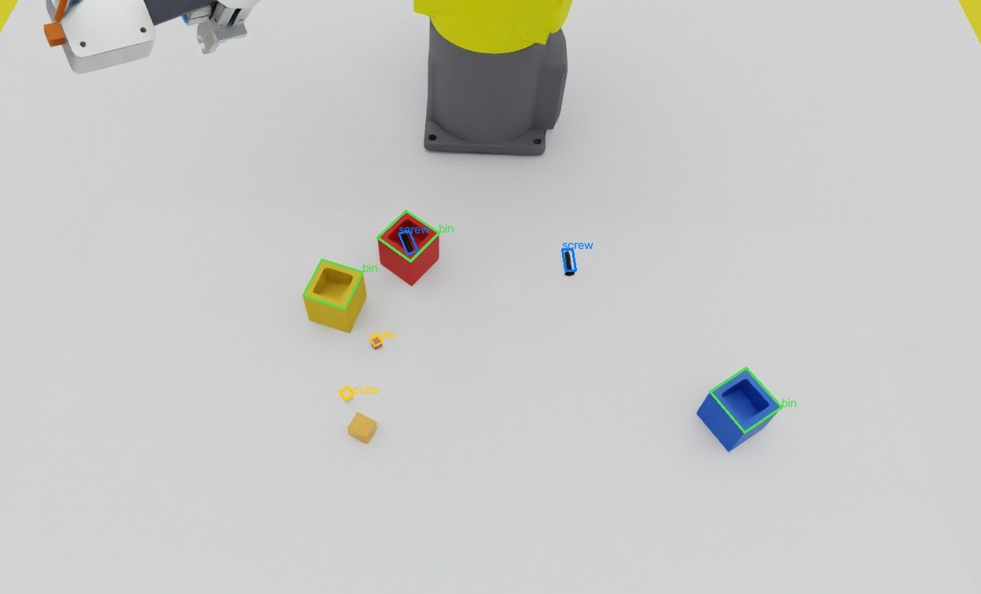
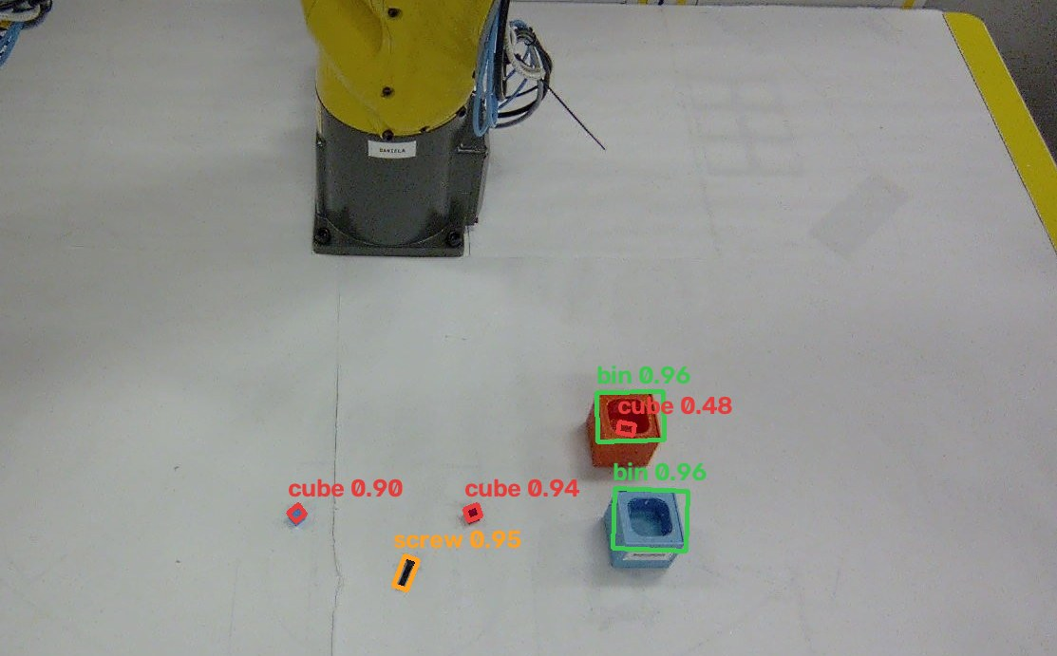
The AI never saw a real training image
Trained on: 3,000 Isaac Sim renders, labels for free
Works on: the real cell camera
Bins anywhere, any colour; random arm poses, lighting, clutter, distractors, paler cube colours
Finds cubes, the screw and both bins with their angles; YOLO11n-OBB, 2.7M parameters, 5.7 MB
Notes:
Left: a picture rendered in Isaac Sim with labels drawn automatically. Right: the real cell camera, with what our model sees. The model is a small YOLO11 oriented-box detector, trained only on simulator images, as the hackathon requires. Real images are used only to test.

Slide 9
How we trained it: simulation only, four rounds
v1
v1 · 500 renders
v2
v2 · 2,000 renders
One arm pose, yellow cubes. Found only 77% of test cubes: the twin was too easy.
Random arm poses, 3 cube colours, clutter, distractors, wide lighting: 100% found, 0.2 mm.
v3
v3 · +2,000 renders
v4
v4 · 3,000 renders
Parts resting inside bins, for the 'did it land?' check: in-bin parts found 53% → 100%.
Bins as a class, anywhere and any colour; paler cubes: bins found 100%, 0.5 mm.
Isaac Sim renders the organizers' FANUC cell with calibrated cameras → labels computed from geometry (no hand labelling, no real images) → YOLO11n-OBB fine-tuned on an NVIDIA DGX Spark (~1.7 h) → runs on a laptop GPU at the cell.
Notes:
We trained the detector in four rounds, all in simulation. Each round fixed what the previous one got wrong: too-easy scenes, parts inside bins, then bins themselves. The labels come from the twin's geometry, so they are perfect and free; we never labelled or trained on a real image.

Slide 10
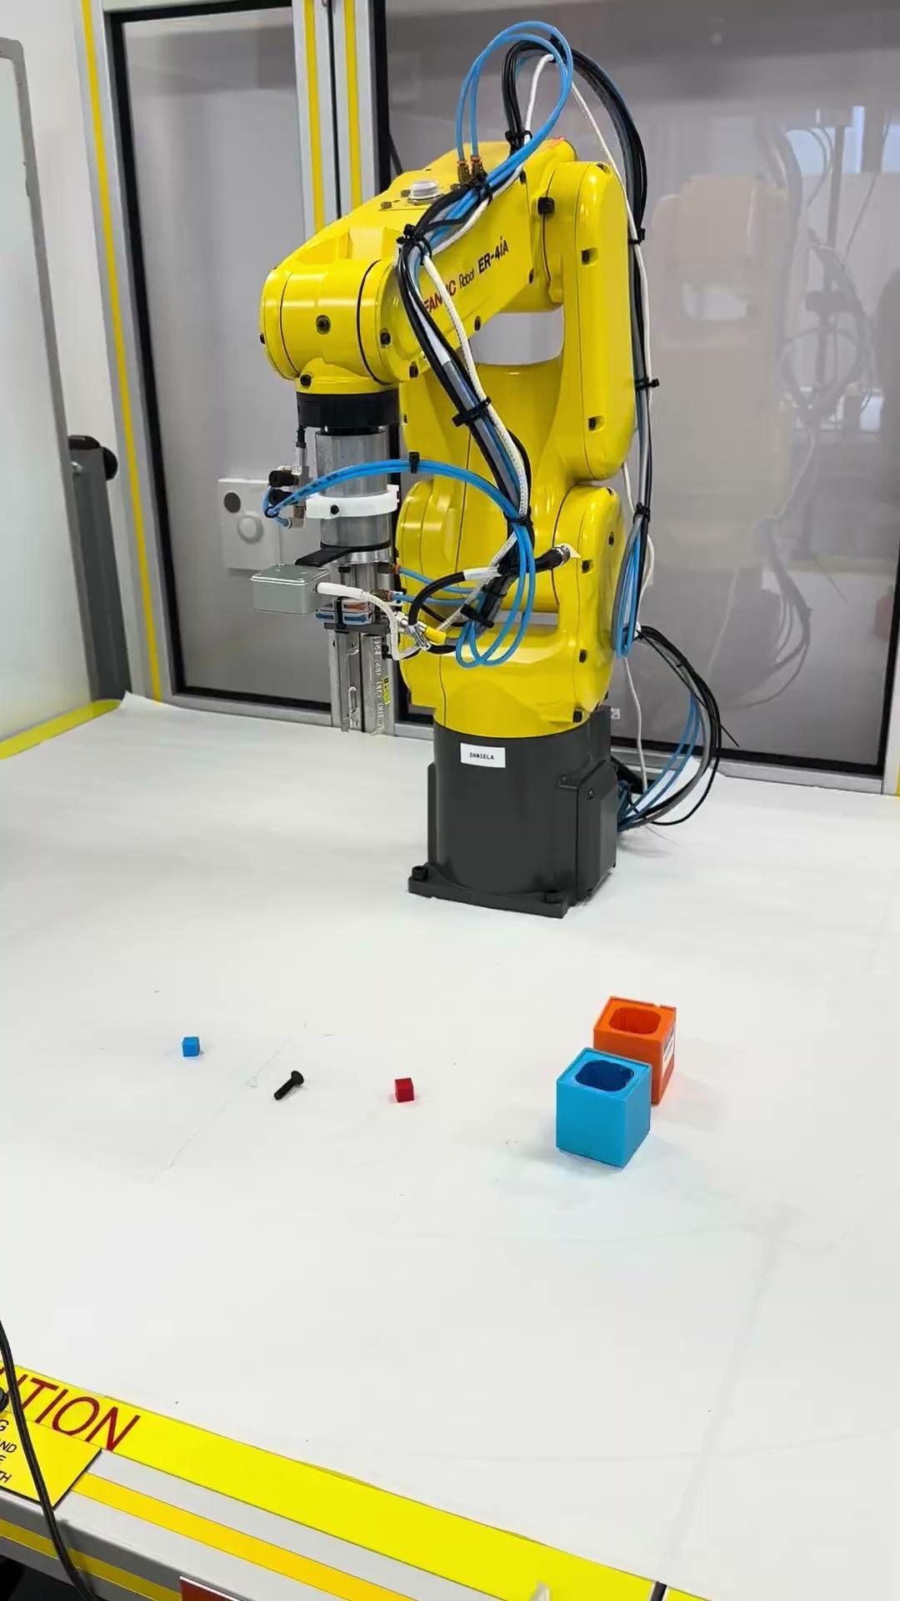
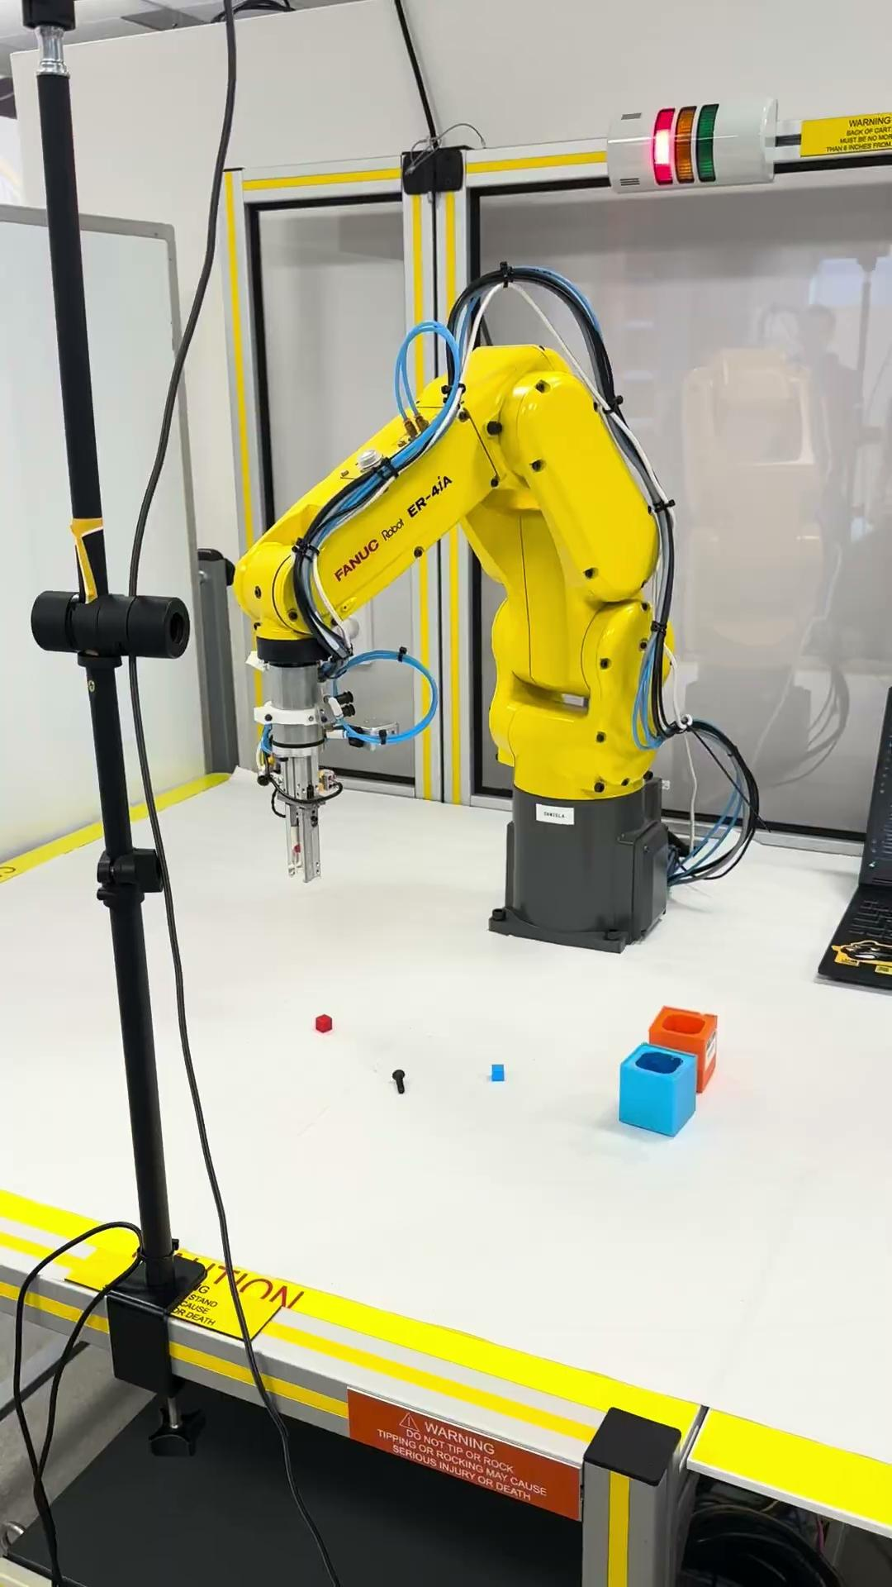
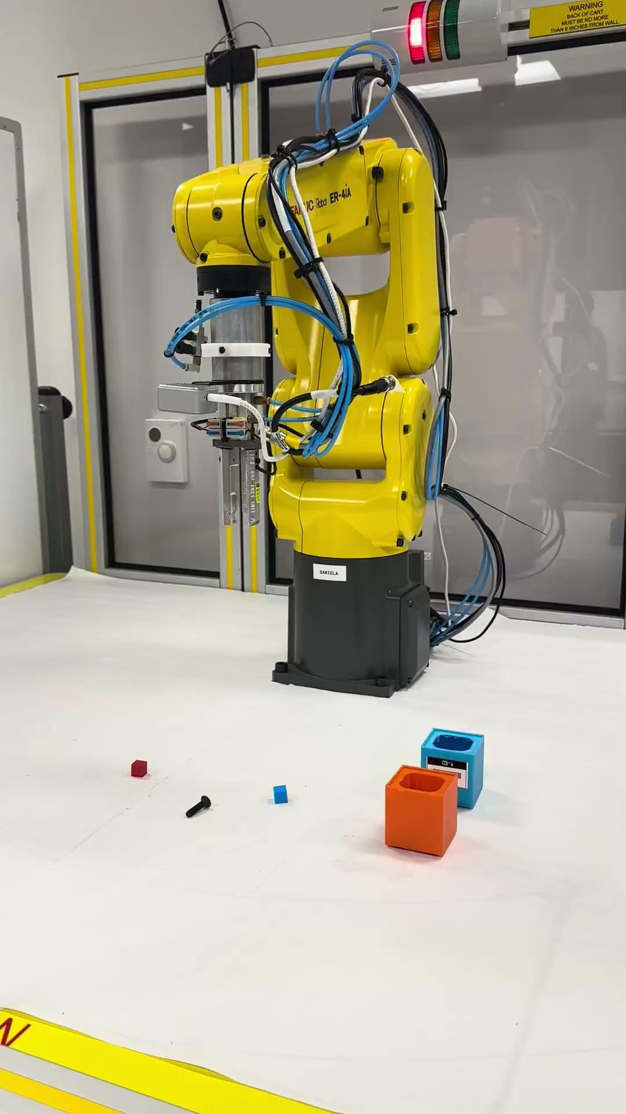
Guideline vs Team Wicked's Creation
Guideline Tests
Our Creation

Slide 11
Detector accuracy on unseen simulator exams
Exam (100 images each) | Class | Found | Typical error | 95% within
Bins moved anywhere, parts in bins | Bin | 100% | 0.5 mm | 0.9 mm
Bins moved anywhere, parts in bins | Cube | 99.4% | 0.3 mm | 1.4 mm
Bins moved anywhere, parts in bins | Screw | 100% | 0.3 mm | 1.8 mm
Parts on the table | Cube | 100% | 0.2 mm | 0.5 mm
Parts on the table | Screw | 100% | 0.2 mm | 0.5 mm
Changeover in an afternoon
New object class (bins) added with
~15 min of rendering
~1.7 h of training
0 minutes of robot time
0 real images
Positions converted to robot millimetres with the organizers' camera calibration. Simulator numbers; the real-cell gap is shown on the next slides.
Notes:
On simulator pictures the detector finds essentially everything, to within a millimetre or two. Adding the bin class took about two hours of compute and zero robot time: that is the changeover story Rockwell asked for.

Slide 12
On the real robot: 9/10 vs 0/10 on the same layouts
9 / 10
0 / 10
1 vs 7
Also measured
0 interventions
96.5 s per sort
rollouts fully sorted by TwinCheck (official operator score)
rollouts sorted by a blind taught program on the same 10 layouts
controller faults: TwinCheck vs the blind program
95% confidence (Wilson): TwinCheck 60-98% vs blind program 0-28% - the ranges don't overlap. Task: 2 cubes + 1 M6 screw into two bins, parts placed up to 3 cm off the taught spots.
Scored by the organizers at hackathon.sidclab.org: TwinCheck run r20261031-79333b, blind baseline run r20261030-dcd07a (Oct 30).
Watch mode flagged all 20 of the blind program's picks as 'will miss' before the arm moved; 19 did.
Notes:
This is the headline. Same robot, same parts, same 10 layouts. A blind taught program sorted none of them and faulted the controller 7 times. TwinCheck sorted 9 of 10, with one fault and no interventions. These are the organizers' official scores, with 95% intervals that do not overlap.

Slide 13
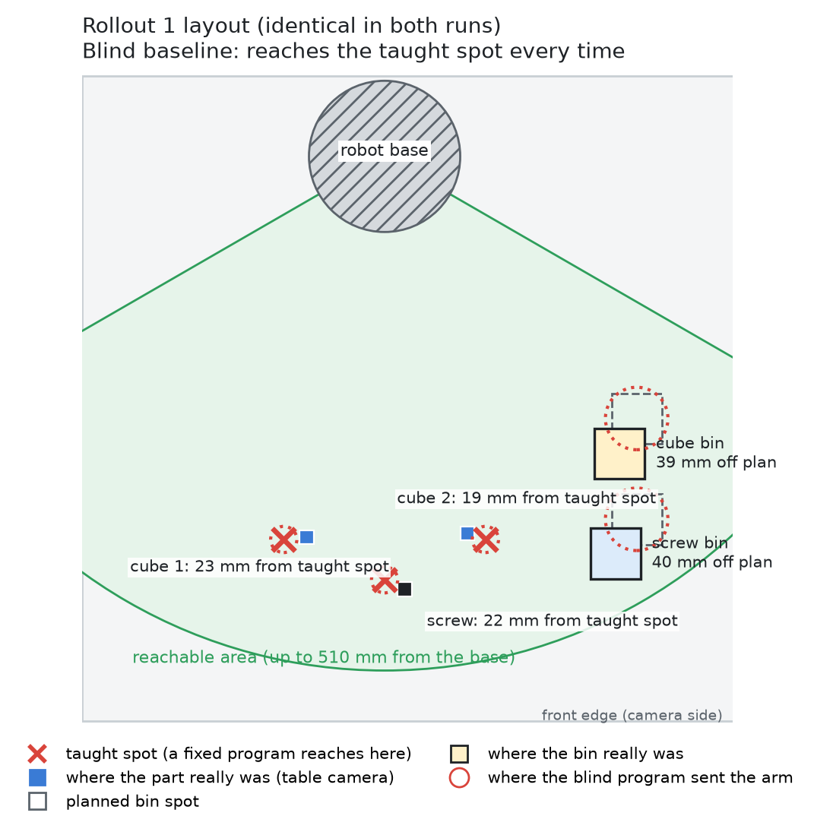
Same setup, different outcome
Identical setup in both runs. Parts and bins were placed on the same marks (the camera saw cube 1 within ~1 mm in both runs).
The marks are not where a taught program expects them. Every part sat 19-23 mm and every bin 39-40 mm from its taught spot (red X). The jaws tolerate about ±3 mm.
The blind program can't know: it reaches the red X every time - empty grasps and crashes.
TwinCheck doesn't use the marks: it goes to the part the camera sees, anywhere in the reachable (green) area.
Same conditions, different outcome: 0/10 vs 9/10.
Notes:
Both runs used exactly the same ten setups, so the pictures look identical - that is the point. The marks are not where a fixed program was taught to reach: each part was about two centimetres off, each bin about four, and the jaws only tolerate about three millimetres. The blind program cannot know that; it goes to the red X every time. TwinCheck never uses the marks: it goes to wherever the camera sees the part, as long as it is reachable. Same conditions, different outcome - the difference is the policy, not the placement.

Slide 14
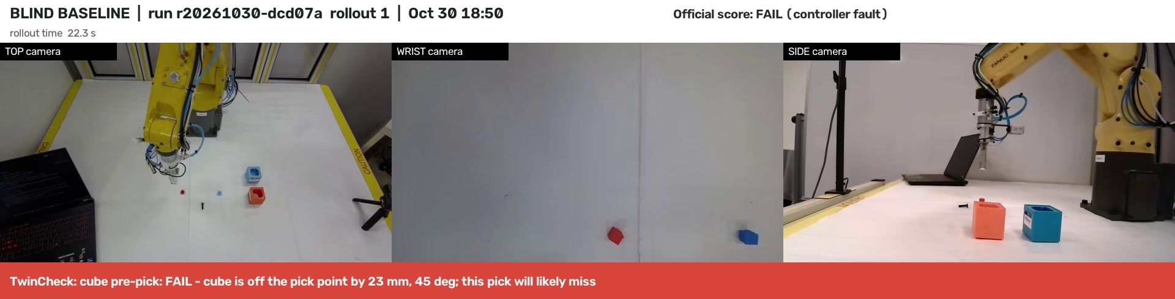
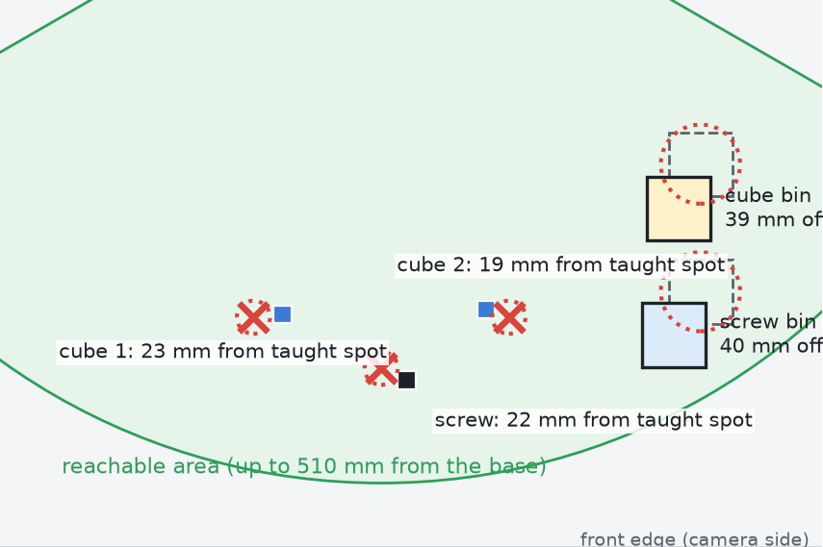
Evidence: blind baseline, rollout 1
Policy / model: TwinCheck-blind-baseline-v2 (Watch mode): fixed taught spots, no camera guidance; the v4 detector (overhead_v4_n3000.pt) only warns
Rollout: run r20261030-dcd07a, rollout 1 (t00) · Oct 30, 18:50:07-18:50:56
Outcome: FAIL. 12 s: pre-pick check - cube 23 mm, 45° off the taught spot, 'will likely miss'; the arm goes there anyway. 29 s: post-grasp - cube still on the table (empty grasp). Screw predicted 21 mm off; the fingertip stopped 9 mm above the table, on the screw: controller fault.
Full rollout (top + wrist + side cameras, organizer viewer): [LINK]
Our phone video of the same rollout: [LINK] (to be merged into the clip above)
Notes:
Here is one real rollout of the blind program, from the cell's own cameras: top, wrist and side, synchronized. The caption is TwinCheck's live log. Before the first pick it says the cube is 23 millimetres off and the pick will likely miss; the gripper comes up empty. Then it predicts the screw miss, and the arm comes down on the screw - the controller stops it. Official score: fail.

Slide 15
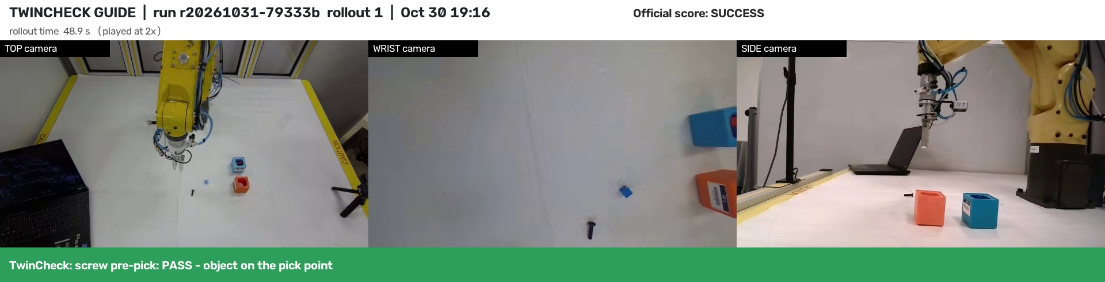
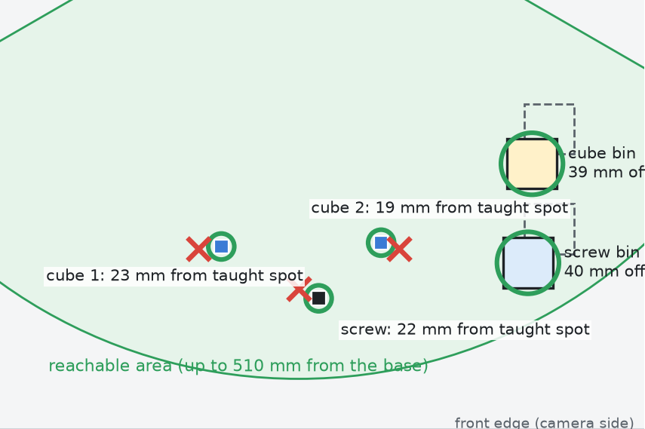
Evidence: TwinCheck Guide, rollout 1
Policy / model: TwinCheck-guide-v6: YOLO11n-OBB detector overhead_v4_n3000.pt (3,000 Isaac Sim images, no real ones) + TwinCheck planner and checks (code commit 000df87)
Rollout: run r20261031-79333b, rollout 1 (t00) · Oct 30, 19:16:31-19:18:20 (clip at 2x)
Outcome: SUCCESS. Aimed at the measured position (377.7, -77.4 mm), not the taught spot; fingers turned to the cube's angle; waited for arrival before closing; held (cube gone from the table); released over the camera-found bin 39 mm from plan. Same for the screw and cube 2: 9 of 9 checks passed.
Full rollout (top + wrist + side cameras, organizer viewer): [LINK]
Our phone video of the same rollout: [LINK] (to be merged into the clip above)
Notes:
Same layout, now with TwinCheck. The camera finds the parts and the bins; the arm goes to where they really are, not to the taught spots. Every check passes: part there, part held, part in the bin - for both cubes and the screw. Official score: success.

Slide 16
Every failure found from data, fixed in the twin
What went wrong on the real arm | Root cause (from the recordings) | Fix
Jaws closed in the air; fingers landed on cubes | Real arm ~55 mm/s and lagging; it cut corners | Wait for measured arrival before every step
Cubes fell outside the bin | Hand-placed bins 1-3 cm off the plan | AI learned to see bins; release over the real bin
Screws would close along the shank | Finger direction was a guess (90° off) | Measured from side + table cameras
Controller faults, hoses tight | Wrist wound half a turn per pick to -360° | Park angle + one angle band; guard test
Real yellow cubes not seen | Paler than the simulated yellow | Colour variation in training renders
Each fix was reproduced and validated in Isaac Sim before the next real slot: the twin is our test bench, not just our data source.
Notes:
This is how we worked: every real failure was diagnosed from the robot's own recordings, reproduced in the twin, fixed, and tested before spending more robot time. Exactly the sim-first method the organizers suggested.

Slide 17
The twin predicted the real result
2 / 5 → 5 / 5
Moved-bin test in the twin, before and after teaching the AI to see bins
0 → 9 / 10
Real FANUC cell, same 10 layouts: blind program → TwinCheck (official)
Notes:
The twin reproduced the exact failure we saw at CSI, then proved the fix, 5 of 5 and 20 of 20, before we spent robot time. On the real cell the same software scored 9 of 10 against 0 of 10 for the blind program.

Slide 18
Why simulation matters for autonomous robots
1
No real training data
2
A test bench before robot time
0 real images. Every label is computed from the twin's geometry: perfect and free (11,000+ in v4).
The twin reproduced our real bin failure (2/5), then proved the fix (5/5, 20/20) before we booked the robot.
3
Safe to fail
4
New products in hours
Crashes, hose wind-ups and drops cost nothing in the twin; on the real cell each one ends a rollout.
A new object class in ~2 h of compute and 0 robot hours: the changeover Rockwell asks for.
Same software, two worlds: 20/20 in the twin, 9/10 on the real FANUC cell (official score).
Notes:
Simulation did four jobs for us: it replaced real training data, it was our test bench for every fix, it let us fail safely, and it turns a new product into hours of compute instead of days of re-teaching.

Slide 19
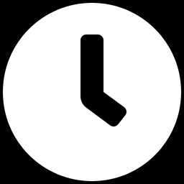
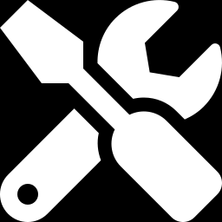
What it saves: time, downtime and expert hours
Changeover
Failures caught early
Downtime avoided
~2 h of compute, 0 robot hours
Every blind miss flagged before it happened
Re-aims instead of crashing
New part from its 3D model: render, train, deploy. No re-teaching on the line.
Watch flagged all 20 blind picks as 'will likely miss' before the arm moved; 19 truly missed.
Guide picked nudged parts the blind program hit; misses retry instead of stopping the cell.
Illustrative cell (assumptions; replace with plant data)
2,000 picks/shift × 5% parts off-position = 100 misses/shift. Blind: each miss = stop + ~3 min reset ≈ 5 h lost/shift. TwinCheck Guide re-aims at the real position, so most become normal picks (9/10 rollouts sorted on the real cell). At $100/h of line time: up to ~$500 per shift per cell.
Notes:
Concrete benefits we measured: hours instead of days per changeover, with zero robot time; every blind miss flagged before it happened; nudged parts picked instead of crashed into. The bottom box is an illustrative calculation with stated assumptions, so a plant can plug in its own numbers.

Slide 20
What adoption takes
1
Cameras + a GPU PC
Overhead camera (and optional wrist/side). Runs on a laptop GPU; our training ran on an NVIDIA DGX Spark.
2
3D model of each part
Render labelled images in Isaac Sim and train the detector. Hours, no line time.
3
Start with Watch
Alerts on the existing program, no reprogramming. Operators build trust from logged checks.
4
Switch on Guide
Where the controller accepts targets: camera-guided picks, retries, bins found by camera.
Notes:
No exotic hardware: cameras, a GPU PC and a 3D model per part. Start with Watch on any robot, then switch on Guide where the controller accepts external targets.

Slide 21

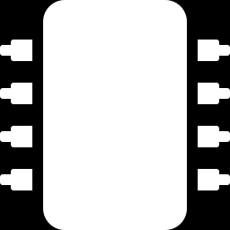
Where it still falls short, and what is next
Honest limits
Next
Small real sample: 10 rollouts per condition
Arm speed capped at ~55 mm/s: 96.5 s per 3-part sort
Parts stacked in one bin can hide each other from the camera
Only parts that fit the 12 mm jaws (10 mm cubes, M6 screws)
Wrist-camera grasp check trained in the twin
More real rollouts for tighter confidence intervals
New parts via custom fingers (vials, caps)
Live operator dashboard for Watch alerts
Notes:
We report where it still fails. These are the limits we measured, and what we would build next.

Slide 22
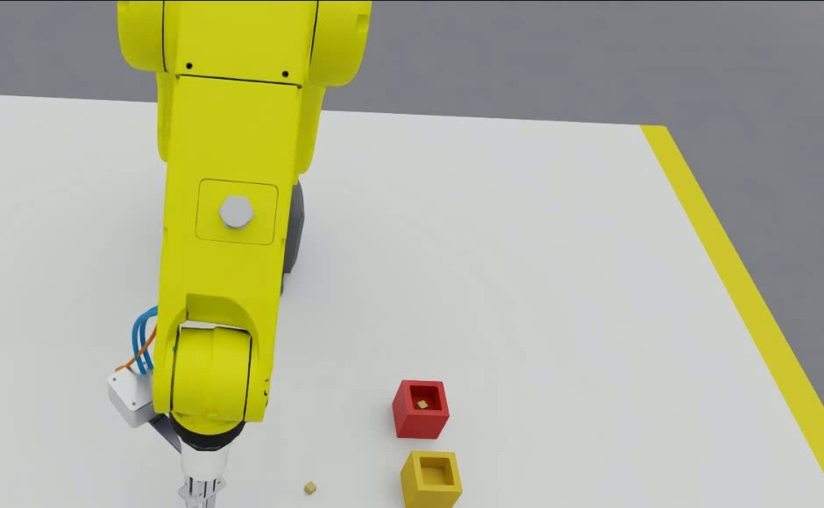
Robots that know when they fail
Trained in simulation. Checked on every pick. Proven on a real FANUC arm.
Team Wicked · Thank you
Notes:
Thank you. TwinCheck: trained only in simulation, checks every pick, and proven on the real FANUC arm.

