Slide 1
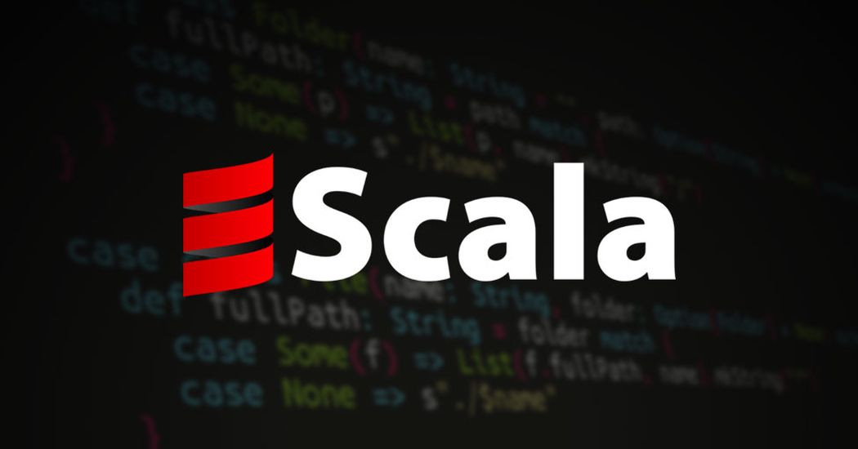
Group-6
Romit zunjarrao
Rohan naik
Riya patel
Murad Mizanur Rahman

Slide 2
History of Scala
Scala is a general purpose programming language. It was created and developed by Martin Odersky.
Martin started working on Scala in 2001 at the Ecole Polytechnique Federale de Lausanne (EPFL). It was officially released on January 20, 2004.
Scala is not an extension of Java, but it is completely interoperable with it. While compilation, Scala file translates to Java bytecode and runs on JVM (Java Virtual machine).
Scala was designed to be both object-oriented and functional. It is a pure object-oriented language in the sense that every value is an object and functional language in the sense that every function is a value.
The name of scala is derived from word scalable which means it can grow with the demand of users.

Slide 3
Current Work in Scala
Android Application
Desktop Applications
Concurrency and Distributed data processing
Front and back ends of web application with scala.js
Distributed computing - because of its concurrency capabilities
Scala is used with Hadoop: Map reduce programs
Big Data and data analysis with Apache Spark
Parallel batch expression
Ad hoc scripting to REPL

Slide 4
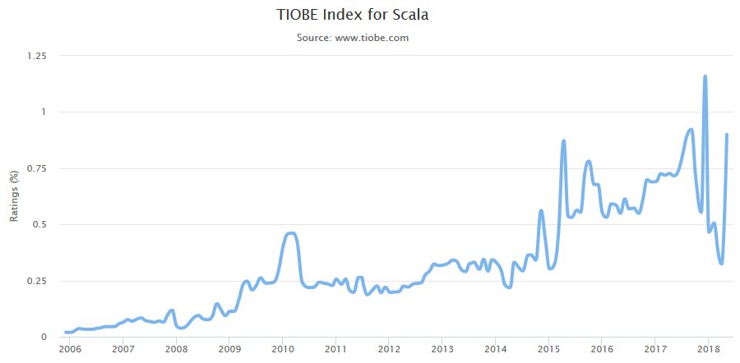
TOIBE Index for Scala

Slide 5
Features of Scala
Type inference
Singleton object
Immutability
Lazy computation
Case classes and Pattern matching
Concurrency control
String interpolation
Higher order function
Traits
Rich collection set

Slide 6
Singleton Object
Scala is more object oriented language than Java so, Scala does not contain any concept of static keyword. Instead of static keyword Scala has singleton object.
A Singleton object is an object which defines a single object of a class.
A singleton object provides an entry point to your program execution. If you do not create a singleton object in your program, then your code compile successfully but does not give output.
So you required a singleton object to get the output of your program. A singleton object is created by using object keyword.

Slide 7
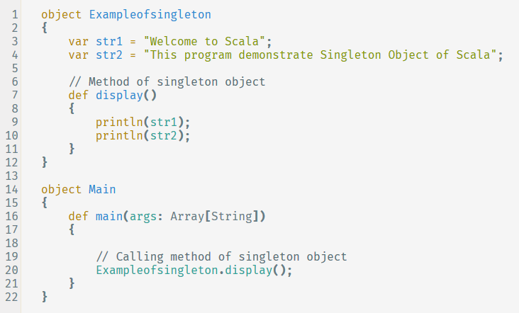
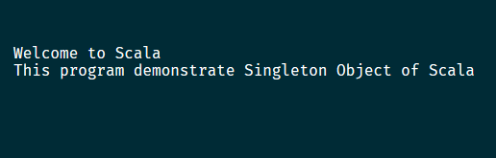
Singleton Object
Output

Slide 8
Lazy Computation
Lazy Computation is an evaluation strategy which delays the evaluation of an expression until its value is needed.
Lazy Computation can help to resolve circular dependencies.
It can provide performance enhancement by not doing calculations until needed — and they may not be done at all if the calculation is not used.
It can increase the response time of applications by postponing the heavy operations until required.

Slide 9
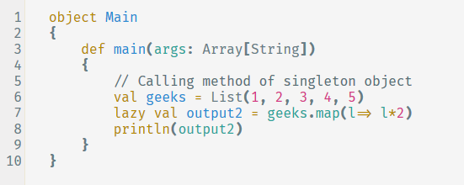
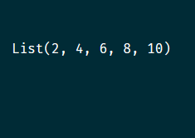
Lazy Computation
Output

Slide 10
String Interpolation
String Interpolation means that the replacement of defined variables or expressions in a given String with values.
String Interpolation is used to process String literals in easy way. To use this concept, We should follow some rules and syntax.
This String Interpolation allows defining the following things in a String Literal to process them by the Scala Compiler:
Variables
Expressions
Method or Function Calls
Object Fields

Slide 11
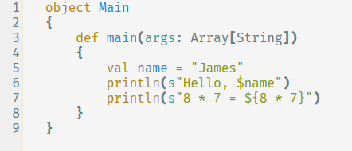
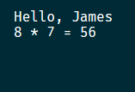
String interpolation
Output

Slide 12
Reference’s
Compiler Link
https://scastie.scala-lang.org/
https://dzone.com/articles/scala-lazy-evaluation
https://www.journaldev.com/10326/scala-string-interpolation-in-depth
https://www.javatpoint.com/features-of-scala
https://ieeexplore.ieee.org/document/7584967
https://ieeexplore.ieee.org/document/6274187

Slide 13


