Slide 1
Exercise 5.1 (The gravitational redshift element)

Slide 2
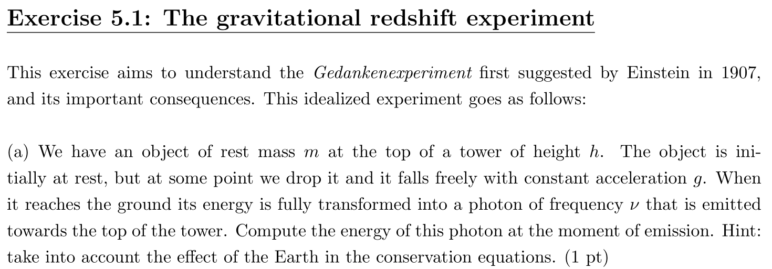

Slide 3
Exercise 5.2 (Geodesic equation and affine parameters)

Slide 4




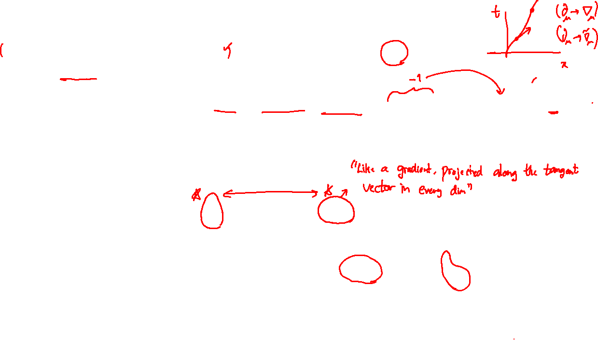


Slide 5





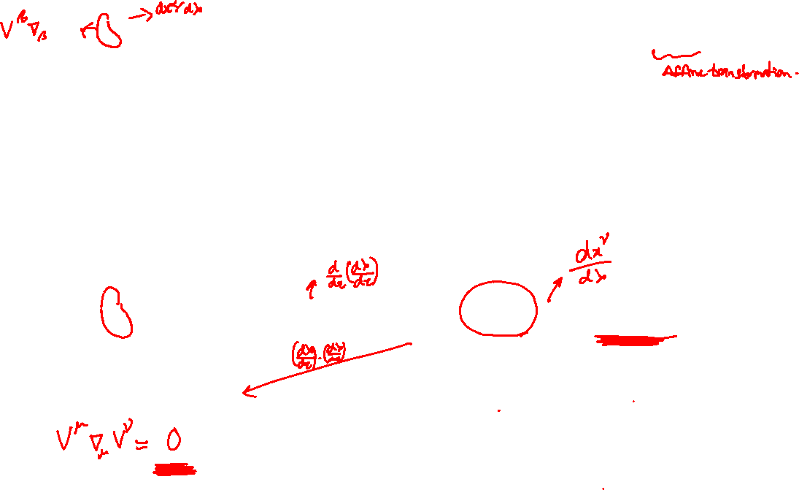

Slide 6




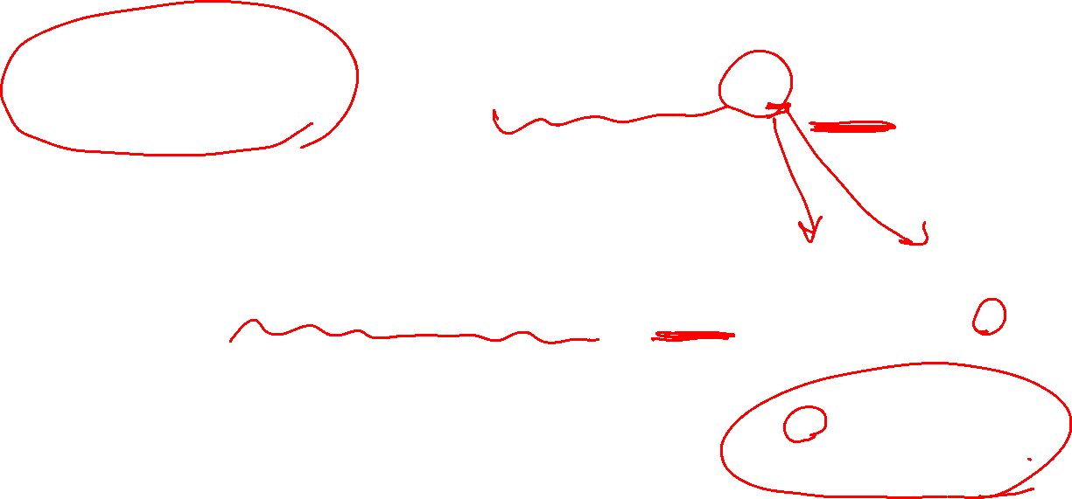

Slide 7



Slide 8
Exercise 5.3 (Proofs : Covariant derivative of a metric)

Slide 9







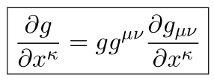

Slide 10


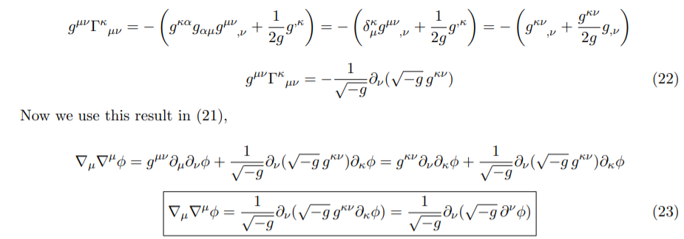

Slide 11
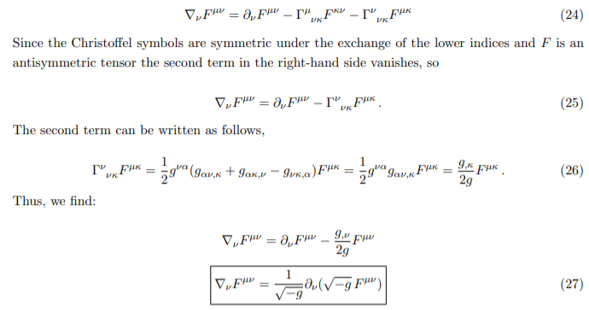

Slide 12
EXTRA - Exercise 5.4 (Parallel transport in Euclidean space)

Slide 13









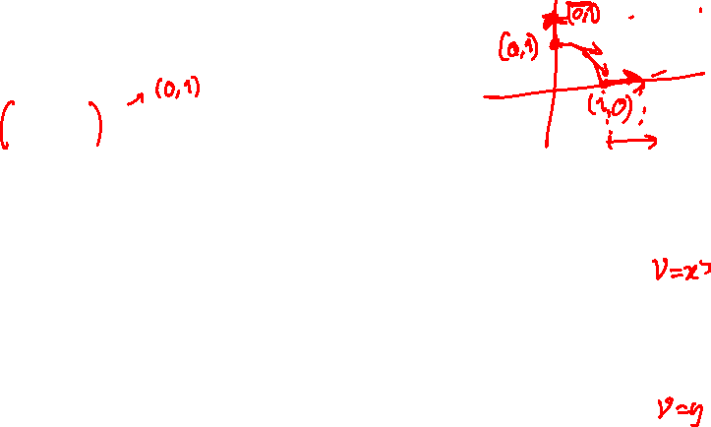

Slide 14
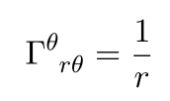





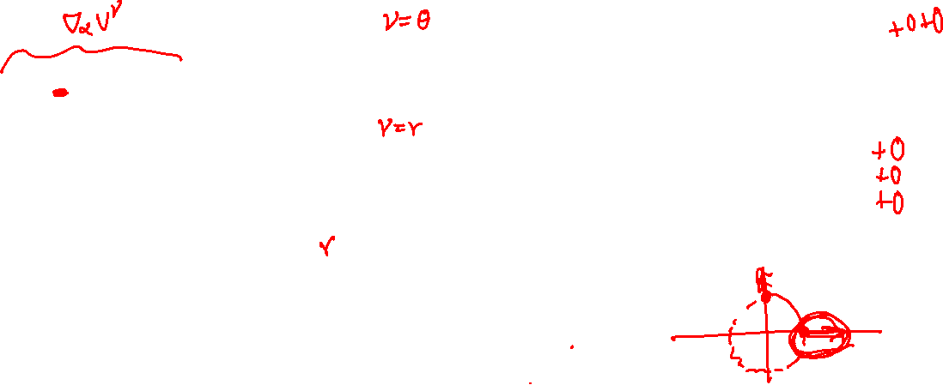

Slide 15
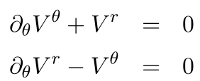






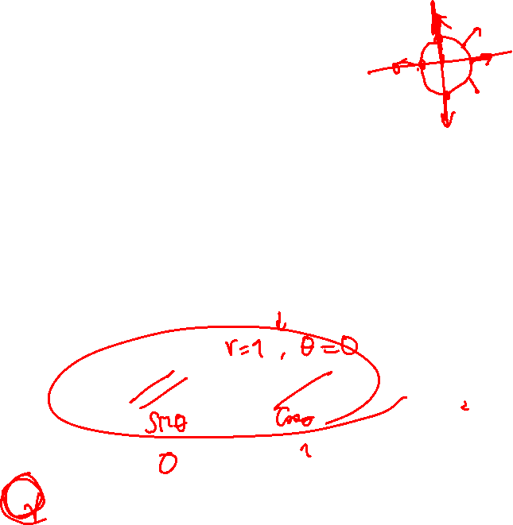

Slide 16
EXTRA - Exercise 5.5 (Conceptual questions – Parallel transport)

Slide 17




