Slide 1
Exercise 6.1 ()

Slide 3
Exercise 6.2 (LIF in weak gravitational field)

Slide 4
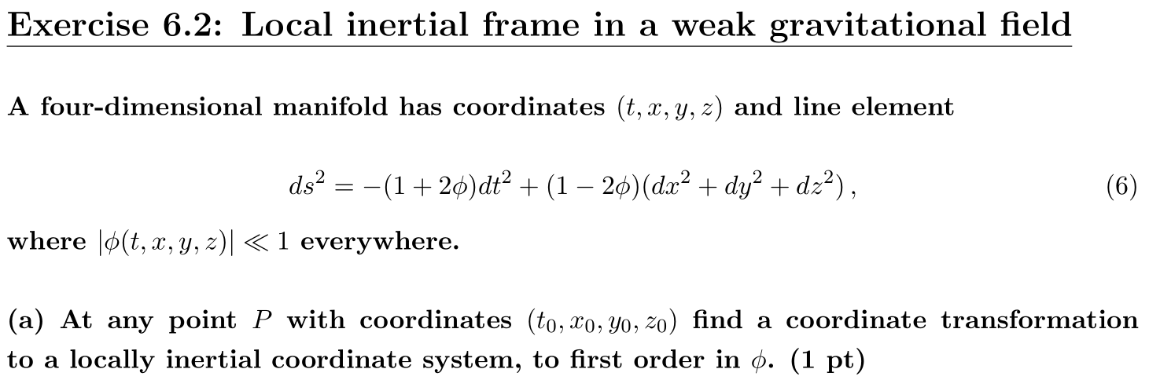





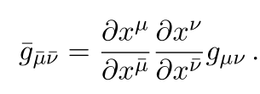



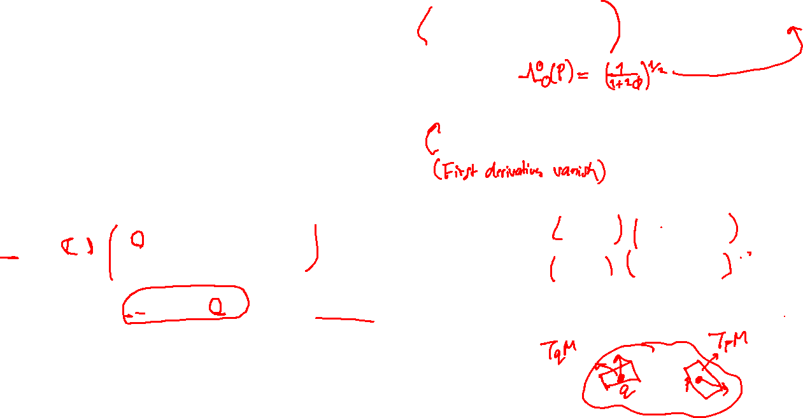
Taylor expansion
and
The elements of the transformation matrix thus read,
with
and with the non-diagonal terms equal to zero.

Slide 5



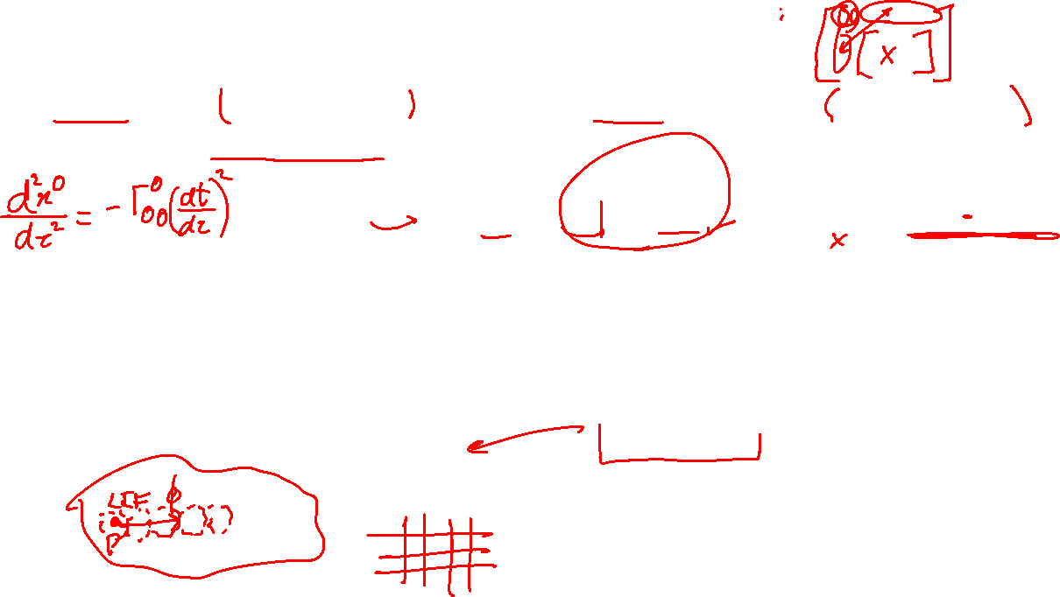

Slide 6
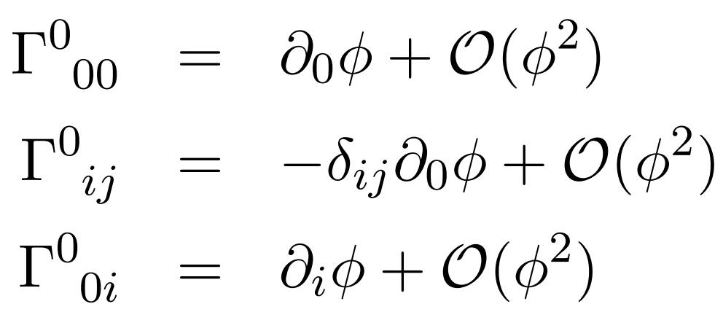




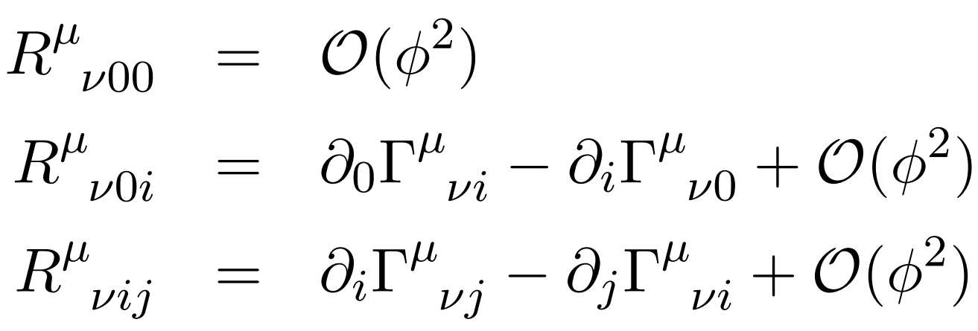
The Christoffel symbols are as follows :

Slide 7
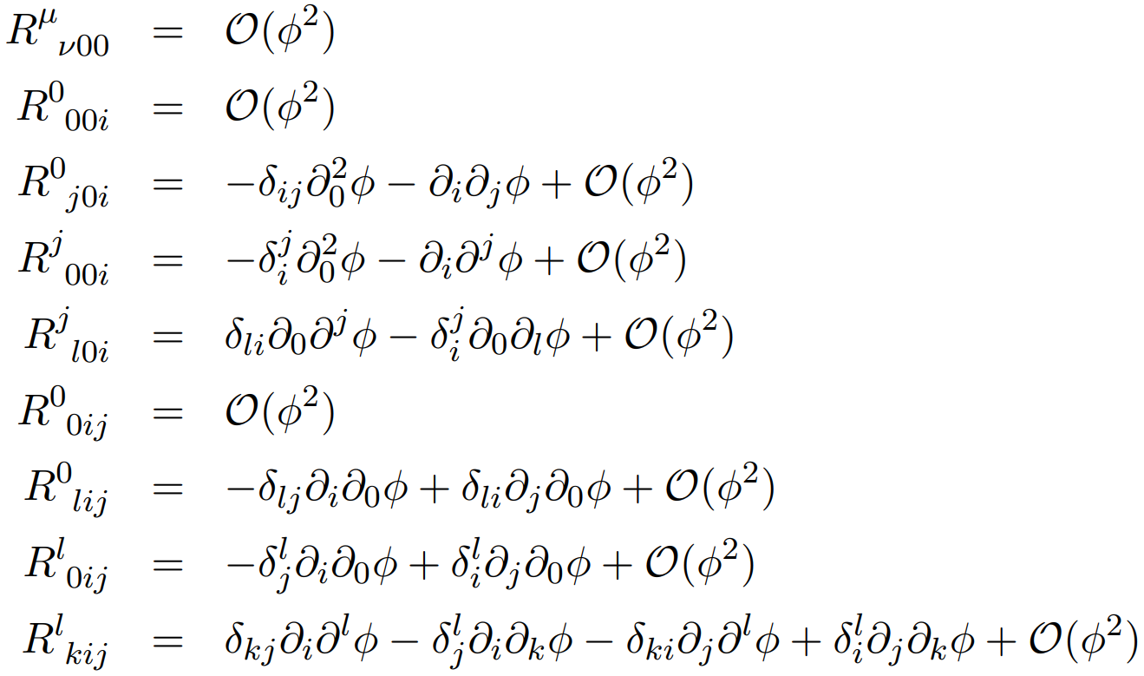
Equivalently,

Slide 8
Exercise 6.3 (Killing vectors and conserved quantities)

Slide 9









Slide 10
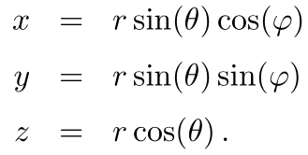




Slide 11




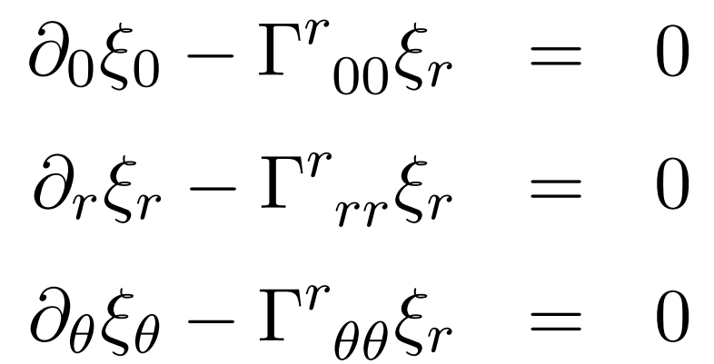
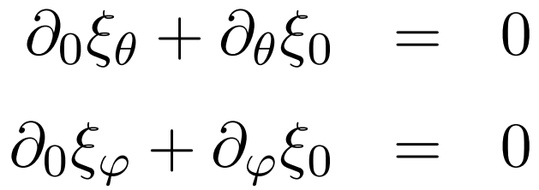
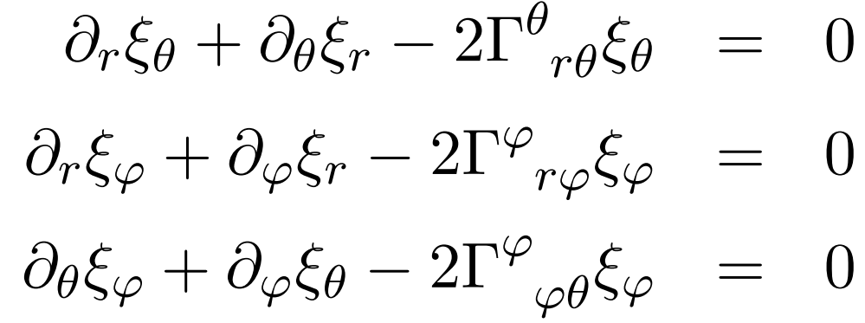



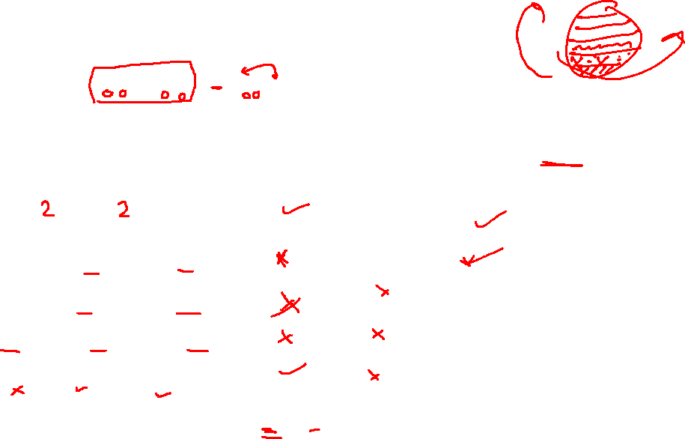

Slide 12


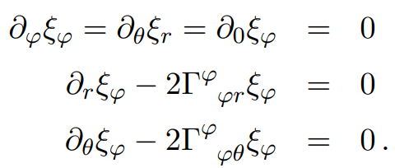


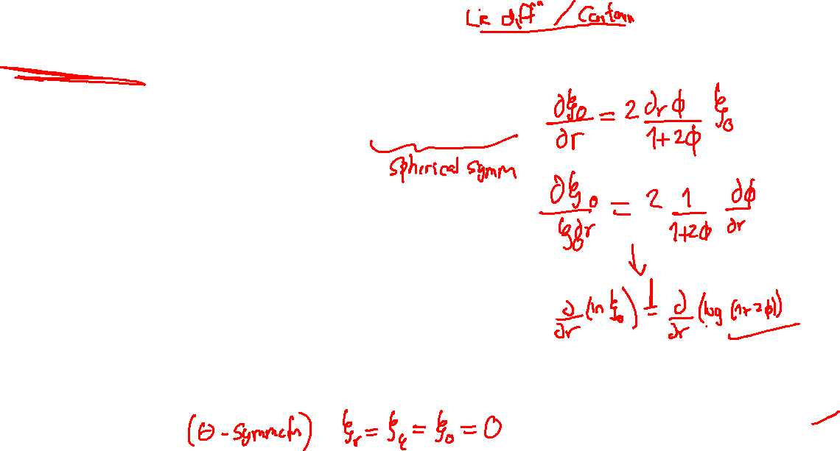

Slide 13
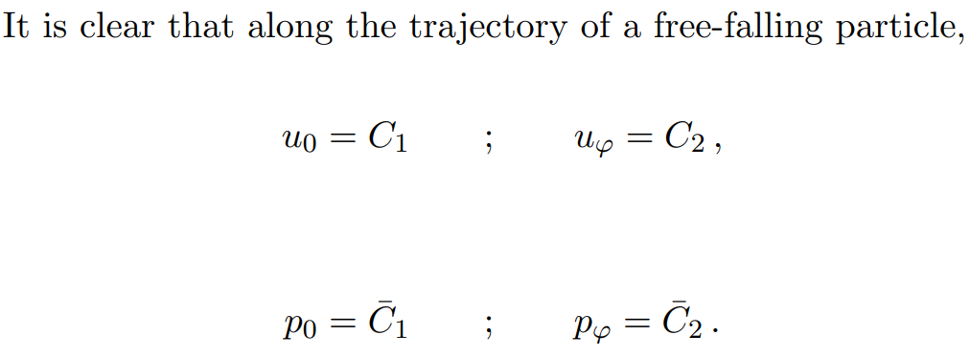

Any linear combination of the two fields will also satisfy the Killing equation

Slide 14


