Slide 1
Exercise 7.1 (Gravitational deflection of light in GR)

Slide 2
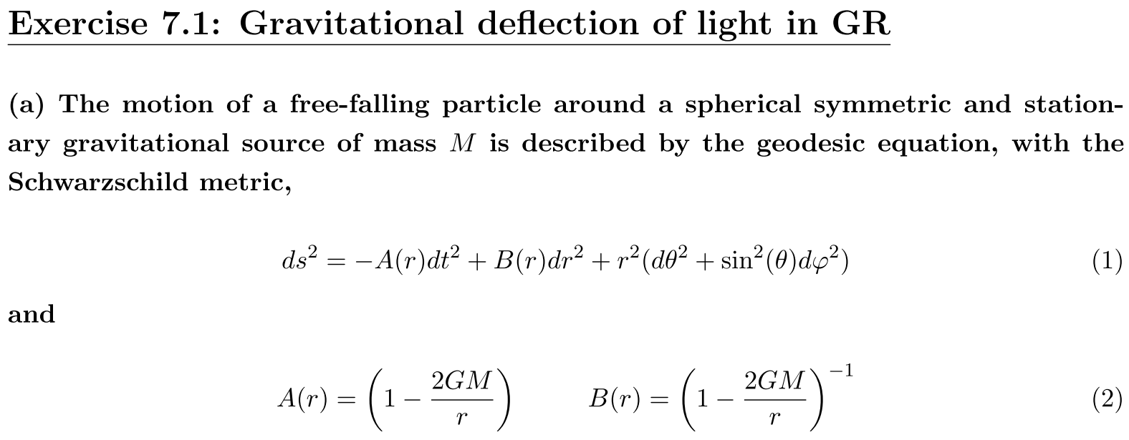



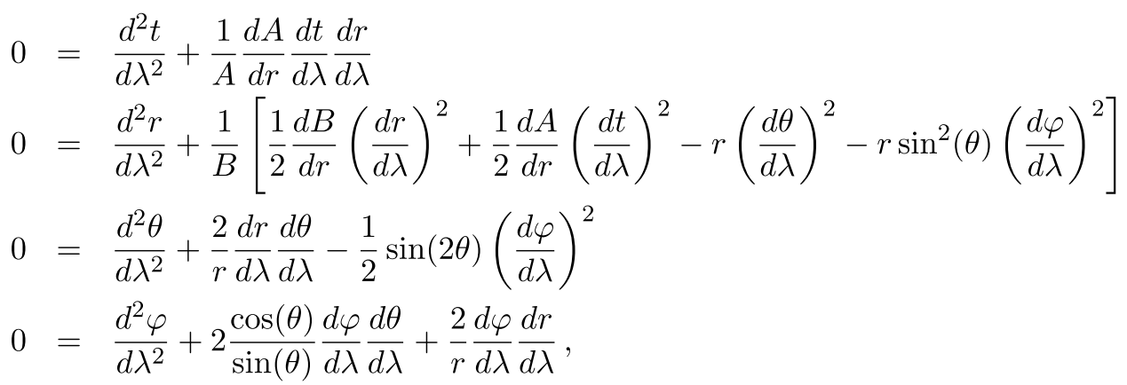
Plug them into the geodesic equation,

Slide 3











Slide 4






Plug in
Get

Slide 5




Slide 6

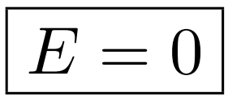
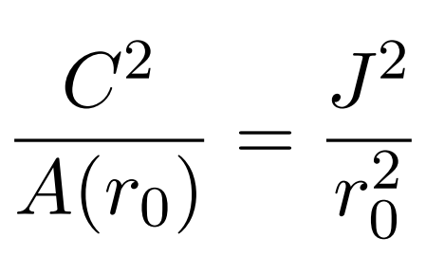
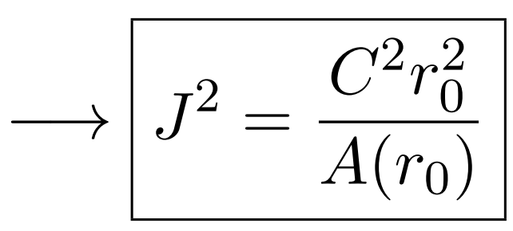


Slide 7




Slide 8


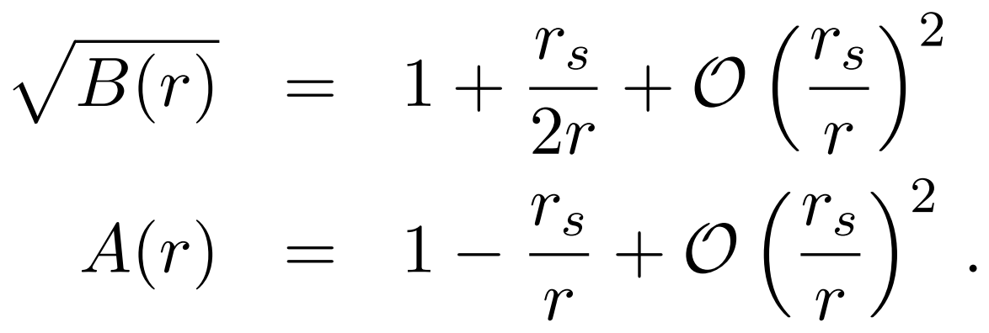







Slide 9
Exercise 7.2 (Gravitational deflection of light in Newtonian Gravity)

Slide 10
Newton’s second law + Newton’s law of universal gravitation $→$ Bodies fall with the same acceleration rate
subject to gravitational fields, just because the inertial and gravitational masses are equal.
Therefore, according to Newton’s theory one should expect the bending of light under the action of a massive object
(even in the limit of massless particles).
He considered light to be formed of very light corpuscles. Newton himself wrote: Are not the rays of light very small
bodies emitted from shining substances? and also, Do not Bodies act upon light at a distance, and by their action bend
its rays, and is not this action (cæteris paribus) strongest at the least distance?

Slide 11








Slide 12



to
in

Slide 13





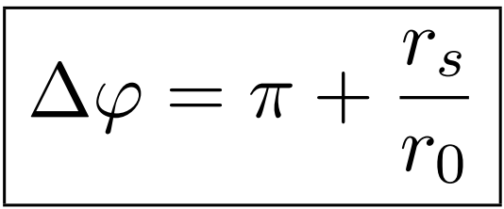

Slide 14



Slide 15
Bonus Question 1

Slide 16



Slide 17

