Slide 1
Exercise 8.1 (Post-Newtonian effects from a rotating source)

Slide 3














Slide 4






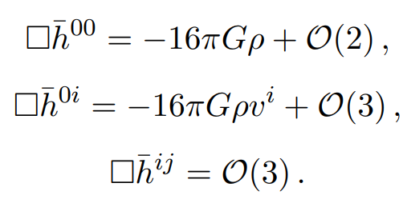

Slide 5

So,

Slide 6







Slide 7



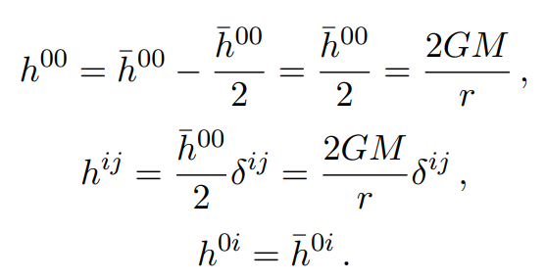
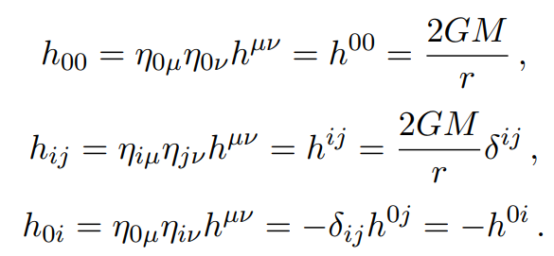
with

Slide 8
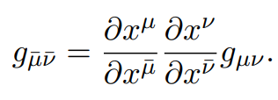



Slide 9



Slide 10



Slide 11



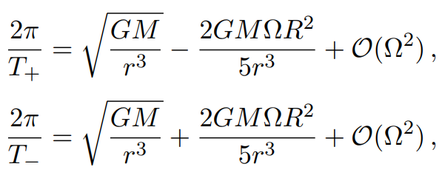





Slide 12
Exercise 8.2 (de Sitter-Schwarzschild metric)

Slide 13



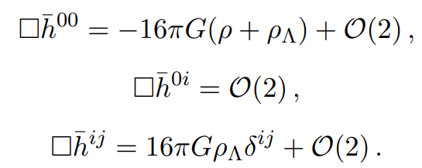


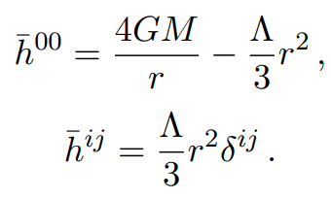

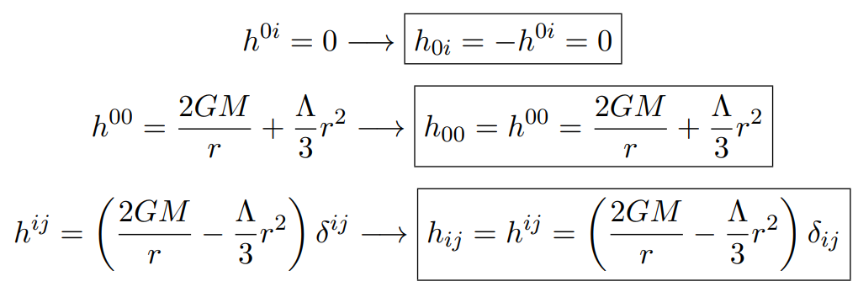

Slide 14






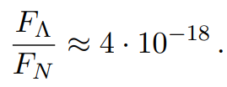
So,

Slide 15



Slide 18
Bonus Question 1

