Slide 1
Exercise 4.1

Slide 2



Slide 3
Exercise 4.2

Slide 4






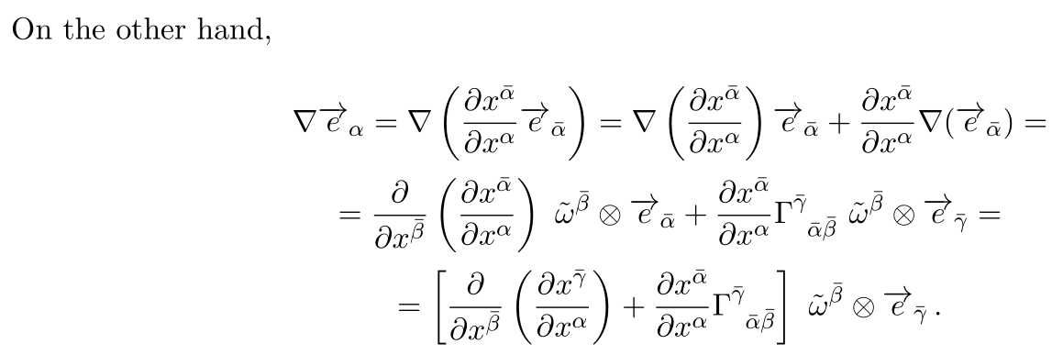



Computing the first term gives us

Slide 5


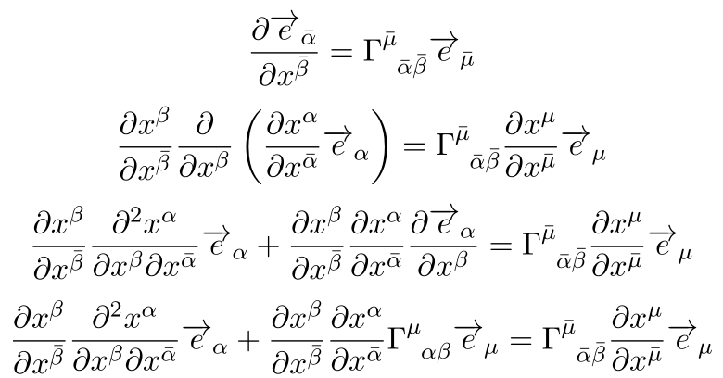
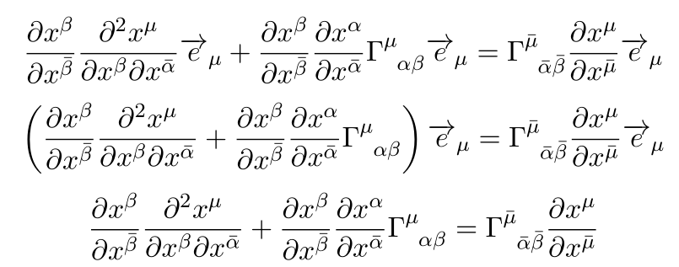


Slide 6


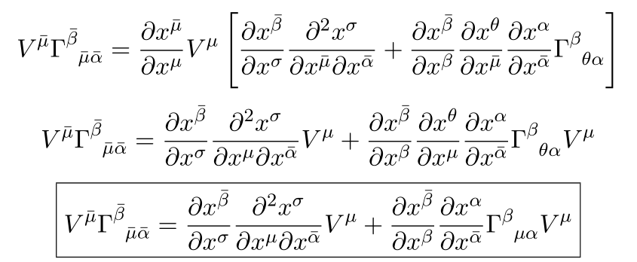
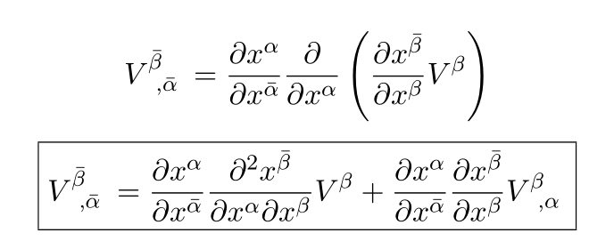




Slide 7
Exercise 4.3

Slide 8


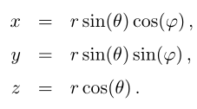







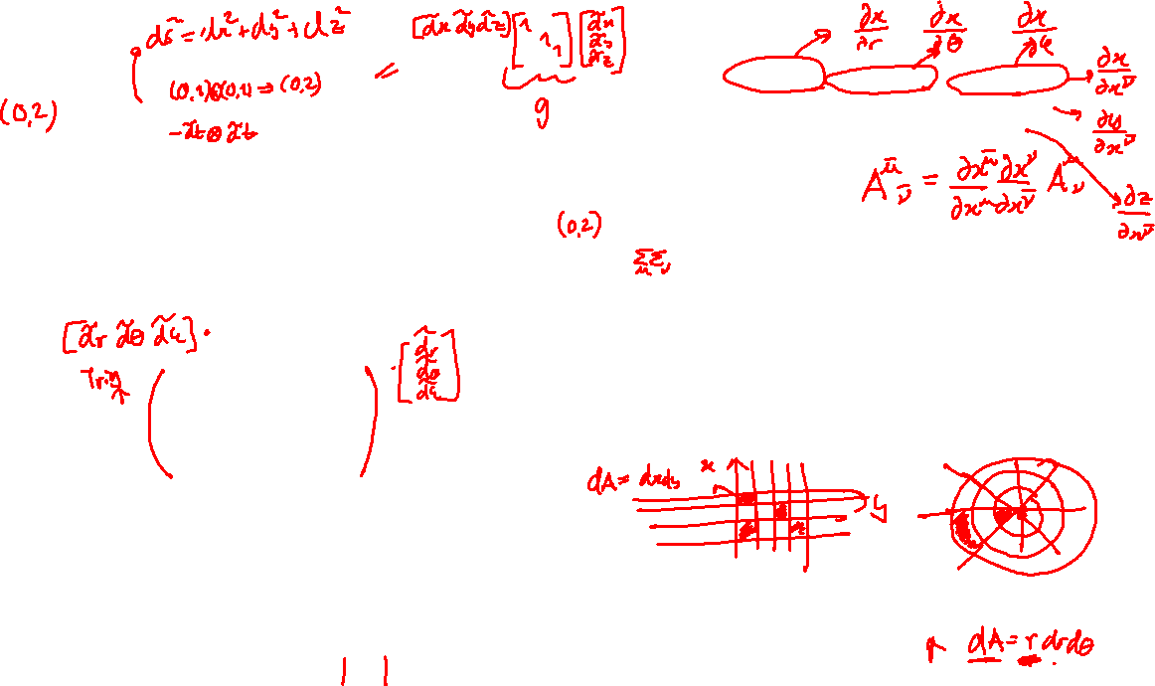
Squared line element
Differential proper volume

Slide 9






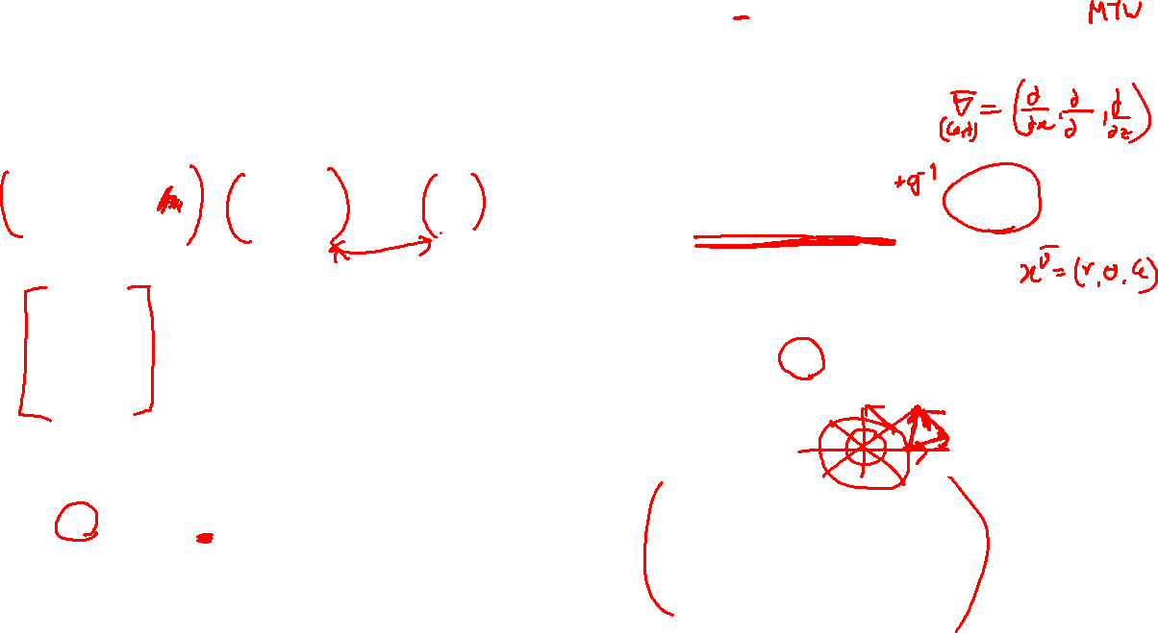
Unit vectors

Slide 10




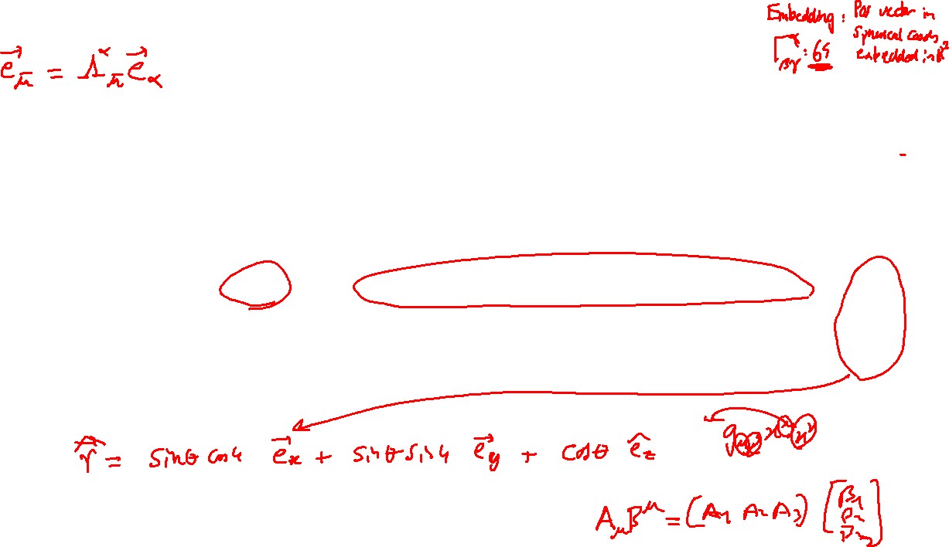
Inverse

Slide 11
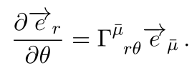




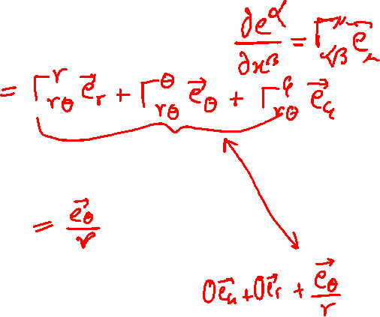
After simplification we get
Notes:
Understand what quantities “plural” we have to compute
Theta is fixed index, the mu bar is repeated – Expand it
Maybe write down the equation for er

Slide 12


Slide 13


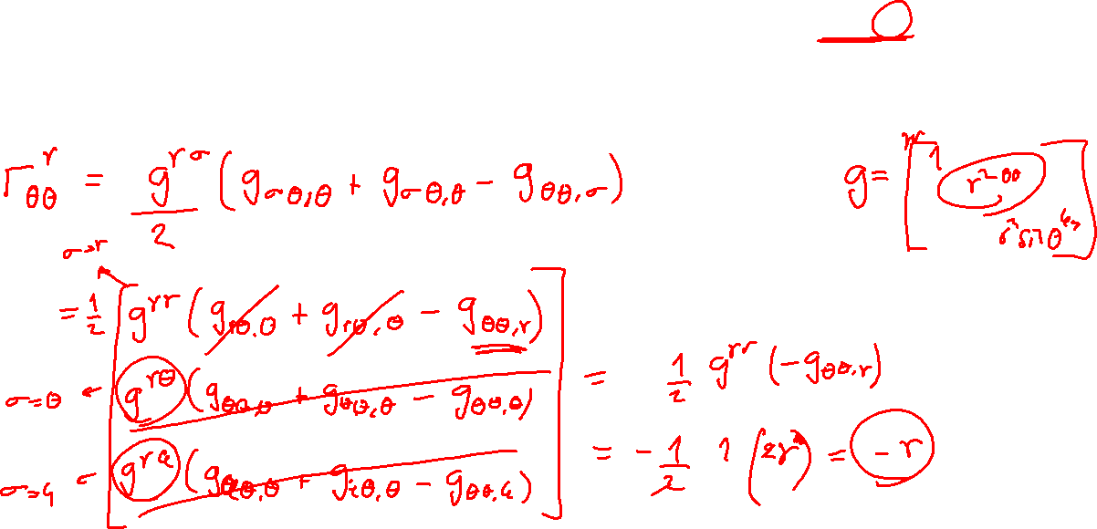
All non-zero Christoffel symbols

Slide 14


Sum over the indices
Use the Christoffel symbols we calculated before

