Slide 1


Antibiotics: Introduction to Classification
Dr. Bhoj R Singh, Principal Scientist (VM)
Head of Division of Epidemiology
Indian Veterinary Research Institute, Izatnagar-243122, Bareilly, UP, India.

Slide 2
WHY WE STUDY ANTIMICROBIALS?
IT IS TO UNDERSTAND:
A. SELECTIVITY
Antibiotics have selective toxicity toward the bacterium rather than the host.
  Disinfectants lack selectivity.
  Selectivity varies
  Higher the selectivity lower the toxicity.
B. THERAPEUTIC INDEX
The ratio of the dose toxic to the host to the effective therapeutic dose. The higher the therapeutic index the better the antibiotic.
C. CATEGORIES OF ANTIBIOTICS
Bactericidal . Bacteriostatic (reversible) Bactericidal antibiotics are preferred
  Bacteriostatic antibiotic is used the duration of therapy must be sufficient to allow cellular and humoral defence mechanisms to eradicate the bacteria.
  Serious infections should be treated with bactericidal antibiotics for prompt eradication of the organisms.
D. ANTIBIOTIC SUSCEPTIBILITY TESTING
Minimum inhibitory concentration (MIC)
Minimum bactericidal concentration (MBC).
The MBC is the lowest concentration of the antibiotic that kills 99.9% of the inoculum in a given time.
E. COMBINATION THERAPY
To prevent the emergence of resistant strains
To treat emergency cases during the period when an etiological diagnosis is still in progress
To take advantage of antibiotic synergism.
Synergism: effects of a combination is greater than the sum of the effects of the individual antibiotics.
Antagonism : One interferes with the effects of another antibiotic.
F. ANTIBIOTICS AND CHEMOTHERAPEUTIC AGENTS
Antibiotic strictly refers to substances of biological origin.
Chemotherapeutic agent is a synthetic chemical.

Slide 3
CLASSIFICATION OF ANTIMICROBIALS BASED ON CHEMICAL NATURE/ STRUCTURE
Β-Lactams
Penicillins
Cephalosporins
Monobactams
Carbapenems
Quinolones and fluroquinolones
Sulfonamides and trimethoprim
Glycopeptides
Phosphonic acids
Lipopetides
Peptide antibiotics
Ionophores

Slide 4
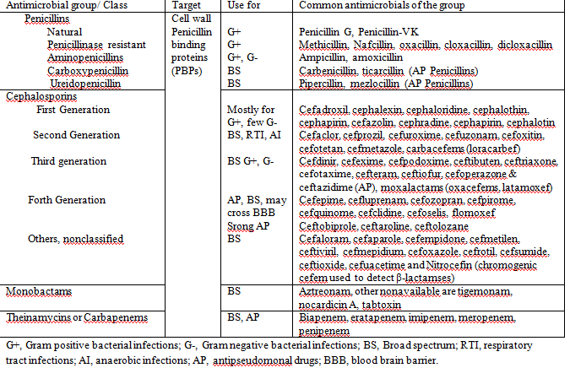
Β-LACTAM ANTIBIOTICS (HAVING LACTAM RING)

Slide 5
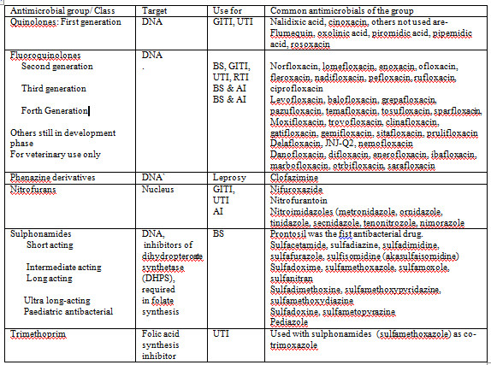
OTHER GROUPS OF CHEMICALLY DIFFERENT ANTIBIOTICS

Slide 6
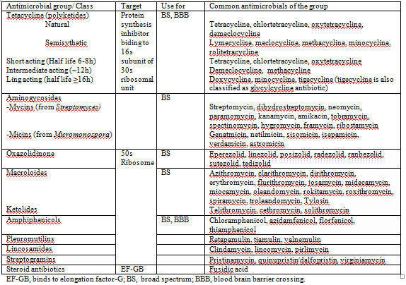

Slide 7
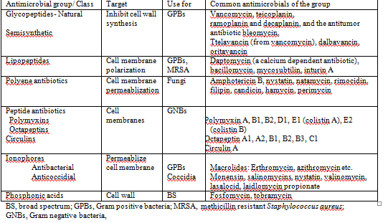

Slide 8
CLASSIFICATION BASED ON MECHANISM
OF ACTION
Affecting Protein Synthesis
Affecting on Nucleic acid synthesis
Antimetabolite antimicrobials
Acting on Cell wall
Acting on Cell membrane

Slide 9
PROTEIN SYNTHESIS AND SITE OF ACTION OF ANTIMICROBIALS THAT INHIBIT PROTEIN SYNTHESIS
A. Interfering with initiation of protein synthesis
  Antimicrobials that bind to the 30s ribosomal subunit
  Irreversibly bind to the 30S ribosome and freeze the 30S initiation complex (30S-mRNA-tRNA)-Aminoglycosides (Bactericidal)
  Reversibly bind to the 30S ribosome and inhibit binding of aminoacyl-t-RNA to the acceptor site on the 70S ribosome. Tetracyclines (Bacteriostatic).
  Reversibly interferes with mRNA interaction with the 30S ribosome without causing misreading of mRNA unlike aminoglycosides. Spectinomycin (Bacteriostatic)
  Antimicrobials that bind to the 50s ribosomal subunit
  Bind to the 50S ribosome to inhibit peptidyl transferase activity. Chloramphenicol, lincomycin, clindamycin (bacteriostatic)
  Inhibit translocation of the peptidyl tRNA from the A to the P site on the ribosome by binding to the 50S ribosomal 23S RNA. Macrolides (bacteriostatic)
B. Affecting peptide elongation
Binds to elongation factor G (EF-G) and inhibits release of EF-G from the EF-G/GDP complex. Fusidic acid (bacteriostatic)

Slide 10
INHIBITORS OF NUCLEIC ACID SYNTHESIS
Inhibitors of RNA synthesis: Bind to DNA-dependent RNA polymerase and inhibit initiation of RNA synthesis. Rifampin, rifamycin, rifampicin (bactericidal)
Inhibitors of DNA synthesis: Bind to the A subunit of DNA gyrase (topoisomerase) and prevent supercoiling of DNA, thereby inhibiting DNA synthesis. Quinolones, fluoroquinolones, oxolinic acid (bactericidal).
Agents That Impair the Template Function of DNA. None of them is therapeutically useful; however, chloroquine and miracil D (lucanthone) inhibit plasmodia and schistosomes, respectively by intercalating into the DNA and thereby to inhibit further nucleic acid synthesis. Acridine dyes such as proflavine act by intercalation mechanism, but because they are toxicity and carcinogenicity in mammals they are not used as antibacterial agents.

Slide 11
ANTIMETABOLITE ANTIMICROBIALS
Inhibitors of folic acid synthesis
  Analogues of para-aminobenzoic acid competitively inhibiting formation of dihydropteric acid. Sulfonamides, Sulfones, Para-aminosalicylic acid (PSA), Depsone (bacteriostatic).
  Bind to dihydrofolate reductase and inhibit formation of tetrahydrofolic acid. Trimethoprim, methotrexate, pyrimethamine (bacteriostatic).

Slide 12
ACTING ON CELL WALL
Inhibit synthesis of mycolic acids. Isoniazid (bacteriostatic).
Inhibition of Bacterial Cell Wall Synthesis: Peptidoglycan synthesis occurs in three stages.
  The first stage takes place in the cytoplasm, where the low-molecular-weight precursors UDP-GlcAc and UDP-MurNAc-L-Ala-D-Glu-meso-Dap-D-Ala-D-Ala are synthesized. Many antibiotics affect this stage.
  UTP and N-acetylglucosamine α-1-P are converted to UDP-N-acetylglucosamine, which is subsequently converted by the enzyme phosphoenolpyruvate: UDP-GIcNAc-3-enol-pyruvyltransferase. Fosfomycins block this transfer by a direct nucleophilic attack on the enzyme.
  Three amino acids are added to the muramyl peptide to yield a tripeptide. The dipeptide D-alanyl-D-alanine is synthesized from two molecules of D-alanine by the enzyme D-alanyl-D-alanine synthetase. D-Alanine is produced from L-alanine by an alanine racemase. Cycloserine inhibits both alanine racemase and D-alanyl-D-alanine synthetase, owing to the structural similarity cycloserine binds to the enzymes better than the D-alanine.

Slide 13
AFFECTING THE 2ND AND 3RD STAGE OF CELL WALL SYNTHESIS
2nd stage is catalyzed by membrane-bound enzymes. The precursor molecules are transferred sequentially to a carrier in the cytoplasmic membrane. This carrier is a phosphorylated undecaprenyl alcohol. The lipid carrier functions as a point of attachment to the membrane for the precursors and allows for transport of the subunits across the hydrophobic interior of the cytoplasmic membrane to the outside surface. Bacitracin, a peptide antibiotic, specifically interacts with the pyrophosphate derivate of the undecaprenyl alcohol, preventing further transfer of the muramylpentapeptide from the precursor nucleotide to the nascent peptidoglycan.
The third stage of cell wall synthesis involves polymerization and the attachment of nascent peptidoglycan to the cell wall. Polymerization occurs by transfer of the new peptidoglycan chain from its carrier in the membrane to the nonreducing N-acetylglucosamine of the new saccharide-peptide that is attached to the membrane. The new peptidoglycan is attached to preexisting cell wall peptidoglycan by a transpeptidase reaction D-alanyl-D-alanine terminus of two peptides. Transpeptidase enzyme cleaves the peptide bond between two D-alanyl residues in the pentapeptide and become acylated via the carbonyl group of the penultimate D-alanine residue. This final reaction can be inhibited by β-lactam antibiotics. These antibiotics undergoes an acylation reaction with the transpeptidases that cross-link the peptide polymers. Penicillins (penams), Cephalosporins (oxacephems and cephamycins), Penems, Thienamycins (carbapenems), and Aztreonam (monobactams)

Slide 14
VANCOMYCIN, ALSO INTERFERES WITH CELL WALL SYNTHESIS
Vancomycin interrupts cell wall synthesis by forming a complex with the C-terminal D-alanine residues of peptidoglycan precursors.
Complex formation at the outer surface of the cytoplasmic membrane prevents the transfer of the precursors from a lipid carrier to the growing peptidoglycan wall by transglycosidases.
Biochemical reactions in the cell wall catalyzed by transpeptidases and D,D-carboxypeptidases are also inhibited by vancomycin and other glycopeptide antimicrobials.
Because of its large size and complex structure, vancomycin does not penetrate the outer membrane of gram-negative organisms thus active only on GPBs.

Slide 15
ACTING ON CELL MEMBRANE
Permeabilizes cell membranes for sodium and potassium ions: Ionophore antibiotics. Valinomycin permeabilizes membranes for K⁺ of both prokaryotic and eukaryotic cells for potassium and therefore cannot be used for antimicrobial chemotherapy. However, Monensin (in cattle) and salinomycin (in pigs) are used exclusively in veterinary practice can inhibit bacteria, protozoa (coccidia) and metazoan parasites.
Binds to the cytoplasmic membrane and then forms oligomeric pores viz., permeabilization of liposomes by Lipopeptide antibiotics. Daptomycin permeabilizes liposomes only when they contain phosphatidylglycerol (PG) thus active on GPBs, outer membrane of GNBs lacking PG interferes its activity.
Binding to LPS to disrupts outer membrane, Cyclopeptide antibiotics, polymyxin B and E (colistin). LPS contains several negative charges interacting with positively charged polymyxins, besides several hydrophobic interactions between the two molecules also disrupts outer membranes. Amino groups in polymyxin B pairs with the phosphates of lipid A in LPS.
Quasi-ionophore antibiotics that include channel-forming agents such as gramicidin and the polyene antibiotics. The polyene antibiotics, which act by binding to membrane sterols, contain a rigid hydrophobic center and a flexible hydrophilic section. They interact with fungal cells to produce a membrane-polyene complex that alters the membrane permeability, resulting in internal acidification of the fungus with exchange of K⁺ and sugars; loss of phosphate esters, organic acids, nucleotides; and eventual leakage of cell protein.
Interfering with the synthesis of lipid membranes. Imidazoles: miconazole, ketoconazole, clotrimazole, and fluconazole. These compounds inhibit the incorporation of subunits into ergosterol and may also directly damage the fungal cell membrane.

Slide 16
RESISTANCE
Clinical Resistance: The MIC of the drug for a particular strain of bacteria exceeds threshold of safety in vivo. It is due to:
  By mutation in the gene that determines sensitivity/resistance to the agent
  By acquisition of extrachromosomal DNA (plasmid) carrying a resistance gene.
Cross Resistance: A single mechanism confers resistance to multiple antimicrobial agents, commonly seen with closely related antimicrobial agents.
Multiple Resistance: It implies to multiple mechanisms involved for resistance to one or more antibiotics, seen with unrelated antimicrobial agents.
MECHANISMS OF RESISTANCE
1. Altered permeability of the antimicrobial agent
Altered permeability may be due to the inability of the antimicrobial agent to enter the bacterial cell or alternatively to the active export of the agent from the cell.
2. Inactivation of the antimicrobial agent
Resistance is often the result of the production of an enzyme that is capable of inactivating the antimicrobial agent.
3. Altered target site
Resistance can arise due to alteration of the target site for the antimicrobial agent.
4. Replacement of a sensitive pathway
Resistance can result from the acquisition of a new enzyme to replace the sensitive one.
5. Excretion or exclusion of antibiotics (Efflux pump mediated resistance)

