Slide 1
Secure Data Hiding in Image Using Steganography
CAPSTONE PROJECT
Presented By: ROHAN ADEPU
Student Name : ROHAN ADEPU
College Name & Department : CMR Institute Of Technology, Hyd

Slide 2
OUTLINE
Problem Statement
Technology used
Wow factor
End users
Result
Conclusion
Git-hub Link

Slide 3
Problem Statement
In the modern digital era, the exchange of sensitive information over the internet has increased dramatically, leading to concerns regarding privacy and security. One technique to safeguard confidential data during transmission is steganography, which involves embedding hidden information within a cover medium, such as an image, in a way that prevents detection by unauthorized individuals. However, existing steganographic methods face challenges in ensuring both the security and imperceptibility of the hidden data, particularly in environments with high security risks.

Slide 4
Technology used
Libraries:
OpenCV (Python)
Pillow (PIL) (Python)
NumPy (Python)
Matplotlib (Python)
PyCryptodome (Python)
Cryptography (Python)
Platforms:
Python : A widely-used programming language for implementing steganography algorithms and cryptographic techniques, with strong support through libraries like OpenCV, Pillow, NumPy, and TensorFlow.
Jupyter Notebooks : A platform for experimenting and testing Python code interactively, useful for prototyping steganography algorithms with libraries like OpenCV, TensorFlow, and PyCryptodome.

Slide 5
Wow factors
Hybrid Steganography with Encryption for double security.
AI & Deep Learning to adaptively hide data in the most efficient and least detectable way.
Compression and Noise Robustness to ensure data survival through various image processing techniques.
Invisible Watermarking to verify data integrity.
Real-Time Embedding and Extraction with instant feedback on image quality.
Cross-Platform compatibility for mobile, desktop, and web-based access.
Blockchain-based verification for immutable integrity tracking.
Quantum-Resistant Encryption to secure data in the age of future technology.

Slide 6
End users
Government & Military: Secure communication of classified information.
Corporate & Financial Institutions: Protect sensitive business or financial data.
Law Enforcement & Security Agencies: Covert communication in investigations.
Healthcare Providers: Safeguard patient data.
Journalists & Whistleblowers: Protect sensitive revelations.
Cryptocurrency Users: Safeguard wallet keys and transactions.
Educational & Research Institutions: Secure academic work and data.
Privacy-Conscious Individuals: Protect personal data.
Digital Forensics & Cybersecurity Experts: Detect hidden malicious data.
Content Creators & Digital Artists: Safeguard digital content with embedded data.

Slide 7
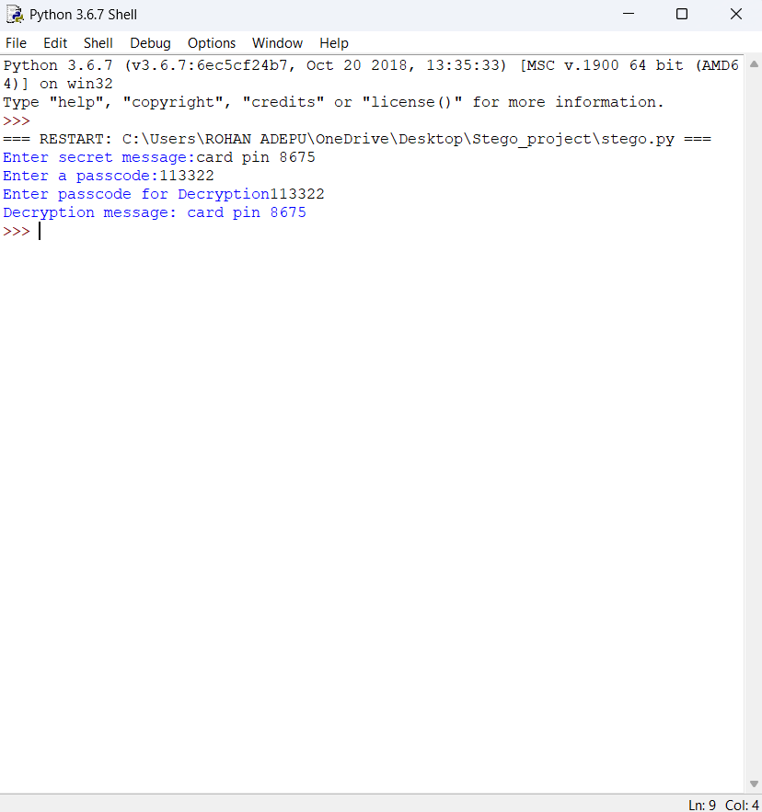


Results

Slide 8
Conclusion
In conclusion, Secure Data Hiding in Image Using Steganography provides a highly efficient, secure, and practical method for embedding and retrieving sensitive data in digital images. The system ensures data security, maintains image integrity, and allows for robust data hiding with practical applications in various fields, from cybersecurity to personal privacy. With advancements in encryption and detection methods, this approach is a powerful tool for future-proofing sensitive communications.

Slide 9
GitHub Link
https://github.com/rohanadepu26/Stego_project

Slide 10
THANK YOU

