Slide 1



Cloud-Based Time Series Prediction of CPU Load Through Advanced Deep Learning Models
MSc Research Project | 22249729

Slide 2

Research Question
What are the most effective cloud-based approaches for forecasting CPU utilization in virtual machines, how can machine learning and deep learning models be implemented in a scalable cloud environment, and why is accurate prediction critical for optimizing resource allocation and reducing operational costs in cloud infrastructure?

Slide 3
INTRODUCTION
Cloud computing enables dynamic resource allocation, but traditional autoscaling lacks predictive intelligence.
This project develops a cloud-native forecasting system using AWS to predict CPU usage of Azure VMs with time-series data.
Various models (Decision Tree, Gradient Boosting, LSTM, BiLSTM, Multihead BiLSTM) are implemented and evaluated.

Slide 4

MOTIVATION
Reactive autoscaling results in under/over-provisioning of resources.
Accurate forecasting can reduce cost, improve performance, and enable proactive scaling.
Machine learning and deep learning models can model complex, non-linear temporal patterns in CPU usage.

Slide 5

Data collection
The data for the CPU Utilization is used from the Azure Public Repository with Virtual Machine Log data.

Slide 6

DATA PREPARATION
The data is first cleaned to remove any inconsistency in the data.
The data is then preprocessed, and feature extraction is done.
Data is visualized for better understanding of data

Slide 7

DATA PROCESSING
Min Max Scaling is applied to scale the data.
Normalized data provides better performance
Create sequences of past data point using Window Rolling

Slide 8
Model development
After data is processed, we started to experiment with different models to test and evaluate the data on traditional models like Decision tree and gradient boosting.
Deep Learning models like LSTM and BiLSTM are also tested with the data.
We also tested a MultiHead BiLSTM model with the data.

Slide 9
MODEL COMPARISON
Model | Root Mean Squared Error (RMSE) | R-Square
Decision Tree Regressor | 0.0480 | 0.866
Gradient Boosting Regressor | 0.0321 | 0.940
LSTM | 0.0331 | 0.936
BiLSTM | 0.0246 | 0.965
Multihead BiLSTM (Best Model) | 0.0213 | 0.974
Deep Learning Models have better performance with the data compared to the Traditional models.
We see a better performance of the Multihead BiLSTM Model when compared to the LSTM and BiLSTM Models.

Slide 10
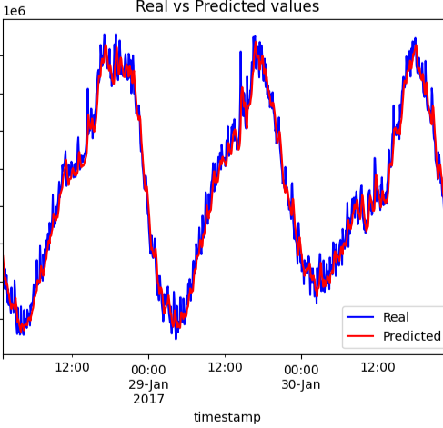
REAL VS PREDICTED VALUES

Slide 11
CONCLUSION
The MultiHead BiLSTM Model showed the best performance on comparison with other Deep Learning and traditional models.
Deploying this in a real time cloud monitoring system will help to manage resources in a better way and also help in reducing costs.
There are still room for improvements like using live streaming data and use of hyperparameter tuning.
This kind of forecasting systems can increase the efficiency of the cloud infrastructures across the globe and help them scale without concerns on the cost.

Slide 12
Thank you!
Rohan Ajila | MSc Cloud Computing | 22249729

