Slide 1
DISTRIBUTED TIC TAC TOE
A project by piyush and rishabh

Slide 2
THE GAME
Designed IN JAVA .
For Graphics we use Swing and Awt CLASS.

Slide 3
THE WORKING
On clicking on any button in grid (but_arr[i][j]) it gets assigned a suitable icon (o or x).
To determine if a button has already been clicked or to determine a victory condition we are using a logic matrix.

Slide 4
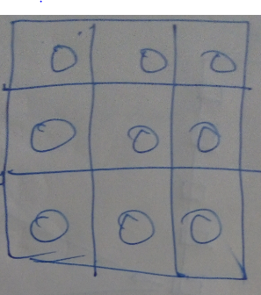
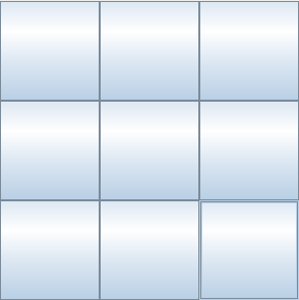
NEW GAME

Slide 5
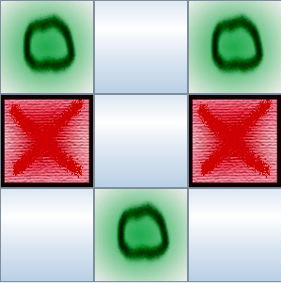
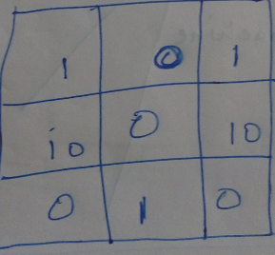

Slide 6
PLAY WITH PC

Slide 7
UDP
User datagram protocol.
Applications can send messages known as datagrams.
unordered and connectionless protocol.
Used in multicasting and broadcasting because it is connectionless.
Key applications: used in DNS,Voip
Notes:
Voip voice over ip
<number>

Slide 8
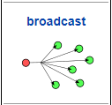
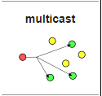
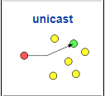
MULTICAST
Data transmission is addressed to a group of destination computers simultaneously.

Slide 9
TCP
Transmission control protocol.
ordered and connection oriented protocol.

Slide 10
CONNECT

