Slide 1
“Sentiment Analysis on Amazon Food Reviews”
By…
Mr. Rohan Jaywant Amrutkar
Roll No.: MST – 02
ERP ID: S1132200392

Slide 2
Objectives
Sentiment Analysis
Text Cleaning
Feature extraction form text data
Sentiment analysis using Python library
Sentiment analysis using classification
Model Performance Metrics

Slide 3
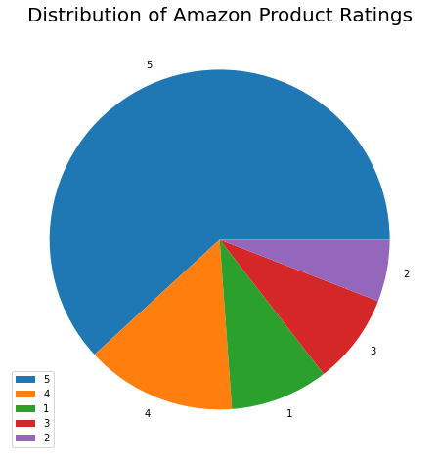
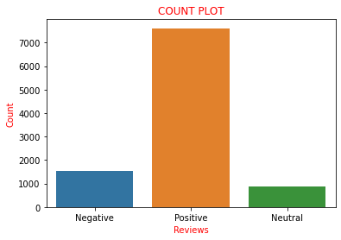
Data Visualization
Pie – Chart Count Plot

Slide 4
Data Visualization
Interpretetion:1) Pie – chart :As above chart clearly depicts about that most of the products have high rating. It concludes that customer satisfaction about product.
2) Count Plot: As in above chart there are high number towards positive score.

Slide 5
SENTIMENT ANALYSIS WITHOUT TEXT CLEANING
Sentiment Analysis using sentimentIntensityAnalyzer() module from Sklearn library:
Sentiment scores: Positive Score:1928.2531
Negative Score:422.9494
Neutral Score: 7646.0830
Interpretation: In above sentiment scores lager value is 7646.083 for Neutral Score.

Slide 6
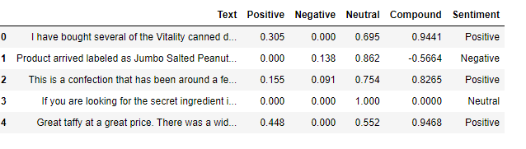
SENTIMENT ANALYSIS WITHOUT TEXT CLEANING

Slide 7
Sentiment Analysis with text cleaning
Sentiment Analysis using sentimentIntensityAnalyzer() module from Sklearn library:
Sentiment scores: Positive Score:2729.6070
Negative Score:435.1539
Neutral Score: 6833.2680
Interpretation: In above sentiment scores there is increase in Positive score and also decrease in Neutral score. So, we can say that after text cleaning there is increase in accuracy of the result.

Slide 8
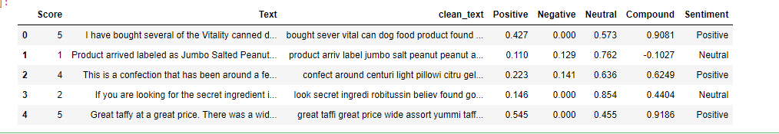
Sentiment Analysis with text cleaning

Slide 9
CLASSIFICATION OF TEXT DATA USING SVM ALGORITHM
Classifying data into three classes: Positive, Negative, Neutral
Cleaning Text data
Feature Extraction
Splitting data set into training and test set
Classifying data using SVM algorithm
Confusion matrix
Accuracy Score
Sensitivity and Specificity

Slide 10

CLASSIFICATION OF TEXT DATA USING SVM ALGORITHM
Confusion Matrix
Interpretation: In above confusion matrix if we see diagonal values (True Values means actual and predicted values are same) are large in number. So, we can say that classification model is perfectly fitted.

Slide 11
CLASSIFICATION OF TEXT DATA USING SVM ALGORITHM
Accuracy
For train dataset: 97.58602
For test dataset: 82.19999
Interpretation: Accuracy score of training data set is 97.58860 and test data set is 82.19999 so both scores are sufficient to say that classification model is perfectly fitted.

Slide 12
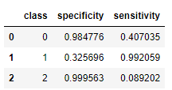
CLASSIFICATION OF TEXT DATA USING SVM ALGORITHM
Specificity and Sensitivity
Interpretation: Above metric table values are also relevant to say that classification model is perfectly fitted.

Slide 13
CONCLUSION
In sentiment analysis of amazon food product reviews, I try to make sentiment analysis using three different methods cause these three methods are useful according to their requirement and perfect prediction.
In first method I go for sentiment analysis without cleaning text data cause sometimes user wants quick results rather than accuracy in result.
In second method I go for sentiment analysis with clean text data and according to cleaning text data there is increase in accuracy in results.
In Third method I go sentiment analysis using machine learning classification algorithm. Sometimes user wants directly classified text data according to there classes.

Slide 14
Thank YOU

