Slide 1
MAMMAL
Follow-up since 6/5
Data gap vs model limit
Alternative models
The diversity finding
Rohan Aryagondi · June 2026

Slide 2
MAMMAL
What the 6/5 check-in asked
• Diagnostic (Graham, Matt) — is MAMMAL's Nav binding failure a data gap or a model limit? Decides whether a Quiver fine-tune helps.
• Slide-9 alternative models (Matt, David) — benchmark ConPLex / Boltz-2 / ADMET-AI / ESM-C on our data, not paper badges.
• PROTON evaluation (Matt, David) — Zitnik Lab's neurology relational FM, closer to the Sapphire KG use case than to binding prediction.
• BBBP characterization (Graham, Mahdi) — why is BBBP "too permissive"? Mahdi's reframe: trust the no's, investigate the yes's.

Slide 3
MAMMAL
Bottom line
• Data volume is necessary, not sufficient — a minority of well-trained targets work, most don't. The high-data regime is bimodal.
• No off-the-shelf alternative beats MAMMAL — ConPLex sits at chance too; the failure is general to the BindingDB-trained DTI tooling space.
• ADMET-AI finally fills the toxicity-gate slot — DILI TPR 0.83 vs MAMMAL ClinTox 0.08. Deprecate ClinTox.
• Protein-embedding pitch is at parity, not superiority — MAMMAL ties open MIT-licensed ESM-2-650M on the canonical CRISPR-N panel.
• mTOR is the next BRAF — truncation falsified; chance even with kinase domain fully visible. Drop from any pitch.
• Project thesis unchanged but sharper — MAMMAL is commodity enrichment. Moat stays Quiver functional trace + V1-T.

Slide 4
MAMMAL
Where is MAMMAL data-suited? — ceiling test
Target | Class | n_pairs | AUROC random | AUROC matched | off-target Δ
RORC | nuclear receptor | 374 | 0.97 | 0.95 | +0.68
CA2 | other (CA) | 269 | 0.87 | 0.84 | +1.97
Adrb2 | GPCR | 211 | 0.87 | 0.88 | +0.83
mTOR | kinase (Quiver) | 192 | 0.76 | 0.56 | −1.12
BRAF | kinase (most-trained!) | 532 | 0.47 | 0.46 | +1.18
HRH1 | GPCR | 184 | 0.40 | 0.33 | +0.68
3 of 6 land at AUROC ≥ 0.80 on both random and MW-matched decoys. BRAF — the most-trained target in BindingDB — is at chance. mTOR collapses on matched and inverts off-target.

Slide 5
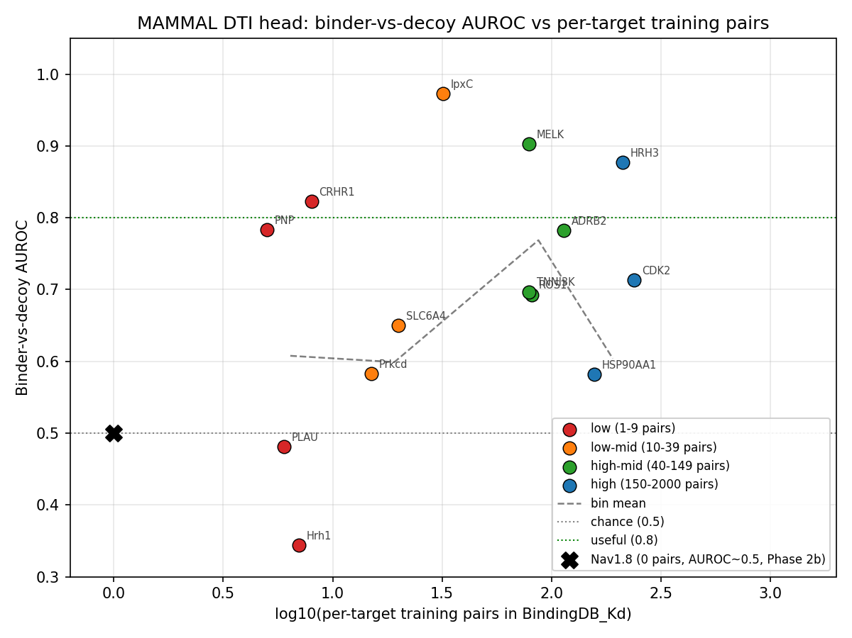
MAMMAL
Threshold curve — AUROC vs training pairs
Non-monotonic. Peaks at the 40–149 bin (0.77 ± 0.09) and drops back to 0.60 in the 150+ bin with σ doubling. Data volume alone doesn't predict success at the high end.

Slide 6
MAMMAL
Why does it fail on some rich-data targets?
• mTOR truncation theory — FALSIFIED — kinase-domain window (451 aa, fully visible, no truncation) keeps AUROC at 0.50. mTOR is the next BRAF, not a truncation artifact.
• Chemodiversity vs AUROC — Spearman = −0.83 — narrower binder sets correlate with higher AUROC across the 6 ceiling targets.
• Memorisation hypothesis — REFUTED — held-out-scaffold test: RORC AUROC 0.93 on the 94 % of binders that aren't the dominant scaffold (vs 0.97 in-scaffold). Ceiling wins are real generalisation.
• Decoy-distance + output-variance — also REFUTED — Spearman = +0.03 / +0.26. Three hypotheses tested; mechanism behind ρ = −0.83 remains genuinely open.

Slide 7
MAMMAL
ConPLex — does it beat MAMMAL? No.
Test | MAMMAL | ConPLex
Correlation (Spearman vs pChEMBL, n=10) | +0.43 PASS | −0.03 FAIL
Named test (suzetrigine → Nav1.8, z-margin) | −0.69 FAIL | −2.35 FAIL
Nav1.8 binder-vs-decoy AUROC | 0.43 | 0.39
mTOR binder-vs-decoy AUROC | 0.54 | 0.58
WDR91 SPR (fine-tuned MAMMAL vs zero-shot ConPLex) | 0.82 STRONG | 0.59
ConPLex does not beat MAMMAL anywhere. Both sit at chance on Nav1.8 / mTOR. Zero-shot DTI failure is general to BindingDB-trained tooling — not MAMMAL-specific.

Slide 8
MAMMAL
ADMET-AI replaces the broken ClinTox head
Endpoint | AUROC | TPR (toxic) | TNR (safe)
ADMET-AI DILI | 0.73 | 0.83 | 0.67
ADMET-AI AMES | 0.67 | 0.17 | 0.93
ADMET-AI ClinTox | 0.50 | 0.00 | 1.00
ADMET-AI hERG | 0.48 | 0.33 | 0.40
MAMMAL ClinTox | 0.28 | 0.08 | 1.00
• ADMET-AI DILI catches 10/12 toxics — vs MAMMAL ClinTox's 1/12. Earns the toxicity-gate slot.
• ClinTox dataset is the wrong endpoint — both models fail. Use mechanism-specific endpoints (DILI / hERG / AMES). Deprecate MAMMAL ClinTox.

Slide 9
MAMMAL
Protein embeddings — at parity, not superiority
Model | License | NN-recall | family gap
MAMMAL 458M | IBM (research) | 0.750 | 0.374
ESM-2 650M (raw cosine) | MIT (open) | 0.725 | 0.039
ESM-2 650M (centered — the textbook fix) | MIT (open) | 0.750 (tie) | 0.417
40-gene CRISPR-N panel · same protocol · mean-pool + cosine NN
• Prior 0.92 vs 0.88 was on a 25-protein toy panel — never re-run on the canonical CRISPR-N until now. On the real panel under the standard anisotropy correction, MAMMAL ties.
• ESM-2-650M is MIT-licensed and a clean swap — Sapphire embedding-layer pitch survives at parity, not superiority. Open option on the table.

Slide 10
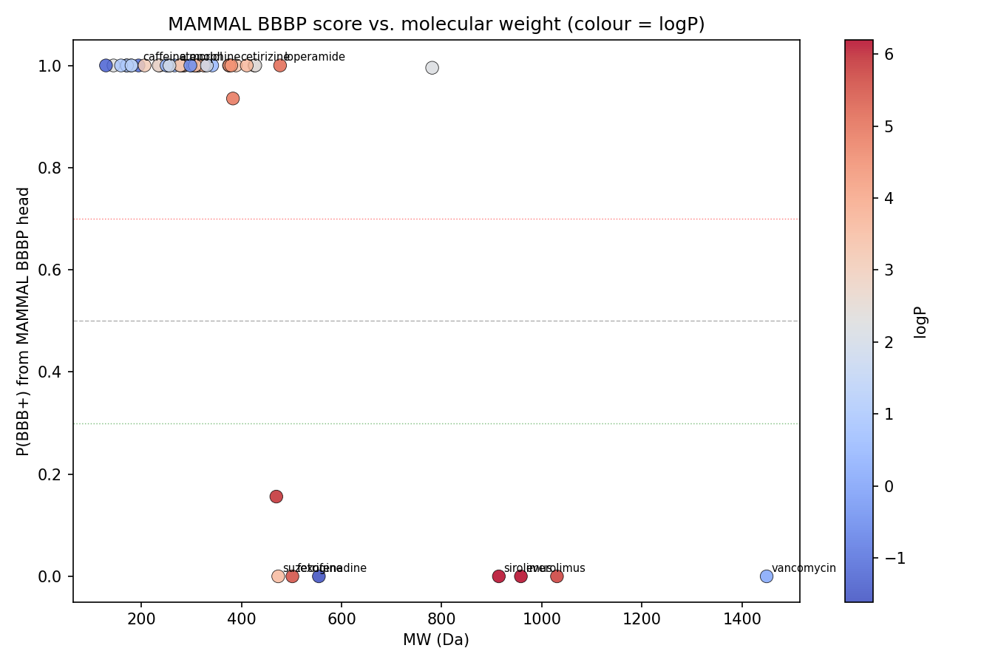
MAMMAL
BBBP head — what is it actually doing?
• Spearman(P(BBB+), MW) = −0.73 — Graham directionally right. HBA −0.67, TPSA −0.61.
• Size + polarity exclusion gate — operative cliff is ≳450 Da + polar → exclude. Not "<300 Da → brain".
• 8/8 "predicted no" are truly non-penetrant — TNR perfect on the <0.3 set.
• 29/43 "predicted yes" are CNS-active (67 %) — only marginally above base rate.
• Saturated 0/1 — no drug lands between 0.3 and 0.7.
Mahdi's reframe — "trust the no's, investigate the yes's" — fully validated.

Slide 11
MAMMAL
PROTON + Boltz-2 — both need AWS, both on hold
• PROTON access — CONFIRMED open — code (mims-harvard/PROTON, MIT) + weights (HuggingFace) + NeuroKG (Harvard Dataverse). No licensing friction.
• PROTON install on macOS ARM64 — impractical — DGL ships no Apple-Silicon wheels; from-source compile ~1 hr, disk at 96 %. Eval needs Linux or AWS g5.
• Boltz-2 — pilot launched then cancelled at $0.11 — g5.xlarge spun up, volume attached, killed on direction. Both Boltz-2 and PROTON queue for the same AWS g5 when AWS is back on.
• Planned PROTON eval (when AWS is back) — (i) embed CRISPR-N panel, compare NN-recall vs MAMMAL/ESM-2; (ii) drug-target link prediction for Nav1.8/mTOR; (iii) hypothesis generation on one Quiver CRISPR-N hit.

Slide 12
MAMMAL
What changed vs going-in beliefs
Prior belief | Updated reading
Nav fails because BindingDB has no Nav → close the gap = done. | True but insufficient. The high end is bimodal; data volume alone doesn't predict success.
Off-the-shelf alternatives might rescue Nav (ConPLex). | No off-the-shelf alternative beats MAMMAL on our targets. Boltz-2 is the only remaining unknown.
MAMMAL is data-suited on rich targets like mTOR. | mTOR is the next BRAF. Truncation falsified. Drop from any pitch.
MAMMAL ClinTox covers tox de-risking. | ClinTox dataset is the wrong endpoint. ADMET-AI DILI is the replacement (TPR 0.83).
MAMMAL embeddings beat ESM-2 → Sapphire layer = MAMMAL. | Parity, not superiority. ESM-2-650M (MIT, open) ties on the canonical panel.
BBBP head is reliable. | Asymmetric. "No" is perfect; "yes" marginally above base rate. Soft positive flag, hard negative gate.

Slide 13
docs/meeting_followup_report.md · full detail in results/

