Slide 1
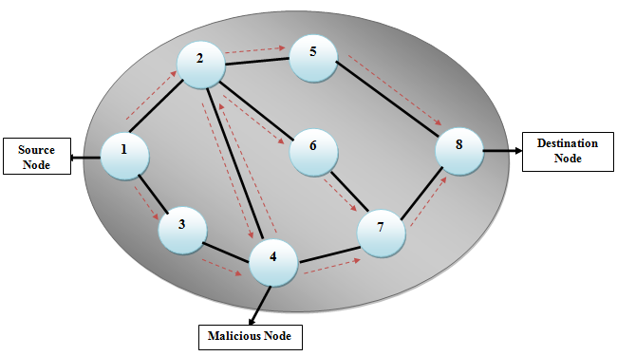
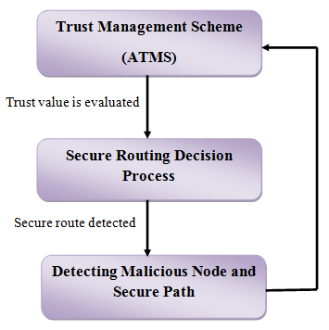
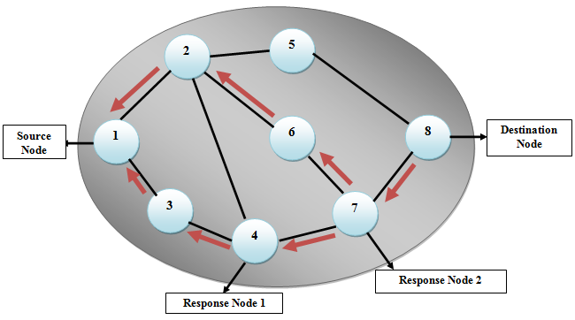
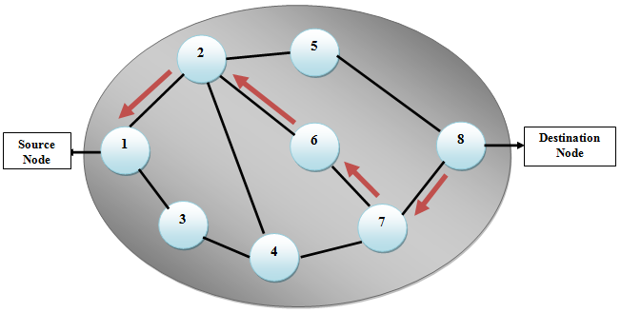
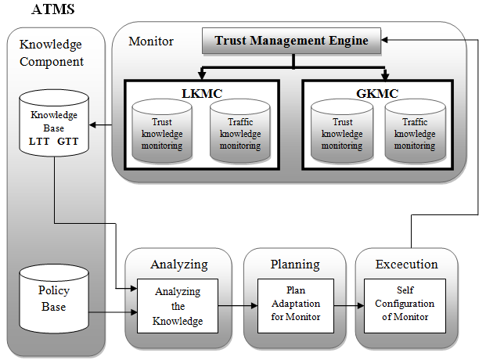

Evolving Trust Model for MANET using Secure Routing Algorithm Supriya. L. Shitole (ME-EXTC) Under the Guidance Of Prof. Vijay. M. Purohit & Prof. Ranjana . R. Gite
Abstract Mobile ad hoc Networks have become a significant emerging technology in mobile computing. In recent years, there has been an enormous use of mobile computing devices that led to the development of ad hoc networking standards and supply the mobile nodes to line up self-organizing, adaptive and temporary networks. A mobile ad hoc network consists of wireless mobile nodes forming a short-lived network without the centralized infrastructure. Trust management in MANETs is essential when nodes establish a network, with an appropriate level of trust themselves. Trust system is used to offer network security services like access management, malicious node detection, secure resource sharing, and authentication. In addition, secure routing based on trust management is an important aspect in MANET system. Trust management is a multifunctional control process throughout which the most necessary task is to establish trust between the nodes that are neighbors and make a routing path. The basic concept of this work is to propose a trust based secure routing theme in MANETs without using any centralized infrastructure. This work projects towards a new data-monitoring theme for trust management on MANETs using autonomic principles. In addition to this, it also proposes a secured routing path selection based on trust information of nodes. 2.Introduction Ad hoc networks are new paradigm of networks providing limited mobility with none underlying infrastructure. An ad hoc network could be a collection of autonomous nodes or terminals that connect with one another by forming a multi-hop radio network and maintaining connectivity during a decentralized manner. Every node functions as a host and as a router. The topology is generally dynamic, since the nodes have a property of varying their positions with time because of node departures, new node arrivals, and the chance of taking mobile nodes. Significant applications of MANETs embrace establishing survivable, efficient, dynamic communication for emergency/rescue operations and military networks that cannot believe centralized and arranged connectivity. Trust is a very important aspect within the design of any system and analysis of secure distribution systems. Trust is an essential part of the method by which relationships develop. A trust model specifies, evaluates and sets up trust relationship among entities. 3.Problem Statement MANET is self organized in nature; nodes in network can behave selfishly for individual interest. The use of wireless link renders an ad hoc network susceptible to link attacks.
Autonomous nodes in an ad hoc network have inadequate physical protection. Any security solution with static configuration would not be sufficient. 4. Proposed Methodology Trust is a vital part of the process. Security must be considered as a milestone requirement. A key concept of this work is to propose a trust based secure routing process scheme based on trust management in MANETs without using any centralized infrastructure.
5. Algorithm for Secure Routing Process
Figure.3. Route Request
Figure.4. Route Response
Figure.1. Proposed method
It uses AUTONOMOUS KNOWLEDGE MONITORING SCHEME (ATMS). That includes the following five components: 1. Monitor 2. Knowledge 3. Analyzing 4. Planning 5. Execution
Fig.5. Data Confirmation from Destination Node
6. Advantages Of Trust Model Knowledge management help system to process all the information in best possible way. This increase the efficiency and performance of complete system 7. Conclusion This work described an autonomic scheme for monitoring trust knowledge on MANETs, called ATMS with secure routing decision process. As future works, to enhance the network performance, using the monitored knowledge as input of a routing decision process.
Figure.2. ATMS
Contact email:
shitoleriya19@gmail.com

