Slide 1

Global Airports Dashboard
Course: Data Visualization
Presenter: Rohan Bali, M.S. Data Science Candidate, UMass Dartmouth

Slide 2
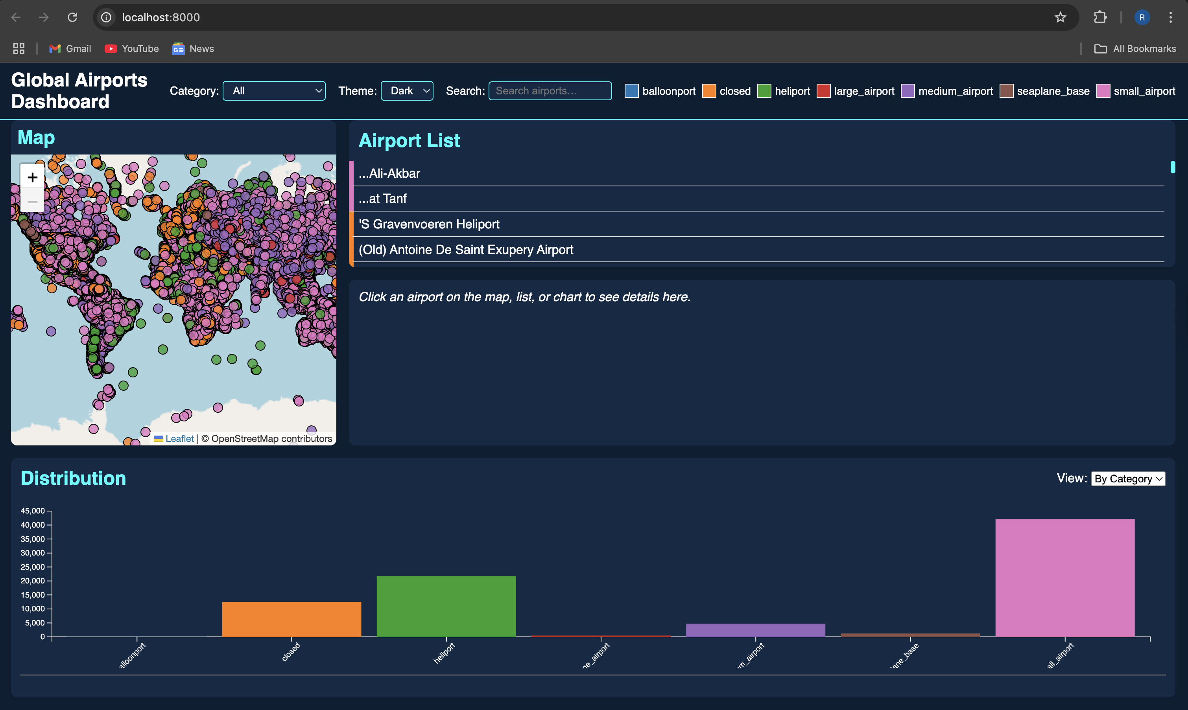
Background & Objectives
Background
• Aviation data is fragmented across hundreds of sources, making global analysis difficult.
• Visual tools help reveal geographic patterns and category‐based trends.
Objectives
Build an interactive web dashboard to explore all the world's airports.
Allow users to filter by airport type (e.g., large commercial, small airstrip).
Enable text search, detail views, and distribution charts by category and region.

Slide 3
Data & Preprocessing
1. Source & Format
Used the OpenFlights “airports.csv” file (46K+ rows).
Fields: id, name, type, municipality, iso_country, continent, latitude_deg, longitude_deg.
2. Cleaning
Parsed each row in JS.
parseRow(d) casts lat/lon to numbers and renames keys.
Filtered out rows missing valid coordinates:
3. Derived Lists
• Extracted unique airport types and continents
4. Color Scales
categoryColor = d3.scaleOrdinal(categories, d3.schemeCategory10)
regionColor = d3.scaleOrdinal(regions, d3.schemeCategory10)

Slide 4
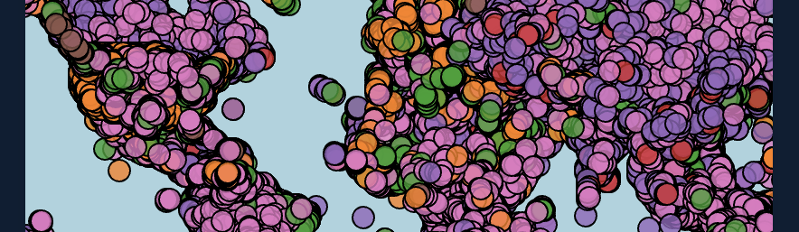
Map Panel Implementation
1. Initialization
2. Marker Layer
3. Plotting Airports
4. Auto‐Zoom

Slide 5
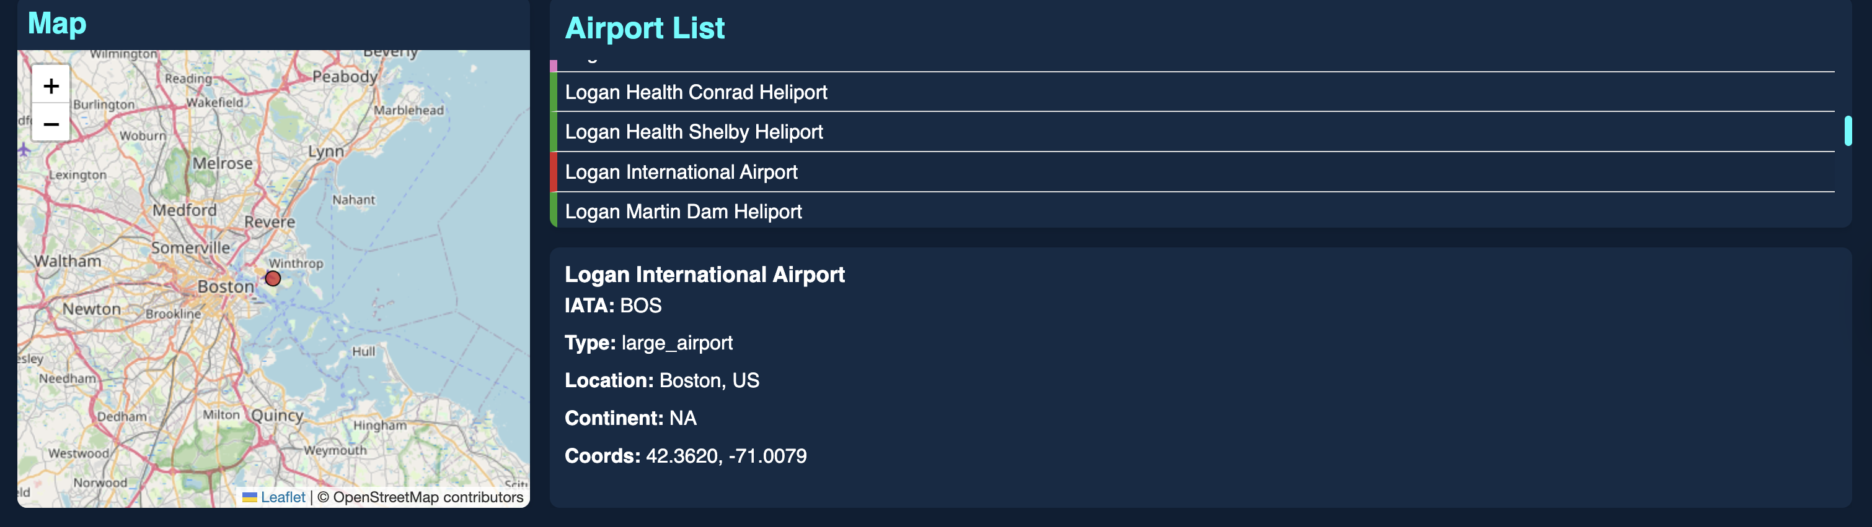
List & Details Panels
Airport List
List of all the available airports in the present selection.
Details Box
Details of the airport selected (either from the map or from the list).

Slide 6
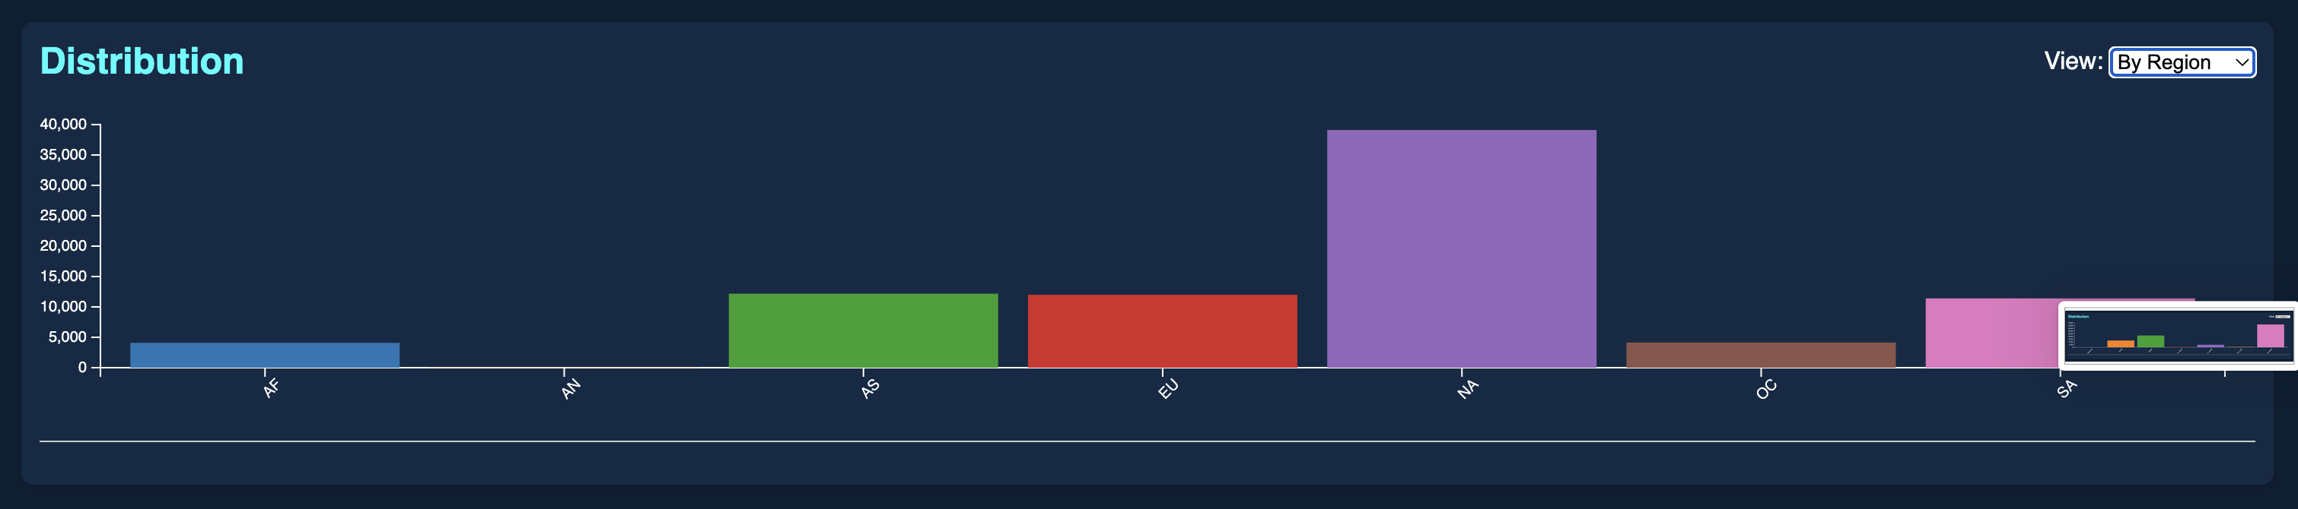
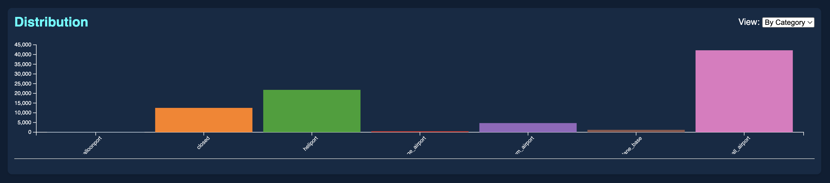
Distribution Chart Panel
A built-in scroll option to see the distribution graph, I have taken two graphs into account.
By Category of the airport.
By the region of the airports.

Slide 7
Search, Filter & Theming
Text Search
Category Filter
Light/Dark Theme
Central Render Function

Slide 8
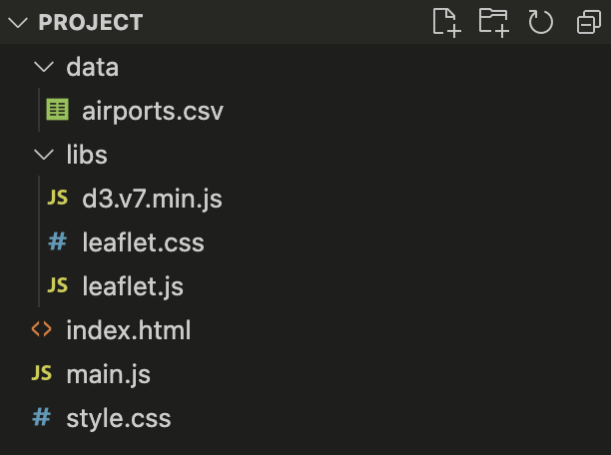
Technical Stack & File Structure
Front-end:
• HTML5/CSS3 (style.css for layout, flex, scrollbars)
• Vanilla JS (ES6 modules in main.js)
Libraries:
• D3.js v7 – CSV loading, scales, axes, chart drawing
• Leaflet.js v1.9.3 – map, markers, feature groups
• OpenStreetMap tiles
Files:
– index.html
– style.css
– main.js
– data/airports.csv

Slide 9
Challenges & Solutions
1. Large marker count → used L.featureGroup to batch and enable fitBounds().
2. Responsive chart resizing → window ‘resize’ listener re‐draws bars.
3. Scrollable panels → CSS flex‐box + overflow-y internal to panel.
4. Asynchronous data load → chained initMap(), initChart(), setupFilters() after d3.csv() promise.

Slide 10
Future Work
• Add marker clustering (Leaflet.markercluster) for performance.
• Incorporate airport traffic statistics & draw flight routes.
• Allow CSV/JSON export of filtered subset.
• Mobile layout: collapsible panels, touch gestures.

