Slide 1
Titanic machine learning problem
TEAM 5
Derek Wu, Akanksha Jhunjhunwala,
Jinghua Zhang, Carissa Ghazalie

Slide 2


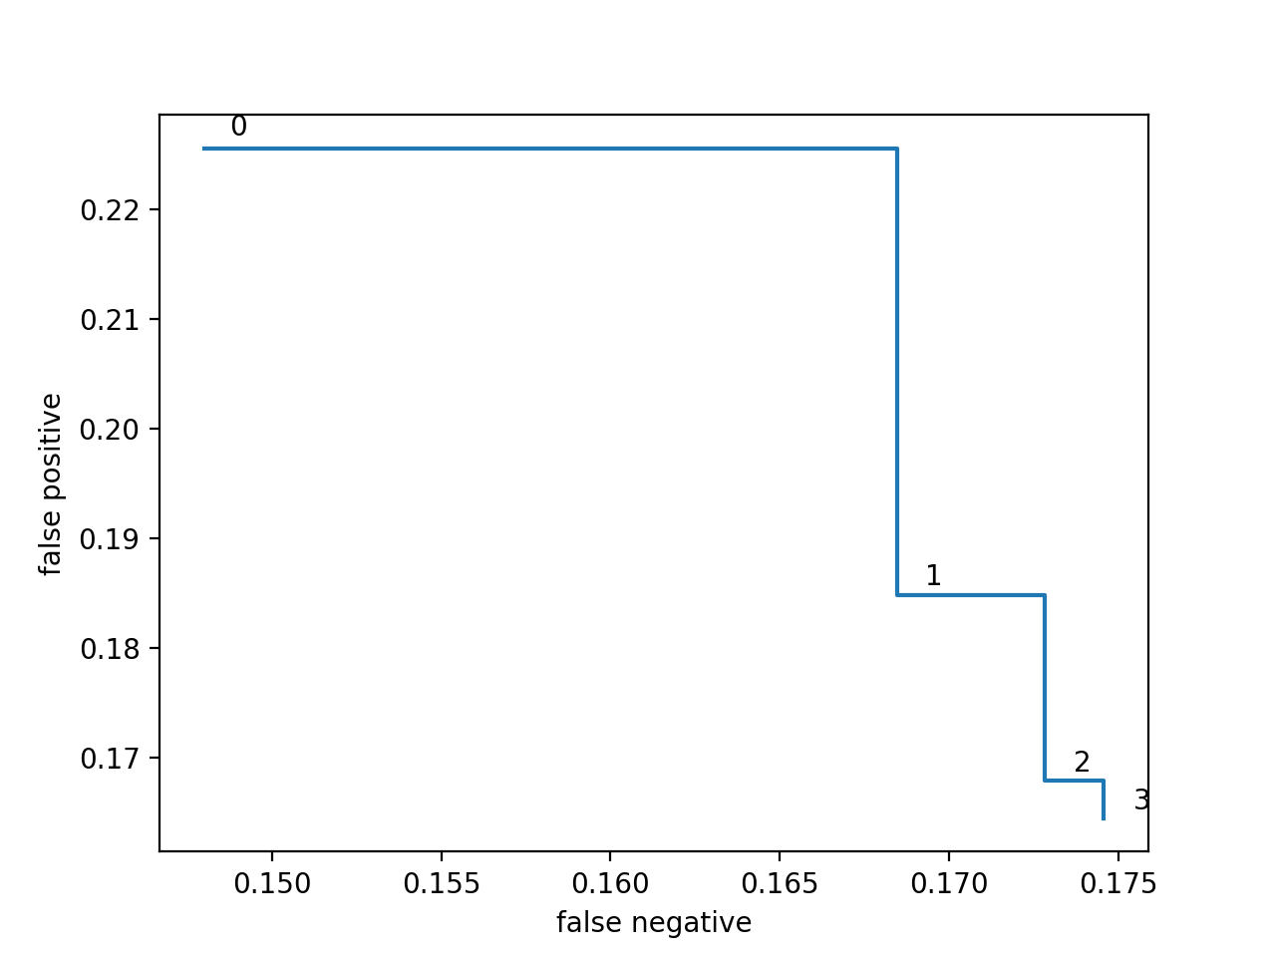
Non- dominated plot
0- SVM with poly kernel degree = 4
1- SVM with rbf kernel degree = 3
2- Gradient Boosting
subsample=0.7, learning_rate=0.005,
n_estimators=200, max_depth=10,
min_samples_split = 3, random_state = 1
3- Random Forest
n_estimators = 100, min_samples_split = 10

Slide 3
Preprocessing methods
Age
Filled missing values with -1
Gender
Changed type to boolean where F=0 and M=1
Parch +SibSp
Combined into one field called 'Family'
Fare
Filled missing values with –1
Dropped 'SibSp','Parch','PassengerId','Sex','Name','Cabin','Embarked','Ticket'

Slide 4
Classifier from SciKit Learn
Feature Engineering
One Machine Learning model

Slide 5
SVM Classifier
Additional data preprocessing: scaling the data
Smaller numbers—easier to work with, faster training times
Polynomial kernels of degrees 4 and rbf kernels
Lower degree meant too many false negatives, not specific enough to consider significant outliers
Higher degree meant too many false positives, too specific and caught too many outliers
rbf produced false positive 18.5%, false negative 16.8%
Degree 4 poly produced false positive rate of 22%, false negative 14.8%

Slide 6
Random Forest Classifier
Number of trees in the forest (n_estimators) was chosen to be 100
min_sample_split was chosen to be 10
Other parameters were set to their default values
False negative approx 17.5%
False positive approx 16.5%. This was the lowest false positive percentage across all models.

Slide 7
Gradient Boosting Classifier
Number of trees in the forest (n_estimators) was chosen to be 200
Gradient boosting is fairly robust to over-fitting so a large number usually results in better performance.
min_samples_split was chosen to be 3
subsample=0.7, learning_rate=0.005, max_depth=10, random_state = 1
Other parameters were set to their default values
False negative approx 17.3%
False positive approx 16.8%.

