Slide 1
Indian Cuisine restaurant in New York city Rohan Bollareddi July 02, 2020

Slide 2
Introduction
Background:
New York is a major central city for diversity since many people from different cultural atmospheres have brought their families and dreams to New York City. The city has consistently seen people from around the world move to the city and call it home. It has been a center for trade and economic growth. New York is known worldwide as a cultural melting pot. While other states have had immigration surges, none have compared to the diversity and sheer number of immigrants that have made their way to the City. So, these number of varies cultures combined to create a great diversity for itself. Since People from all over the world tend to come up here, we can see some many of their cultural aspects Transport, Food, Clothing, and so on...
Problem:
Restaurant is a place where people come to have food and drinks for a cost, People love to do many things and try something new or stick with their own routines, it depends on the individual and there are so many of them with different cultural and various aspects in New York city. There are so many cuisines, which is based on the style of cooking, the ingredients, dishes and techniques. For our problem lets stick with Indian cuisine.

Slide 3
Let's assume in this one of the world's most diverse region we want to open an Indian restaurant, so what are all the factors we must take into account such as follows,
Market Places
Competition in particular location
Aiding places that make people come to restaurants like Gym, Entertaining Public places
Population
Menu from competitors
And so on... So, our solution needs to be data driven for avoiding or considering low risk criteria and high success rate and thus apply our overall knowledge in the techniques and the tools gained so far in this course.

Slide 4
Interest
The main interest of the Business to be started as an Indian Cuisine restaurant would be to know about the many criteria that leads to come to a data driven conclusion for selecting the best neighborhood for opening one. But some of the criteria we are going to be focusing on in our project is as follows,
Best Neighborhood for opening Restaurant (Indian Cuisine) in New York.
Area which lack Indian Restaurants.
Places with best Indian Cuisine.
Areas with Potential Indian Restaurants.

Slide 5

Data Acquisition and Cleaning

Slide 6
Data Sources
Since we will be focusing on New York for opening our restaurant, we will be gathering the data for the same and the three main data we are going to use are the New York Neighborhood data which we already used in the Neighborhoods in New York and the data about the cuisines in New York and the Geo spacial data of boundaries of the Neighborhoods in New York.

Slide 7
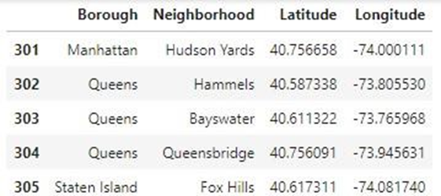
New York Neighborhood Data which will be used to get to know about the various neighborhoods which are going to take into consideration for our Project. Data source: https://cocl.us/new_york_dataset

Slide 8
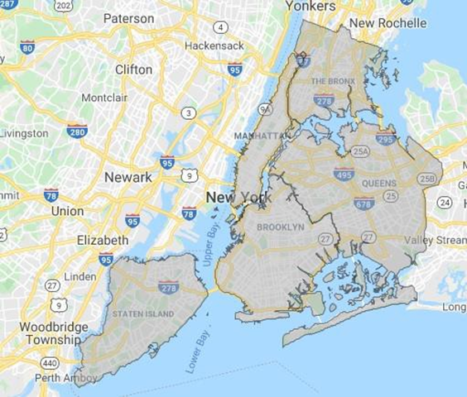
Geo-spacial data of the New York to get a better understanding of the neighborhoods in it and their corresponding locations in the Folium map would make certain things clear for the Project. This will be achieved using the acquired data and visualize the same using Choropleth maps. Data source: https://data.cityofnewyork.us/City-Government/Borough-Boundaries/tqmj- j8zm

Slide 9
Finally, the data going to be collected/acquired from the Foursquare API about the various restaurants in each neighborhood of New York city especially Indian cuisine, which will be used for acquiring the information regarding same for all the venues of each neighborhood.
Data source: Foursquare

Slide 10
Data Cleaning and approach
Acquire the data from the various sources as mentioned below,
New York neighborhood data from https://cocl.us/new_york_dataset
Borough Boundaries data from https://data.cityofnewyork.us/City-
Government/Borough-Boundaries/tqmj-j8zm
Indian Cuisine related data from Foursquare
Filter the data for the required data acquired from Foursquare which is only about Indian Cuisine.
Acquire the tips and from that get the rating of every restaurant in the neighborhood of New York.
Visualize the findings using Matplot lib and Folium for better understanding.

Slide 11
Exploratory Data Analysis
Number of Neighborhoods in New York city
The visualization gives us the understanding of the boroughs in New York city and the number of neighborhoods in it.

Slide 12
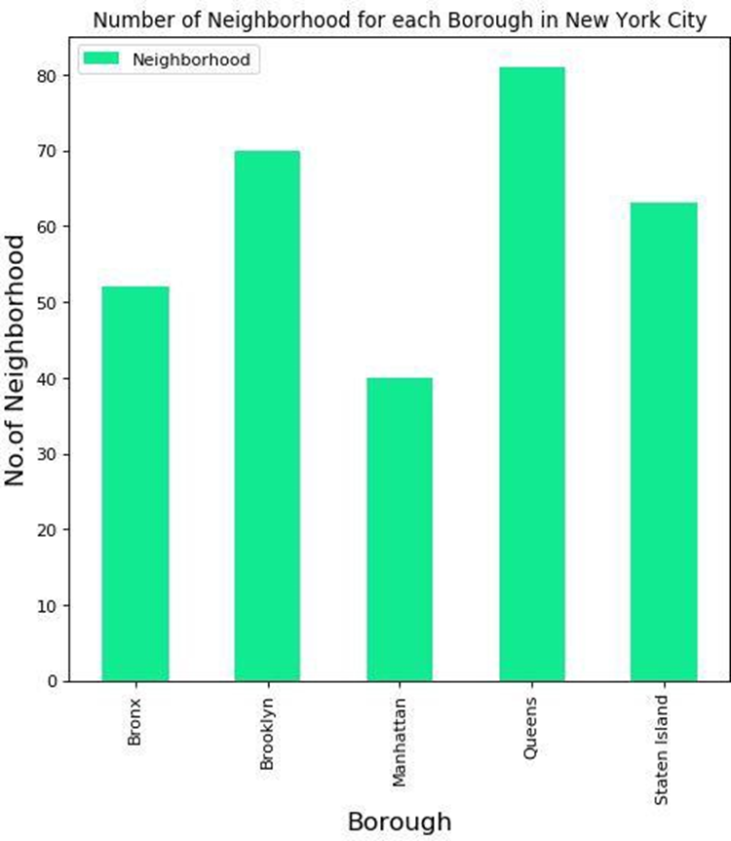

Slide 13
Boroughs vs. Indian cuisine restaurants – New York
The Queens seems to have the highest number of Indian cuisine restaurants in the New York City and Bronx seems to have the least number of Indian restaurants in New York city, this is just something to be with the number of restaurants and we have so much to explore based on ratings

Slide 14
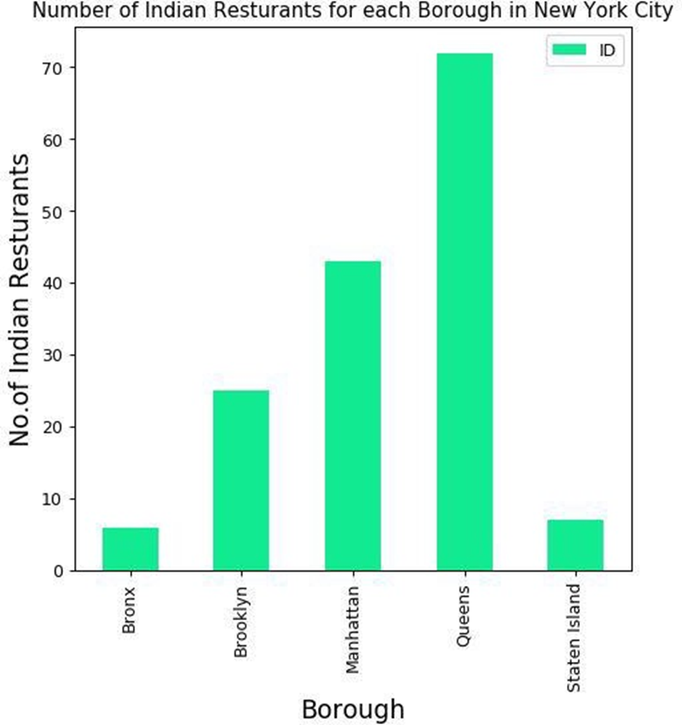

Slide 15
Top Neighborhoods based on number of Indian restaurants
Floral park neighborhood seems to have highest number of Indian cuisine restaurants in New York. And Richmond hill and Woodside both holds the second position in the numbers. Other 12 top neighborhoods are for your eyes to see.

Slide 16
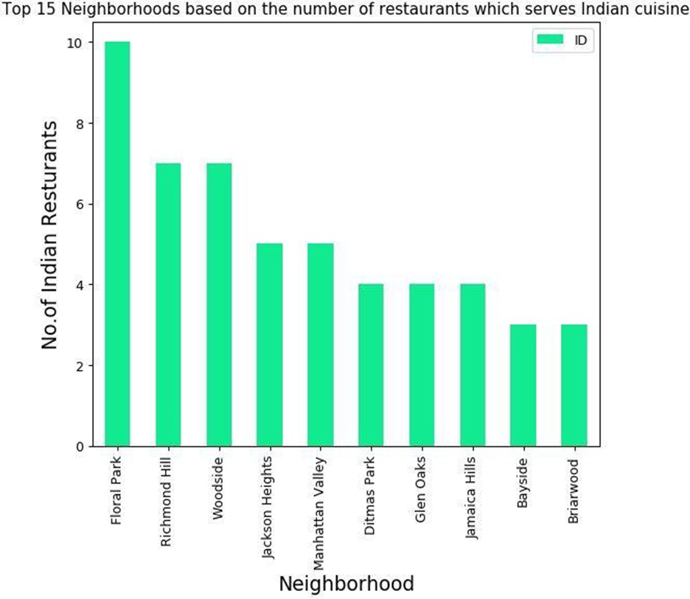

Slide 17
Boroughs based on Average rating of Indian restaurants
Manhattan seems to hold the first place with the highest average rating of Indian restaurants, and Staten Island seems to go to the last position in this regard, Bar chart below will show details about others,

Slide 18
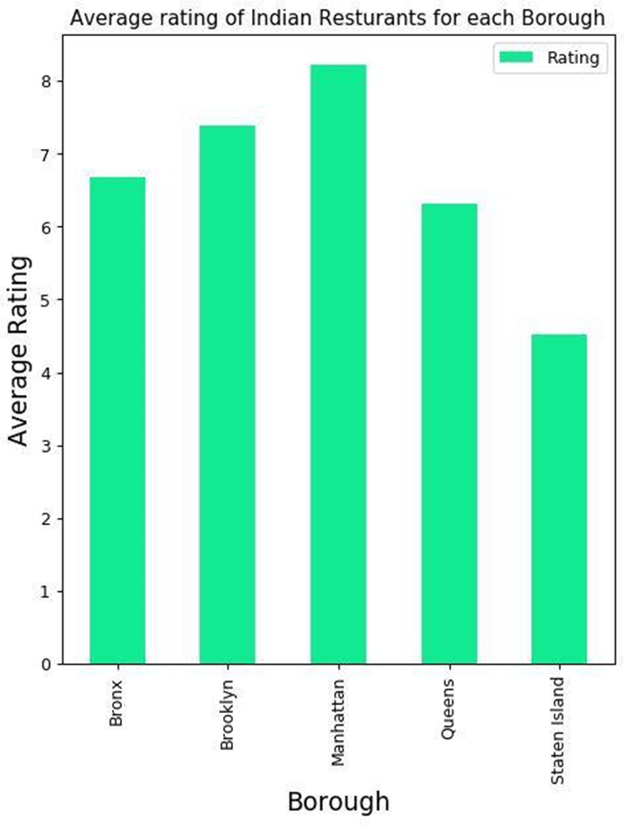

Slide 19
Results

Slide 20
Top Neighborhoods based on the average rating of Indian restaurants
Only five of the Neighborhoods are having an average rating of 9.0 based on the data acquired from Foursquare places API, which are as follows,
Astoria, Queens.
Blissville, Queens.
Civic Center, Manhattan
Greenwich Village, Manhattan
Tribeca, Manhattan
These are marked in the map, which is visualized in below image

Slide 21
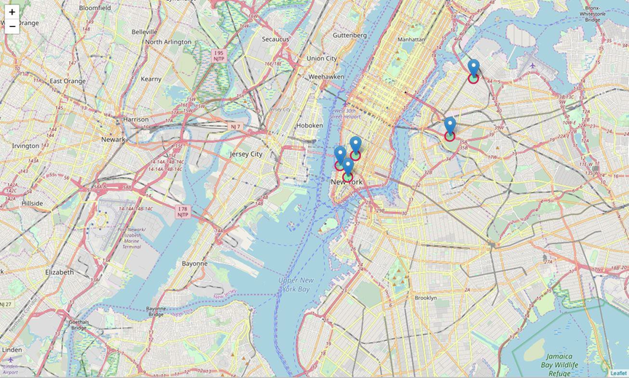

Slide 22
Boroughs with the Average rating as Choropleth map
The below choropleth map is similar to the previous bar chart but in the map, it gives us even better understanding based on the boundaries,

Slide 23
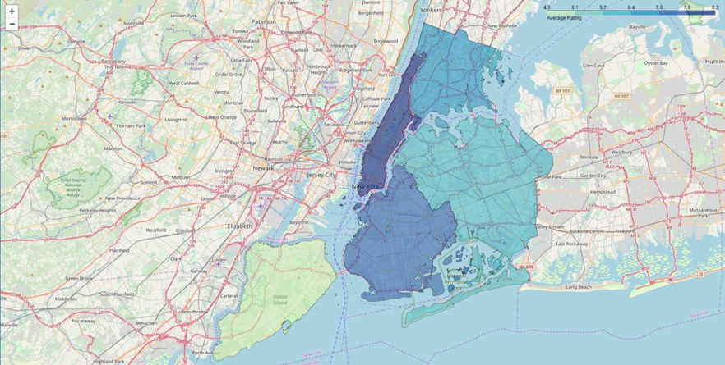

Slide 24
Discussion
The Analysis covers an important criterion which is the Neighborhoods and Boroughs of New York city and the following in it
Competition (Other Indian Restaurants)
People’s interest in Indian cuisine
This gives us a great advantage in selecting the areas where the restaurants can be established based on the various requirements like growth, or initiation or expansion.

Slide 25
Conclusion
Based on the Data Analysis and Visualization using Folium and Matplotlib we have rendered various bar charts and two maps from which we can come to a better understanding of the interests we had earlier to be discovered which are specified as follows.
Best Neighborhood for opening Restaurant (Indian Cuisine) in New York.
Astoria (Queens), Blissville (Queens), Civic Center (Manhattan) are some of the best neighborhoods for Indian cuisine.
Area which lack Indian Restaurants.
Staten Island ranks last in average rating of Indian Restaurants.
Places with best Indian Cuisine.
Manhattan is the best place to stay if you prefer Indian Cuisine.
Areas with Potential Indian Restaurants.
Manhattan have potential Indian Restaurant Market

