Slide 1



Loan Default Prediction Modeling
Team New York:
Cynthia Li
Dora Gao
Kris Ilkiw
Rob Phillips
Rohan Venkatesh
Teddy Zhou

Slide 2


PART 01
Business Understanding
Business Background
Objective

Slide 3

Business Understanding & Objective
Background
A digital lending company focusing on credit risk prediction to minimize defaults and maximize profitability.
SuperLender
Key Drivers
Willingness to pay and Ability to pay.
Objective
Build a model to classify loans as Good (1) or Bad (0) for informed decisions on loan approval.

Slide 4
PART 02
Data Exploration
Datasets Overview
Primary Key: ‘customerid’ Analysis
Descriptive EDA

Slide 5
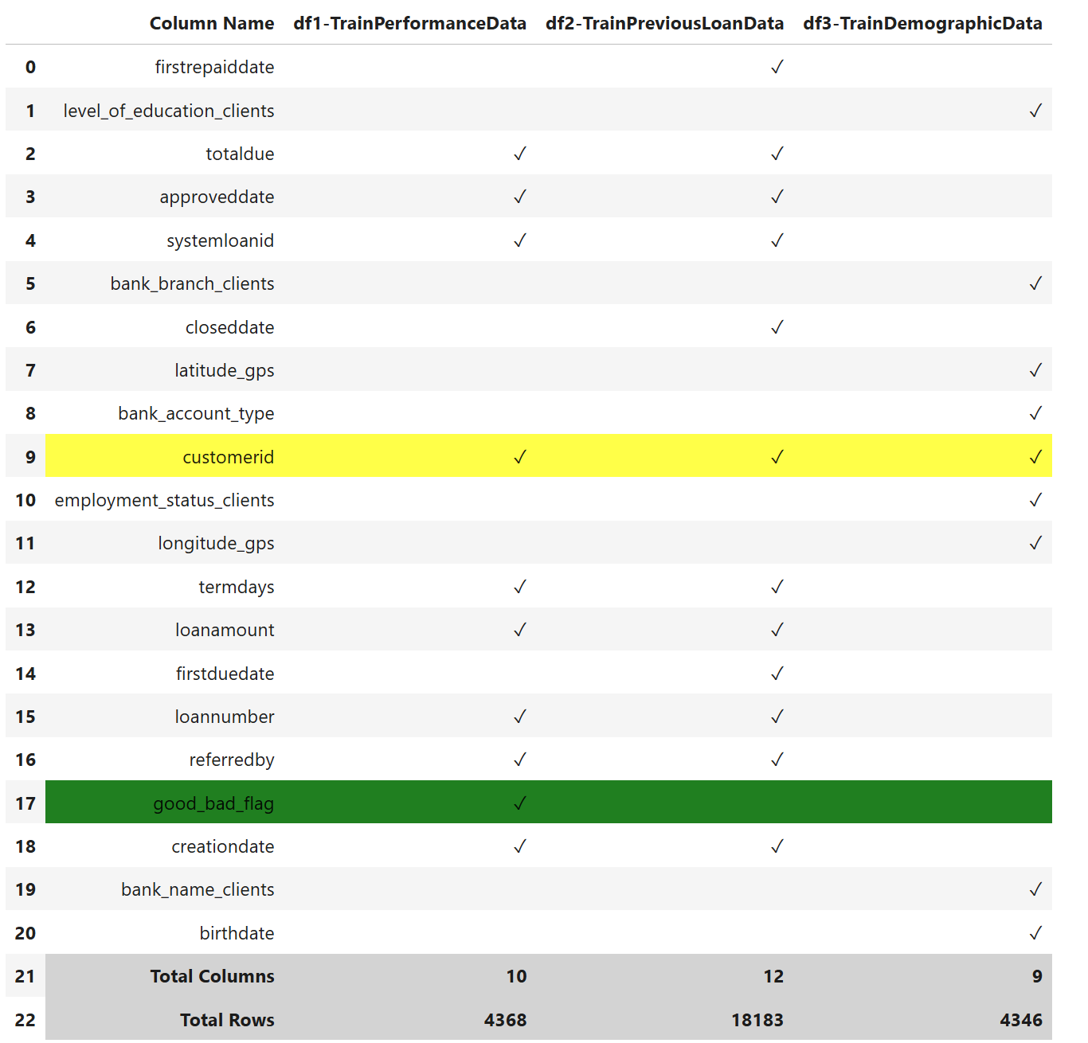
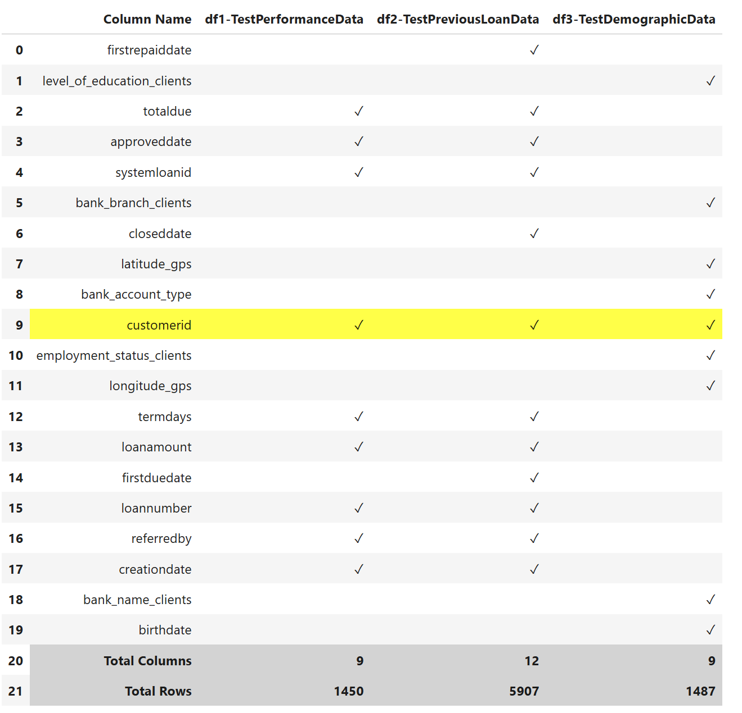
Data Sets Overview
Primary Key for Data Merging
Target Variable that needs to predict
Train Data Sets
Test Data Sets

Slide 6
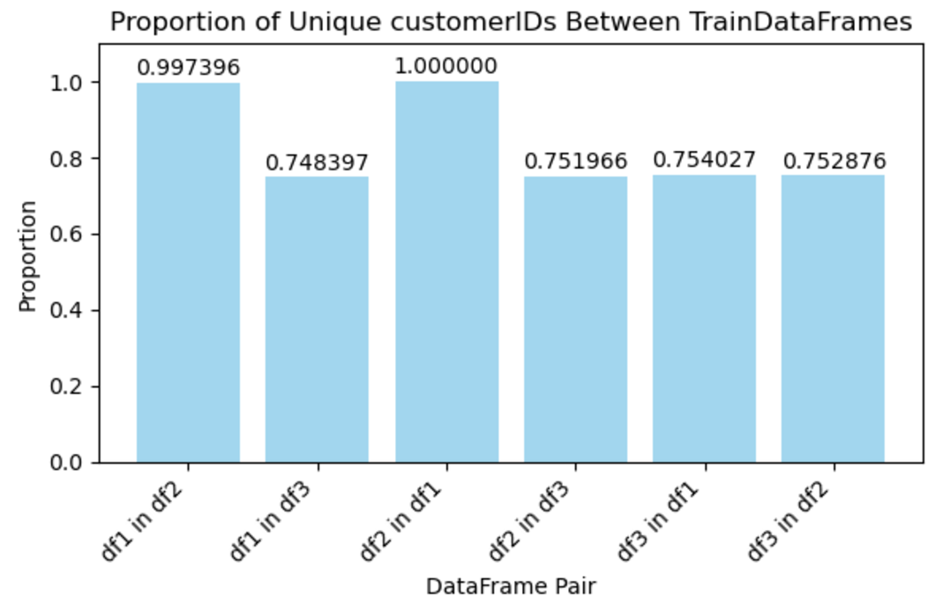
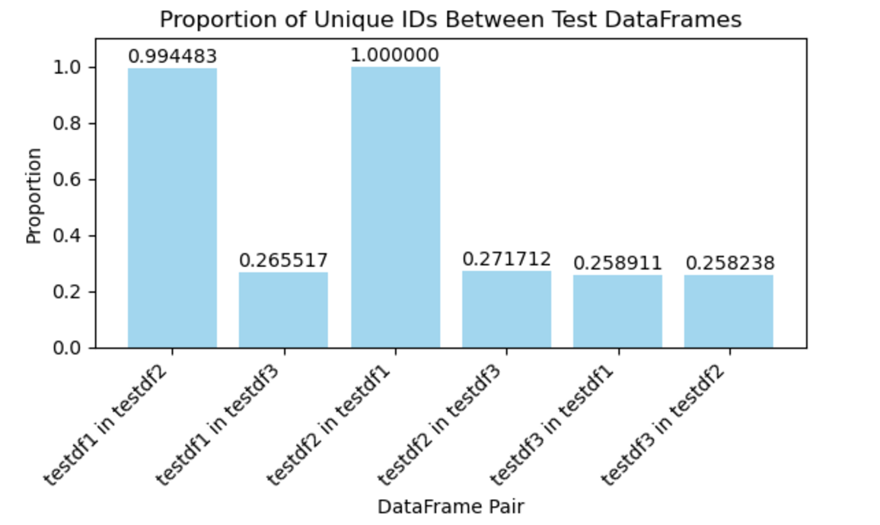
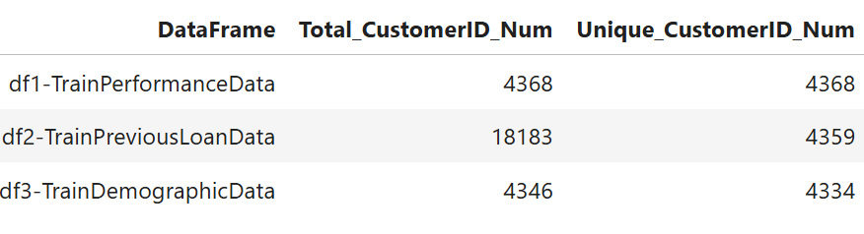
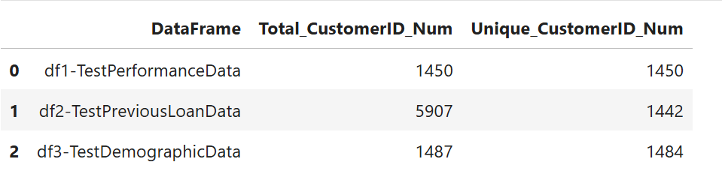
Primary key: ‘customerid’ Analysis
High overlap
High overlap
1. Duplicates in df3 (demographic)
Removed
2. Multiple Records for a single
‘customerid’ in df2 (previousloan)
Aggregation
Train Data Sets
Test Data Sets

Slide 7
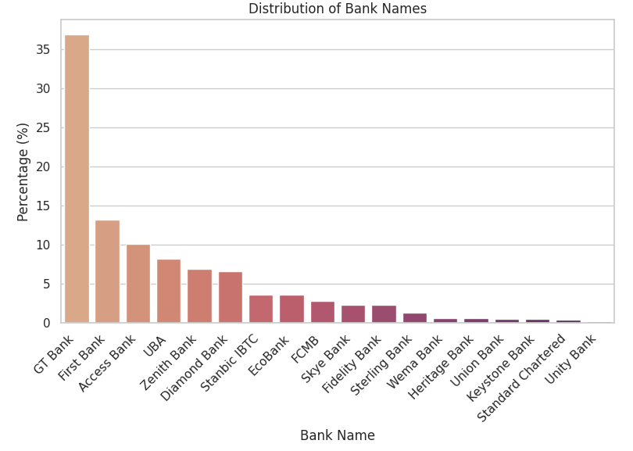
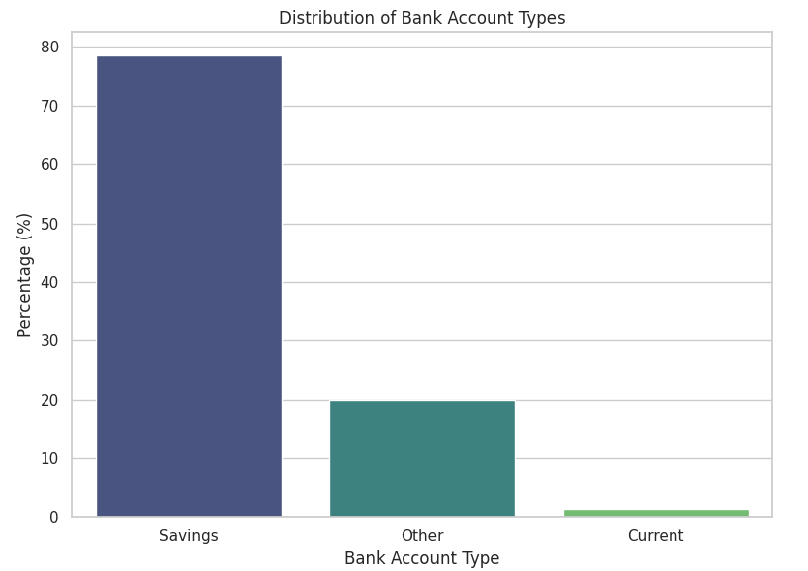
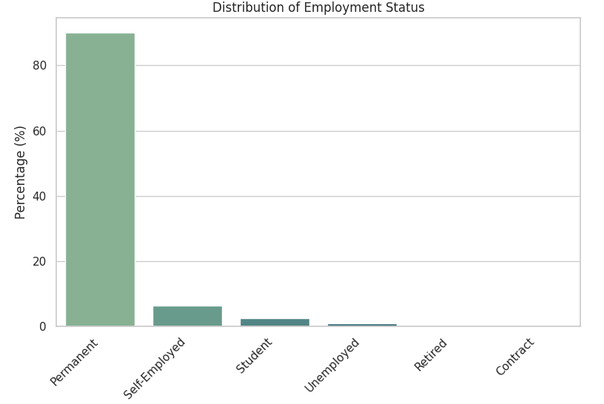
Descriptive EDA
Bank Account Types: Savings dominate (78%), minimal Current (1%).
Employment Status: Mostly permanent (90%), few self-employed (6.3%).
Bank Names: GT Bank leads (36%), followed by First Bank (13%).

Slide 8
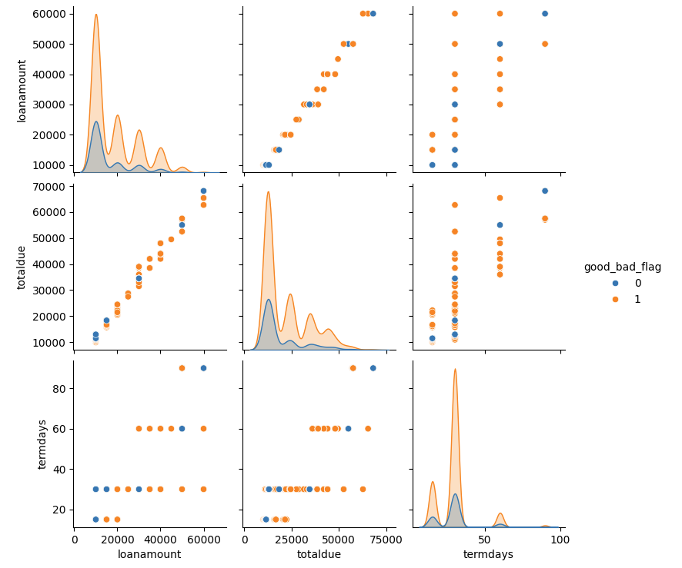
Descriptive EDA2
Larger loans, longer terms, and specific loan amounts appear to be associated with higher risk.

Slide 9
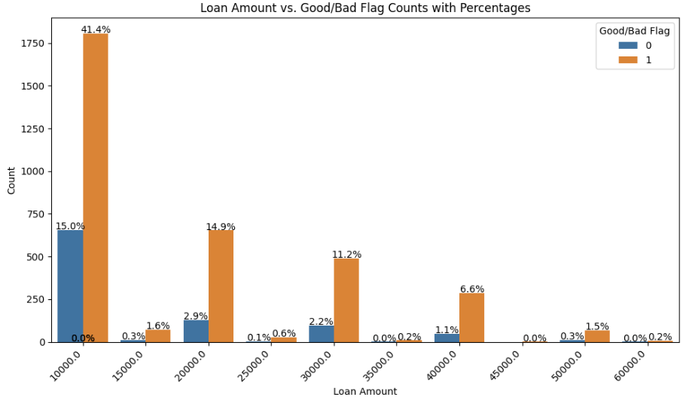
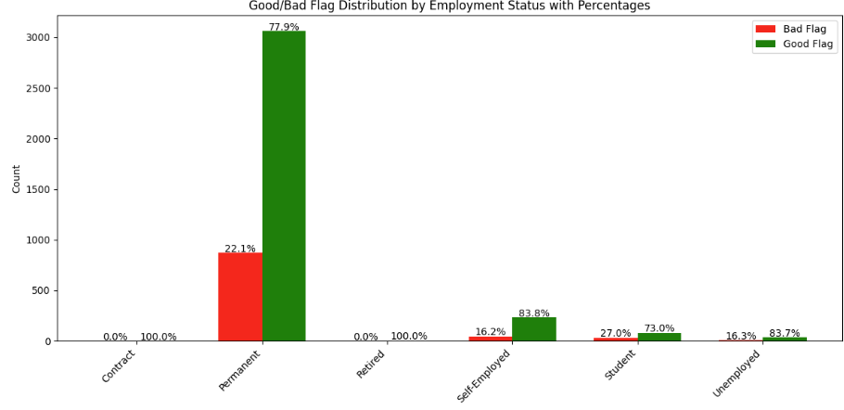
Descriptive EDA3
Loan Amount: The smallest loan amounts exhibit the highest default rates. As the loan amount increases, the default rate gradually declines.
Employment Status: Students face the highest default rate at 27%, followed by permanent employees at 22%. Self-employed individuals and unemployed clients have a lower default rate, both around 16.3%.

Slide 10
PART 03
Data Preparation
Data Merging
Data Cleaning
Data type change
Missing value imputation
Feature Engineering(FE)
Encoding
New features adding
Drop features

Slide 11
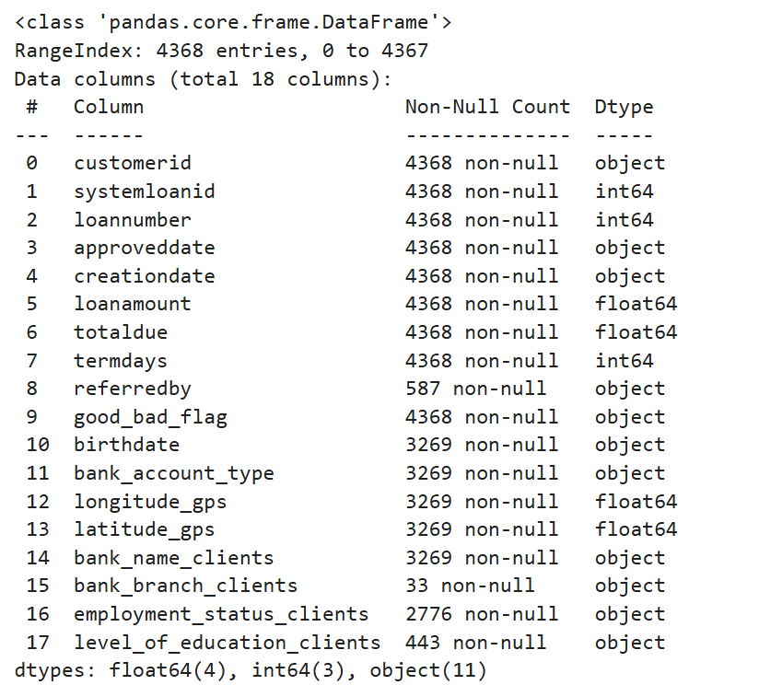
Step 1: Data Merging1 - Performance Data ‘df1’ & Demographic Data ‘df3’
Performance df1
4368 * 10
Demographic df3
4346 * 9
Left Join on ‘customerid’
4368 * 18
merged_df13
‘merged_df13’: 4368 * 18
‘merged_testdf13’ : 1450 * 17

Slide 12
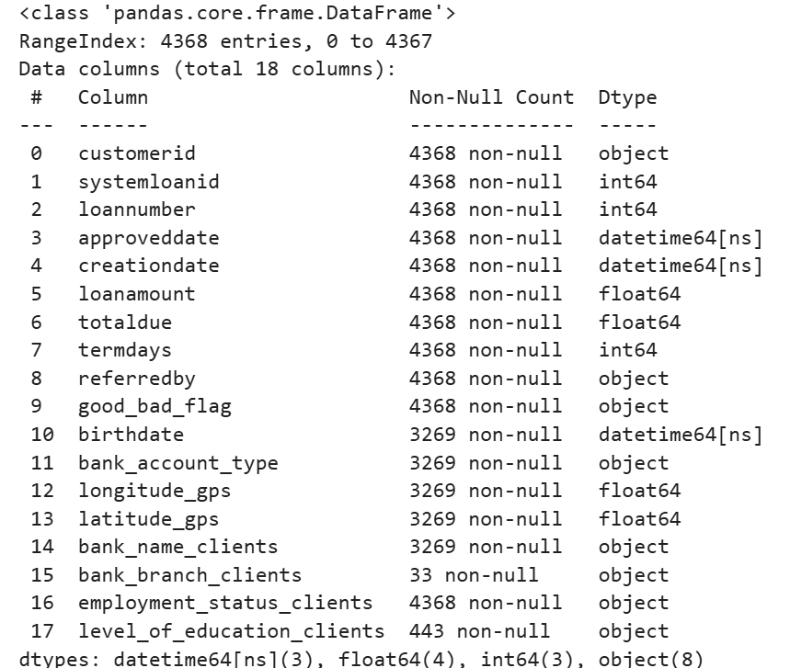
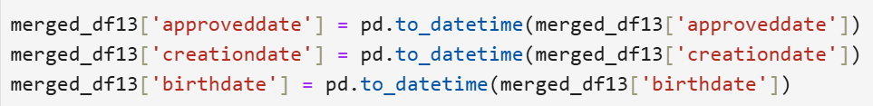
Step2: Data Cleaning1 – ‘merged_df13’ & ‘merged_test_df13’
.
Fill ‘referredby’ with 'norefer' for missing values.
Fill ‘employment_status_clients’ with the most frequent value.
Merged_df13
Original
Data Type Change
Merged_df13
After the data type change and missing value imputation
Missing Value Imputation
Object
‘approvedate’
‘creationdate’
‘birthdate’
Date
Time
‘merged_df13’: 4368 * 18
‘merged_testdf13’ : 1450 * 17

Slide 13
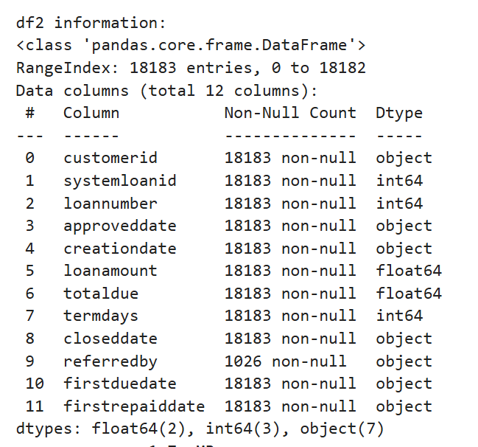
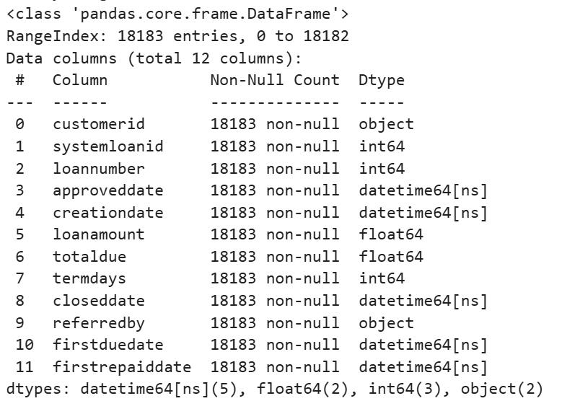
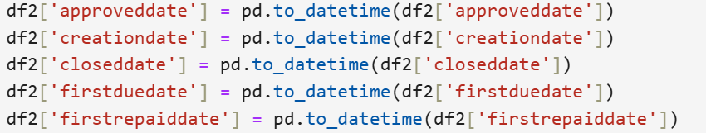
Step2: Data Cleaning2 – Previous Loan ‘df2’ & ‘testdf2’
.
Fill ‘referredby’ with 'norefer' for missing values
df2
Original
Data Type Change
df2
After the data type change and missing value imputation
Missing Value Imputation
Object
‘approvedate’
‘creationdate’
‘closedate’
‘firstduedate’
‘firstrepaiddate’
Date
Time
‘df2’: 18183 * 12
‘testdf2’: 5907 * 12

Slide 14
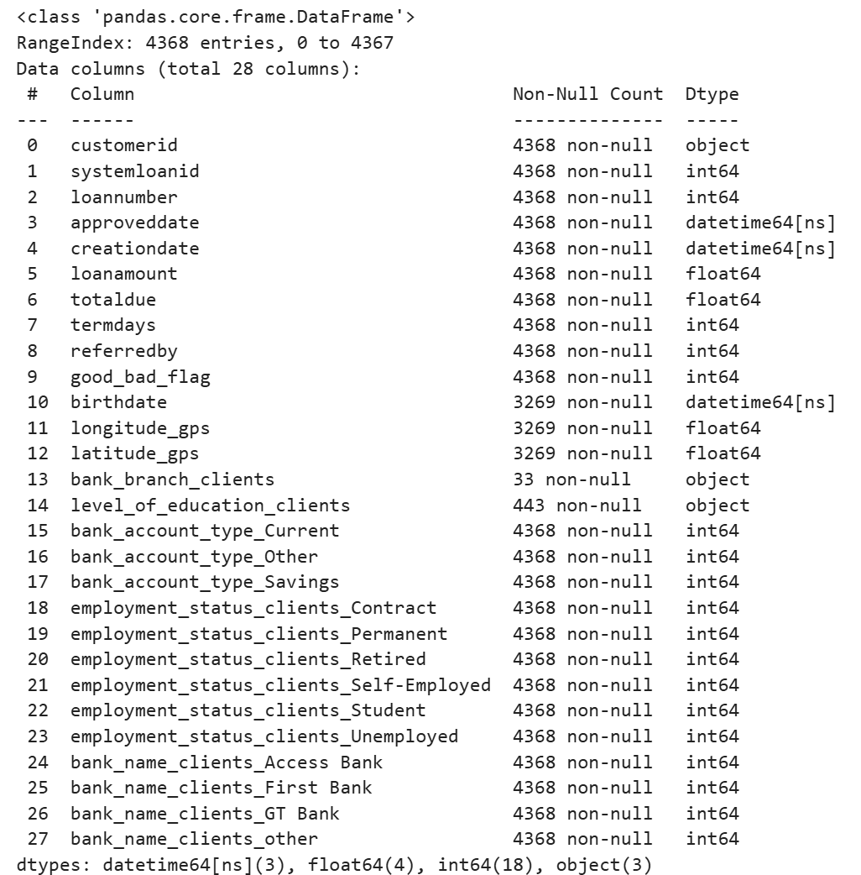
Step3: Feature Engineering1 (FE ) – Encoding ‘merged_df13’ & ‘merged_testdf13’
'bank_name_clients’
Select the top 3 most frequency values, and name the rest ‘other’
(4 values)
Dummy Variable
‘good_bad_flag’
Good: 1
else: 0
‘referredby’
norefer: 0
else: 1
Encoding
'bank_account_type’
(3 values)
Dummy Variable
'employment_status_clients’
(6 values)
Dummy Variables
‘Merged_df13’: 4368 * 28
‘Merged_testdf13’: 1450 * 26

Slide 15
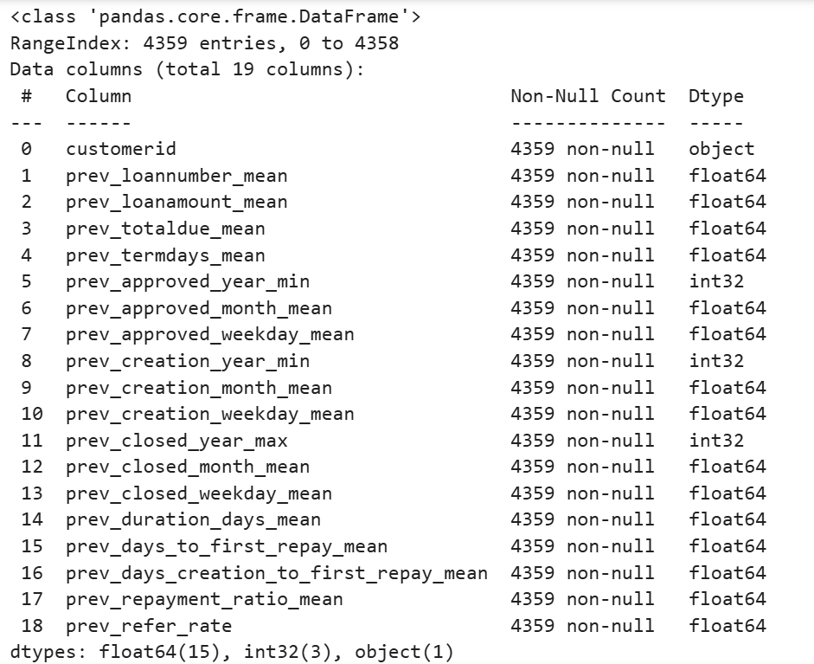
Step3: Feature Engineering2
– Privious Loan Dataset ‘df2’ & ‘testdf2’ -> ‘aggregated_df2’ & ‘aggregated_testdf2’
‘aggregated_df2’: 4359 * 19
‘aggregated_testdf2’: 1442 * 19
‘df2’ after data cleaning
Adding New Features
Aggregation
Group by ‘customerid’
‘aggregated_df2’
+
+
‘approveddate’ -> ‘approved_year’, ‘approved_month’, ‘approved_weekday’
‘creationdate’ -> ‘creation_year’, ‘creation_month’, ‘creation_weekday‘
‘Closeddate’ -> ‘closed_year’, ‘closed_month’, ‘closed_weekday’
‘duration_days’ = ‘closeddate’ – ‘approveddate’
‘days_to_first_repay’ = ‘firstrepaiddate’ – ‘approveddate’
‘days_creation_to_first_repay’ = ‘firstrepaiddate’ – ‘creationdate’
‘repayment_ratio’ = ‘totaldue’ / ‘loanamount’
Rule | Columns
max | 'closed_year'
mean | 'loannumber', 'loanamount', 'totaldue', 'termdays', 'approved_month', 'approved_weekday', 'creation_month', 'creation_weekday', 'closed_month', 'closed_weekday', 'duration_days', 'days_to_first_repay', 'days_creation_to_first_repay', 'repayment_ratio'
min | 'approved_year', 'creation_year'

Slide 16
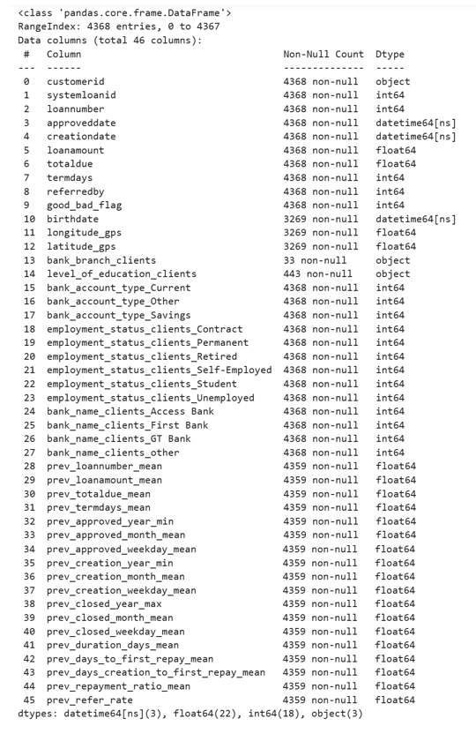
Step4: Final Datasets – ‘merged_final_df’ & ‘merged_final_testdf’
‘merged_df13’
4368 * 28
‘aggregated_df2’
4359 * 19
Left merge on ‘customerid’
4368 * 46
‘merged_final_df’
‘Merged_final_df’: 4368 * 46
‘Merged_testdf13’: 1450 * 44

Slide 17
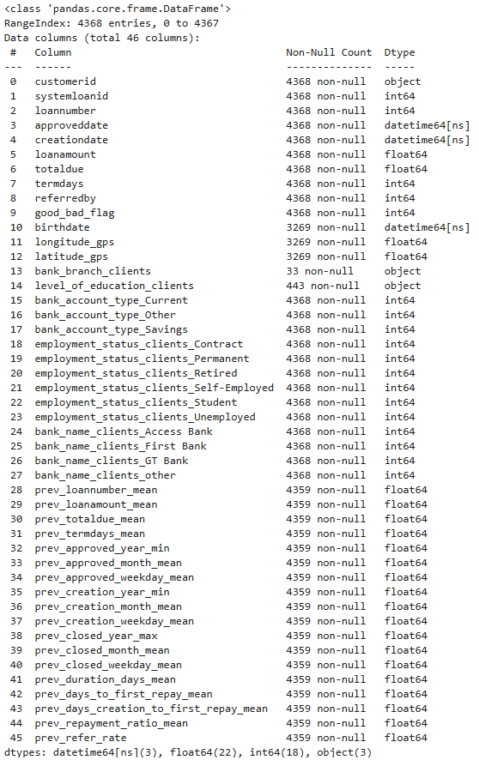
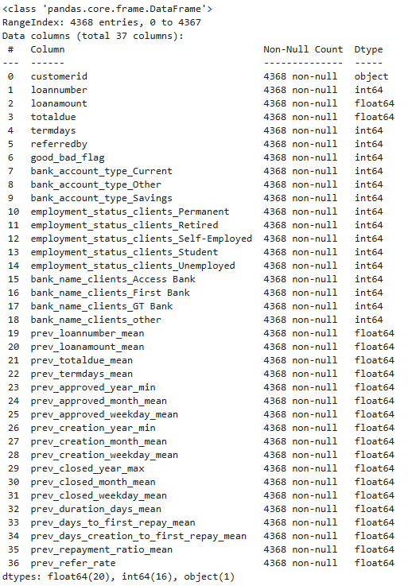
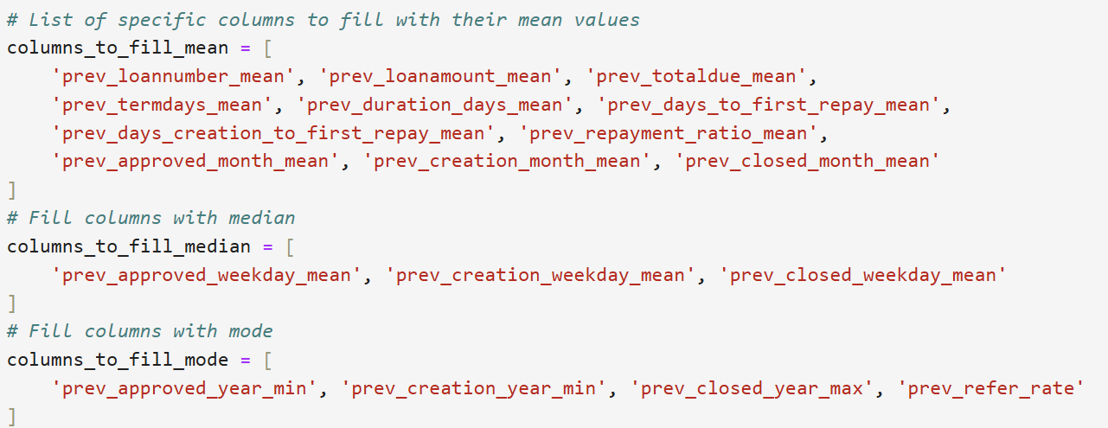
Step5: Final Cleaning
Drop irrelevant features
Fill ‘merged_final_df’ with respective mean/median/mode
‘Merged_final_df’: 4368 * 37
‘Merged_testdf13’: 1450 * 36

Slide 18
PART 04
Modelling
Modelling Comparison
Hyperparameter
Insights & Takeaways
Rank

Slide 19
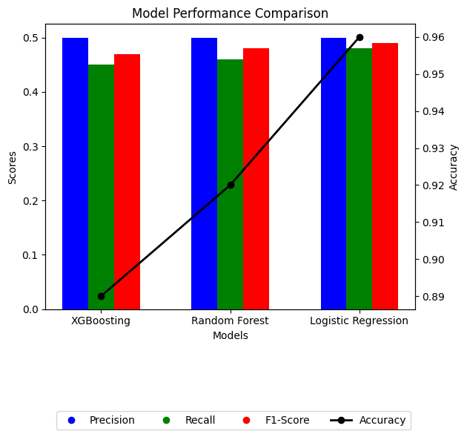
Modeling - Comparison
Logistic Regression had an accuracy of 0.96
Precision and Recall for XGBoosting is lower than Random Forest and Logisitic Regression
Logisitic Regression outperformed based on F1 Score
Considering higher accuracy and F1 – Score

Slide 20
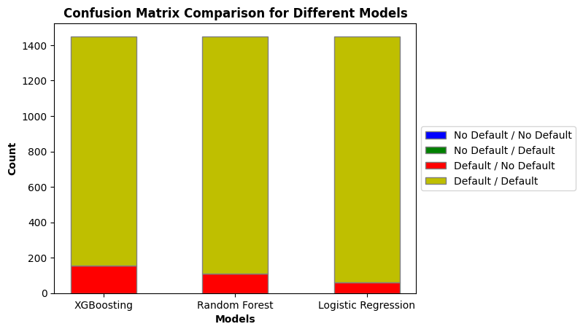
Modeling – Comparison, Continued
Logistic Regression is most successful at predicting defaults
All models failed to identify No Default Instances
Logistic Regression minimizes the number of misclassified defaults (61)

Slide 21
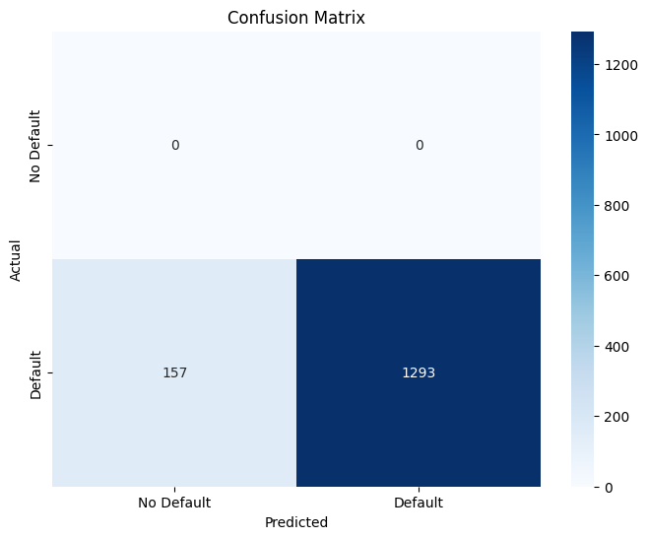
Modeling – XGboosting
 | Precision | Recall | F1-Score | Support
0 | 0 | 0 | 0 | 0
1 | 1 | 0.89 | 0.94 | 1450
Accuracy |  |  | 0.89 | 1450
Macro Avg | 0.5 | 0.45 | 0.47 | 1450
Weighted Avg | 1 | 0.89 | 0.94 | 1450

Slide 22
RANK
Model | Scores
Random Forest | 0.210344827
Logistic Regression | 0.22275862
Gradient Boosting Machine (GBM) | 0.209655172
LightGBM | 0.216551724
XG Boost | 0.235172413

Slide 23

Hyperparameter – Randomized Search CV
Objective - Build and fine-tune a Gradient Boosting Machine (GBM) to accurately predict if a customer will default on their loan.
Process:
Randomized Search CV tested 20 parameter combinations for settings like:
Number of trees (50–200), Learning rate (0.05–0.2), and Tree depth (3–7).
The best parameters were used to train the GBM model.
Model performance evaluated using accuracy, precision, recall, and confusion matrix.
Key Results:
Accuracy: 91.72% - High reliability in predictions.
Precision: 100% - No false alarms for flagged defaulters.
Recall: 92% - Captured most defaulters, missed 120 out of 1,450.
Performance improved by 2.72% after tuning.
Business Impact:
Reliable model minimizes financial risks by correctly identifying true defaulters.
Missed defaulters indicate potential improvements in data processing or feature engineering.

Slide 24
Hyperparameter Tuning- Grid Search
Objective - Build and fine-tune a Gradient Boosting Machine (GBM) to accurately predict if a customer will default on their loan.
Process:
Grid Search tested different values for 6 hyperparameter and 324 total combinations
The best parameters were used to train the GBM model
N_estimators (200), learning rate(0.05), max depth (3), min samples split (2), and min samples leaf (4), subsample (1)
Model performance evaluated using accuracy, precision, recall, and confusion matrix.
Key Results:
Accuracy: 91.6% - High overall reliability.
Precision: 100% - No false alarms for flagged default.
Recall: 92% - Captured most defaulters, missed 122 out of 1,450.
Performance improved by 2.59% after tuning.
Business Impact:
Reliable model minimizes financial risks by correctly identifying true defaulters.
Missed defaulters indicate potential improvements in data processing or feature engineering.
Potential for further optimization using other hyperparameter tuning techniques

Slide 25
Optuna – GBM Model
Objective:
Improve the GBM model’s ability to predict loan defaults by fine-tuning its settings using Optuna.
Process:
Optuna tested 50 different parameter combinations (e.g., number of trees, learning rate, tree depth).
Trained GBM with the best settings and evaluated its predictions.
Key Results:
Accuracy: The model predicted loan defaults correctly 91.72% of the time.
Improvement: Accuracy improved by 2.72%.
Precision: 100% - All predicted defaulters were actual defaulters.
Recall: 92% - The model identified 92% of actual defaulters.
Missed Defaults: Out of 1,450 defaulters, 120 were missed.

Slide 26
Insight & Key Take Away
Strengths of the GBM Model:
Achieved 91.72% accuracy and 100% precision, reliably predicting defaulters.
High recall (92%) ensures most risky customers are identified.
Weaknesses:
Missed 120 actual defaulters out of 1,450.
Does not predict "No Default" cases, which could be important in some scenarios.
Improvements:
Cleaning and feature engineering to create better predictors like "debt-to-income ratio."
Add external data (e.g., credit scores, repayment history).
Use class imbalance techniques (resampling) to improve recall.
Fine-tune hyperparameters further or explore alternative models like CatBoost.
Business Impact:
Reliable model for identifying risky customers.
Minimizes financial risks with precise predictions.
Improvements could address missed defaulters and optmize risk management further.

Slide 27
Thank You
Team New York:
Cynthia Li
Dora Gao
Kris Ilkiw
Rob Phillips
Rohan Venkatesh
Teddy Zhou

Slide 28
Appendix

Slide 29
Insight & Key Take Away - Summary
Modelling:
3 Machine Learning Techniques were employed
XGBoosting, Random Forest and Logistic Regression
Logistic Regression performed the best of the 3
Hyperparameter Tuning:
3 Hyperparamater Turning process were employed
Grid Search, Randomized Search CV and Optuna
Optuna performed the best
Model Goal:
Reduce the number of customers who default on loans by avoiding lending them money
To do this we want to minimize customers who are predicted to not default but do

Slide 30

Modeling – Random Forest – Appendix
 | Precision | Recall | F1-Score | Support
0 | 0 | 0 | 0 | 0
1 | 1 | 0.92 | 0.96 | 1450
Accuracy |  |  | 0.92 | 1450
Macro Avg | 0.5 | 0.46 | 0.48 | 1450
Weighted Avg | 1 | 0.92 | 0.96 | 1450

Slide 31

Modeling – Logistic Regression – Appendix
 | Precision | Recall | F1-Score | Support
0 | 0 | 0 | 0 | 0
1 | 1 | 0.96 | 0.98 | 1450
Accuracy |  |  | 0.96 | 1450
Macro Avg | 0.5 | 0.48 | 0.49 | 1450
Weighted Avg | 1 | 0.96 | 0.98 | 1450

