Slide 1

JAWAHAR EDUCATION SOCIETY
A.C. PATIL COLLEGE OF ENGINEEING
DEPARTMENT OF AI&DS
Image-to-Image Translation Using Pix2Pix GAN
NAME OF GROUP MEMBERS:-
1. Rohan Ramchandra Chorge(10)
2. Yash Dhondu Gawade(13)
3.Vedant Vikas Kharade(24)

Slide 2
IMAGE-TO-IMAGE TRANSLATION
USING PIX2PIX GAN
From Building Layout Maps to Realistic Building Facades
INPUT
MODEL
OUTPUT
→
→
Building facade label/map
U-Net + PatchGAN
Generated facade image
Sem 7 Deep Learning Mini Project
Student: [Add your name] | Guide: [Add faculty name] | College: [Add college name]

Slide 3
Problem Statement & Motivation
PIX2PIX GAN
Problem Statement
Motivation
Convert a simple building facade layout or label map into a realistic facade image while preserving the structure and spatial arrangement.
Manual architectural visualization can take time. Image-to-image translation explores how deep learning can create visual drafts from structured layouts.
Project Goal
Train a conditional Generative Adversarial Network (cGAN) that learns the mapping between paired facade layouts and real building photographs.
Deep Learning Mini Project | Image-to-Image Translation Using Pix2Pix GAN
2

Slide 4
Objectives & Dataset
PIX2PIX GAN
Objectives
Dataset: Facades
• Learn paired image translation
• Build a U-Net generator
• Build a PatchGAN discriminator
• Train using adversarial + L1 loss
• Compare input, target and generated images
• Public paired building-facade dataset
• Input: facade label/map image
• Target: corresponding real facade photo
• Images resized to 256 × 256
• Paired examples are essential so the model learns the intended mapping
Deep Learning Mini Project | Image-to-Image Translation Using Pix2Pix GAN
3

Slide 5
Proposed Workflow
PIX2PIX GAN
1. Load Data
2. Preprocess
3. Generator
4. Discriminator
Download paired Facades images
→
Resize, normalize, split
→
U-Net predicts a facade
→
PatchGAN judges realism
↓
8. Evaluate
7. Repeat
6. Update Weights
5. Calculate Loss
Display input, target, output
←
Train across selected epochs
←
Backpropagation each batch
←
Adversarial + L1 losses
The generator and discriminator compete during training, improving image realism over time.
Deep Learning Mini Project | Image-to-Image Translation Using Pix2Pix GAN
4

Slide 6
Pix2Pix Model Architecture
PIX2PIX GAN
Generator — U-Net
Discriminator — PatchGAN
• Encoder downsamples the input and extracts features
• Decoder upsamples features into an image
• Skip connections preserve fine spatial details
• Output: generated facade image
• Receives input paired with real or generated image
• Evaluates local image patches
• Predicts whether each patch looks real or fake
• Encourages realistic textures and details
Conditional GAN: both networks use the input layout as context.
Deep Learning Mini Project | Image-to-Image Translation Using Pix2Pix GAN
5

Slide 7
Loss Functions & Training
PIX2PIX GAN
Generator Loss
Discriminator Loss
L_G = L_GAN + λ L1
Adversarial loss encourages realistic images; L1 loss keeps the generated image close to the paired target.
L_D = L_real + L_fake
The discriminator learns to classify real pairs as real and generated pairs as fake.
Training loop
• Load a batch of paired images
• Generate a facade and calculate losses
• Update generator and discriminator weights; repeat for each epoch
Deep Learning Mini Project | Image-to-Image Translation Using Pix2Pix GAN
6

Slide 8
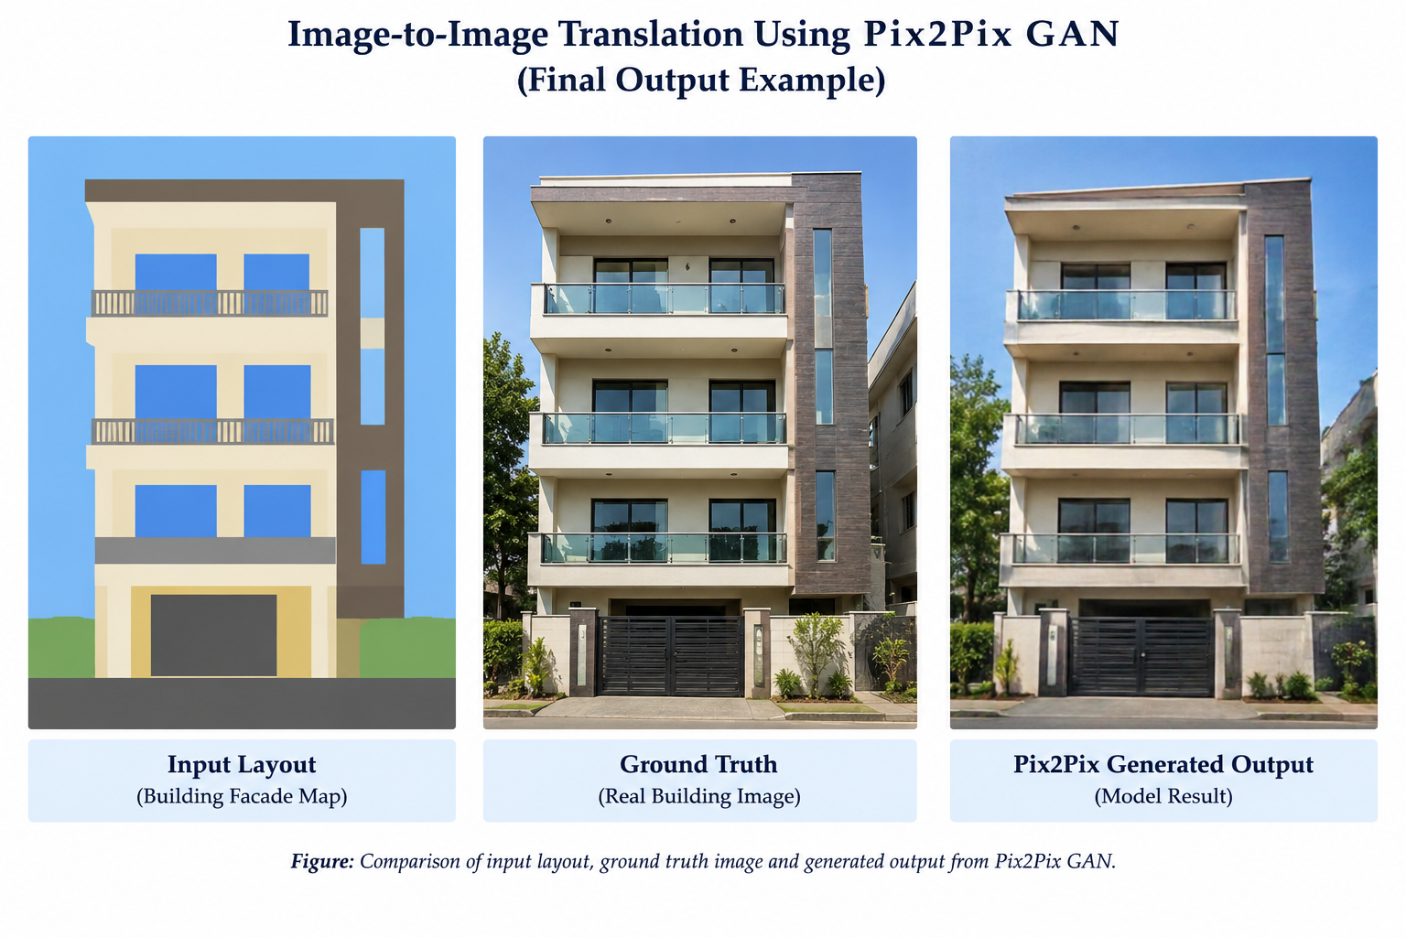
Results & Evaluation
PIX2PIX GAN
What to observe
• Does the output follow the layout?
• Are windows and floors placed sensibly?
• Are colours and textures plausible?
• Does quality improve across epochs?
Note: the shown comparison is illustrative. Replace it with actual model output from your Colab run before claiming experimental results.
Deep Learning Mini Project | Image-to-Image Translation Using Pix2Pix GAN
7

Slide 9
Applications, Limitations & Future Scope
PIX2PIX GAN
Applications
Limitations
Future Scope
• Architectural concept visualization
• Urban planning mock-ups
• Game and simulation assets
• Image editing research
• Output depends on dataset quality
• Low epochs may produce blurry details
• Limited to learned facade patterns
• Not a substitute for architectural validation
• Train for more epochs
• Use larger and more diverse data
• Improve resolution and details
• Test other translation domains
Deep Learning Mini Project | Image-to-Image Translation Using Pix2Pix GAN
8

Slide 10
Conclusion & References
PIX2PIX GAN
Conclusion
Pix2Pix is a paired image-to-image translation method. A U-Net generator produces a facade image from a layout, while a PatchGAN discriminator encourages realistic local details. Adversarial and L1 losses guide training.
References
• Isola, P. et al., “Image-to-Image Translation with Conditional Adversarial Networks,” CVPR, 2017.
• Official Pix2Pix project: https://phillipi.github.io/pix2pix/
• TensorFlow Pix2Pix tutorial: https://www.tensorflow.org/tutorials/generative/pix2pix
Deep Learning Mini Project | Image-to-Image Translation Using Pix2Pix GAN
9

