Slide 1
Icoder
A directory of wonderful things…

Slide 2

DR. VISHWANATH KARAD MIT WORLD
PEACE UNIVERSITY, PUNE, MAHARASTRA, INDIA
Affiliated To
DR. VISHWANATH KARAD MIT WORLD PEACE UNIVERSITY, PUNE
A PROJECT REPORT ON
COMPILER CONSTRUCTION
AS A PARTIAL REQUIREMENT FOR THE DEGREE OF
MASTER OF COMPUTER APPLICATION [ MCA SCIENCE ]
_____________________________________________ _____________________________________________
SUBMITTED BY: GUIDED BY:
Varma Sonika R. [1132220233] Prof. Dr. Anuradha Kanade
Dhanani Rohan J. [1132220432] Prof. Swapnil Goje
Date :- 1/12/2023

Slide 3
ACKNOWLEDGEMENT
Our self Varma Sonika and Dhanani Rohan. Have opportunity to express our knowledge. we would like to express our gratitude to all those who gave us the possibility to complete our project.
Success is such a comprehensive project can not achieve single-handed. It is team effort that sails the ship to the coast. so we would like to express our sincere thanks to all the dignitaries who were involve in making this project the great joy and turning it our into successful piece of work.
Prof. Dr. Anuradha Kanade and Prof. Swapnil Goje – our professor and project co-ordinates has been very prudent to us threw out the collage studies. They are the person who has giving this direction to our work and the shape to our imagination. we express our regard to them from the core of our heart.
From,
Varma Sonika R.
Dhanani Rohan J.

Slide 4
Introduction
In the era of collaborative and remote programming, the demand for accessible and efficient coding tools has never been higher. Our project introduces an innovative solution to meet this demand an Online Compiler Platform.
This platform is designed to provide developers with a seamless and collaborative coding experience, enabling them to write, compile, and execute code from any location with an internet connection.
Our project envisions a coding environment where geographical boundaries and local machine constraints no longer hinder the development process. By providing a user-friendly and collaborative online compiler platform, we aim to empower developers to focus on what they do best — writing great code — without the hassle of infrastructure concerns.

Slide 5
What Does the Website do ?
Using compiler user write the code in different languages after he compile and run their code so, he get correct output otherwise error.
It can play an important role in student’s life.
Eliminating the need for local installations makes it easier for students, especially those using shared or restricted computers, to start coding immediately.
Our compiler provides a unified environment for students working on codes or assignments.
Using save code feature user can save their code into database.
User can change the compiler themes as per their mood like dark black, white etc…

Slide 6
Step to access the compiler website
Go To Google and Search https://www.ICoder.com/.
Register yourself as a new user.
Login yourself using username and password.
From the home page, go to the Compiler where you can write and run your code.
In Compiler you can change coding languages as per your code.
In Compiler you can change themes of coding pad.
If you forget your login password, you can change your password using forget password page.

Slide 7
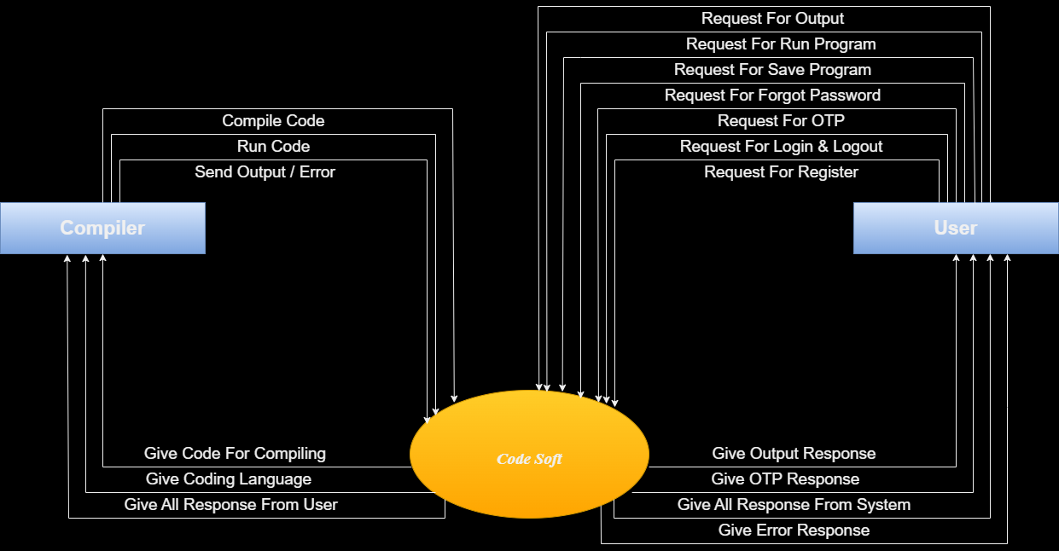
Data flow diagram

Slide 8
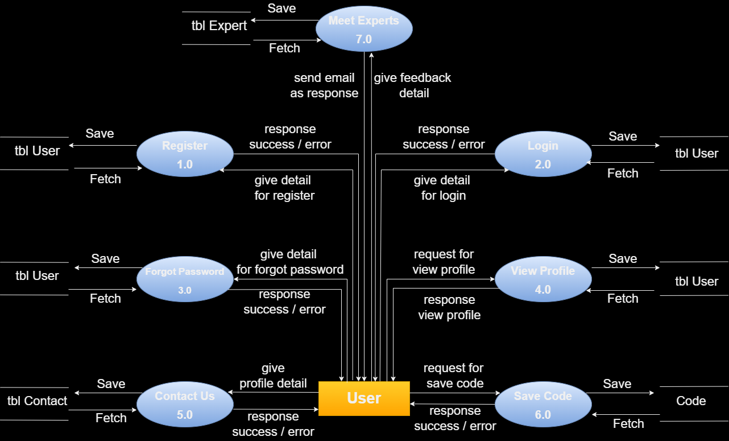

Slide 9
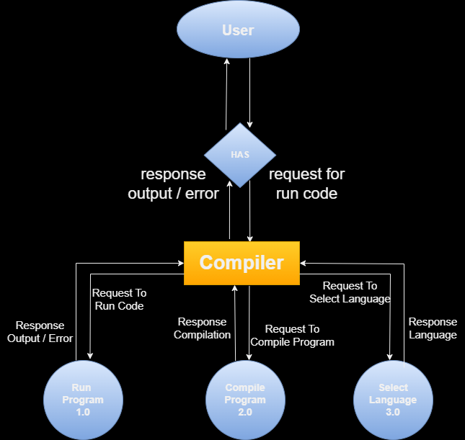

Slide 10
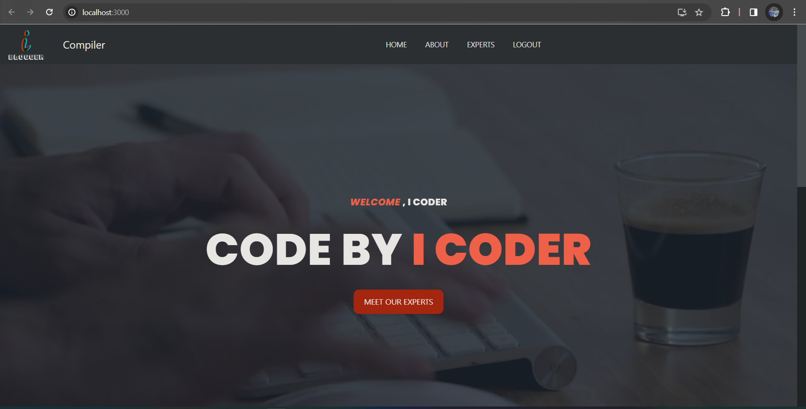
Project design
Home Page :-

Slide 11
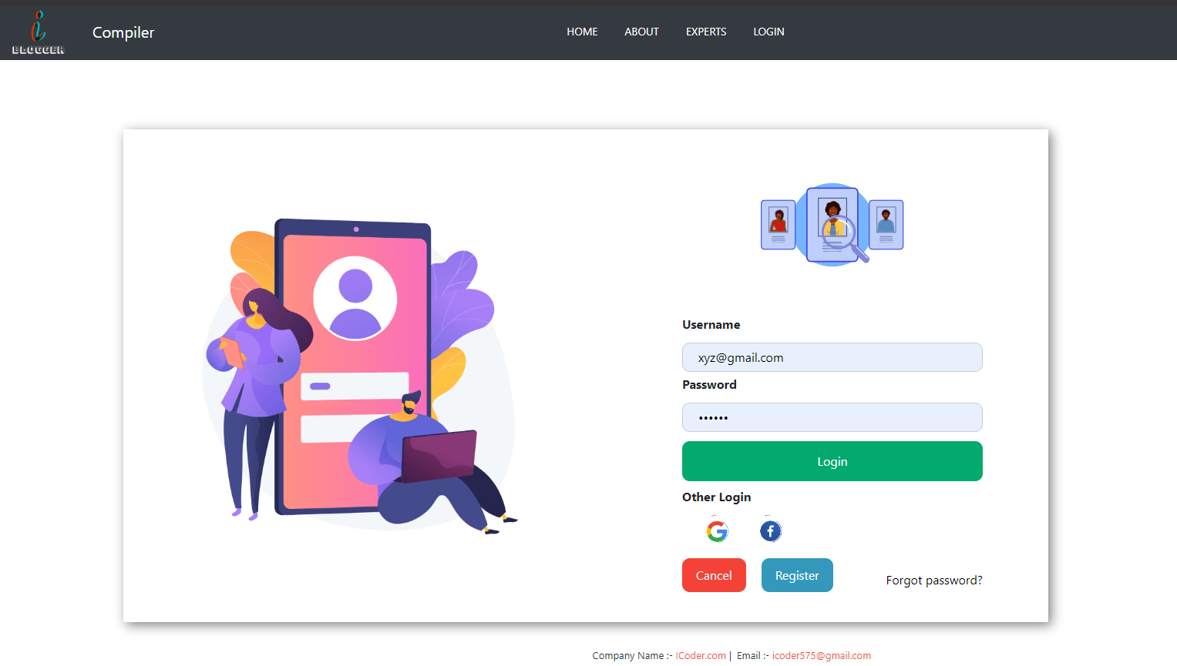
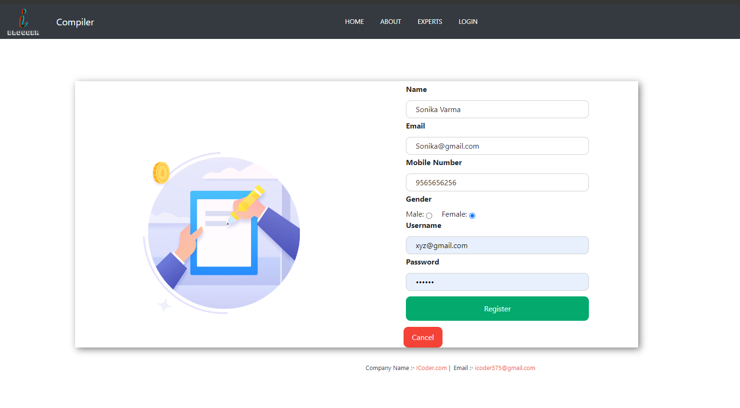
Login Page :-
Register Page :-

Slide 12
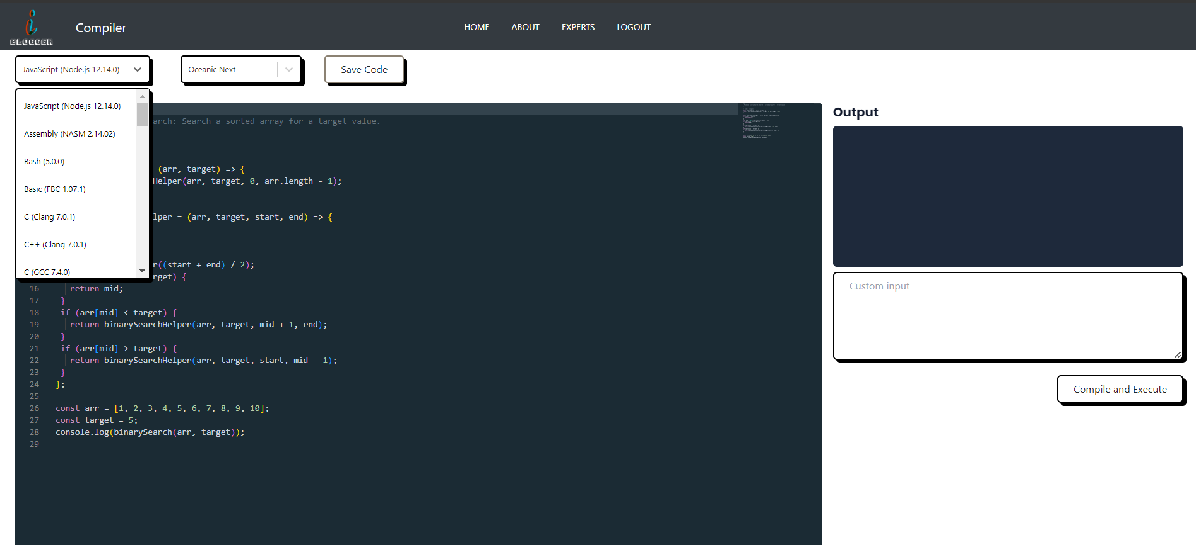
Compiler :-

Slide 13
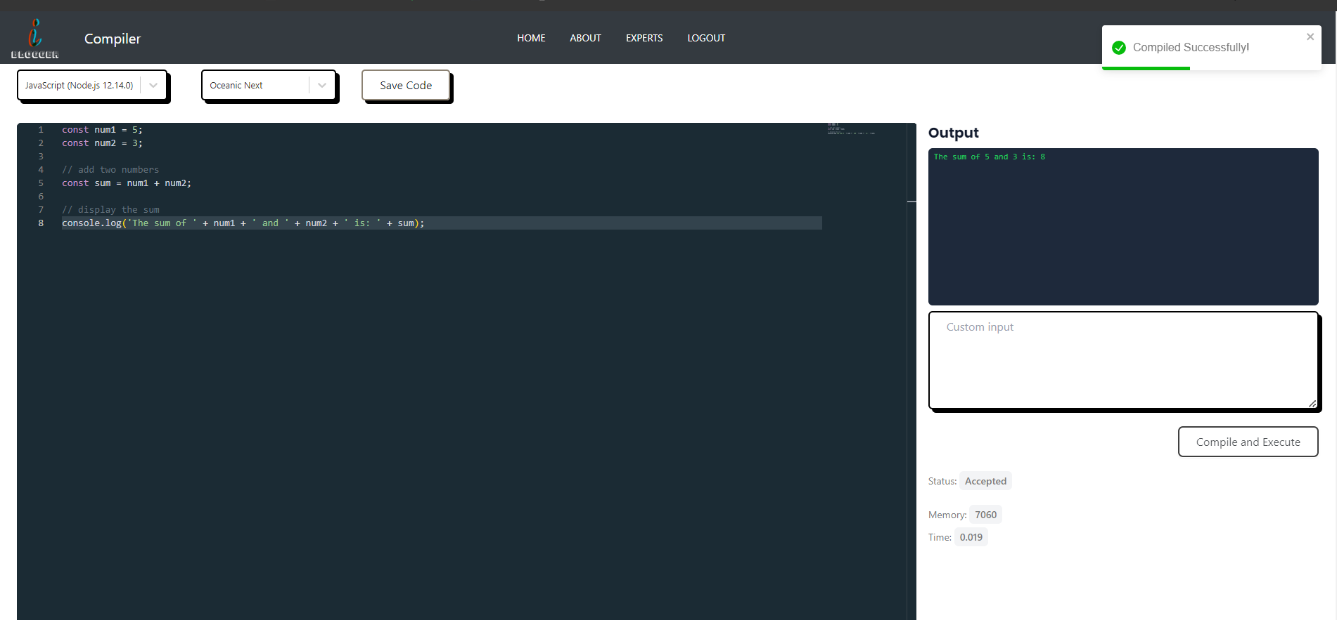
Compiler :-

Slide 14
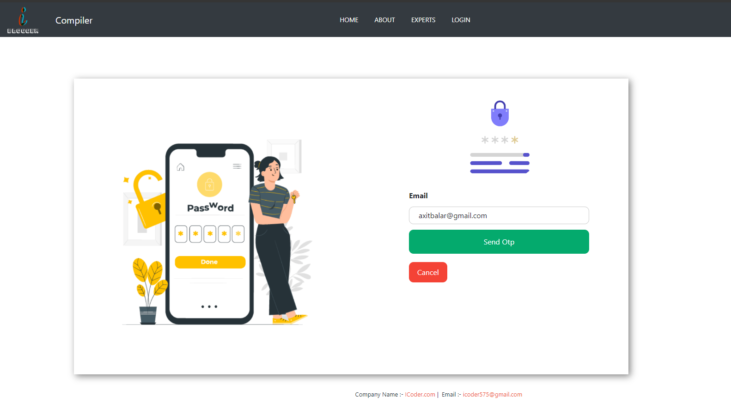
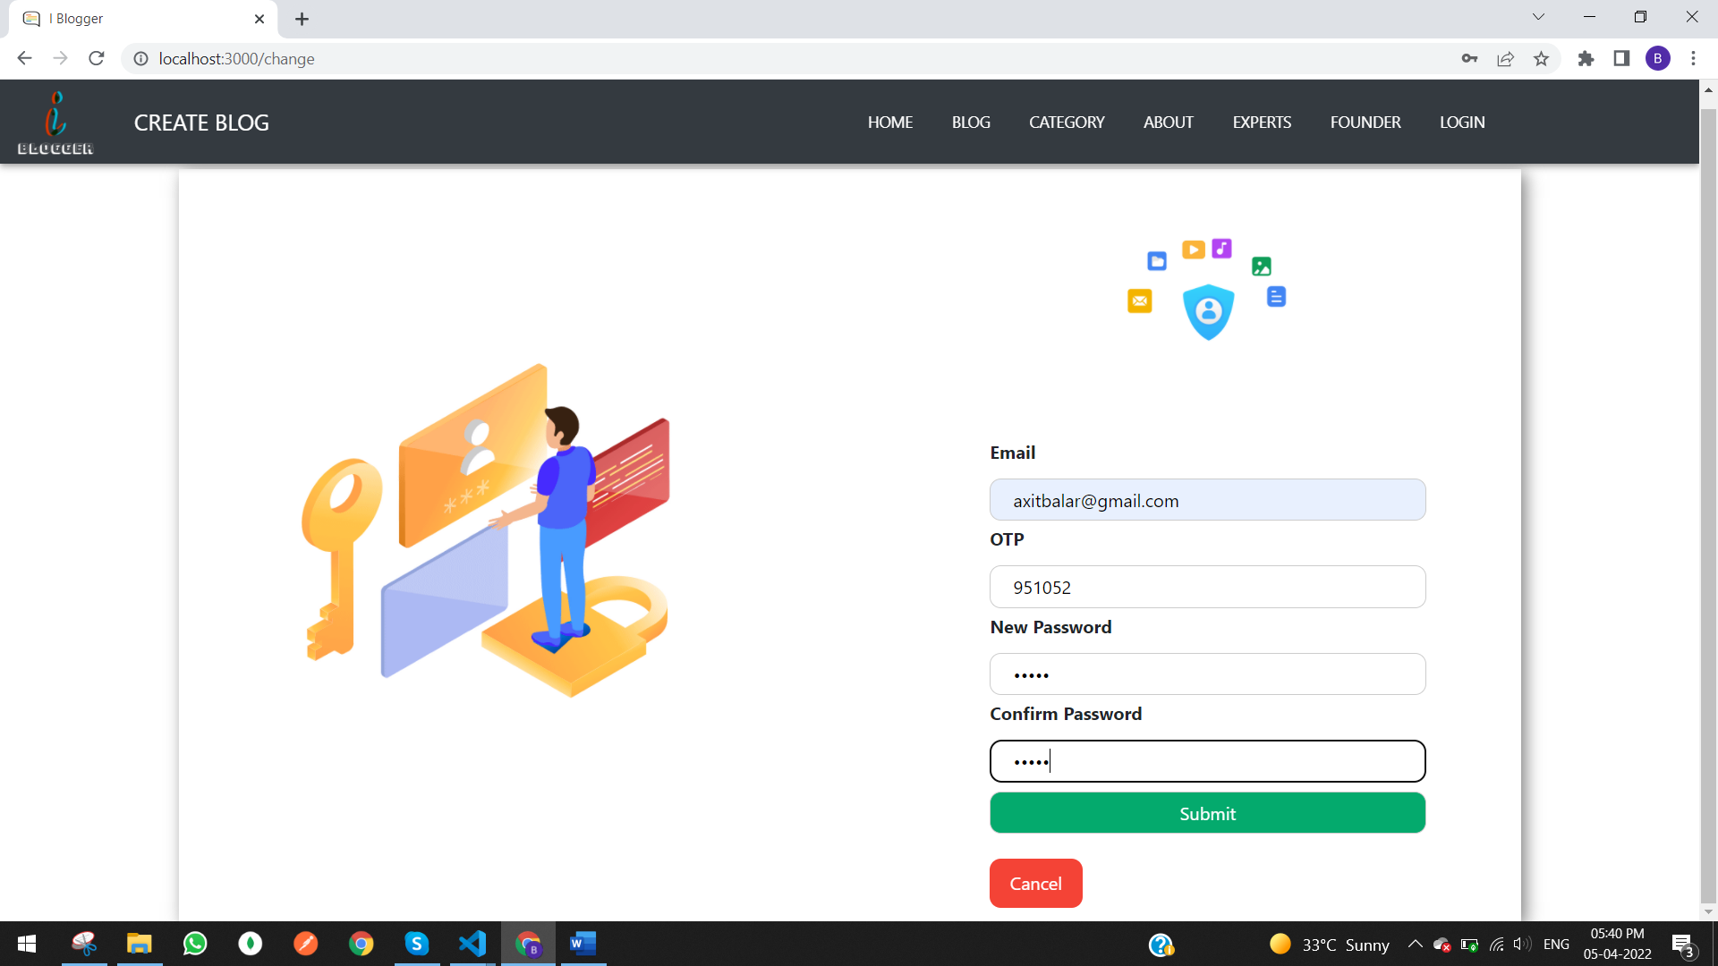
Send-Email-OTP Page :-
Forgot Password Page :-

Slide 15
Any Questions ?

Slide 16
Thank you
Let’s begin Your Coding journey with ICoder…

