Slide 1

Enhancing Text Classification with Custom Vectorization and Multinomial Naive Bayes on ISEAR
by Rohan Dhupar(St191592, 3757169)

Slide 2
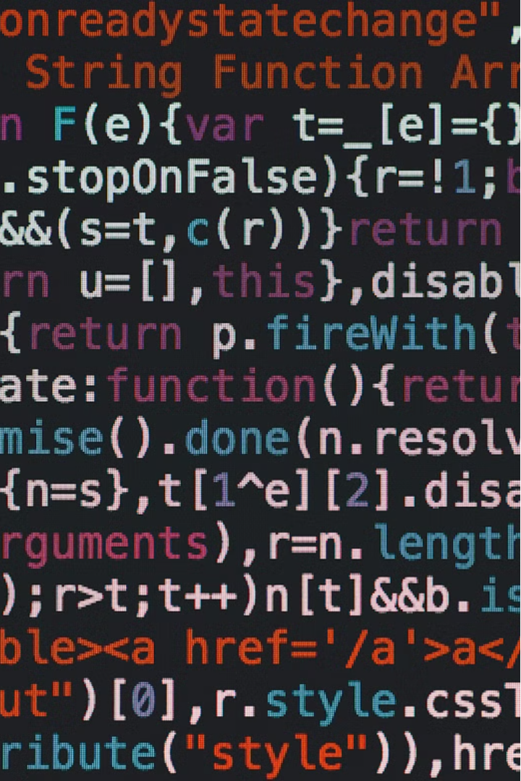
Custom Vectorization Implementation
In this project, we implemented a custom vectorization approach that seamlessly integrates text preprocessing directly into the vectorization process. The SimpleCountVectorizer class was developed to handle cleaning, tokenizing, and converting text data into a numerical format suitable for machine learning models.
By encapsulating these text processing steps within the vectorizer, we ensure consistency and efficiency throughout the entire pipeline. This custom implementation allows for greater control and flexibility, enabling fine-tuning of the preprocessing stages to best suit the specific requirements of the text classification task at hand.

Slide 3
Vectorizing the Dataset
Fitting the Vectorizer
Transforming the Data
Preparing for Modeling
We applied the SimpleCountVectorizer to the training data, allowing it to learn the vocabulary and create the numerical representation of the text. This step is crucial for the vectorizer to understand the unique terms and their frequencies within the dataset.
Once the vectorizer was fitted to the training data, we used it to transform both the training and test datasets into the numerical format required for model training and evaluation. This ensures consistency in the data representation across the entire workflow.
The vectorized data is now ready to be used as input to the machine learning model. The text has been converted to a format that the model can understand and process, setting the stage for the next steps in the text classification pipeline.

Slide 4
Training the Multinomial Naive Bayes Classifier
1
Selecting the Model
2
Fitting the Model
3
Evaluating Model Performance
For this text classification task, we chose to train a Multinomial Naive Bayes classifier. This model is well-suited for working with the feature representation (word counts) provided by the custom vectorizer.
We fitted the Multinomial Naive Bayes model to the vectorized training data, allowing it to learn the underlying patterns and relationships between the text features and the target emotional labels.
To assess the effectiveness of the trained model, we evaluated its performance on the held-out test dataset using various metrics, such as precision, recall, and F1-score, calculated for each emotion category.

Slide 5
Evaluating Model Performance
1
Training Set Evaluation
On the training set, the Multinomial Naive Bayes model achieved an average F1-score of 0.5318, with the best performance on the 'fear' and 'joy' emotions. However, the model struggled more with emotions like 'anger' and 'shame', indicating potential areas for improvement.
2
Testing Set Evaluation
When evaluated on the held-out test set, the model's performance dropped significantly, with an average F1-score of only 0.1629. This gap between training and testing scores suggests potential overfitting or the need for further model refinement and optimization.
3
Validation Set Evaluation
The validation set results mirrored the test set, with an average F1-score of 0.1629. This consistent performance drop on unseen data highlights the importance of thorough model evaluation and the need for strategies to improve generalization.

Slide 6
Implementing Dummy Prediction Methods
Random Predictions
Majority Vote Predictions
As a baseline, we implemented a random prediction method that assigns a random emotion label to each test instance. This provides a reference for the model's performance, as random guesses would be expected to have low scores across all metrics.
Additionally, we developed a majority vote prediction method that always predicts the most common emotion label in the dataset. This approach represents a simplistic but often challenging baseline, as it leverages the inherent class imbalance in the data.

Slide 7
Comparing Model Performance
Naive Bayes Model
Dummy Prediction Methods
Future Directions
The Multinomial Naive Bayes model, with its custom vectorization implementation, demonstrated improved performance over the dummy methods, particularly on the training set. However, the significant drop in performance on the validation and test sets suggests the need for further model refinement and optimization.
To enhance the model's performance, potential next steps could include exploring more advanced text preprocessing techniques, experimenting with different vectorization methods, and investigating the incorporation of additional features or context-aware information. Ongoing model optimization and cross-validation strategies will be crucial for improving the generalization capabilities of the text classification system.
The random prediction and majority vote approaches, while simple, provided a valuable baseline for comparison. These methods helped quantify the added value of the Naive Bayes model and highlighted areas where the more complex model could be further improved to better generalize to unseen data.

Slide 8



Advancing the Approach
Deep Learning
Ensemble Methods
Feature Engineering
Exploring the use of deep learning architectures, such as recurrent neural networks (RNNs) , CNN(Convolutional Neural Networks) or transformers, could provide more sophisticated text modeling capabilities and potentially improve the model's performance on unseen data.
Combining multiple models, such as the Naive Bayes classifier with other techniques like logistic regression or decision trees, could leverage the strengths of different algorithms and lead to more robust and accurate text classification.
Incorporating additional features, such as sentiment analysis, named entity recognition, or contextual information, could provide the model with richer and more discriminative input, potentially enhancing its ability to capture the nuances of emotional expression in text.

