Slide 1
Rohan Singh 2010992056

Slide 2
Gizmos United
Contents :
About the Website
Website pages
Future prospects

Slide 3
About the website
I have created E- commerce website selling electronic products.
Website contains a home page,login ,category,signup,About us , and feedback Page.

Slide 4
Future Prospects
In future Subcategory page , animation
The website can be made more attractive by use of javascript and bootstrap
I plan on using react in my website for creating incredible ui/ux.
The animations and subcategory page can be more smooth and visually appealing respectively.

Slide 5
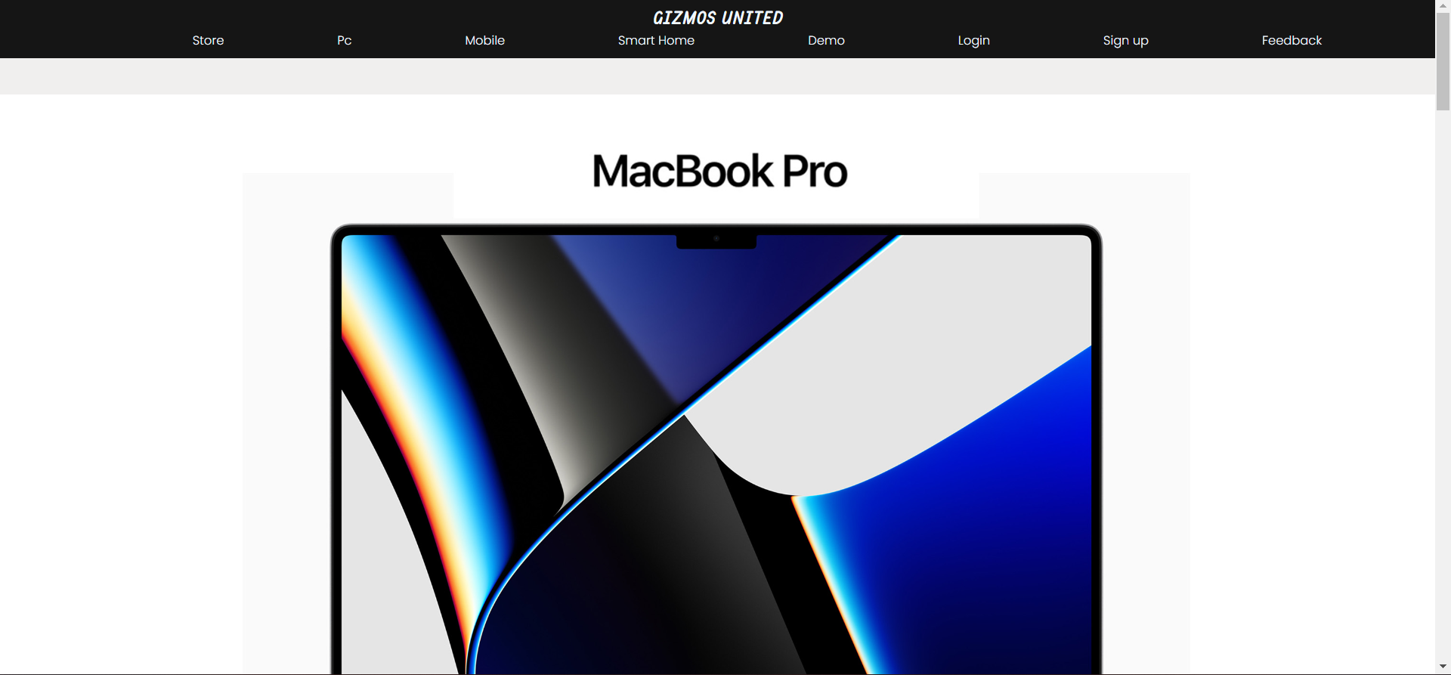
Home page :

Slide 6
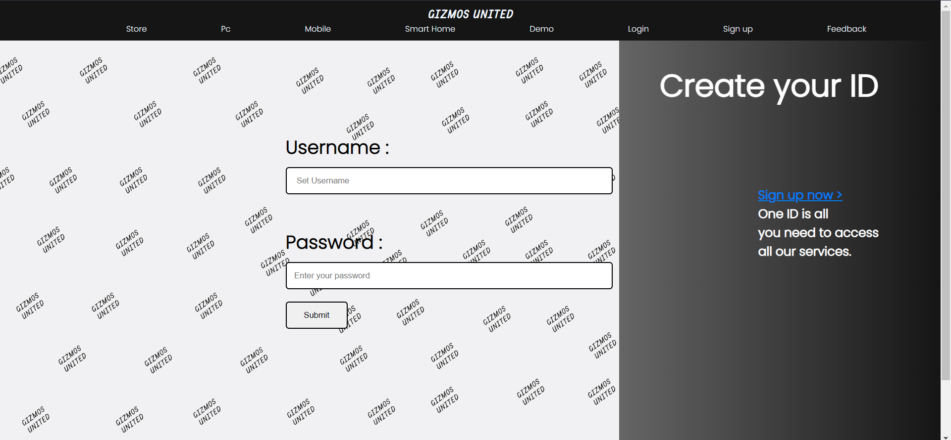
Login :

Slide 7
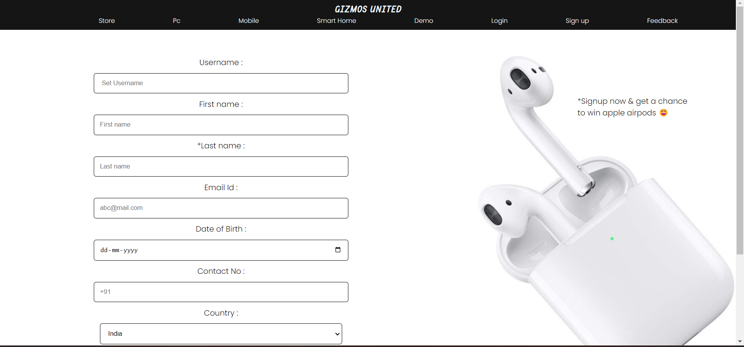
Sign Up :

Slide 8
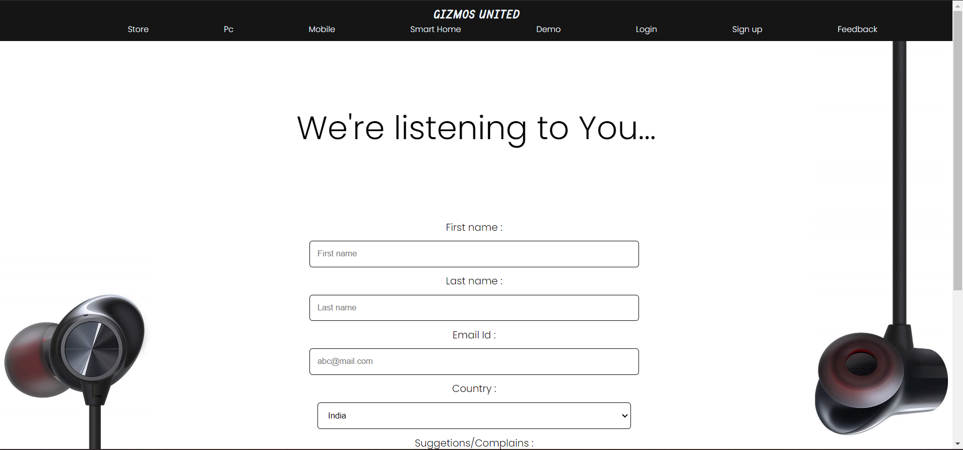
Feedback :

Slide 9
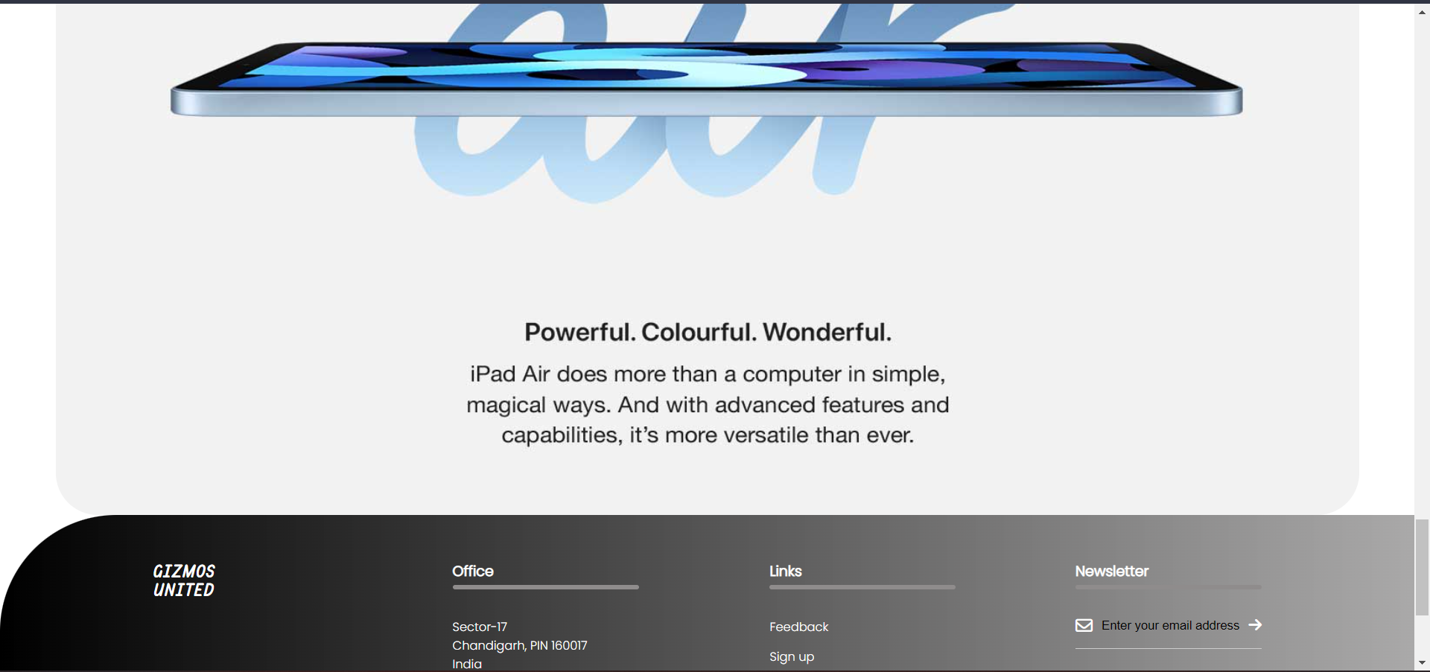
Footer :

